Slide 1




JUBCOR
2024
CONFERENCE & EXHIBITION
INNOVATIVE SOLUTIONS FOR CORROSION CHALLENGES
Jubcor Presentation
Presented By: Saeed Kadasah
Metallurgical Investigation for a Crossover Pressure Taping Weld Joint
Saeed Kadasah, Funani Sivuyile, Syed Jainulaudeen, Faris Al-Adainan

Slide 2


Background
During a re-vamping shutdown, the furnace cross over lines were inspected because of:
Previous inspection recommendations
Repeated failures of pressure tapping line branch weldments.
The inspection revealed that 7/8 pressure tapping branches were cracked at the branch weldments and gusset support.
In order to determine failure causes, a spool containing the crack was cut from pass #6 and submitted to Metallurgical & Corrosion Analysis (MCA) Laboratories to conduct a thorough analysis, which will help in providing recommendations with the cooperation with Center of Excellence (CoE) team.

Slide 3
Background
Failure History:
Modification History:
Date | Extent of cracking
July/2010 | Commissioning
Jan/2nd /2015 | Pass # 2, 4, 5, 6, 7, 8 (6/8)
Oct/17th /2015 | Pass # 1, 3, 6 (3/8)
Mar/6th/ 2016 | Pass # 5, 7 (2/8)
Oct/25th /2016 | Pass # 2, 6 (2/8)
Dec/23rd /2017 | 8/8 Passes
Dec/27th /2021 | Pass # 1, 3, 4, 5, 6, 7, 8 (7/8)
Jan/2nd /2015 (Original Design) | Oct/17th /2015 (Welded Nipolet) | Dec/23rd /2017 (Gusset Support)
Pressure tapping line supported by the structure | Brunch strengthen through a welded Nipolet. | Addition of gusset support plates.

Slide 4
Background
The crossover headers carry mixed feed from the convection section to the radiant section
The crossover headers are insulated during operation while the pressure tapping line is not
Only the area of the pressure tapping line close to the header (from the branch up to the first valve) is insulated
Flow direction on the header is from top downwards
The material of construction is ASTM A 312 GR. TP 304 H

Slide 5
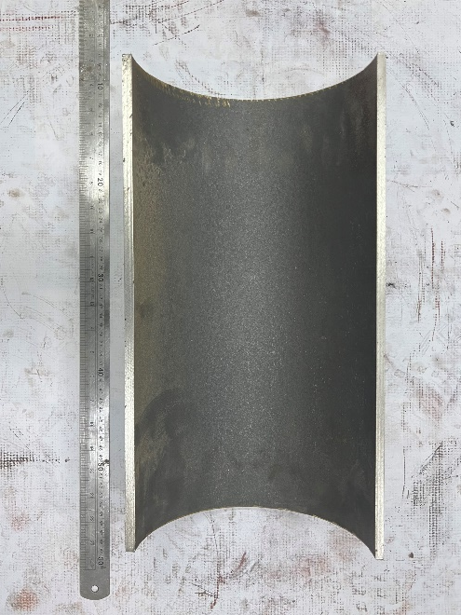
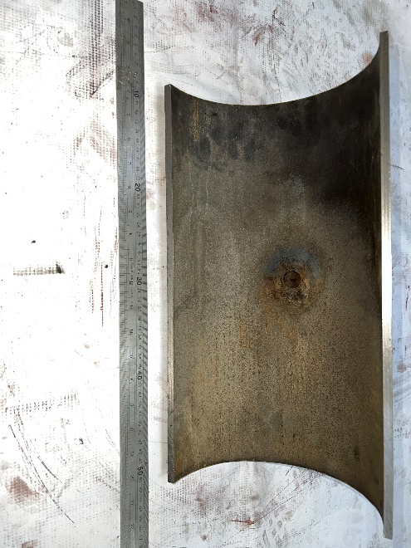
Visual Examination
Outer Surface
Internal Surface
Valve Side
Flow Direction
Header Side
The area around the branch is covered in black scale
The rest of the outer surface is covered in brownish scale
The cracking at the toe of the branch weld at 6H00 position could be observed
The inner surface of the header opposite the branch is covered in black scale with no sign of corrosion.
The inner surface of the header adjacent to and downstream/below of the branch is covered in brownish scale with signs of corrosion.
The inner surface of the nipolet has deposits and show signs of corrosion especially the bottom side.

Slide 6
Chemical Composition
Table 1: SEM-EDS Elemental Analysis by XRF for the pipe and the nipolet.
Mass % | C | Mn | P | S | Si | Cr | Ni | Mo | Cu | Al | V | Ti
Pipe | 0.083 | 1.62 | 0.005 | 0.002 | 0.43 | 19.19 | 9.78 | 0.530 | 0.496 | 0.091 | 0.063 | 0.02
Nipolet | 0.087 | 1.33 | 0.059 | 0.018 | 0.60 | 19.65 | 8.53 | 0.229 | 0.400 | 0.180 | 0.097 | 0.005
TP 304H | 0.04 – 0.10 | 2 max | 0.045 max | 0.030 max | 1.00 max | 18.0 - 20.0 | 8.00 - 11.0
The chemical compositions of both the crossover pipe and nipolet fall within the specified range for TP304H as per design
The P content of the nipolet is higher than the specified maximum content for TP304H by a value within the error limit of the technique which is negligible

Slide 7
Metallography (Pipe)
DS Outer Surface
DS Outer Surface
DS Inner Surface
DS Inner Surface
Most of the cracks on the outer surface are dagger shaped, wide, filled with oxide and transgranular which is typical of thermal fatigue cracks.
One crack on the outer surface has features of corrosion fatigue (wide, filled with oxide and has multiple lobes, branched to form “rabbit ears”)
The cracks on the inner surface are wide, filled with oxide and their tips are intergranular and branching which indicates that the cracking on the inner surface is corrosion fatigue.

Slide 8
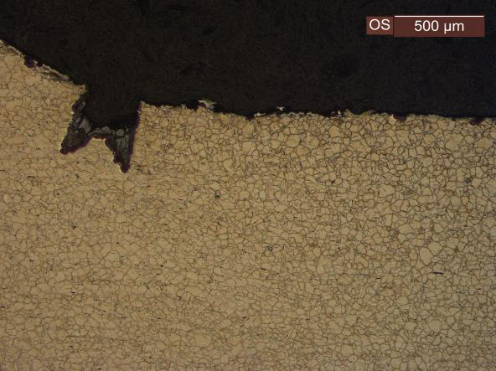
Metallography (Nipolet)
Outer Surface
Nipolet Sample
Inner Surface
Inner Surface
At the change of section on the outer surface, thermal fatigue micro-crack could be observed.
Elongated pits (which could be corrosion pits + fatigue micro-cracks, so elongated by cracking)could be observed on the inner surface.
This indicates that corrosive condensate formed and caused corrosion at the bottom of the horizontal nipolet.

Slide 9
Sensitization (Nipolet)
Valve Side
Cross Section
Pipe Side
Optical microscope study of the sample showed a dual structure (ASTM A 262 Practice A) indicating sensitization for both ends but the ditches are thicker on the pipe side of the sample indicating that the degree of sensitization is higher on the pipe side.
The varying degree of sensitization along the sample is an indication of a temperature gradient along the sample that existed during operation.
A temperature gradient is a source of thermal stresses which can lead to thermal fatigue when the stress is cyclic

Slide 10
SEM (Pipe)
Inner Surface (As Received)
Table 2: SEM-EDS Analysis of the sample from the pipe as received condition.
Sp | C | O | Na | Mg | Al | Si | S | Cl | K | Ca | Cr | Mn | Fe | Ni | Total
A1 | 8.17 | 29.72 | 1.32 | 0.88 | 2.51 | 10.12 | 1.96 | 0.66 | 0.51 | 3.58 | 12.44 | 0.63 | 22.43 | 5.06 | 100.0
A2 | 12.87 | 41.62 | 1.58 | 2.50 | 1.31 | 3.04 | 1.26 | 0.79 | 0.26 | 5.91 | 9.96 | 0.46 | 14.34 | 4.11 | 100.0
A3 | 9.88 | 32.96 | 0.88 | 0.43 | 0.46 | 0.96 | 0.37 | 0.30 |  | 0.62 | 2.24 | 0.76 | 48.60 | 1.53 | 100.0
A4 | 6.01 | 30.92 | 1.45 | 0.52 | 0.60 | 1.89 | 0.95 | 0.90 | 0.16 | 0.85 | 19.27 | 0.54 | 26.71 | 9.24 | 100.0
Significant amounts of Na, Mg, Al, S, Cl, K, Si (very high amount and can not be from the material but from the steam) and Ca could be observed.
The S is probable from H2S which is a product of the decomposition of DMDS but could also originate from the steam and condensate.
Both H2S and Cl are corrosive.

Slide 11
SEM (Pipe)
Outer Surface (As Prepared)
Inner Surface (As Prepared)
Table 3: SEM-EDS Analysis of the sample from the pipe as prepared condition.
Table 4: SEM-EDS Analysis of the sample from the pipe as prepared condition.
Spectrum | C | O | Si | Cr | Mn | Fe | Ni | Cu | Total
A1 | 5.00 | 34.50 | 0.21 | 3.35 | 0.89 | 53.78 | 2.28 |  | 100.0
A2 | 9.64 | 35.11 |  | 2.03 | 0.82 | 50.72 | 1.68 |  | 100.0
A3 | 6.90 |  | 0.40 | 17.73 | 1.70 | 64.62 | 8.10 | 0.54 | 100.0
P1 | 5.08 | 21.97 | 0.63 | 27.42 | 3.31 | 24.27 | 16.22 | 1.11 | 100.0
P2 | 4.85 | 28.28 | 0.52 | 22.98 | 3.17 | 16.33 | 22.47 | 1.41 | 100.0
Spectrum | C | O | Si | S | V | Cr | Mn | Fe | Ni | Cu | Mo | Total
A1 | 3.99 | 27.31 | 0.56 | 0.17 |  | 25.59 | 2.50 | 27.41 | 12.47 |  |  | 100.0
P1 | 5.31 | 30.67 | 1.77 | 5.72 | 0.40 | 44.93 | 6.13 | 4.67 | 0.42 |  |  | 100.0
P2 | 5.35 | 8.01 | 1.41 |  |  | 6.48 | 0.93 | 27.12 | 48.82 | 1.88 |  | 100.0
A2 | 5.12 | 32.03 | 0.31 |  |  | 12.12 | 2.00 | 45.49 | 2.93 |  |  | 100.0
A3 | 6.21 |  | 0.43 |  |  | 17.82 | 1.84 | 64.55 | 8.07 | 0.66 | 0.43 | 100.0
P3 | 34.61 | 21.58 | 2.87 | 0.30 |  | 26.70 | 5.17 | 8.07 | 0.70 |  |  | 100.0
P4 | 9.86 | 36.68 | 4.03 | 0.18 |  | 39.34 | 4.61 | 4.68 | 0.61 |  |  | 100.0
The cracks are filled with metal oxides.
No corrosion agents could be observed
This confirms the metallography observation that the cracks on the external surface are thermal fatigue cracks
Significant amounts of S could be observed in the corrosion product inside the crack indicating that the cracking mechanism is corrosion fatigue
Grain boundary attack which is a sign of sulphidation could be observed.

Slide 12
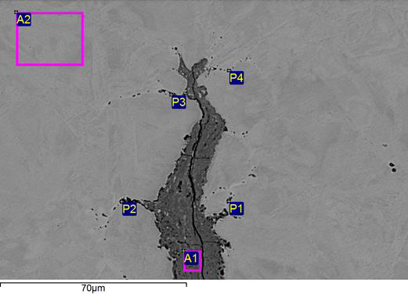
SEM (Nipolet)
Inner Surface (As Received)
Inner Surface (As Prepared)
Table 5: SEM-EDS Analysis of the sample from the nipolet as received condition.
Table 6: SEM-EDS Analysis of the sample from the nipolet as prepared condition.
Spectrum | C | N | O | Mg | Al | Si | S | K | Ca | Ti | Cr | Fe | Ni | Total
A1 | 10.57 | 2.66 | 56.70 |  | 0.12 | 1.70 | 7.75 |  | 0.17 |  | 5.81 | 14.23 | 0.29 | 100.0
A2 | 10.13 | 2.38 | 52.43 |  |  | 4.76 | 6.79 |  |  |  | 7.79 | 15.34 | 0.38 | 100.0
P1 | 17.54 | 3.34 | 61.61 |  |  | 1.31 | 6.39 |  | 0.63 |  | 2.82 | 6.00 | 0.37 | 100.0
P2 | 9.33 |  | 56.53 | 0.42 | 11.00 | 5.70 | 1.76 | 0.12 | 11.41 | 0.84 | 0.95 | 1.62 | 0.33 | 100.0
A3 | 18.06 | 2.81 | 57.58 | 0.13 | 0.18 | 3.04 | 7.75 |  | 0.38 |  | 4.69 | 4.17 | 1.21 | 100.0
A4 | 11.71 |  | 55.67 |  |  | 3.36 | 12.51 |  |  |  | 8.21 | 5.70 | 2.85 | 100.0
Spectrum | C | O | Si | S | V | Cr | Mn | Fe | Ni | Total
A1 | 3.76 | 31.10 | 0.61 | 1.24 |  | 16.34 | 1.63 | 42.93 | 2.39 | 100.0
P1 | 8.27 |  | 0.34 | 8.22 |  | 14.37 | 0.89 | 58.07 | 9.83 | 100.0
P2 | 7.10 | 22.92 | 6.26 | 7.27 | 0.42 | 30.51 | 1.92 | 19.84 | 3.75 | 100.0
P3 | 4.26 | 21.32 | 1.44 | 1.17 | 0.27 | 25.47 | 3.18 | 37.33 | 5.54 | 100.0
P4 | 6.44 |  | 0.45 | 6.23 |  | 15.51 | 0.62 | 58.07 | 12.68 | 100.0
A2 | 5.54 |  | 0.56 |  |  | 18.27 | 1.32 | 67.38 | 6.93 | 100.0
Significant amounts of N, S, Si and Ca could be observed
Significant amounts of S could be observed in the corrosion product inside the elongated pits/micro-cracks
The presence of the dark dots in the grain boundaries ahead of the crack is indicative of sulphidation

Slide 13
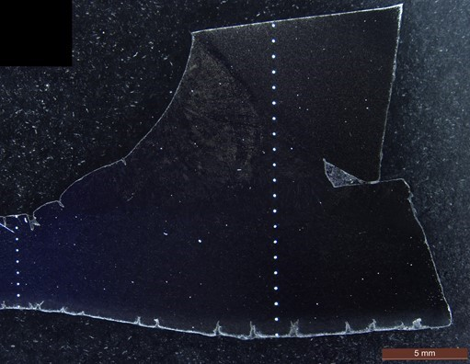
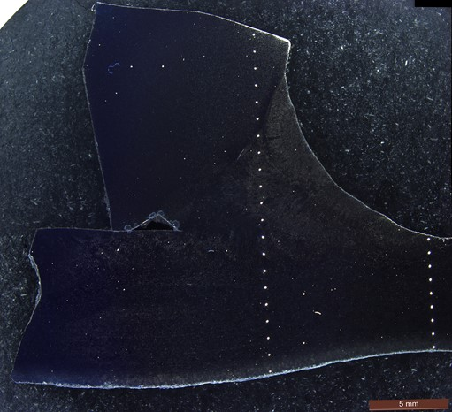
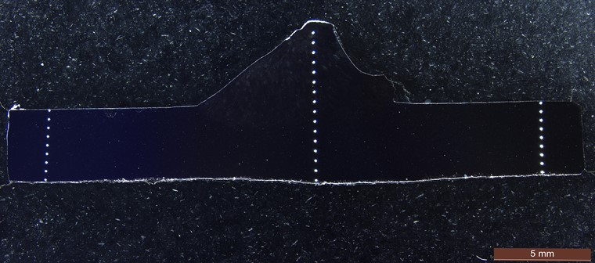
Hardness Testing
Pipe (Downstream)
Pipe (Upstream)
Nipolet
Valve Side
Pipe Side

Slide 14
Conclusion
Recommendations
Cracking is limited to the bottom of the horizontal short branch/nipolet. This is most probable because condensation formation is an important factor in this failure.
The condensate could have flowed back into the crossover line and evaporated repeatedly. Evaporation leads to concentration of corrosion agents in the condensate. Aqueous corrosion could have occurred at the bottom of the pipe.
Corrosion pits could have acted as initiation points for corrosion fatigue cracks at the internal surface around the joint.
Repeated condensate formation, flow back and evaporation could have resulted in cyclic thermal stresses in the vicinity of the branch joint.
These cyclic thermal stresses could be driving the corrosion fatigue cracking at the internal surface and the thermal fatigue at the external surface. The thinner bottom (due to corrosion) probable have higher stresses than the top
A complete design review study including stress/thermal analyses should be conducted to determine the magnitude of thermal stresses in the joint.
Such a stress analysis study should include but not limited to the following:
1- Simulation of the effect of introduction of the colder back flowing condensate on the hotter joint should be done.
2-The effect of insulating the pressure tapping line on the magnitude of the thermal stresses and condensate formation.
Any change in design should be done in accordance with SABIC MOC process and after accurate identification of damage mechanism and failure contributing factors
A review of the steam quality should be conducted to ensure that all impurity levels are within specification

Slide 15
References
[1] American Petroleum Institute (API). Damage Mechanisms Affecting Fixed Equipment in the Refining Industry. 3rd ed., Washington, DC, American Petroleum Institute (API), 2020, pp. 105-110.
[2] American Petroleum Institute (API). Damage Mechanisms Affecting Fixed Equipment in the Refining Industry. 3rd ed., Washington, DC, American Petroleum Institute (API), 2020, pp. 320-326.
[3] ASTM International. “Standard Guide for Preparation of Metallographic Specimens” West Conshohocken, ASTM International, 2017, pp. 1-12.
[4] ASTM International. “Standard Practice for Microetching Metals and Alloys” West Conshohocken, ASTM International, 2023, pp. 1-22.
[5] ASTM International. “Standard Practices for Detecting Susceptibility to Intergranular Attack in Austenitic Stainless Steels” West Conshohocken, ASTM International, 2021, pp. 1-20.
[6] ASTM International. "Standard Specification for Seamless, Ewlded, and Heavily Cold Worked Austenitic Stainless Steel Pipes” West Conshohocken, ASTM International, 2021, pp. 3.
[7] Damage Mechanisms Affecting Fixed Equipment in the Refining Industry. Third ed., 2020, pp. 265-66.

Slide 16




JUBCOR
2024
CONFERENCE & EXHIBITION
YOUR LOGO
INNOVATIVE SOLUTIONS FOR CORROSION CHALLENGES
THANK YOU
Reach out.
Calle Cualquiera 123, Cualquier Lugar
phone
email

