Slide 1



Corrosion Protection of Reinforced Concrete Structures with
Galvanic Surface Anode System:
(An effective and Long-term Performance Case History)
Presenter:
Dr Zia Chaudhary
Engineering Manager
D.Phill (Oxon), MSc, BSc, FICorr,
Corrosion Specialist (AMPP), CP Specialist (ICorr L4)

Slide 2




State of the art construction products
Specialty contracting
Forensics & Engineering services
Solutions that integrate products, engineering, and construction
Notes:
There are three companies that make up Structural Group.
We provide products and a broad ranger of engineering support services through Structural Technologies.
And industry leading comprehensive specialty repair and new construction services through our two contracting companies, STRUCTURAL and PULLMAN.
By combining these capabilities we offer our customers comprehensive turnkey solutions that integrate products, engineering support and contracting.

Slide 3
Contents
An Overview of Corrosion of Reinforcing Steel
Cathodic Corrosion Protection
Galvanic Cathodic Protection of Steel in Concrete
  Description and Components of Surface Anode System (SAS)
  SAS Field Installations and System Performance
Conclusions

Slide 4
Corrosion of Steel Reinforcement

Slide 5
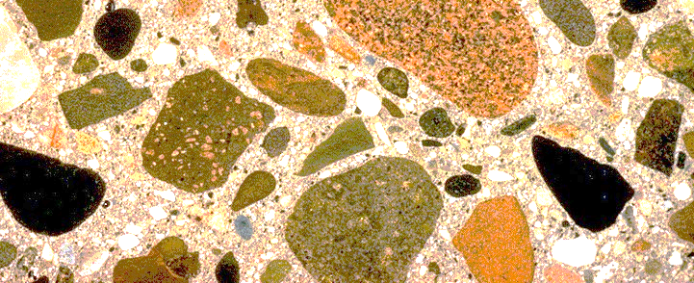
Passivation of Steel in New Concrete
High pH environment creates passivation layer

Slide 6
Cover
Steel
REINFORCEMENT
CO₂
Pitting Corrosion
CO₂
Cl
Cl
CO₂
General Corrosion
Cl
Cl
Cl
CO₂
Cl
CO₂
ELECTROLYTE
PASSIVE FILM
pH>13
CO₂

Slide 7
Volume of Iron & Reaction Products
Fe(OH)₃.3H₂O
Fe(OH)₃
Fe(OH)₂
Fe₂O₃
Fe₃O₄
FeO
Fe

Slide 8


CORROSION PRODUCTS CRACK CONCRETE
The corrosion products
are more than 6 times the
volume of the steel consumed
Hydrated
ferric oxide
(rust)

Slide 9
Cathodic Corrosion Protection of Steel Reinforcement

Slide 10
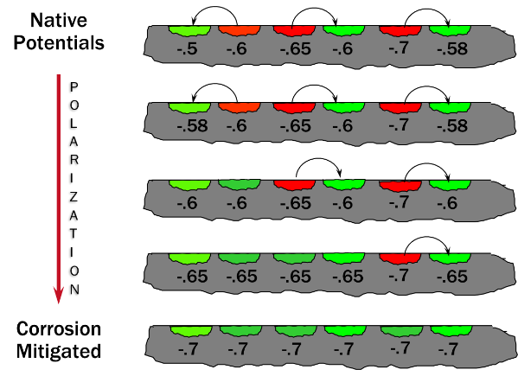
Cathodic Protection
Cathodic Protection - the polarization of all noble potential areas (cathodes) to the most active potential (anodes) on the metal surface
Cathodic protection is achieved by making the structure the cathode of a direct current circuit.
Proven method in arresting corrosion of steel in chloride contaminated structures
Two Types:
  Galvanic Cathodic Protection Systems
  Impressed Current Cathodic Protection Systems
Polarization of a Structure

Slide 11
Ch.3
Galvanic Cathodic Protection of Steel in Concrete Using:
Surface Anode System (SAS)
SAS Description & Components
Field Installations and System Performance

Slide 12
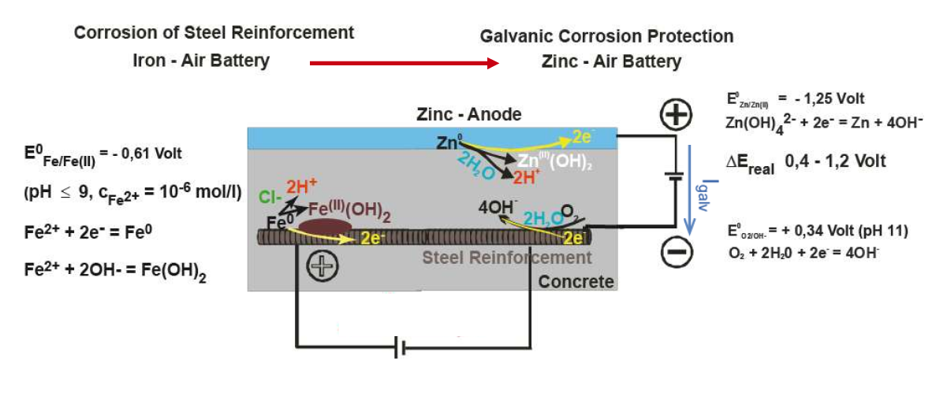
Galvanic Surface Anode System (SAS)
Working Principle

Slide 13
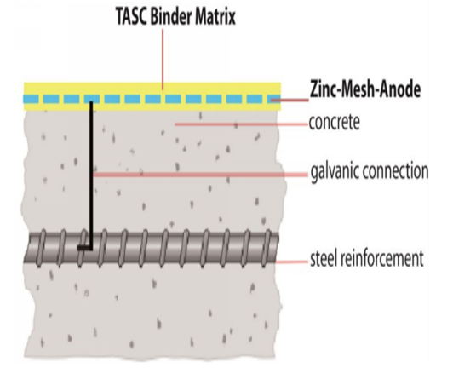
Galvanic Surface Anode System (ZSAS)
Components & Circuit
Zinc Mesh Anode:
Zinc mesh (2 to 4 Kg/m²) embedded in proprietary solid matrix.
Binder Matrix:
Formed by hardening of the shrinkage reduced embedding zinc activating cement (SEZAC) containing Tecto-Aluminosilicate-Cement (TASC).
Galvanic Connection
An electrical (cable) connection between steel and zinc anode, electrical current flow.
Concrete (Pore Water)
An electrolyte that conduct ionic current between steel and zinc anode.
Monitoring Probes
Embedded in concrete close to steel to evaluate galvanic system performance
Monitoring Probe

Slide 14
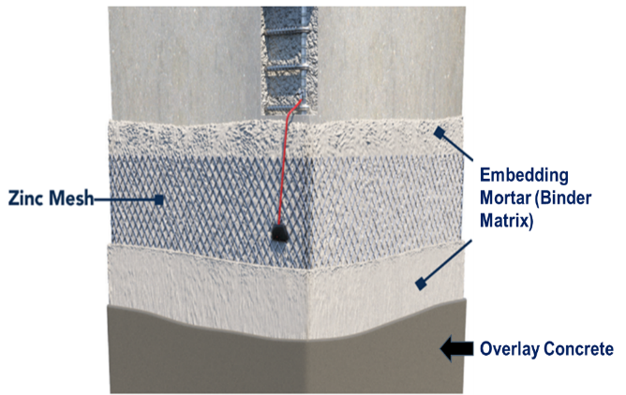
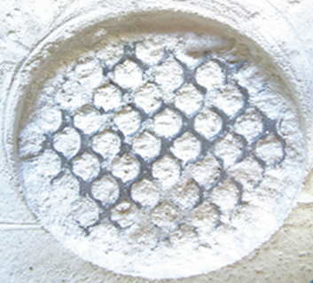
Galvanic Surface Anode System (ZSAS)
Components & Circuit

Slide 15
Galvanic Surface Anode System (ZSAS)
SEZAC Binder Matrix: Properties
Maintain an optimum electrolytic contact between the zinc anode and concrete overlay.
Maintain durable galvanic activity of zinc anode for long-term performance.
Prevent self-passivation of the zinc anode.
Assure high and durable adhesion towards the concrete overlay, >1.5 Mpa.
High electrolytic conductivity, specific resistance at 75% RH, <90 ohm.m
Provide enough space for anodic products formed
Suitable for pre-stressed concrete elements

Slide 16
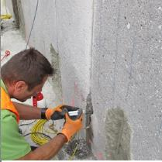
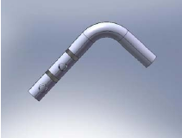
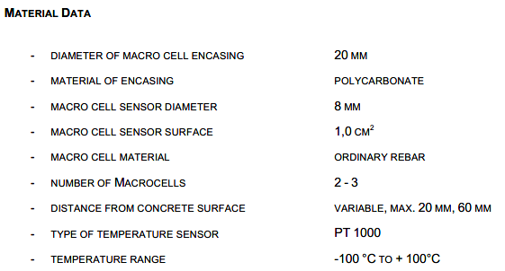
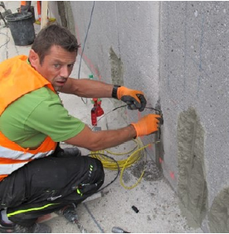
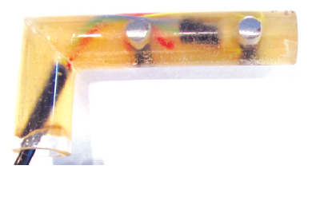
Galvanic Surface Anode System (ZSAS)
Components: Macro-cell Sensor

Slide 17
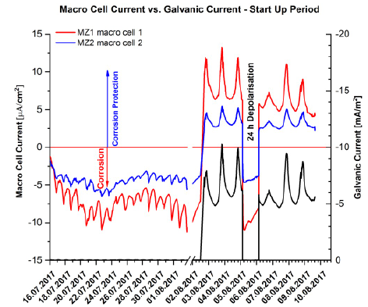
Galvanic Surface Anode System (ZSAS)
Components: Macro-cell Sensor
Combined Reinforced Steel Corrosion – Concrete Temperature Sensor designed for monitoring Galvanic Protection Efficiency
Designed for monitoring cathodic protection (ICCP) and galvanic protection efficiency
  Monitor and measure local corrosion currents
  Monitor and measure concrete temperature
  Positive currents signify cathodic protection
  Negative currents signify corrosion current

Slide 18
SAS Field Installations / Performance

Slide 19
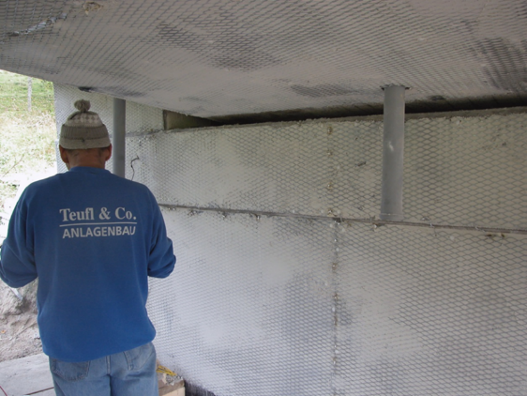
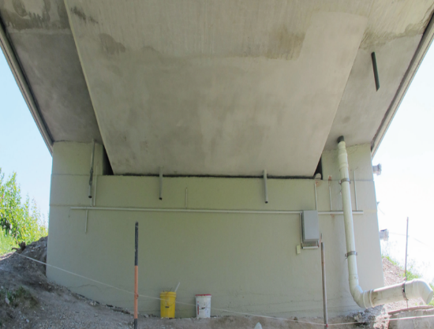
ALPLGRABEN BRIDGE, STYRIA, AUSTRIA:
11 Years of Galvanic Protection by SAS

Slide 20
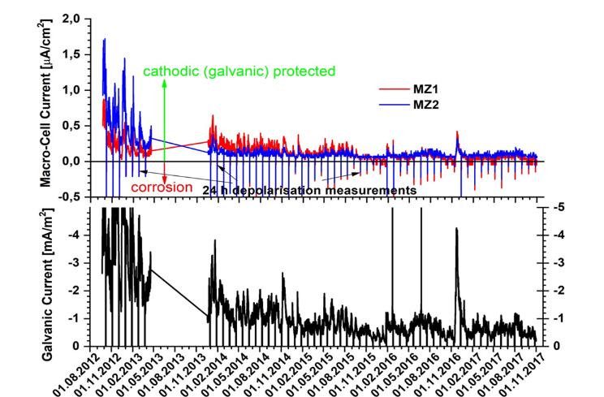
ALPLGRABEN BRIDGE, STYRIA, AUSTRIA:
11 Years of Galvanic Protection by SAS
Chloride contents of 4 to 5.6% by wt of cement was recorded in frequently wetted areas, and 0.5 to 0.9% in less wet areas.
System was installed / commissioned in Sept. 2007 and refurbished in July/August 2012 (zinc mesh was replaced on 1 m2, a cover coat applied) and restarted on 10 August 2012
Galvanic current in relation to macrocell currents indicating efficiency of galvanic corrosion protection

Slide 21
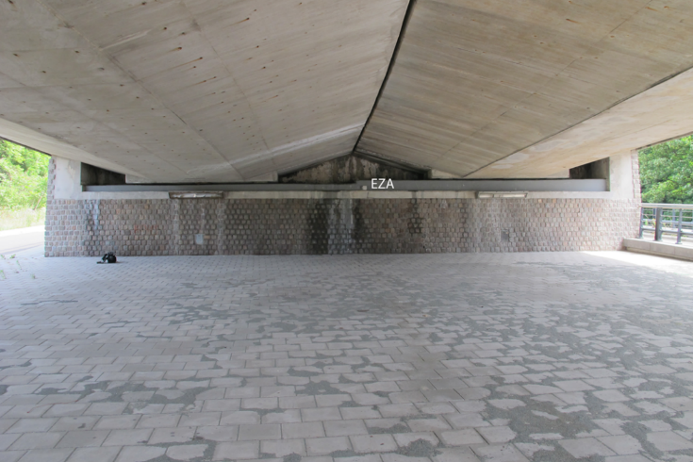
HUBERTUS VIADUCT, DEN HAAG
SAS installed on Beams of Hubertus Viaduct in 2008.

Slide 22
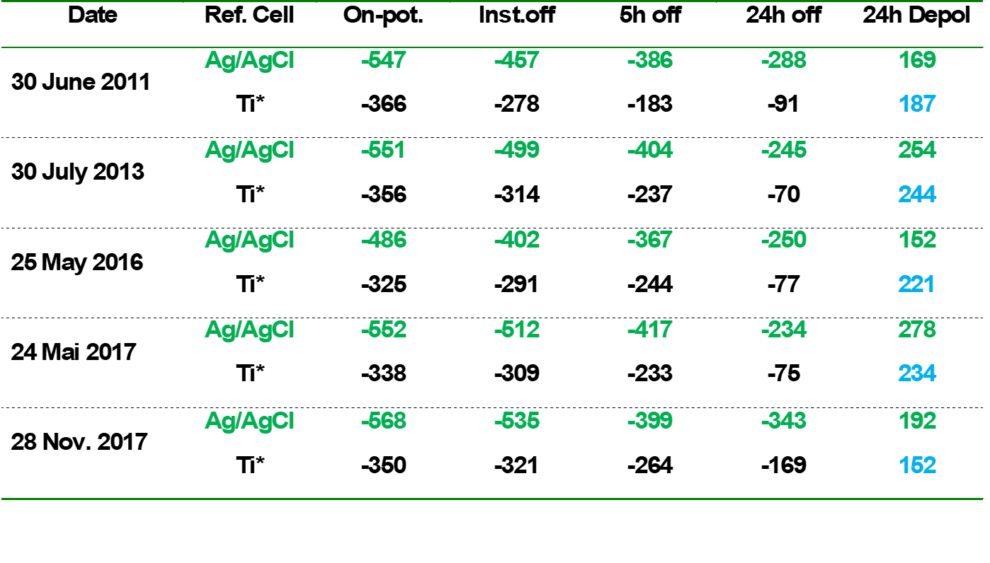
HUBERTUS VIADUCT, DEN HAAG
SAS installed on Beams of Hubertus Viaduct in 2008.

Slide 23
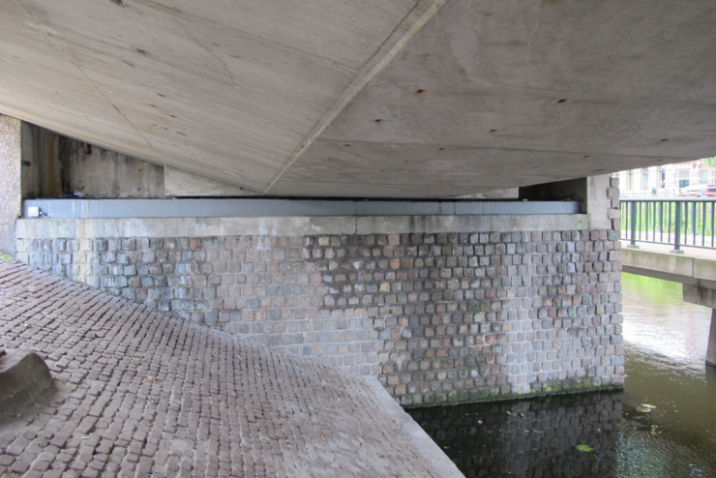
HUBERTUS VIADUCT, DEN HAAG
SAS installed on Beams of Hubertus Viaduct in 2008.

Slide 24
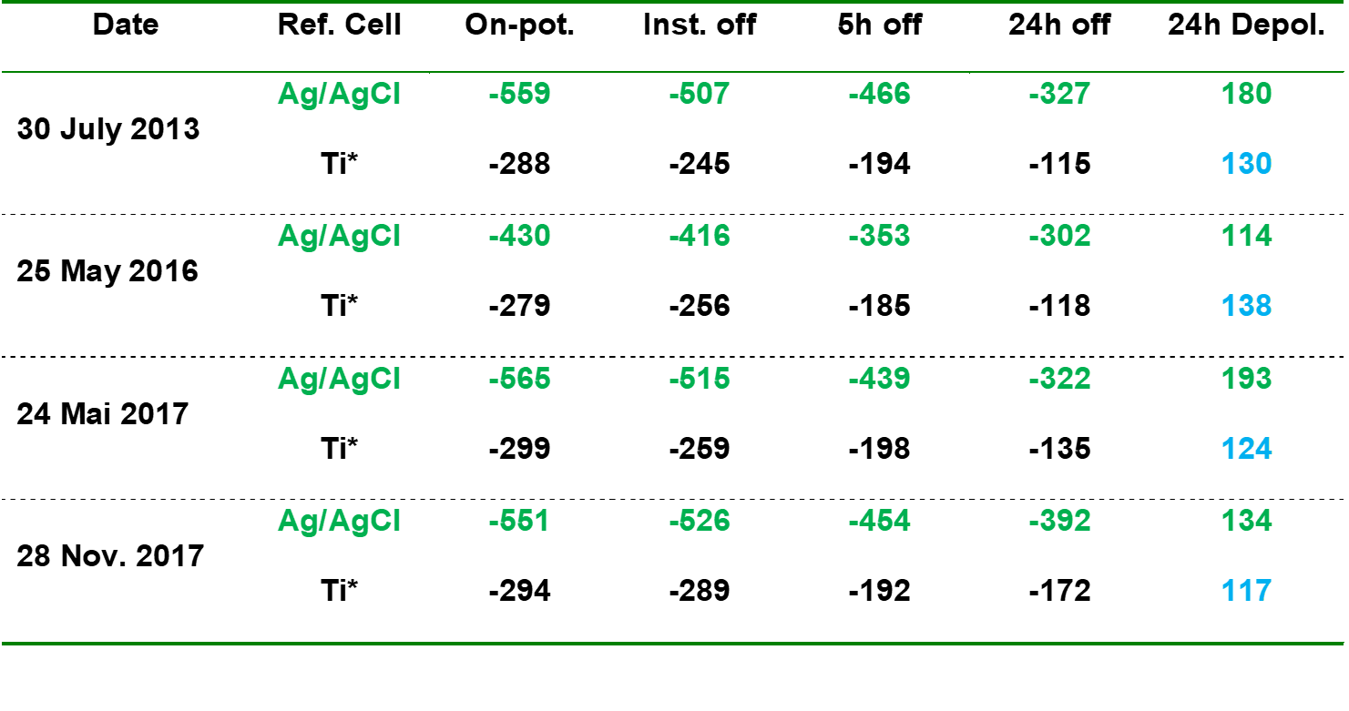
HUBERTUS VIADUCT, DEN HAAG
SAS Performance: Depolarization Test Data..

Slide 25
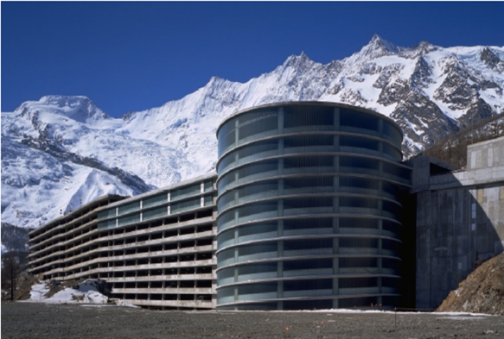
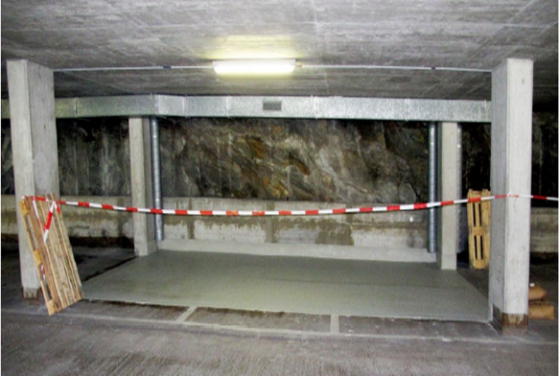
PARKING DECK IN SAAS FEE, SWITZERLAND
SAS installed on Parking Deck Slab in 2011.

Slide 26
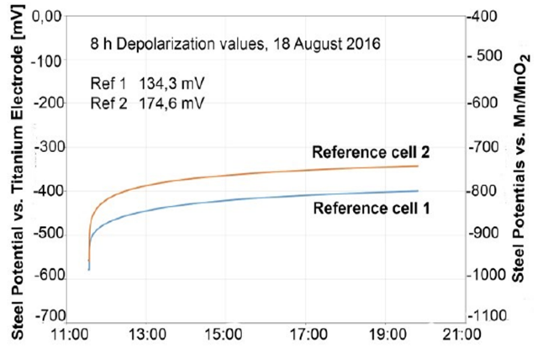
PARKING DECK IN SAAS FEE, SWITZERLAND
SAS Depolarization Test Data Recorded in 2016.
SAAS FEE Car Parking Deck was built in 1979/80 and extended in 1981/82, with a total of 60,000 m2 of parking area.
The decks are reinforced with unbonded Post-Tensioned Tendons concrete.
Chloride contents of 0.5 – 3.0% by wt. of cement were recorded in deck slab ((source: Deicing Salt).
SAS was installed over deck slab in 2011 and coated with waterproofing and wearing surface of solid epoxy and covered with high abrasion resistant sealcoat.
SAS is in operation since 2011 and meeting the specified depolarization criterion.

Slide 27
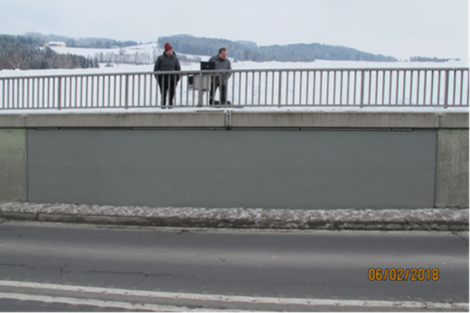
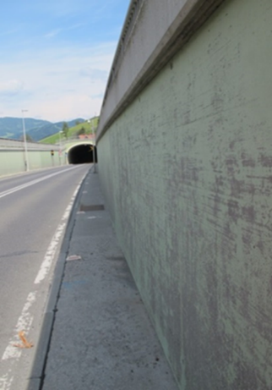
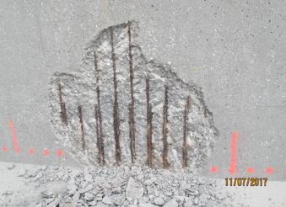
ALPINE TUNNEL ENTRANCE, STYRIAN ALPS
SAS installed on Retaining Walls in 2018.

Slide 28
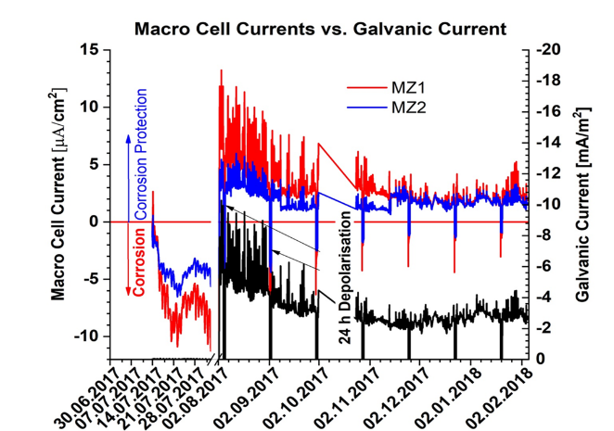
ALPINE TUNNEL ENTRANCE, STYRIAN ALPS
SAS Monitoring Using Macro-Cell Sensors
Retaining walls at tunnel entrance are exposed to very high thaw deicing salt loads.
Impact of salt exposure is intensified by wind channel effect.
Chloride contents of 1.6 – 6.0% by wt. of cement were recorded in R. Walls.
SAS was installed over Walls in 2017 and coated with epoxy coating (Sikagard-332) and topped dirt repellent protective coating (Sikagard-260).
ERE-20 reference cells and Macro-cell sensors were installed to monitor the SAS performance in protecting reinforcing steel from corrosion.

Slide 29
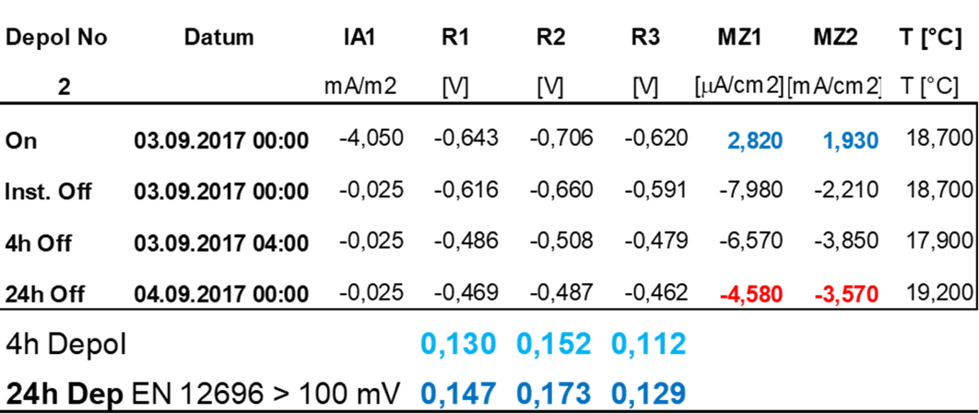
ALPINE TUNNEL ENTRANCE, STYRIAN ALPS
SAS Performance: Depolarization Test Data

Slide 30

ALPINE TUNNEL ENTRANCE, STYRIAN ALPS
SAS Performance: Depolarization Test Data

Slide 31
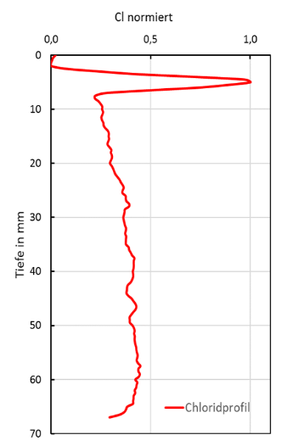
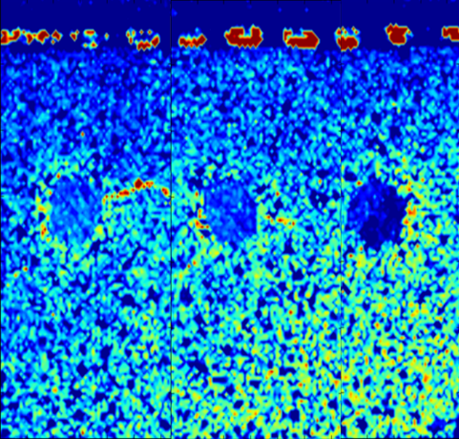
Galvanic Surface Anode System (SAS)
Field Samples Indicate Chloride Movement towards Zn Anode

Slide 32
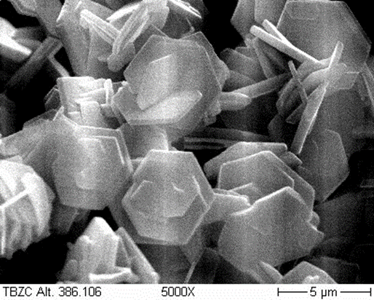
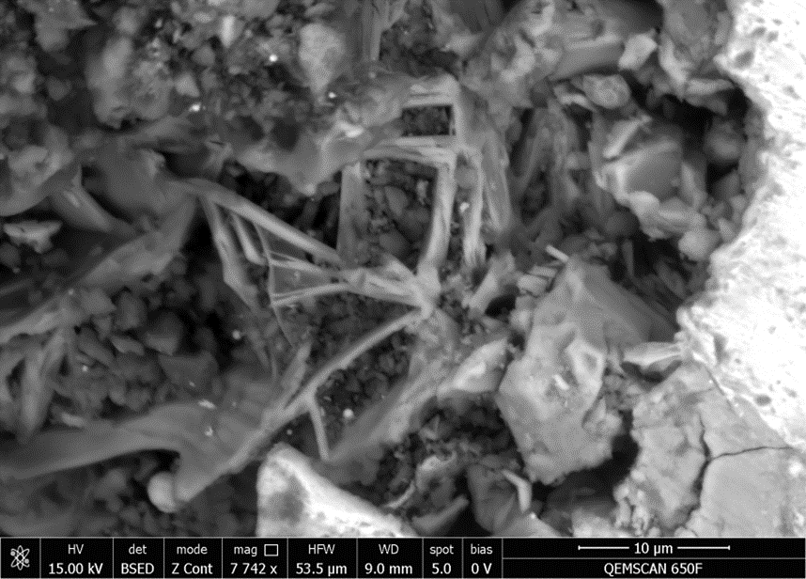
Galvanic Surface Anode System (SAS)
Field Samples Indicate Chloride Extraction
Chlorides migrate towards the zinc-anode during the CP operation and are immobilized as zinc-hydroxide-chloride,
a natural mineral Simonkolleite

Slide 33
CONCLUSIONS
The galvanic protection afforded by SAS to the steel reinforcement is uniform, reliable, and long lasting.
No indication of passivation of zinc over an operational period of > 12 years
Expected service life of SAS with 2 to 4 Kg Zinc/m² of steel is 20 - 30 years.
From a mean galvanic current of 3.6 mA/m², one would expect a service life of 30-36 years.
Strong indication for chloride extraction and immobilization into SAS, coated with a water impermeable membrane
The SAS allows reliable protection and rehabilitation of RC structures under conditions ranging from alpine (low temperature, very dry periods) to marine environment (high temperature, high humidity, high chloride).

Slide 34
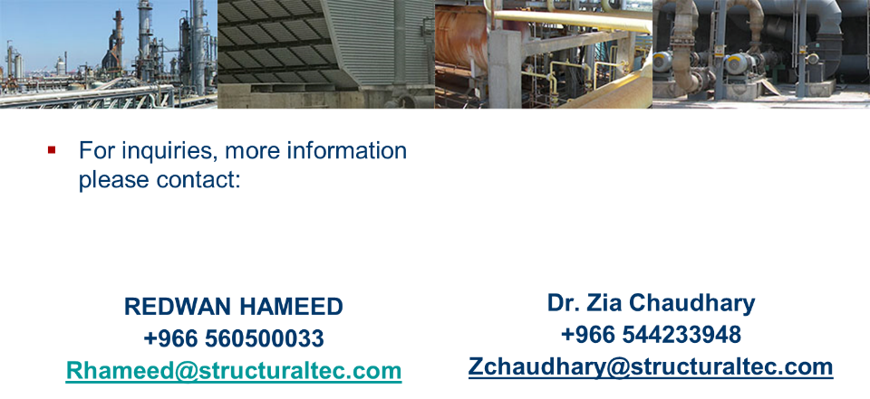
Thank You!

