Slide 1
JUBCOR
2024
CONFERENCE & EXHIBITION
INNOVATIVE SOLUTIONS FOR CORROSION CHALLENGES
Presented By:
Turki Misfer Al-Otaibi
Corrosion Prevention and Protection of Civil Assets

Slide 2
Corrosion Prevention and Protection of Civil Assets
Definition of Corrosion
Corrosion is a natural process in which a refined metal is converted to a more chemically stable form, such as oxide, hydroxide, or sulphide. It is the gradual decomposition of materials (usually metals) as a result of chemical and/or electrochemical reactions with their surroundings.

Slide 3
Corrosion Prevention and Protection of Civil Assets
Importance of Corrosion Control
Lack of Corrosion Control is Expensive
The global cost of corrosion is estimated to be US$2.5 trillion, which is equivalent to 3.4% of the global GDP (Gross Domestic Product)
Based on Experience, if corrosion control is not included in design, cost of corrosion repairs GREATLY EXCEEDS the sum of both the original cost of repaired component & its missing protection
Thus, it is prudent to establish a corrosion control policy as part of any project by integrating it into an organizations management system and achieving it by its proper implementation

Slide 4
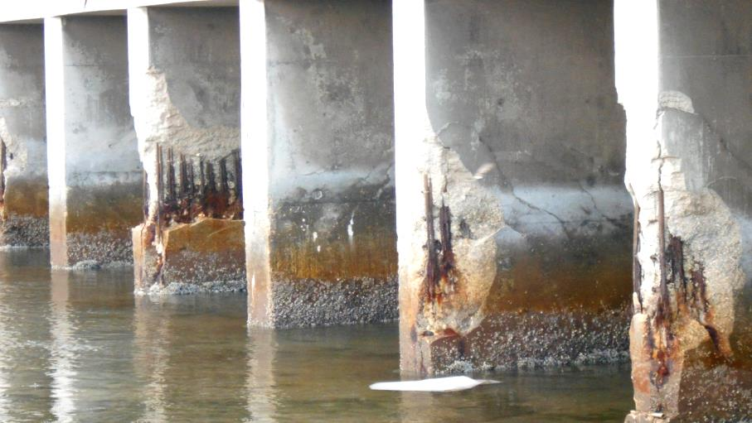
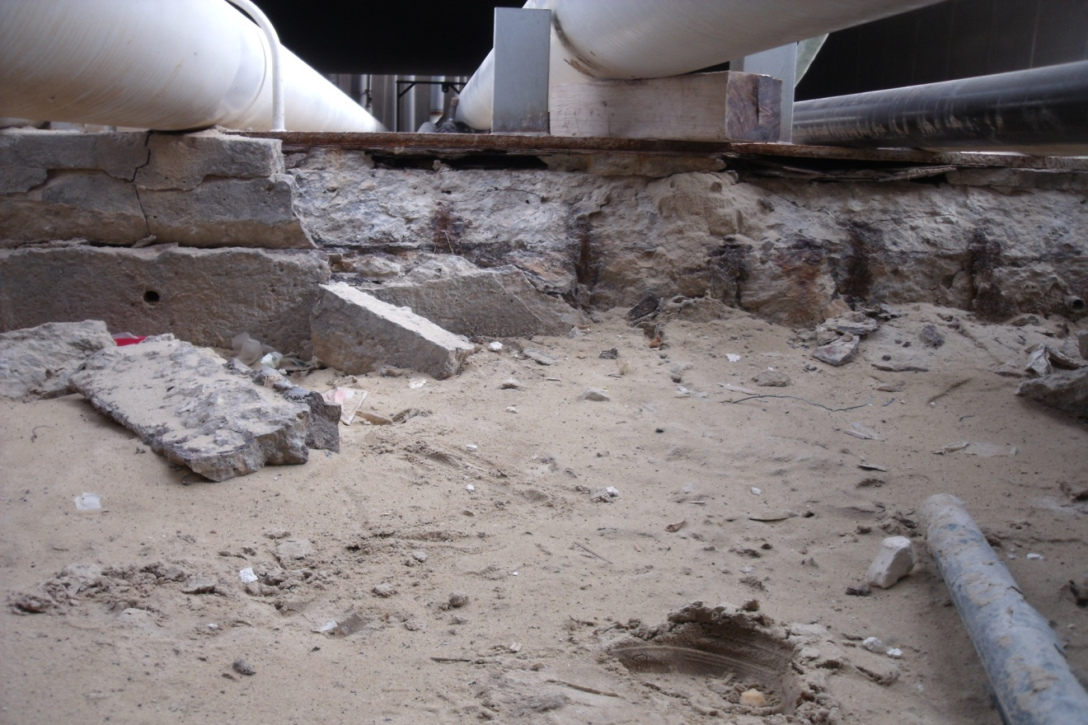
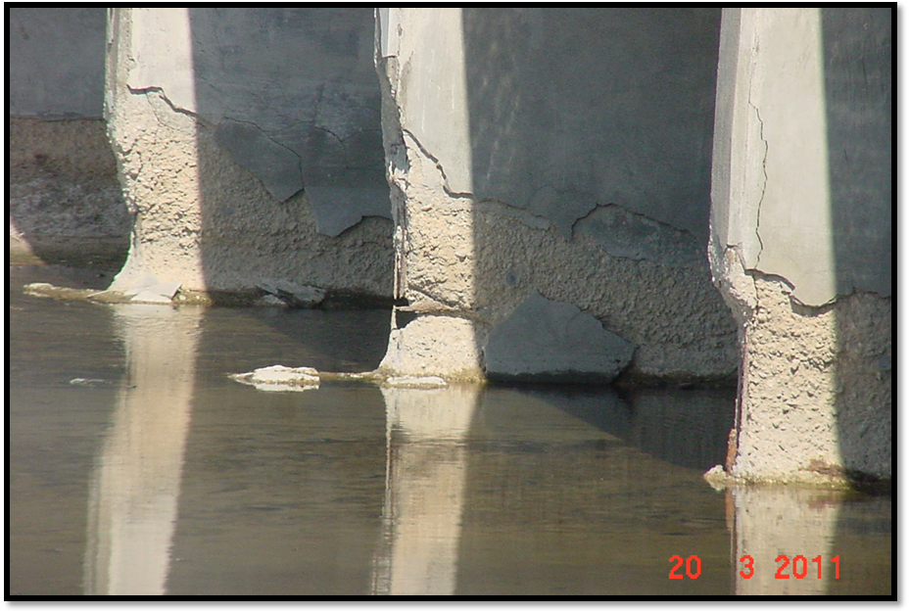
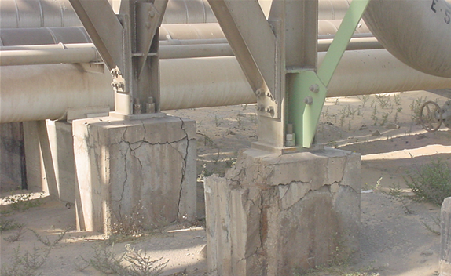
Corrosion Prevention and Protection of Civil Assets
Importance of Corrosion Control
Bridge
Pipe Sleeper
Culvert
Pipeline Loop Support Structure

Slide 5
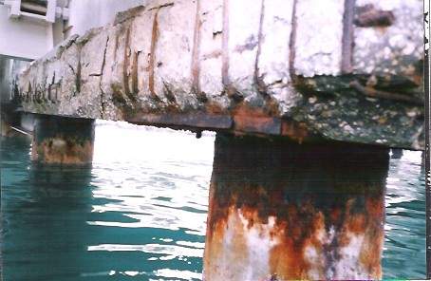
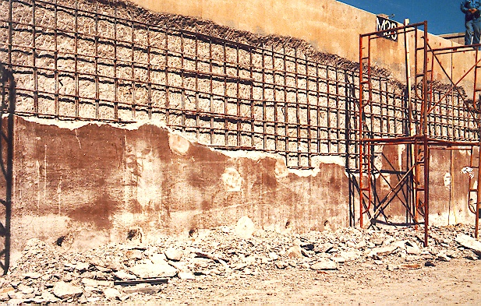
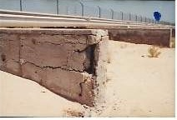
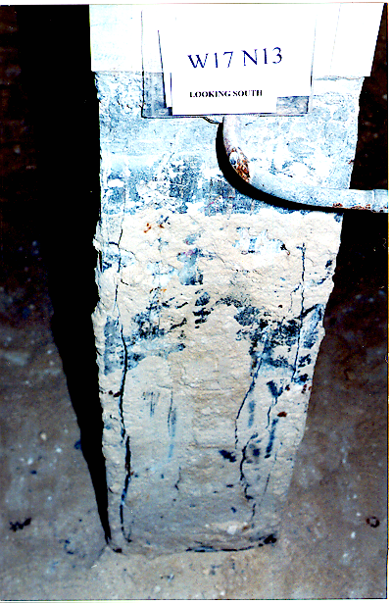
Corrosion Prevention and Protection of Civil Assets
Importance of Corrosion Control
Concrete Pile Cap
Seawater Cooling Canals
Corridors Sleepers
RC Office Building Pedestal

Slide 6
Corrosion Prevention and Protection of Civil Assets
Recommendation from NACE (AMPP)
It is recommended by NACE (AMPP) to select control methods based on knowledge gained from past successes & failures (i.e. past experiences).
Past successes can be repeated;
past failures should be avoided.

Slide 7
Corrosion Prevention and Protection of Civil Assets
Criteria for Aggressive Environment
Criteria of Aggressive Environment | Condition at Al-Jubail Environment
High levels of chlorides in soils & groundwater | Groundwater in Jubail exceeds 100,000 ppm
High levels of chlorides in the natural waters | Arabian Gulf is 5.5% salt (3% elsewhere)
High ambient temperatures, i.e. > 40° C | Summer temperatures in Jubail > 50° C)
High relative humidity, i.e. > 90% | Summer humidity in Jubail up to 100%
Atmospheres containing large amounts of airborne salt compounds | All industries in Jubail are located in a coastal environment
Jubail Industrial City’s environment meets these criteria and is found to be one of the most aggressive exposure environment in the world for Corrosion.

Slide 8
Corrosion Prevention and Protection of Civil Assets
Dossier of Past Achievements at Royal Commission in Jubail Resulting from Implementation of an Effective Corrosion Prevention Program
Effective and detailed Corrosion Prevention Program that includes work from Research to Construction for over 40 years at Royal Commission has many achievements
Research
Engineering
Construction
Research Contracts
Corrosion Consultation Contracts
Corrosion Repair Contracts

Slide 9
Corrosion Prevention and Protection of Civil Assets
Dossier of Past Achievements at Royal Commission in Jubail Resulting from Implementation of an Effective Corrosion Control Program
Research Achievements: The following below RC Specs were updated (Pictures to follow)
“Underground Piping Materials” | “Paints”
“FRP Pipes” | “High Performance Coatings”
“Reinforcement for Concrete” | “ICCP of Submerged and Buried U/G Metallic Structures”
“Portland Cement” | “SACP of Submerged and Buried U/G Metallic Structures”
“Structural Concrete” | “Sheet Waterproofing”

Slide 10
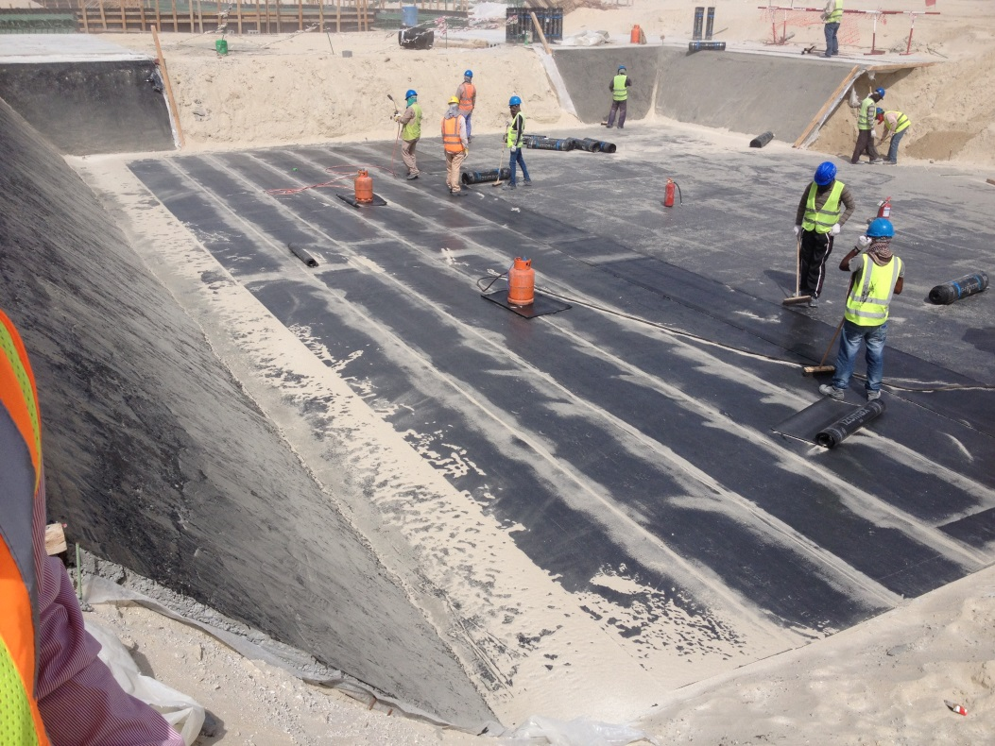
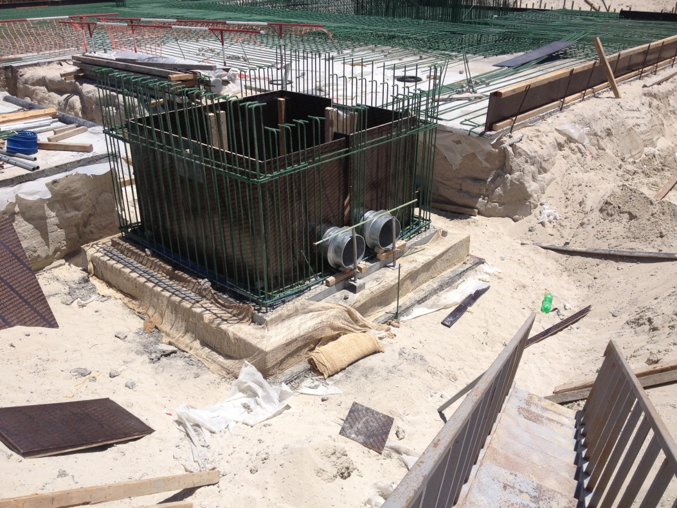
Corrosion Prevention and Protection of Civil Assets
Dossier of Past Achievements at Royal Commission in Jubail Resulting from Implementation of an Effective Corrosion Control Program
Raft Foundation Protection – “Sheet Waterproofing”
Manhole For Chilled Water Underground Network – “High performance coatings”

Slide 11
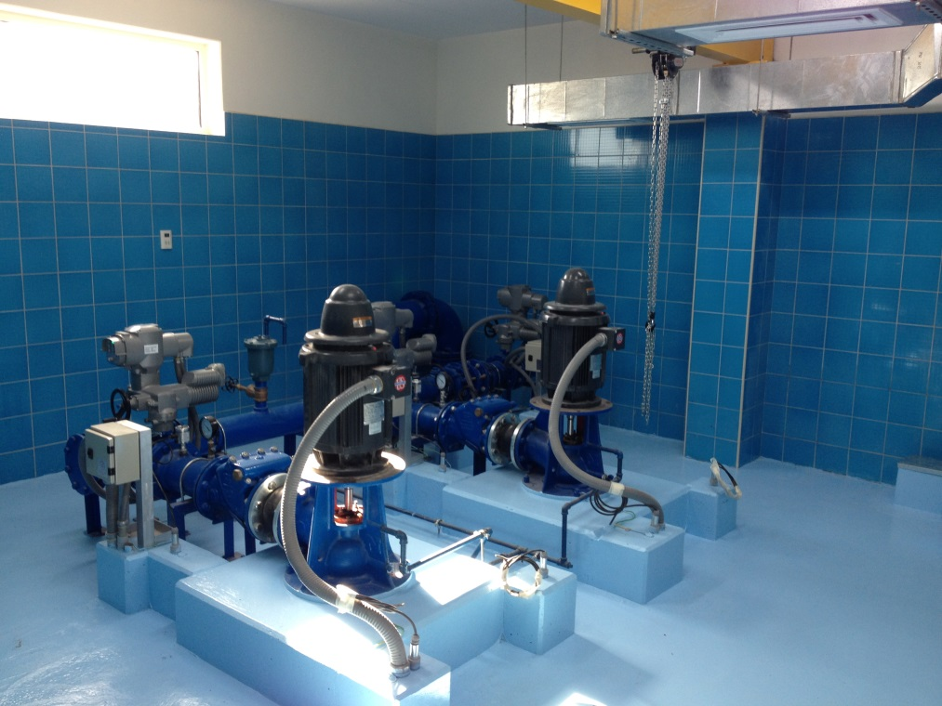
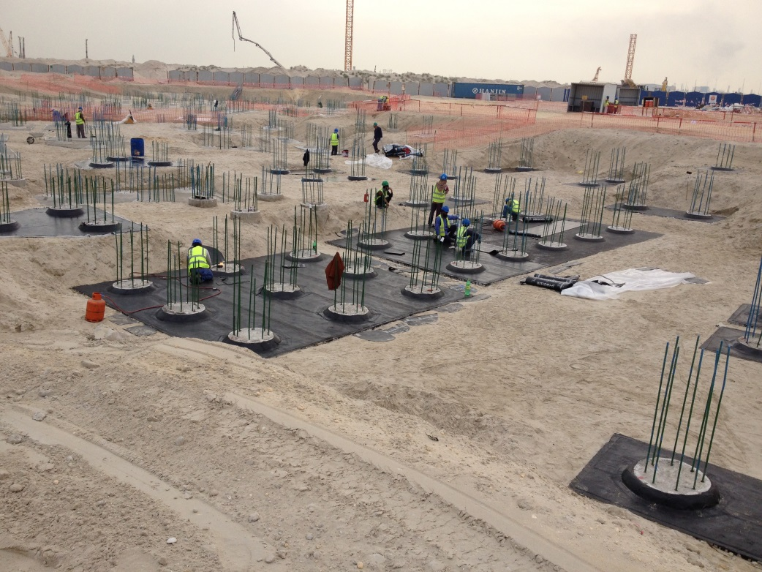
Corrosion Prevention and Protection of Civil Assets
Dossier of Past Achievements at Royal Commission in Jubail Resulting from Implementation of an Effective Corrosion Control Program
Potable Water Pump Station – “Paints” & “High Performance Coatings”
Pile Caps Waterpoofing – “Sheet waterproofing”

Slide 12
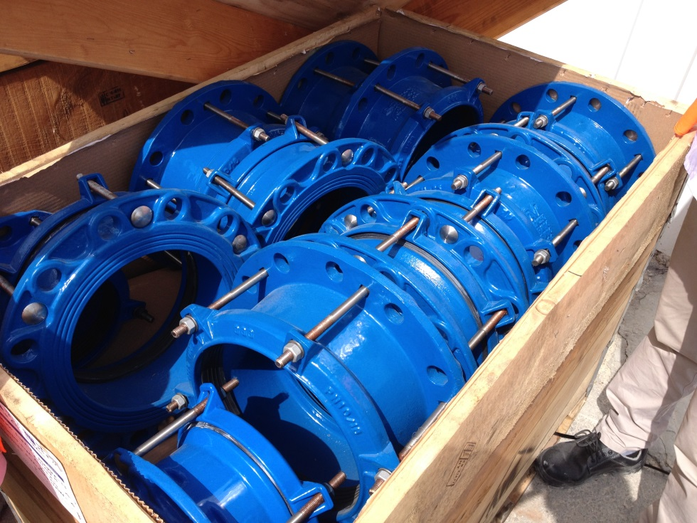
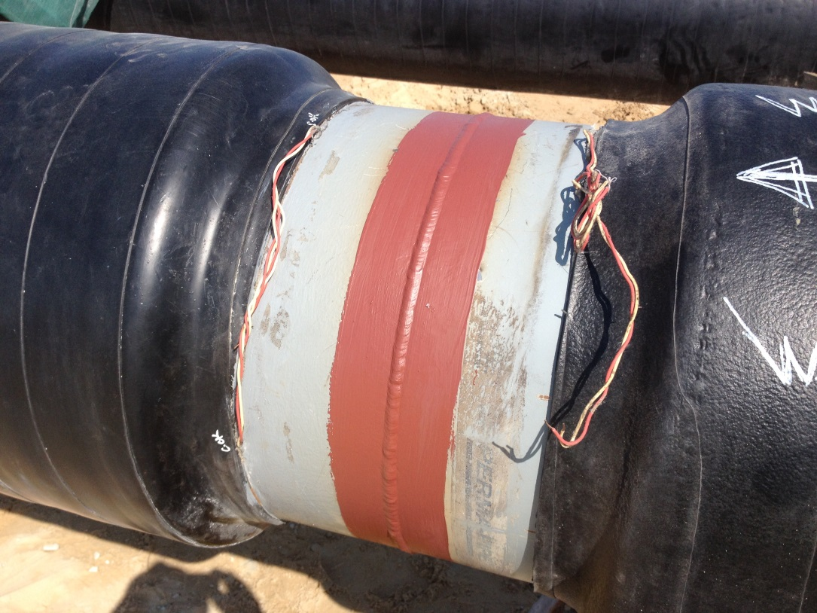
Corrosion Prevention and Protection of Civil Assets
Dossier of Past Achievements at Royal Commission in Jubail Resulting from Implementation of an Effective Corrosion Control Program
Protective coating in cast iron materials, fittings,
Valves etc. used in all bellow ground and above ground installations
Carbon Steel Pipes in CHW underground
system of the new City Centre area

Slide 13
Corrosion Prevention and Protection of Civil Assets
Royal Commission Arrangement in Engineering Department for
Corrosion Prevention and Protection of Civil Assets
Focusing monitoring and Initiation of the repair/replacement processes of highly critical structures from safety and operational perspective such as bridges, culverts, buildings and pipeline structures inside pipeline corridor
Implementation of Operation and maintenance of these structures through future Royal Commission repair Contracts .
Specialized consultation services and repair contractors are utilized to carry out these O & M works

Slide 14
Corrosion Prevention and Protection of Civil Assets
Royal Commission Arrangement in Engineering for
Corrosion Prevention and Protection of Civil Assets
Inspection Team
Monitoring Team
Corrosion Prevention and Protection of Civil Assets
CP Monitoring of Structures
Produce an Inspection Schedule
Reviewed and approved by RC
Produce a monitoring schedule
Reviewed and approved by RC
Good Condition
Severe/Moderate Condition
Submit Bi-monthly reports
Reviewed and approved by RC
Detailed Inspection and reporting
Reviewed and approved by RC
Schedule for
Re-inspection after 5 years
Submit Six-monthly reports
Reviewed and approved by RC
Add structure to repair contract
Execute the repair/replacement

Slide 15
Corrosion Prevention and Protection of Civil Assets
Royal Commission Arrangement in Engineering for Corrosion Prevention and Protection of Civil Assets
Reports Produced for Various RC Facilities between 2008 to 2024

Slide 16
Corrosion Prevention and Protection of Civil Assets
Royal Commission Arrangement in Engineering for Corrosion Prevention and Protection of Civil Assets
For the time period 2008-2024
3689 Reports Produced
1 Report every 1.6 days (which includes Mobilisation/Demobilisation, Inspection, Calculations, Drawings production, Report Submission)

Slide 17
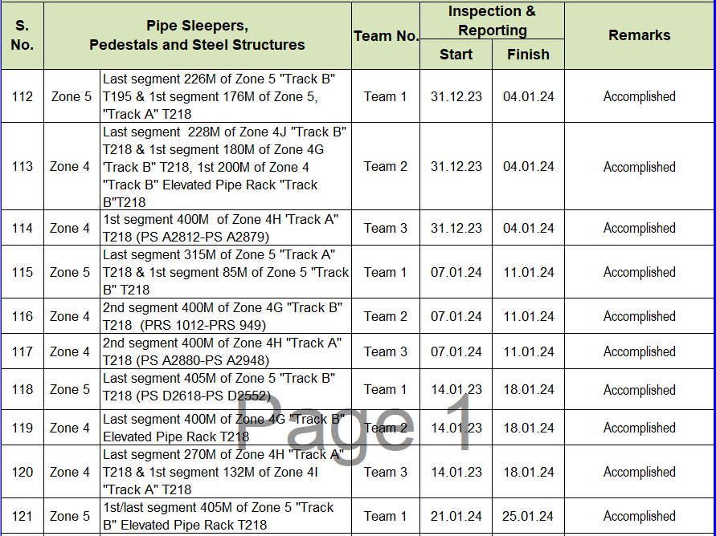
Corrosion Prevention and Protection of Civil Assets
Royal Commission Arrangement for Corrosion Prevention and Protection of Civil Assets
(Example of Survey Schedule)

Slide 18
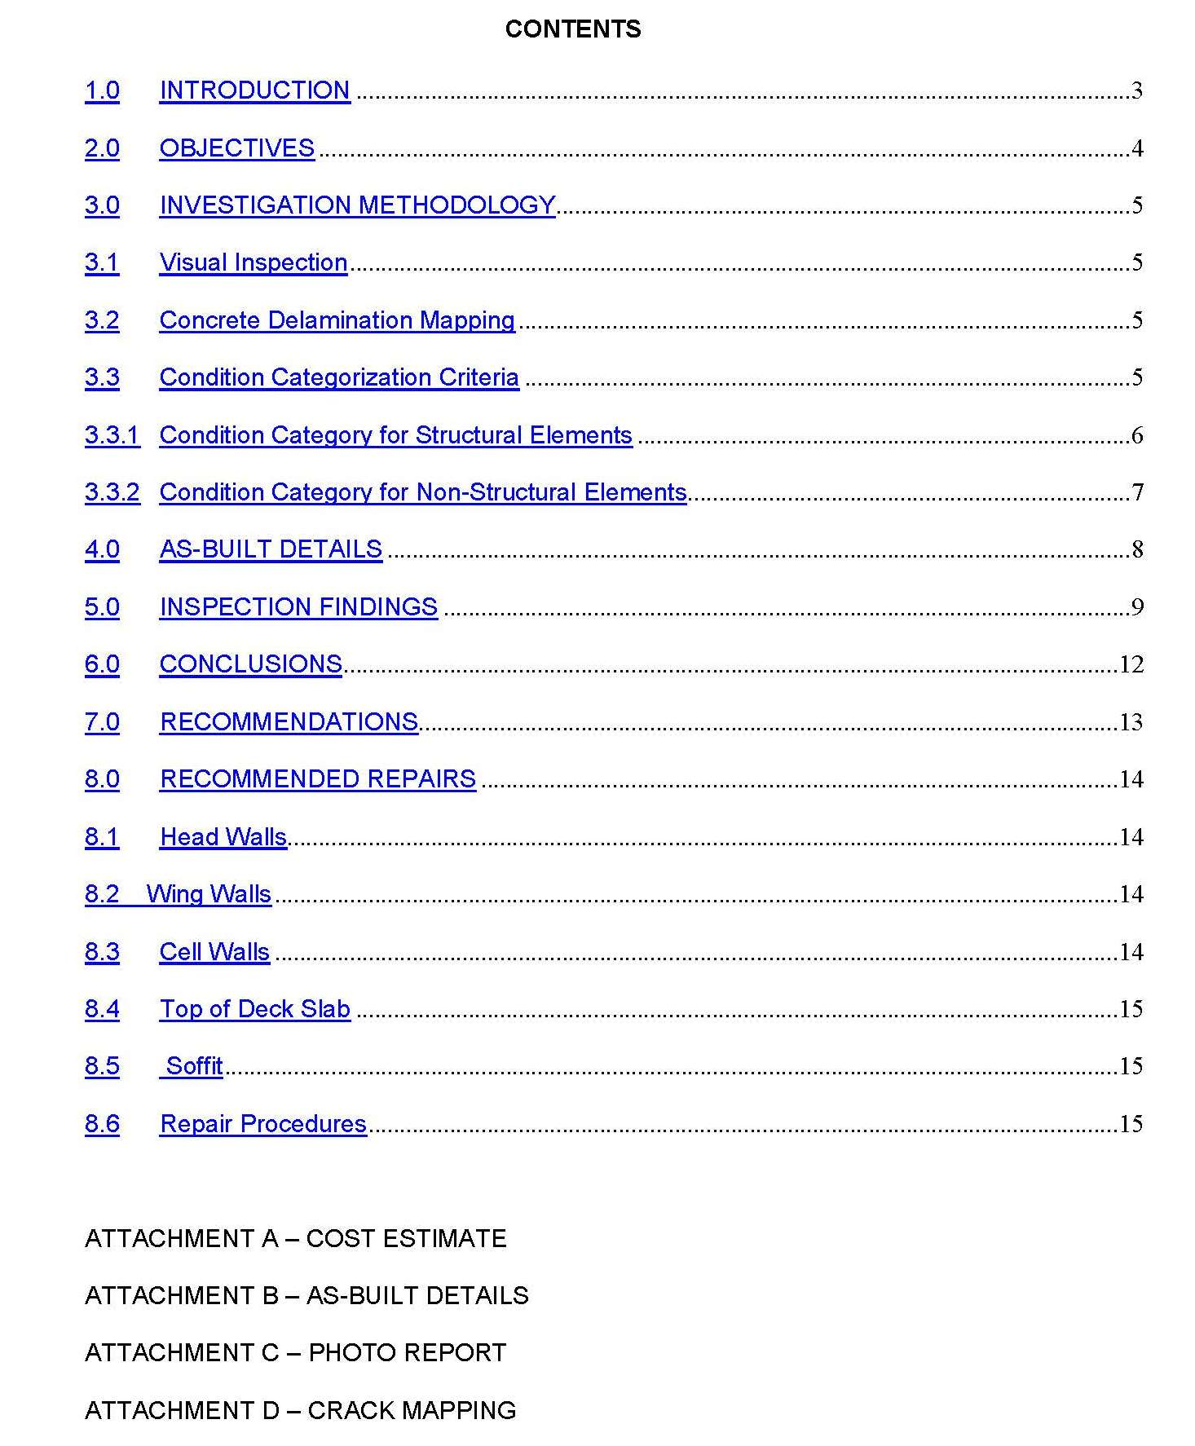
Corrosion Prevention and Protection of Civil Assets
Royal Commission Arrangement for Corrosion Prevention and Protection of Civil Assets
(Example of Report)

Slide 19
Corrosion Prevention and Protection of Civil Assets
Impact of Survey/Monitoring on Corrosion Condition of RC Structures from 2008 to 2024

Slide 20
Corrosion Prevention and Protection of Civil Assets
Royal Commission Arrangement for Corrosion Prevention and Protection of Civil Assets
Monitoring of Cathodic Protection System:
Building Foundations at Royal Commission Main Headquarters (Jubail)
Steel Tanks -21 Nos. (Jubail)
Concrete Tanks -3 Nos. (Fanateer and Deffi area)
Reclaimed Water Pipeline (From SWTP -9 to Community area)
Tie rods holding back the seawall at Al-Fanateer Corniche
Monitoring & Reporting of CP Sytem: Bi-Monthly & Six Monthly

Slide 21
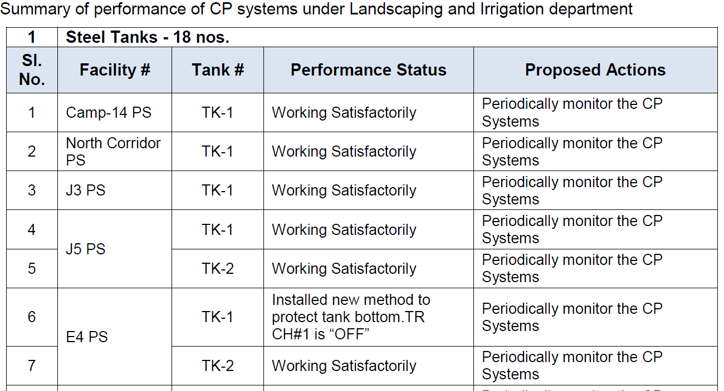
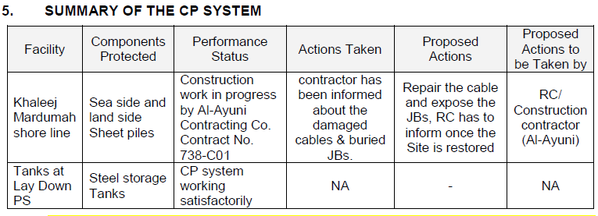
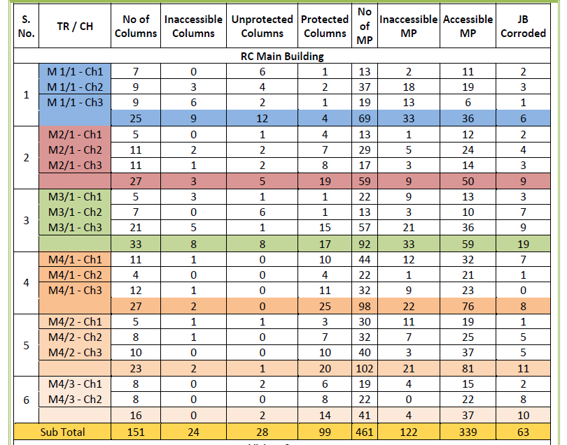
Corrosion Prevention and Protection of Civil Assets
Royal Commission Arrangement for Corrosion Prevention and Protection of Civil Assets
(Sample of CP Reports)
Report to L& I Dept.
Report to Roads Dept.
Report to Buildings Dept.

Slide 22
Corrosion Prevention and Protection of Civil Assets
Royal Commission Arrangement for Corrosion Prevention and Protection of Civil Assets
(Corrosion Contracts Input in Updating the Manual and Specs)
General Engineering Manual
Engineering Guideline Specifications:
Specifications related to Concrete
Specifications related to Coating
Specifications related to Cathodic Protection (CP)

Slide 23
Corrosion Prevention and Protection of Civil Assets
Royal Commission Arrangement for Corrosion Prevention and Protection of Civil Assets
(Corrosion Database)
It contains the following which is updated every 3 months:
List of Issued Reports
List of Research Studies
List of Corrosion Studies and Repair Contracts
Inspection, Repairs, and As-Built Data:
Culverts
Bridges and Jersey Barriers
Buildings
Water Storage Tanks
Reclaimed Water Pipelines and Valve Chambers
Play Parks & Picnic Shelters
Pipeline Corridor Concrete Support Structures

Slide 24
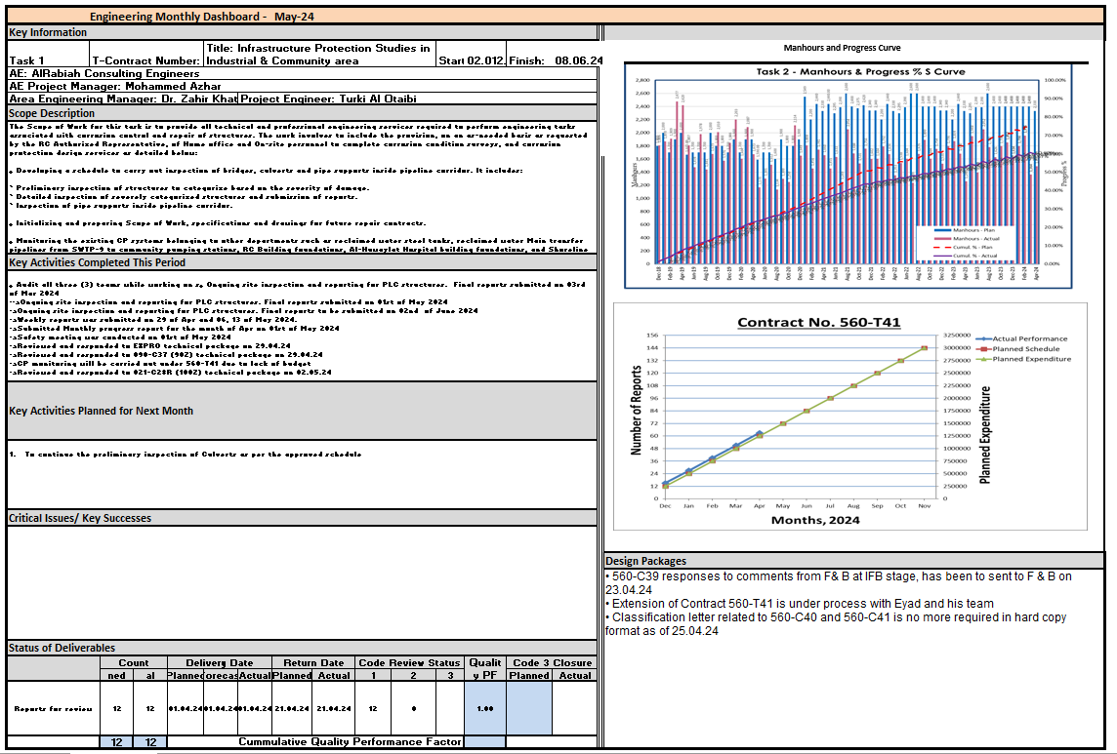
Corrosion Prevention and Protection of Civil Assets
Royal Commission Arrangement for Corrosion Prevention and Protection of Civil Assets
(Every 15 days Dashboard to Monitor Performance, Example May 2024)

Slide 25
Corrosion Prevention and Protection of Civil Assets
Management of Corrosion From RC Engineering to RC Construction
The Corrosion condition surveys and reports produced under corrosion consultation contracts constitute the basis of prioritizing the repairs of structures based on the risk hazard analysis they pose for structural and public safety.
The developed structure priority list, is then included under a Corrosion Repair Contract, wherein the structures are repaired/replaced.
Two types of Repair Contracts are formulated, which mainly include repair of structures such as bridges, culverts, buildings, pipeline Corridors structures, Irrigation pipes and steel tanks, Community parks etc.

Slide 26
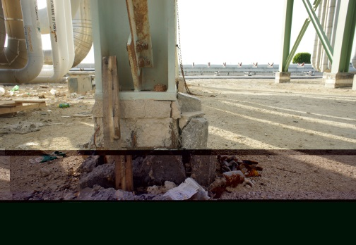
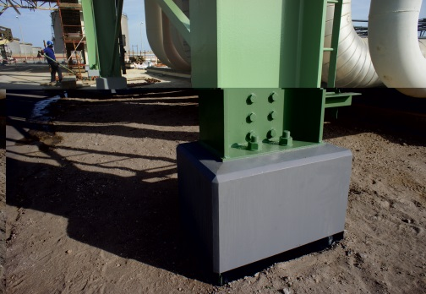
Corrosion Prevention and Protection of Civil Assets
Management of Corrosion From RC Engineering to RC Construction
(Sample Photos of Repairs)
Loop Support foundation
Before Repairs
Loop Support foundation
After Repairs

Slide 27
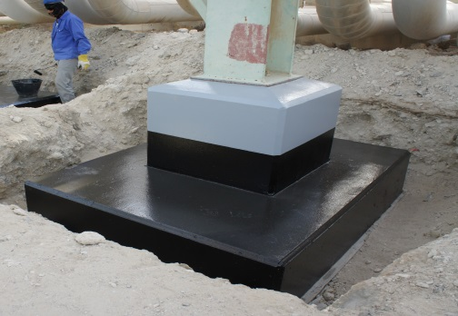
Corrosion Prevention and Protection of Civil Assets
Management of Corrosion From RC Engineering to RC Construction
(Sample Photos of Repairs)
Loop Support foundation
Before Repairs
Loop Support foundation
After Repairs

Slide 28
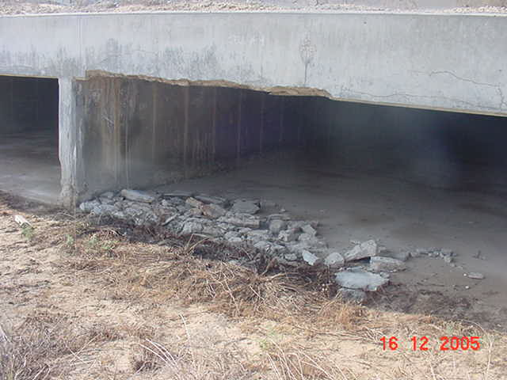
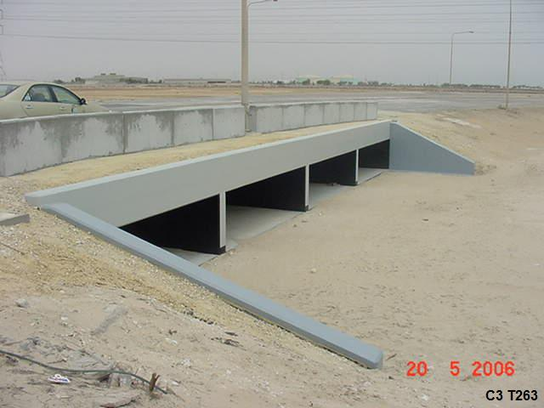
Corrosion Prevention and Protection of Civil Assets
Management of Corrosion From RC Engineering to RC Construction
(Sample Photos of Repairs)
Culvert
Before Repairs
Culvert
After Repair

Slide 29
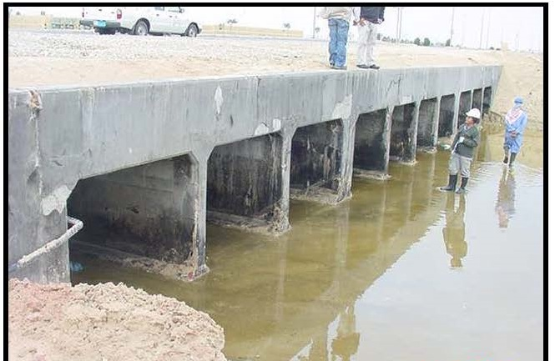
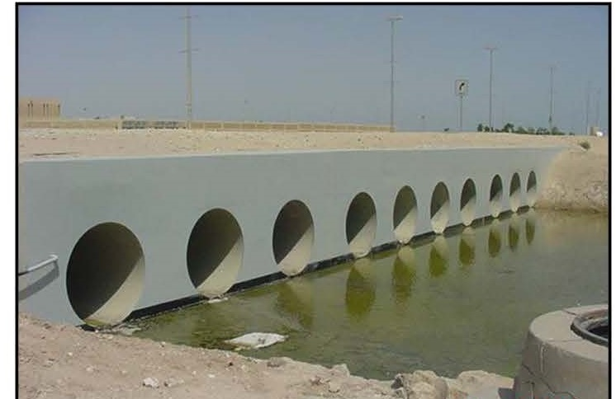
Corrosion Prevention and Protection of Civil Assets
Management of Corrosion From RC Engineering to RC Construction
(Sample Photos of Repairs)
Culvert
Before Repairs
Culvert
After Replacement

Slide 30
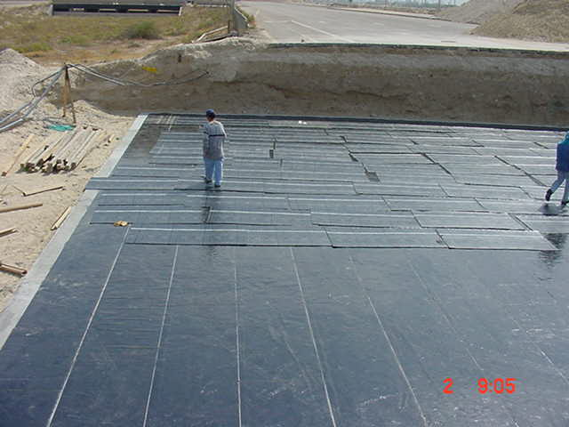
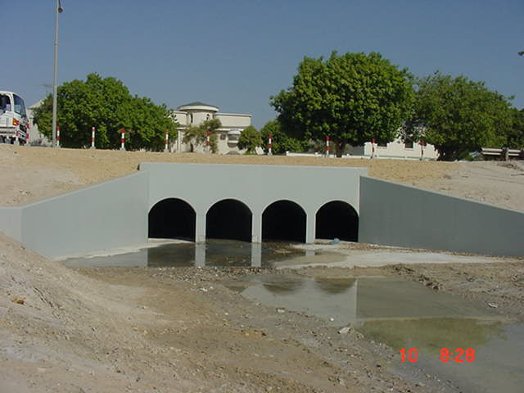
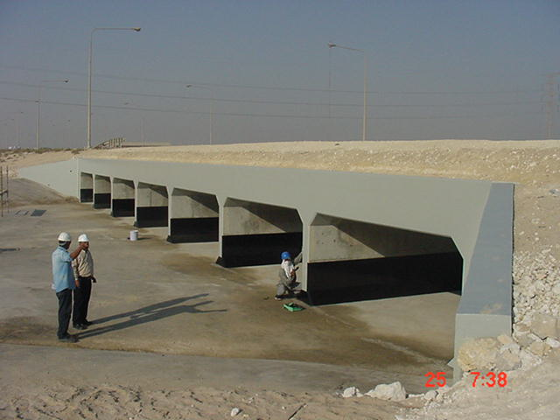
Corrosion Prevention and Protection of Civil Assets
Management of Corrosion From RC Engineering to RC Construction (Sample Photos of Repairs)
Culvert Replacement under Corrosion Repair Contract

Slide 31
Corrosion Prevention and Protection of Civil Assets
Chart of Corrosion Repair Contracts issued to Maintain the Condition of RC Structures

Slide 32
Corrosion Prevention and Protection of Civil Assets
Conclusions
For over 40 years in Royal Commission, the Corrosion Prevention and Protection of Civil Assets is a success story and a result of a very detailed oriented work from Research to repair Execution
For the safe and proper operation/usage of all the structural assets of Royal Commission, Corrosion Management is vital
The Scope and the requirements of the Corrosion Consultation Contracts increases with the increase in the development of Jubail Industrial City
The Corrosion Consultation Contracts are the backbone of the Corrosion Repair Contracts, under which the construction activities are executed

Slide 33
JUBCOR
2024
CONFERENCE & EXHIBITION
INNOVATIVE SOLUTIONS FOR CORROSION CHALLENGES
THANK YOU

