Slide 1



JUBCOR
2024
CONFERENCE & EXHIBITION
INNOVATIVE SOLUTIONS FOR CORROSION CHALLENGES
Presented By: Shamsuddeen Palliyali
Sr Engineer I, Mechanical Static , Technical
Degradations of Concrete Assets due to re-bar corrosion & Protection method

Slide 2


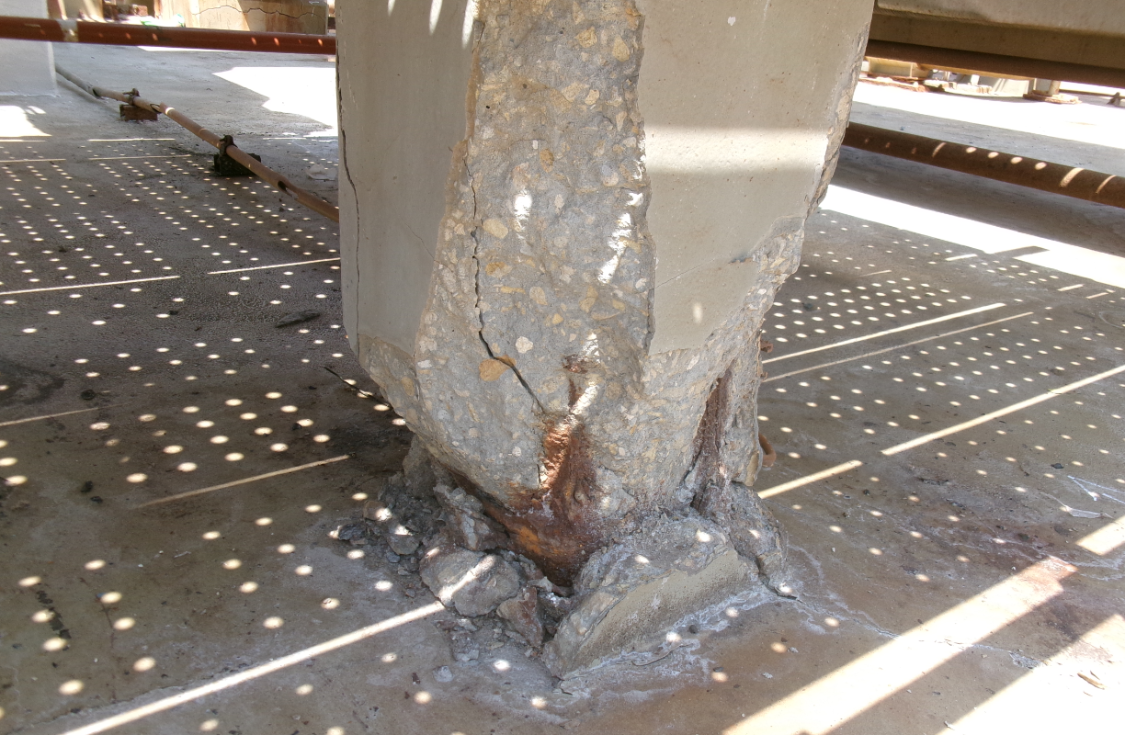
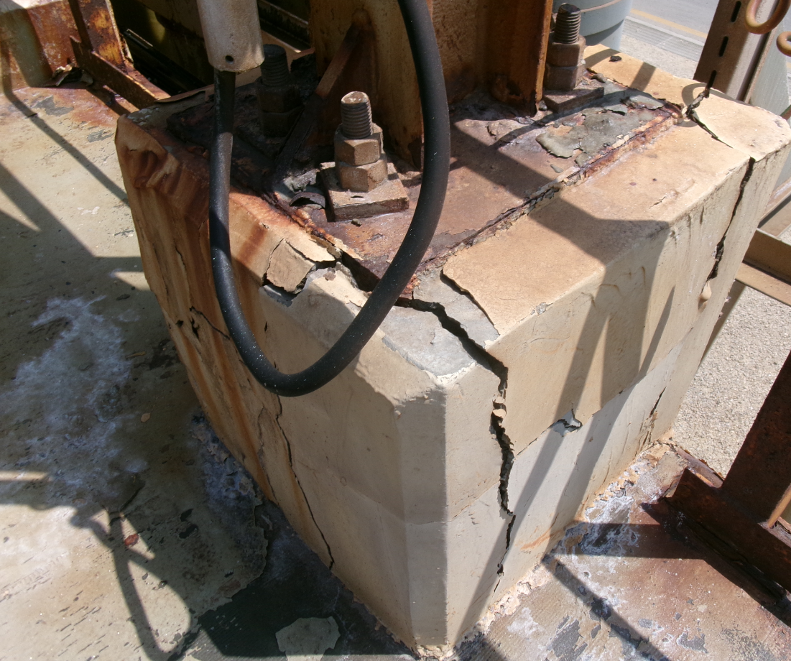
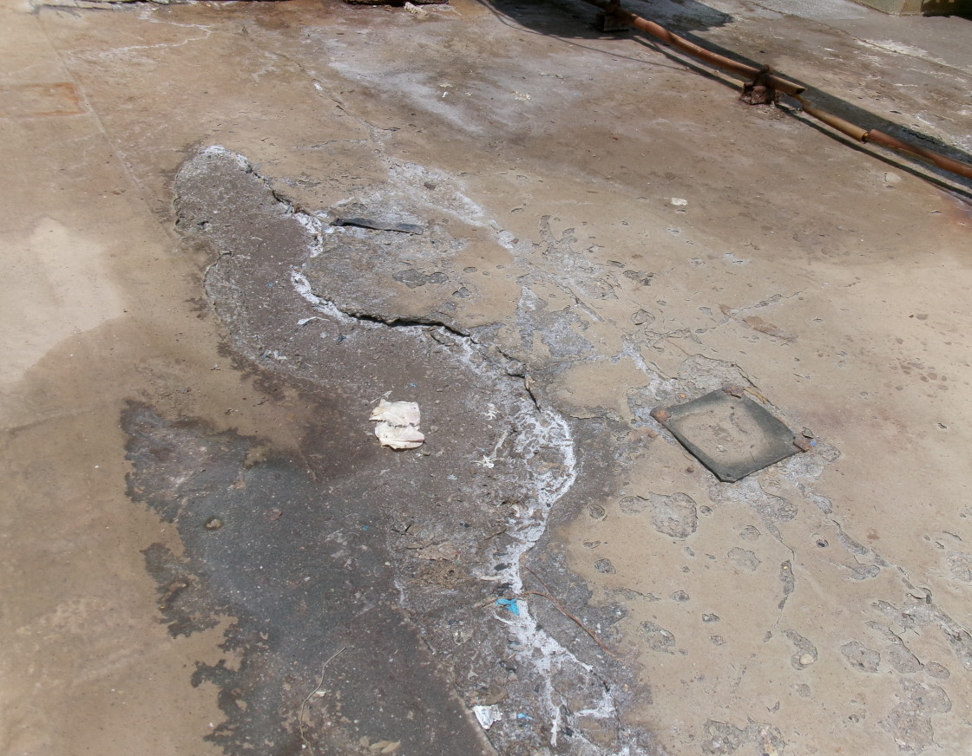

DEGRADATIONS OF CONCRETE
Concrete is a porous material, which absorbs contaminants from surroundings.
Contaminants (H2O,O2 and Cl¯) lead to corrosion of rebar.
React with the iron to create corrosion products
Corrosion that weakens the structural integrity of concrete elements.
Posing a serious threat to the stability of infrastructure.
Cracks/Damages on RC structures
The main reason for the damages for re-bar & concrete is saltwater presence in the vicinity.
Surface Damage/cracks

Slide 3
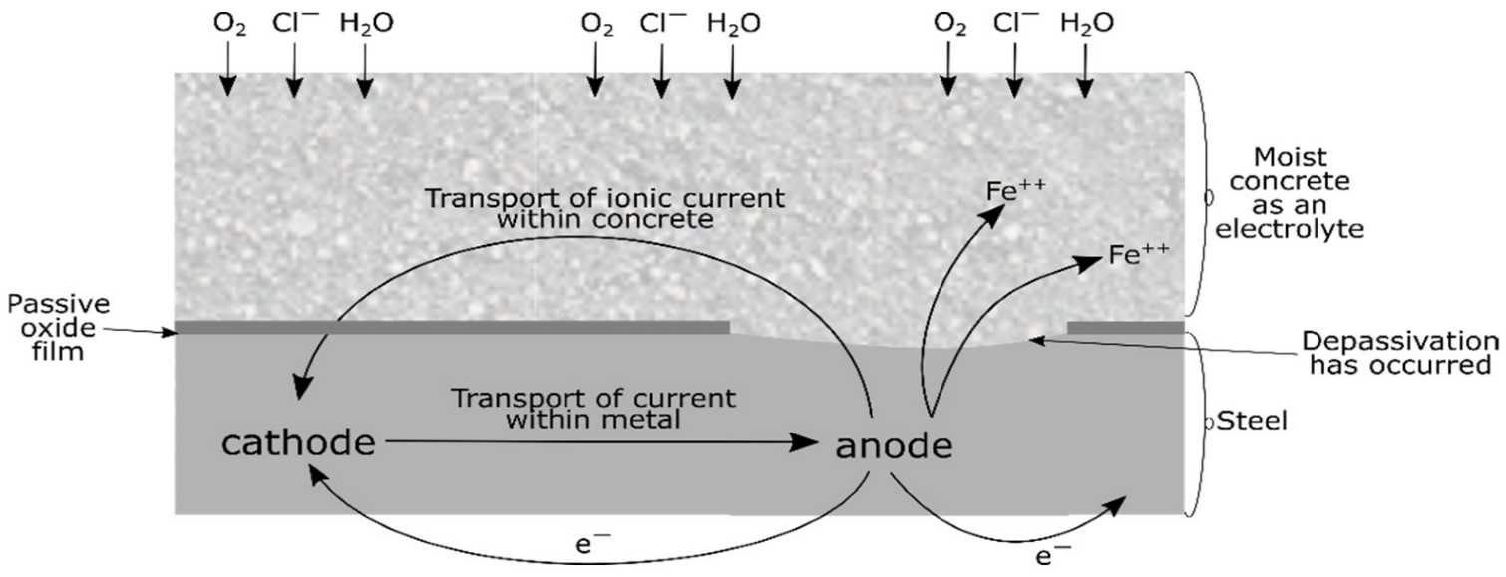
RE-BAR CORROSION (COTND)
This creates +ve areas, i.e. ferrous ions, which dissolve into the pore solution
Potential differences between 2 parts causes electrons to be released from -ve areas.
The areas where ferrous ions are created are known as anodes or corrosion sites.
The areas where electrons are released to form hydroxyl ions are called cathodes, i.e. non-corroding sites.

Slide 4
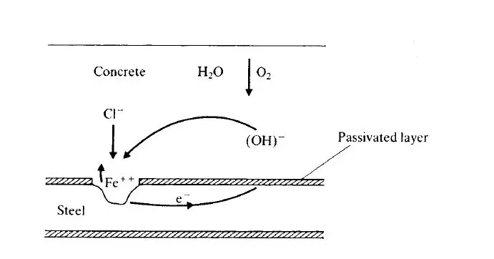
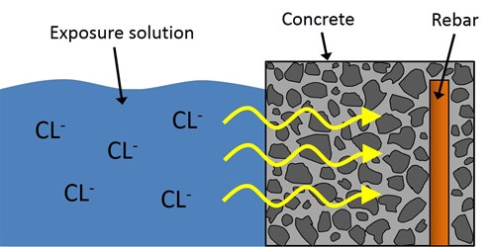
RE-BAR CORROSION (COTND)
Ferrous cation formed from corrosion reacts with Cl¯ ions to form a soluble complex of FeCl3.
This compound leaving the metal surface attacks the protective layer of Fe (OH)2 so that corrosion continues.
Penetration of Chloride ions
Concrete
Rebar

Slide 5
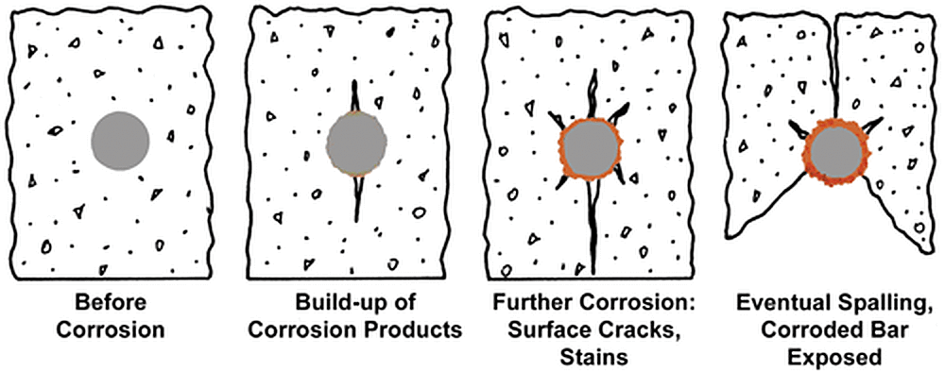
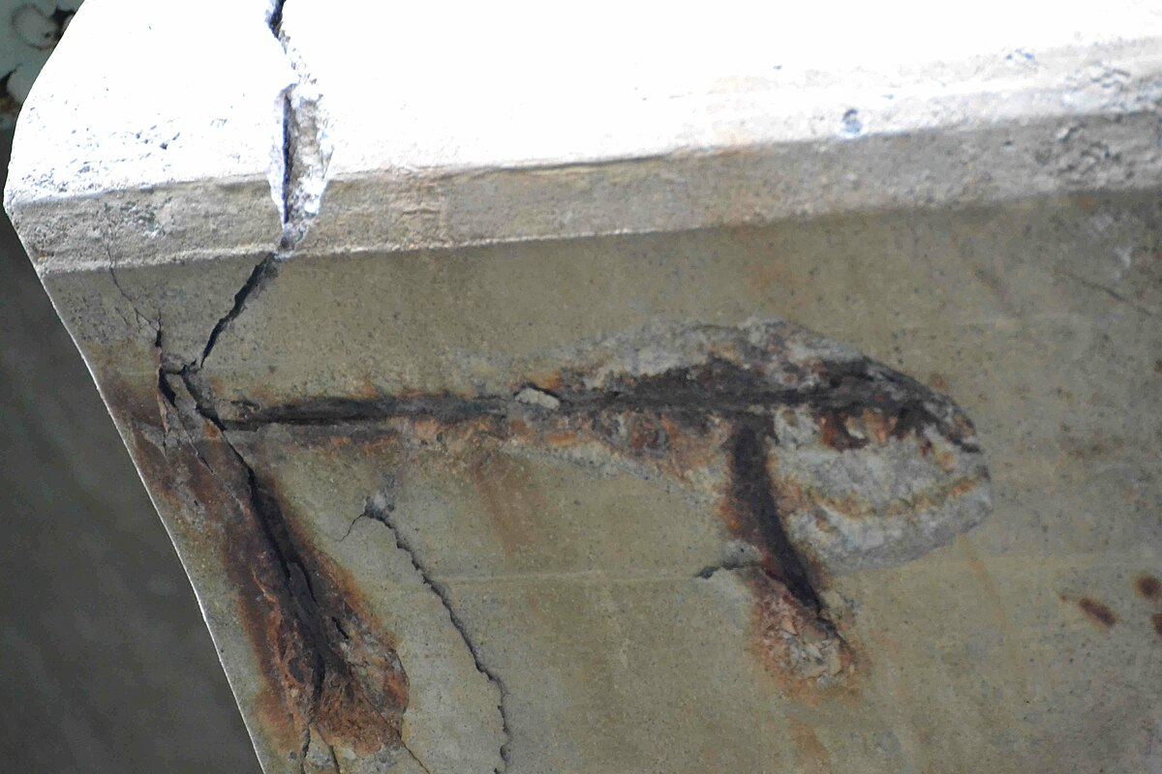
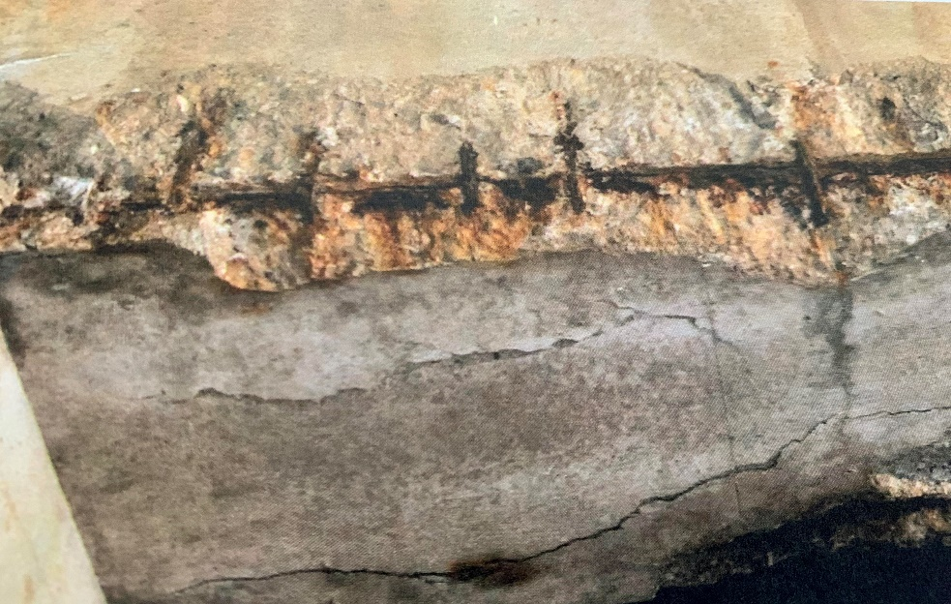

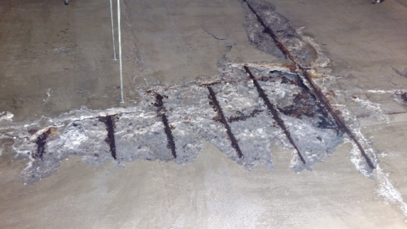
RE-BAR CORROSION (COTND)
Cl¯ & O2 penetrate the concrete,
causing it to corrode & expand
Cracking
Expansion creates tensile stresses in the concrete & leads to
Spalling
Delamination

Slide 6
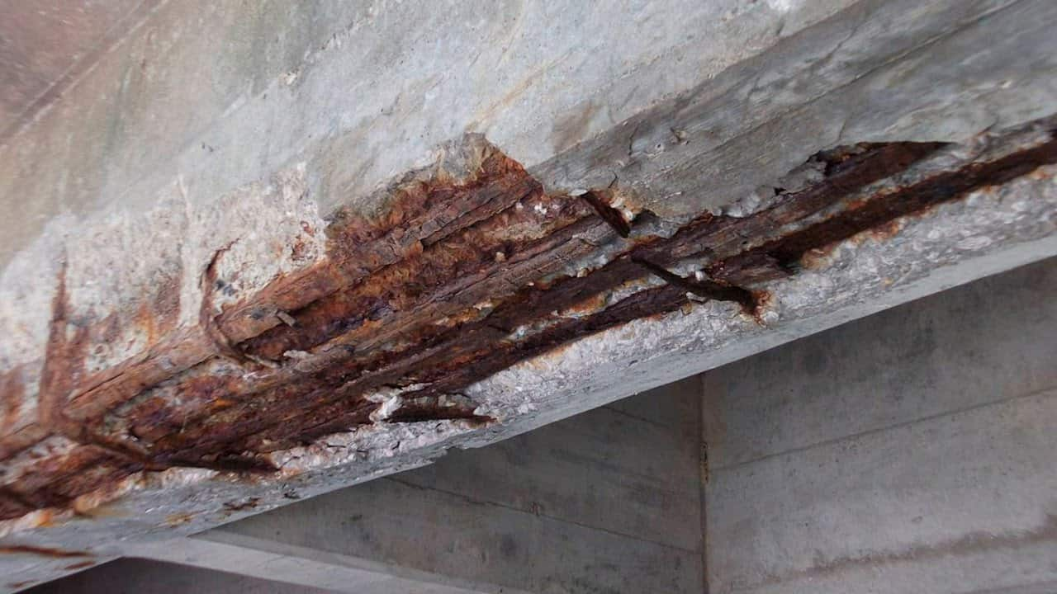
CHLORIDE-INDUCED REBAR CORROSION
STEEL CORRODES BECAUSE.
  It is not a naturally occurring material.
  The production steps that transform iron ore into steel add energy to the metal.
  Thermodynamically unstable under normal atmospheric conditions .
  It will release energy and revert to its natural state—iron oxide, or rust.

Slide 7
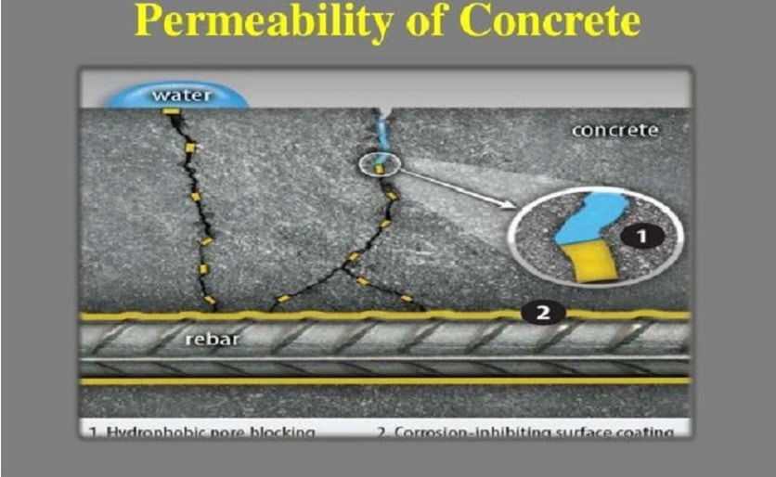


CHLORIDE-INDUCED REBAR CORROSION (CONTD)
PERMEABILITY OF CONCRETE.
When forming inside concrete, CAOXY crystals expand, causing internal cracks & crumbling leads to Cl¯ & O2 penetration.
The Ca(OH)₂ present in concrete reacts with the CaCl2 in salt, creating calcium oxychloride (CAOXY) in salt, this weaking concrete infrastructure.
  Penetration time depends on:
  The concentration of Cl¯.
  Permeability of the concrete.
  % of humidity present.
  Corrosion occurs with a combination of two factors, both of which are required for the process.

Slide 8
CHLORIDE-INDUCED REBAR CORROSION (CONTD)
Concrete highly alkaline
pH 12-13.8
Process of corrosion
pH around 9.5 the corrosion will increase
At pH 7 or less the environment is totally acid, & the life of bars terminates
High pH due to the existing oxide and alkali metal contents.
There is no any corrosion in this stage
Leaching of Ca(OH)2 the pores occurs , salts & water enters to bars and pH value will be decrease
The pH value be 10.5 the corrosion will start but there is a layer Consists & protect the bars

Slide 9
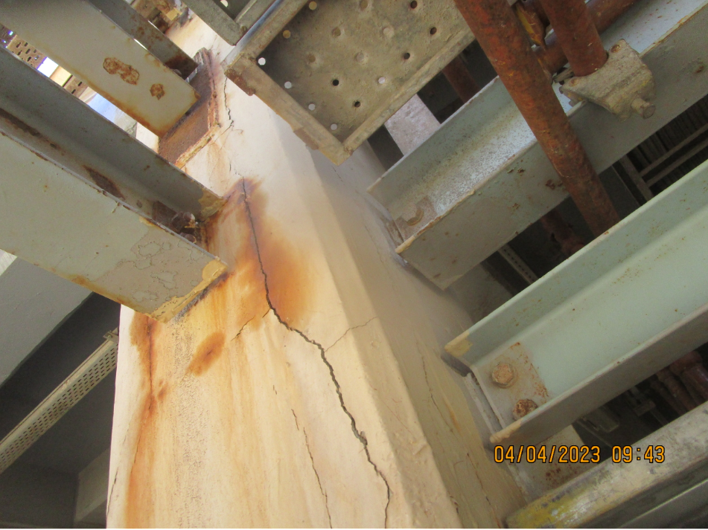
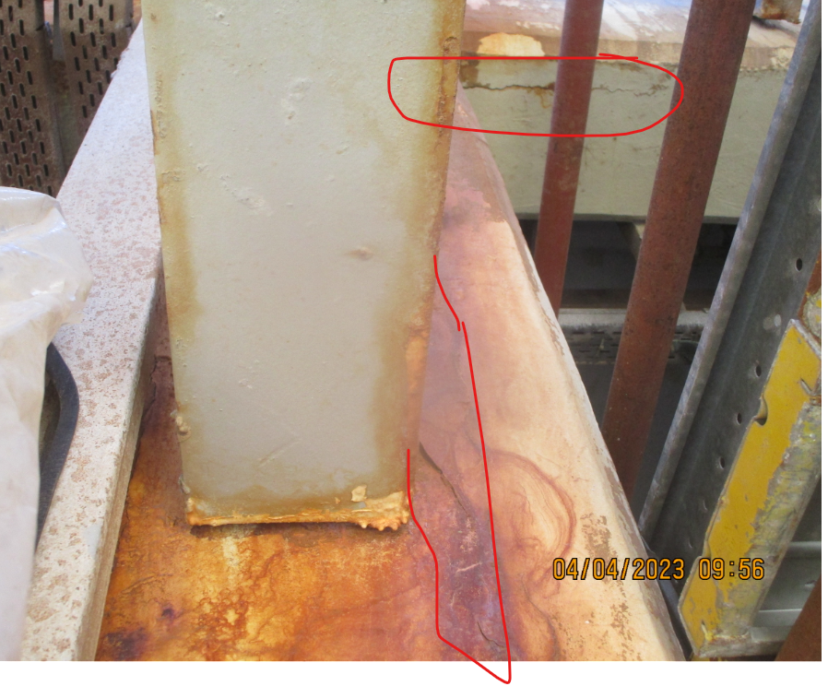
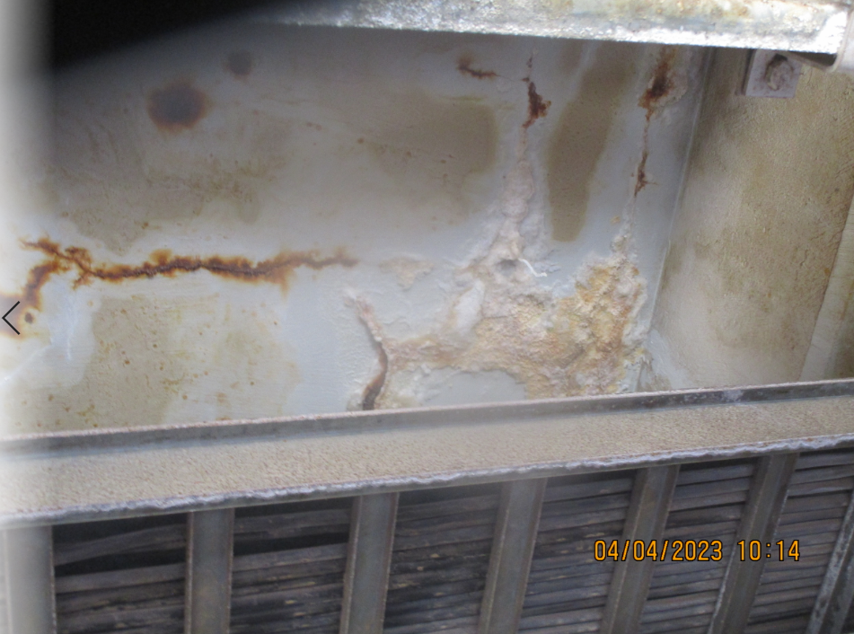
CHLORIDE-INDUCED REBAR CORROSION (CONTD)
Effects of corrosion
Causes of rebar corrosion
  Exposure to moisture
  Chloride ions:
  Carbonation:
  Chemical exposure:
Reduced load-bearing capacity
  Cracking and spalling.
  Structural deformation
  Brittle failure of reinforcement
  Corroded structures pose safety issue.
Reduced load-bearing capacity
Identifying Signs of Corrosion in Concrete Structures.
  Signs of corrosion include cracking/spalling/discoloration /staining.
  The presence of rust stains /flakes on the surface.

Slide 10
RE-BAR CORROSION & PROTECTION METHODS
  Design life more than the concrete structure.
  Mesh and mesh ribbon formats to suit all applications.
Cathodic protection is applied to either prevent or halt of corrosion of rebar.
.
Proven track record.
.
Suitable for both new build and repair applications.
Cathodic Protection Best way to control re-bar corrosion that have Cl¯ contaminated concrete.

Slide 11
COMPARISON OF CATHODIC PROTECTION
WITH OTHER TECHNIQUES
Technology | Effective Life | Comments
Cathodic Protection | >100 Years | Permanent protection. Proven track record. Longest effective life.
Stainless Steel Bars | Not known | Expensive option. Lifetime unproven. Not suitable for hot marine environments.
Coated Reinforcement | Highly variable | Very sensitive to contractor handling. There is inevitably coating damage during the fabrication and concrete pouring.
Chemical Inhibitors | Highly variable | Limited “active” life. Conflicting data as to effectiveness.
Patch Repair | <5 to 10 Years | Incipient anode effect renders corrosion inevitable in adjacent parts of the structure

Slide 12
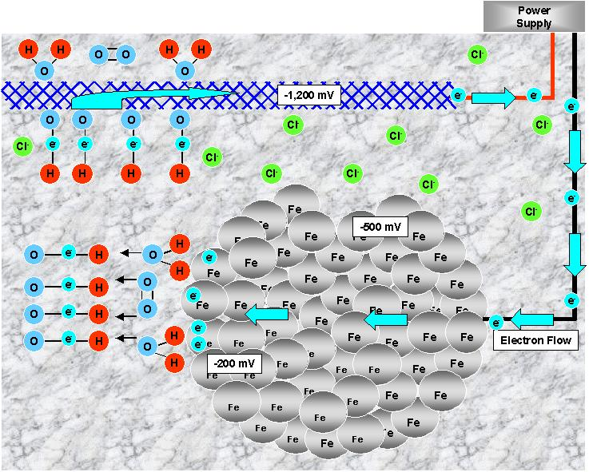
CATHODIC PROTECTION
The anodic reaction on the new anode reverses this process to convert hydroxide ions back into water & O2 .
These electrons are spread & they electrolyze H2O & O2 to make hydroxide ions.
A new anode material is introduced into the concrete.
With more negative than
any part of the reinforcement.
It releases its excess electrons.

Slide 13
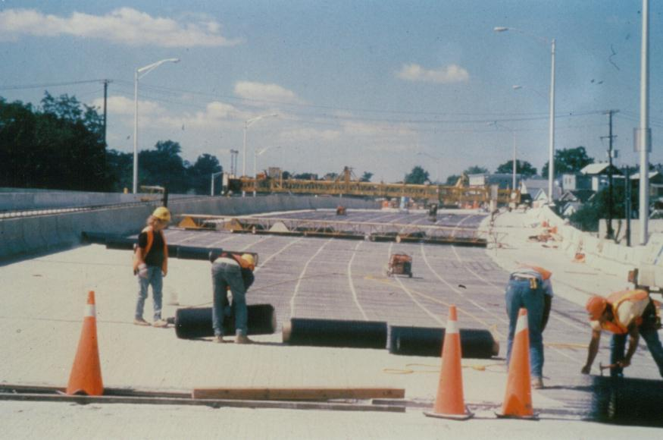
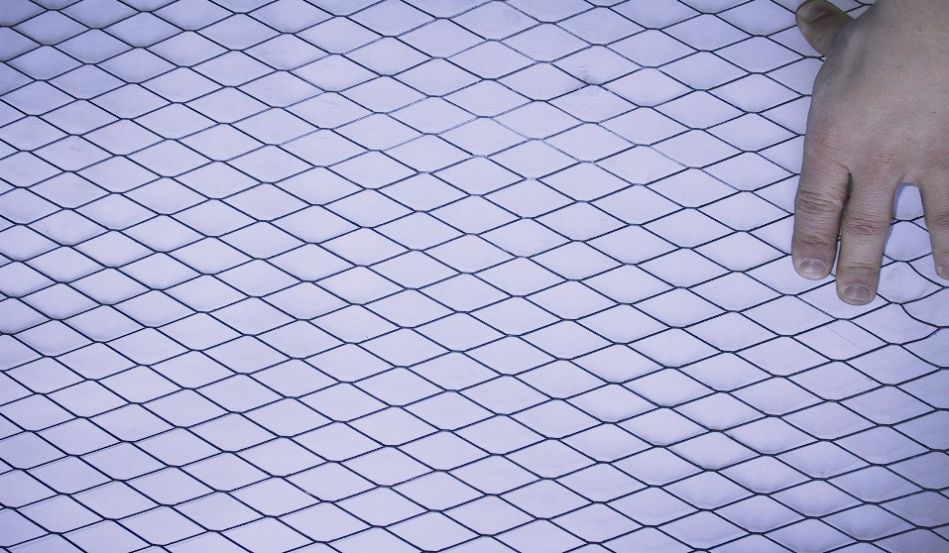
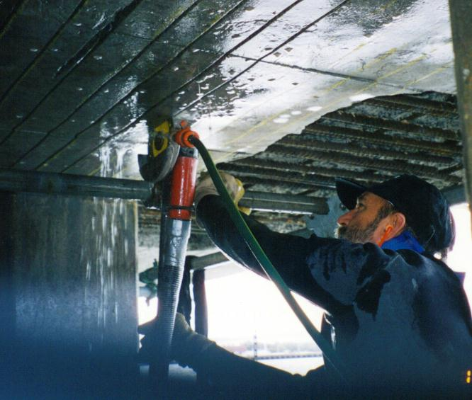
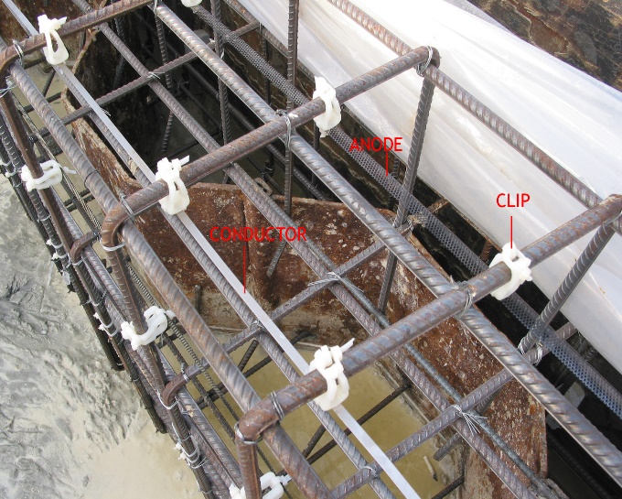
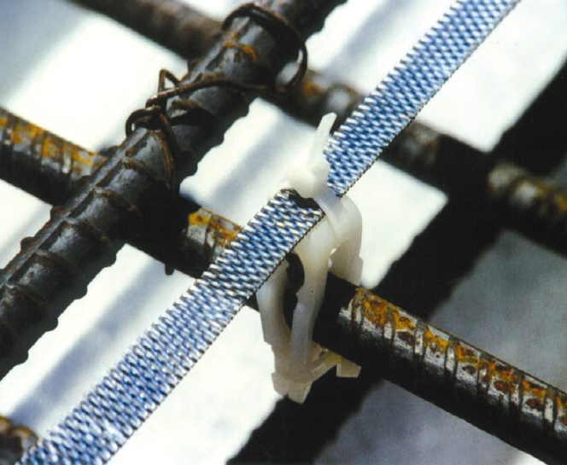
CATHODIC PROTECTION (CONTD)
Repair of Existing deteriorated concrete
Cutting saw slots into the concrete & grouting in a ribbon mesh
Applying anode mesh and encapsulating as exterior overlay
Cathodic prevention
from starting
Ti/MMO ribbon mesh mounted on the reinforcement using non-metallic spacers

Slide 14
TECHNIQUES FOR MONITORING REBAR CORROSION
Techniques for monitoring rebar corrosion
Electrical resistivity measurement
Half-cell potential measurement
Sensors and monitoring systems
Ultrasonic testing: Ground-penetrating radar
Visual inspection
Sensors and monitoring systems :
These systems can include wireless sensors, data loggers, and cloud-based platforms, allowing for remote monitoring and analysis.

Slide 15
CONCLUSION
Rebar corrosion poses a significant threat to the integrity and safety of structures.
By implementing effective corrosion protection methods and structural health monitoring systems, the risk of corrosion-induced structural failures can be minimized
Cathodic protection is best way to control corrosion on steel reinforced concrete structures that have chloride contaminated concrete
Protecting against rebar corrosion not only extends the service life of structures but also ensures the safety of the plant.

Slide 16



JUBCOR
2024
CONFERENCE & EXHIBITION
INNOVATIVE SOLUTIONS FOR CORROSION CHALLENGES
THANK YOU
Reach out.
0133599578
s.palliyali@tansee.com

