Slide 1




JUBCOR
2024
CONFERENCE & EXHIBITION
INNOVATIVE SOLUTIONS FOR CORROSION CHALLENGES
Presented By:
Dr. Aisha Al-Moubaraki
Revan Baqurayn
Remaz Alghamdi
Jood Alwajeeh
Effectiveness Washingtonia fruit extract as sustainable green inhibitor of mild steel corrosion in acidic environments
Department of Chemistry, College of Science, University of Jeddah, Jeddah, Saudi Arabia

Slide 2







Introduction
Corrosion and its different forms
Classification of Corrosion Inhibitors
Green Inhibitors
Saudi vision and sustainability
OUTLINES
Experimental
Materials
Methods
Green Corrosion Inhibitor and sustainability
Results and Discussion
Effect of WFE Concentration on Corrosion Rate and Inhibition Efficiency.
Adsorption Isotherms.
Microscopic Observation
Explanation for Inhibition
Conclusion
Notes:
Today I will be talking about
An Overview of the petroleum system
Role of Geochemistry in E&P
my Projects.
And conclusion

Slide 3
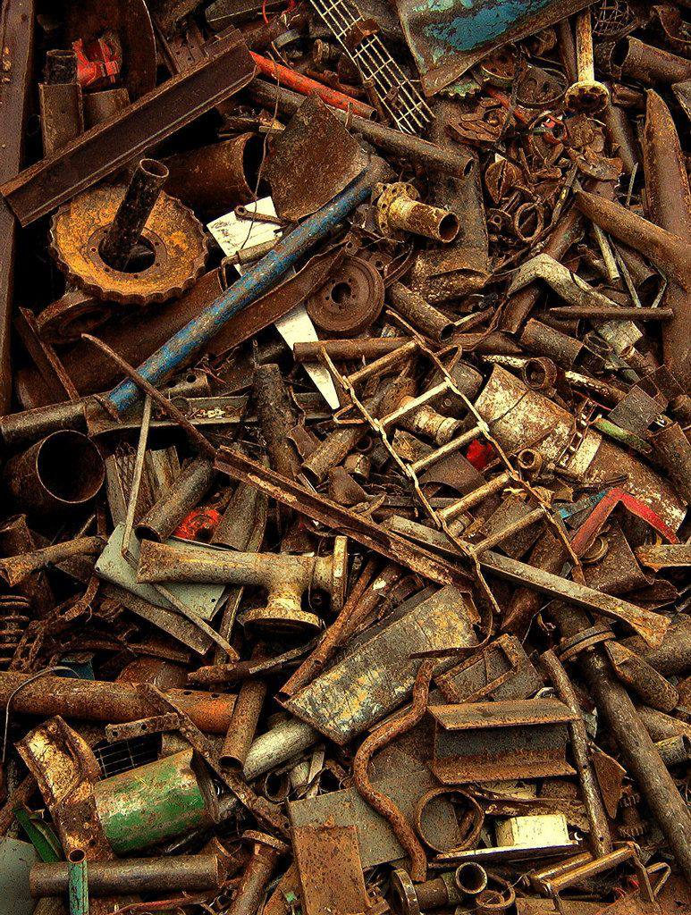

Slide 4



Introduction
  Corrosion
Corrosion is a common phenomenon that occurs when metals react with eenvironmental factors such as moisture and oxygen, leading to the deterioration of the metal (physical, chemical, and mechanical properties) and a decrease in its expected lifespan.
Notes:
The petroleum system consist of four main elements which are:
Source rock
Reservoir
Seal
Trap
Under high temperature and pressure the hydrocarbons stored in the source start to expel to the reservoir (through the permeability and porosity of the rocks) and eventually the seal help the hydrocarbons to be trapped.

Slide 5

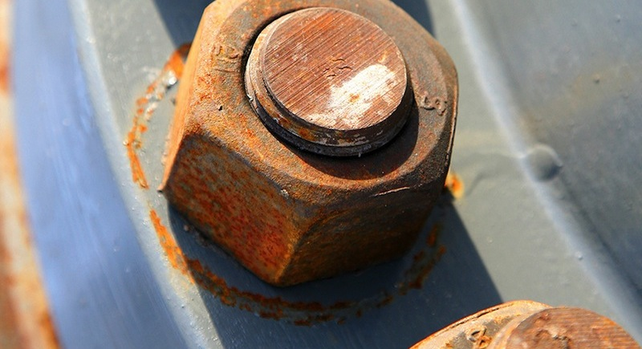
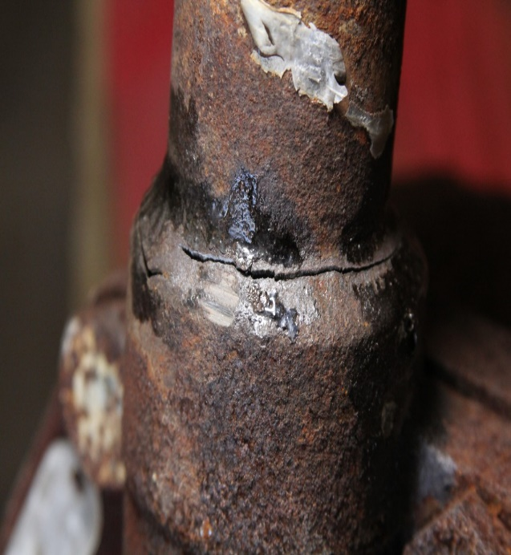
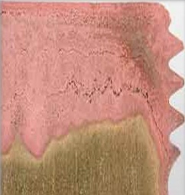
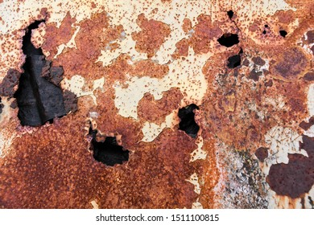
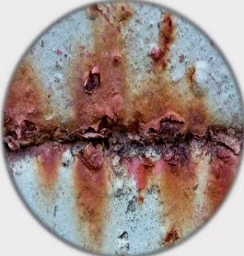
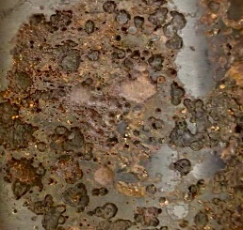
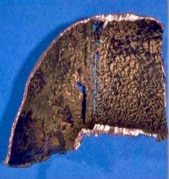
Introduction
Different forms of corrosion
Uniform or General Corrosion
Galvanic (Two Metals) Corrosion
Stress Corrosion Cracking
Selective Leaching
Pitting Corrosion
Crevice Corrosion
Intergranular Corrosion
Erosion Corrosion
Notes:
The petroleum system consist of four main elements which are:
Source rock
Reservoir
Seal
Trap
Under high temperature and pressure the hydrocarbons stored in the source start to expel to the reservoir (through the permeability and porosity of the rocks) and eventually the seal help the hydrocarbons to be trapped.

Slide 6
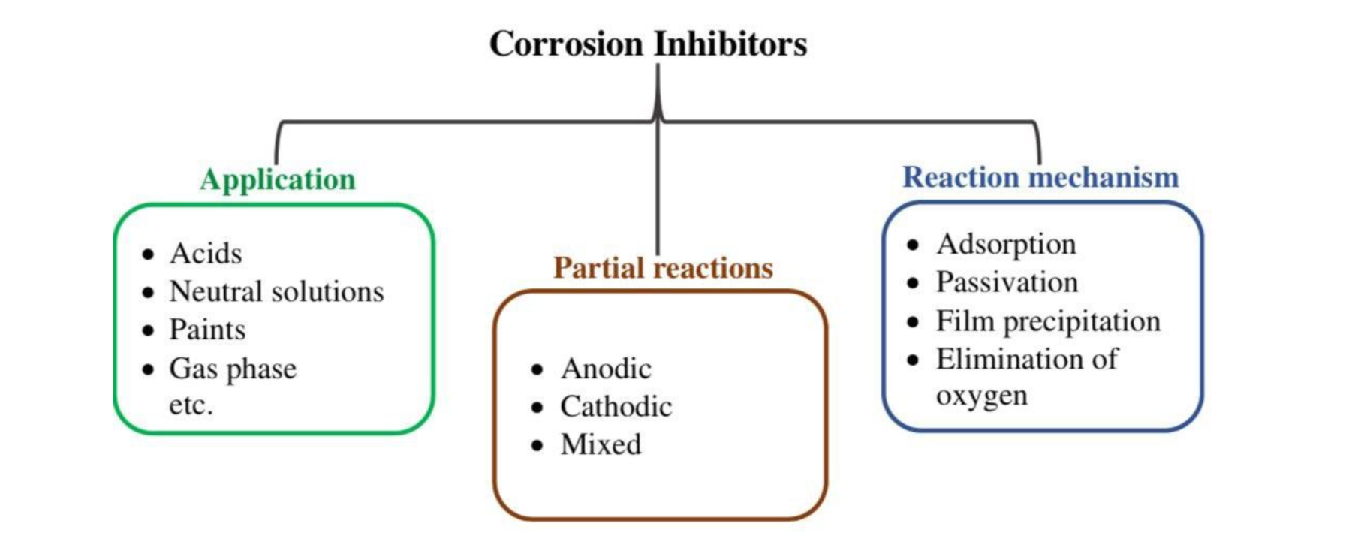

Introduction
Classification of Corrosion Inhibitors
Notes:
The petroleum system consist of four main elements which are:
Source rock
Reservoir
Seal
Trap
Under high temperature and pressure the hydrocarbons stored in the source start to expel to the reservoir (through the permeability and porosity of the rocks) and eventually the seal help the hydrocarbons to be trapped.

Slide 7

Introduction
Green Inhibitors
Green inhibitors offer an alternative approach by providing effective corrosion protection while ensuring minimal environmental harm. They are typically derived from renewable resources and comply with eco-friendly principles.
Notes:
The petroleum system consist of four main elements which are:
Source rock
Reservoir
Seal
Trap
Under high temperature and pressure the hydrocarbons stored in the source start to expel to the reservoir (through the permeability and porosity of the rocks) and eventually the seal help the hydrocarbons to be trapped.

Slide 8

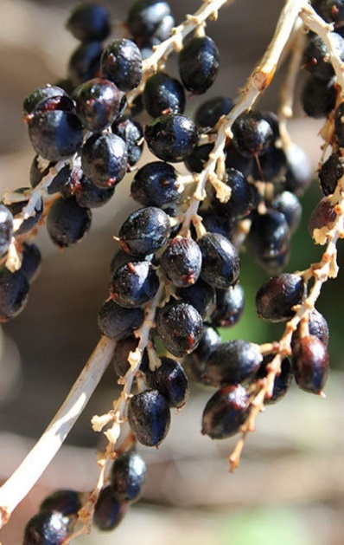
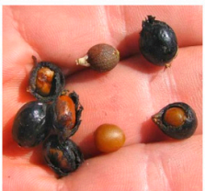
Introduction
Washingtonia Fruit
a
b
c
Figure 1. (a) Planting Washingtonia filifera at campus of College of Science, University of Jeddah, (b) washingtonia fruit, and (c) the seeds.

Slide 9

Introduction
Saudi Vision and Sustainability
is a strategy framework designed to lessen Saudi Arabia’s reliance on oil and diversify its economy. Initiatives in green chemistry and sustainable practices, especially the application of plant-based inhibitors for corrosion prevention, which is in line with international environmental and sustainability goals.
Notes:
The petroleum system consist of four main elements which are:
Source rock
Reservoir
Seal
Trap
Under high temperature and pressure the hydrocarbons stored in the source start to expel to the reservoir (through the permeability and porosity of the rocks) and eventually the seal help the hydrocarbons to be trapped.

Slide 10
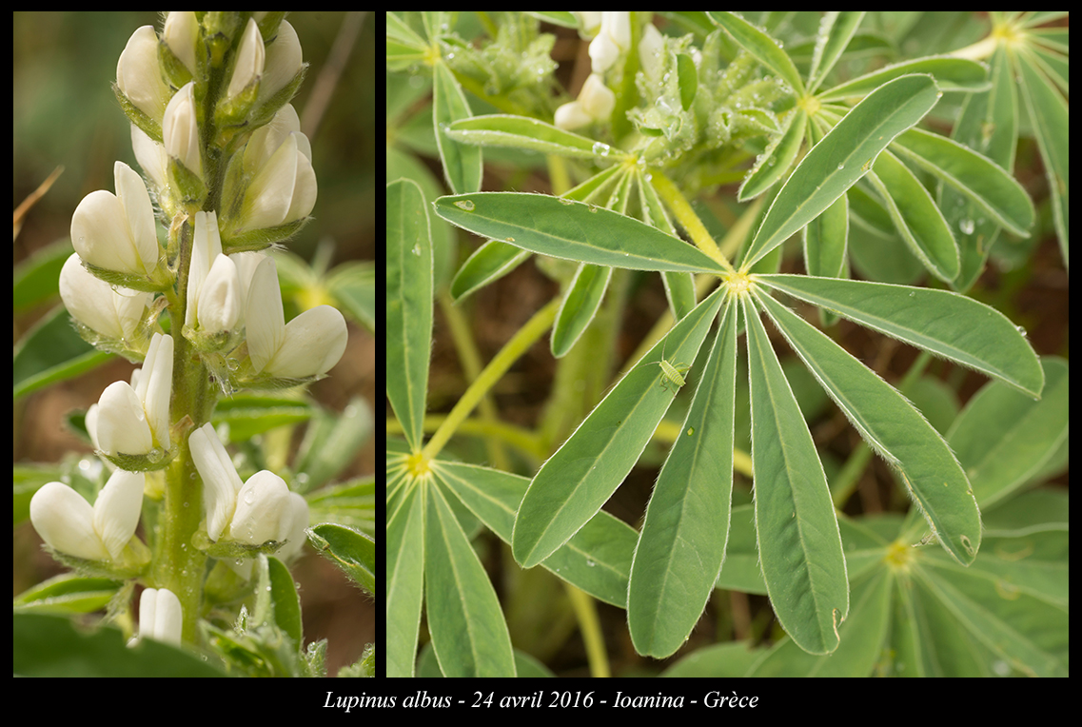
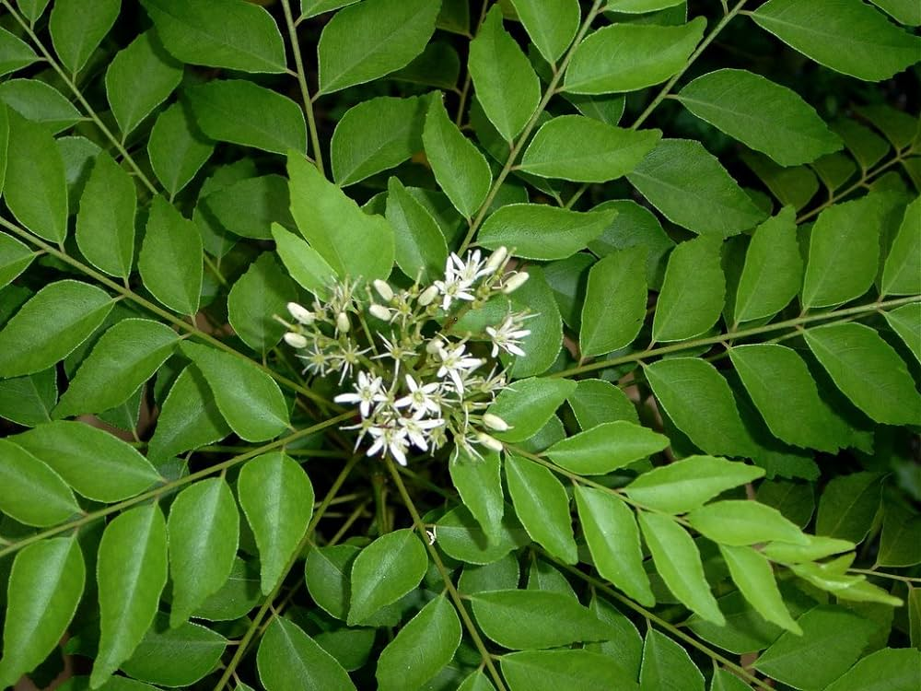


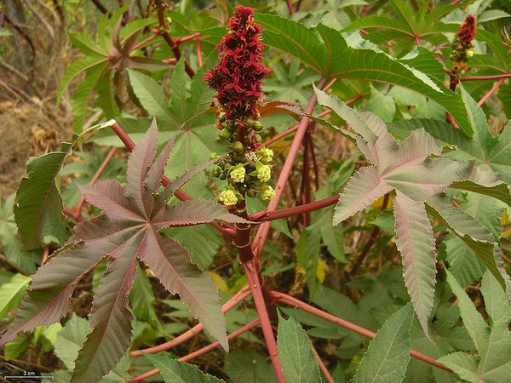
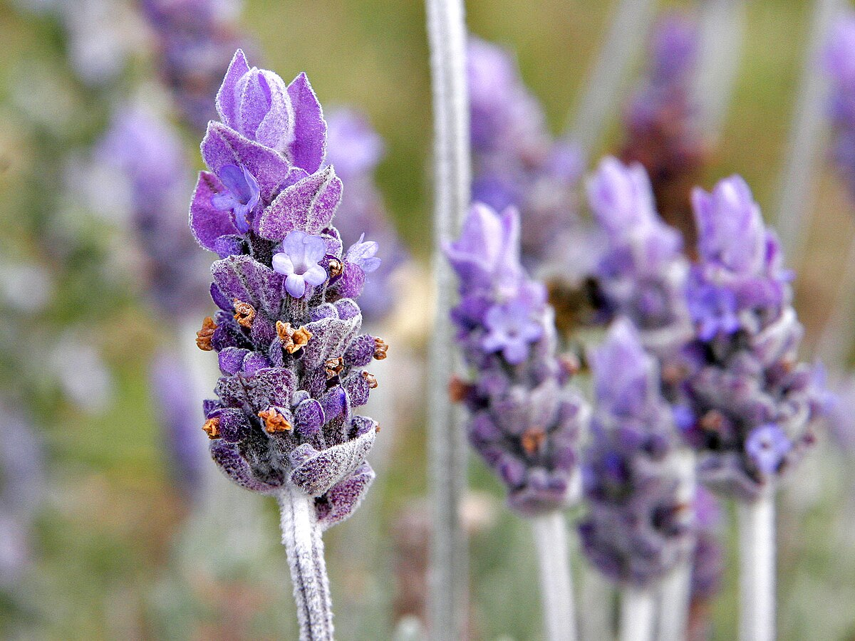
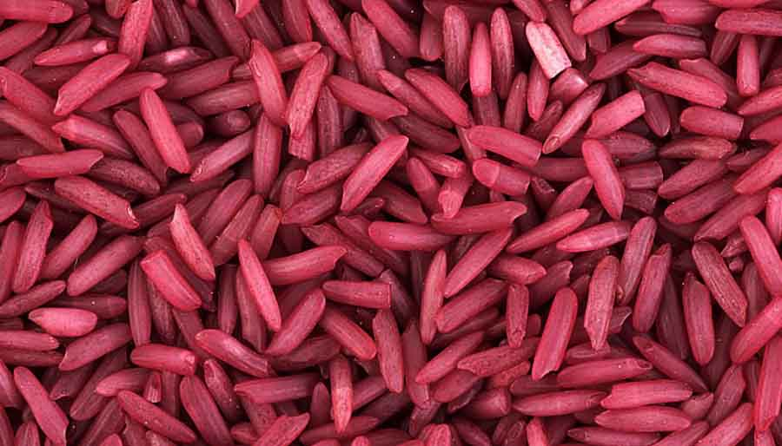
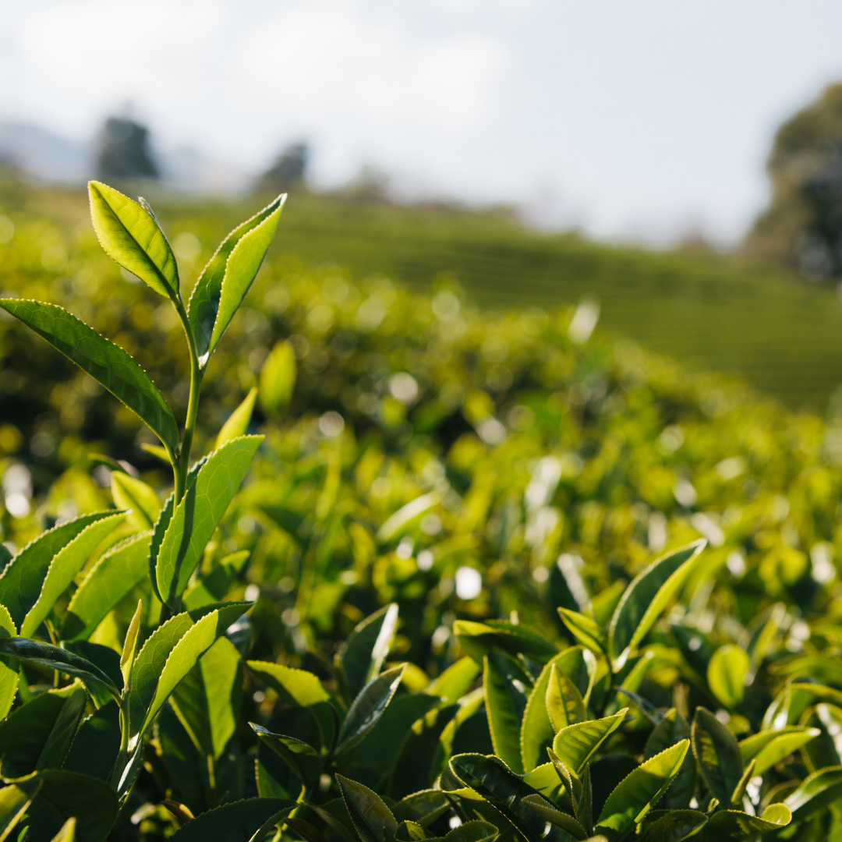
Some plants used as inhibitors in both 1 M HCl and 0.5 M H₂SO₄
Lupinous albus L. (2009)
Murraya koenigii (2010)
ginkgo leaves (2012)
Dendrocalmus sinicus Chia et J.L. (2012)
ricinus communis and lavender (2019)
purple rice bran (2022)
Vang tea leaves (2023)

Slide 11
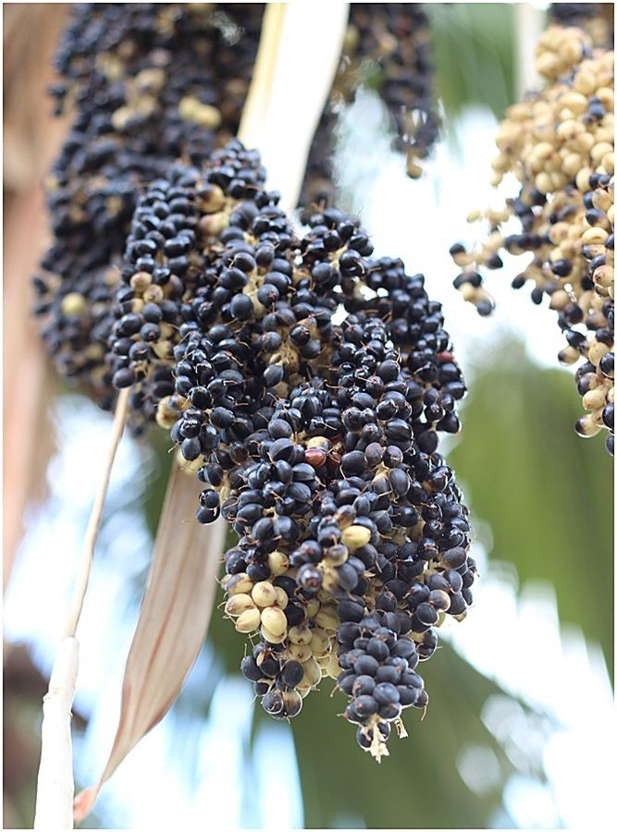
Aim of the study
The objective of this work is to determine, using weight loss, electrochemical (EIS & PDP) measurements and optical microscope (OM) techniques, for the first time, the inhibitory effect of Washingtonia fruit extract (WFE) on the corrosion of mild steel in 1 M HCl and 0.5 M H₂SO₄ solutions. It was looked into how altering WFE concentrations affected the suppression of corrosion. There is also a discussion of the inhibitory performance comparison between HCl and H₂SO₄. It is anticipated that important data regarding WFE's adsorption and inhibition of mild steel in acidic solutions would be gathered.

Slide 12
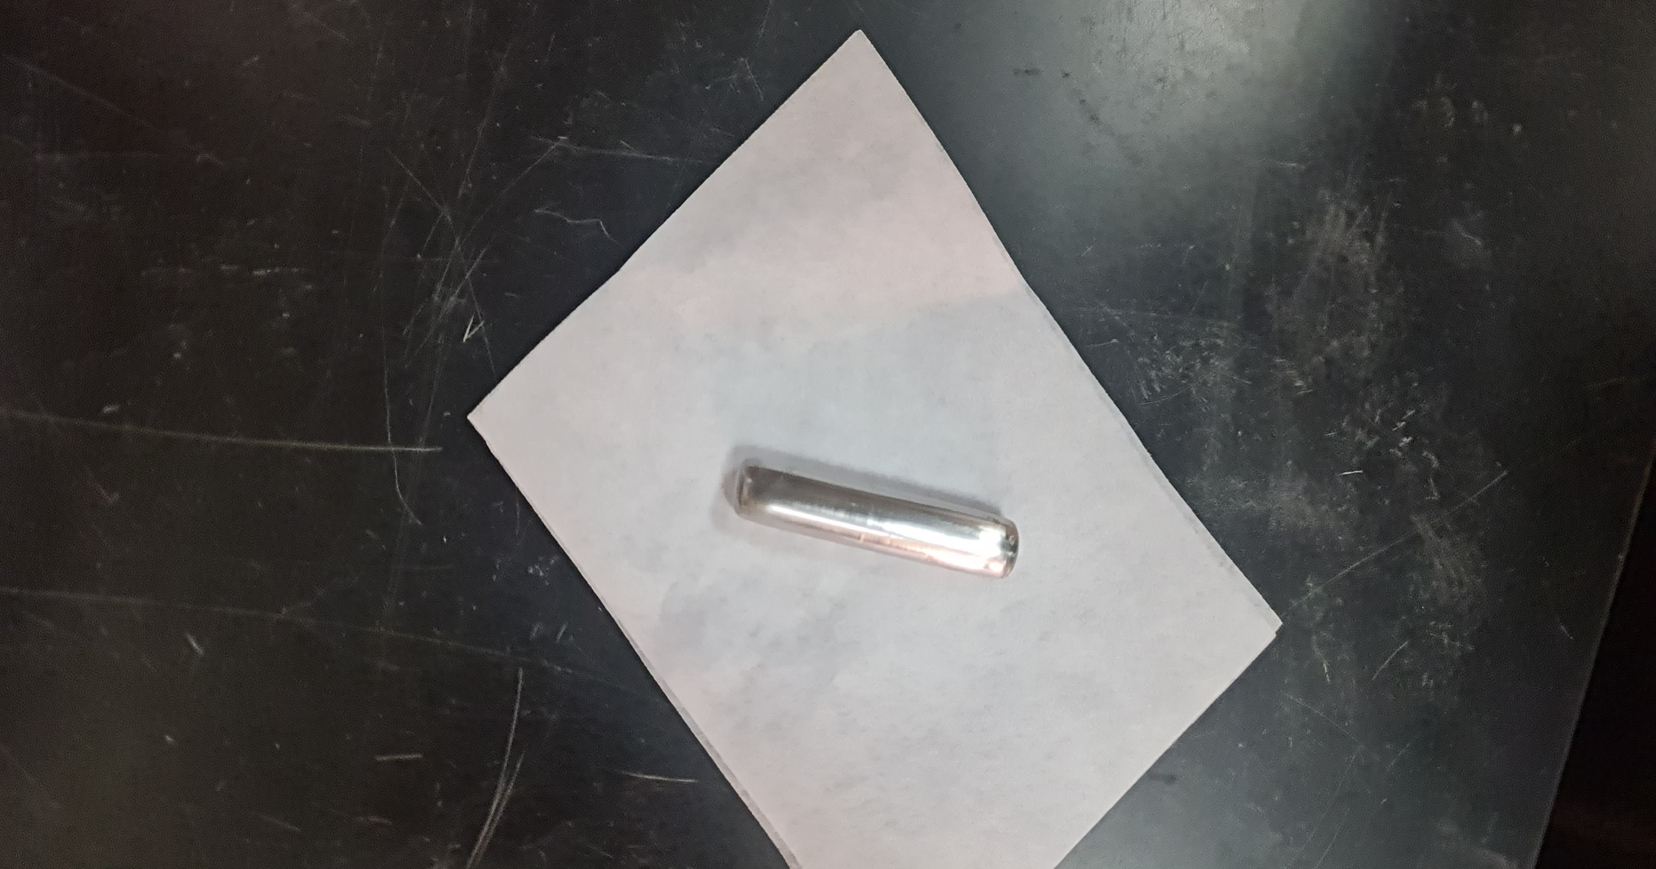
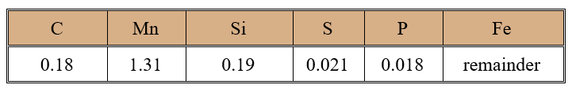
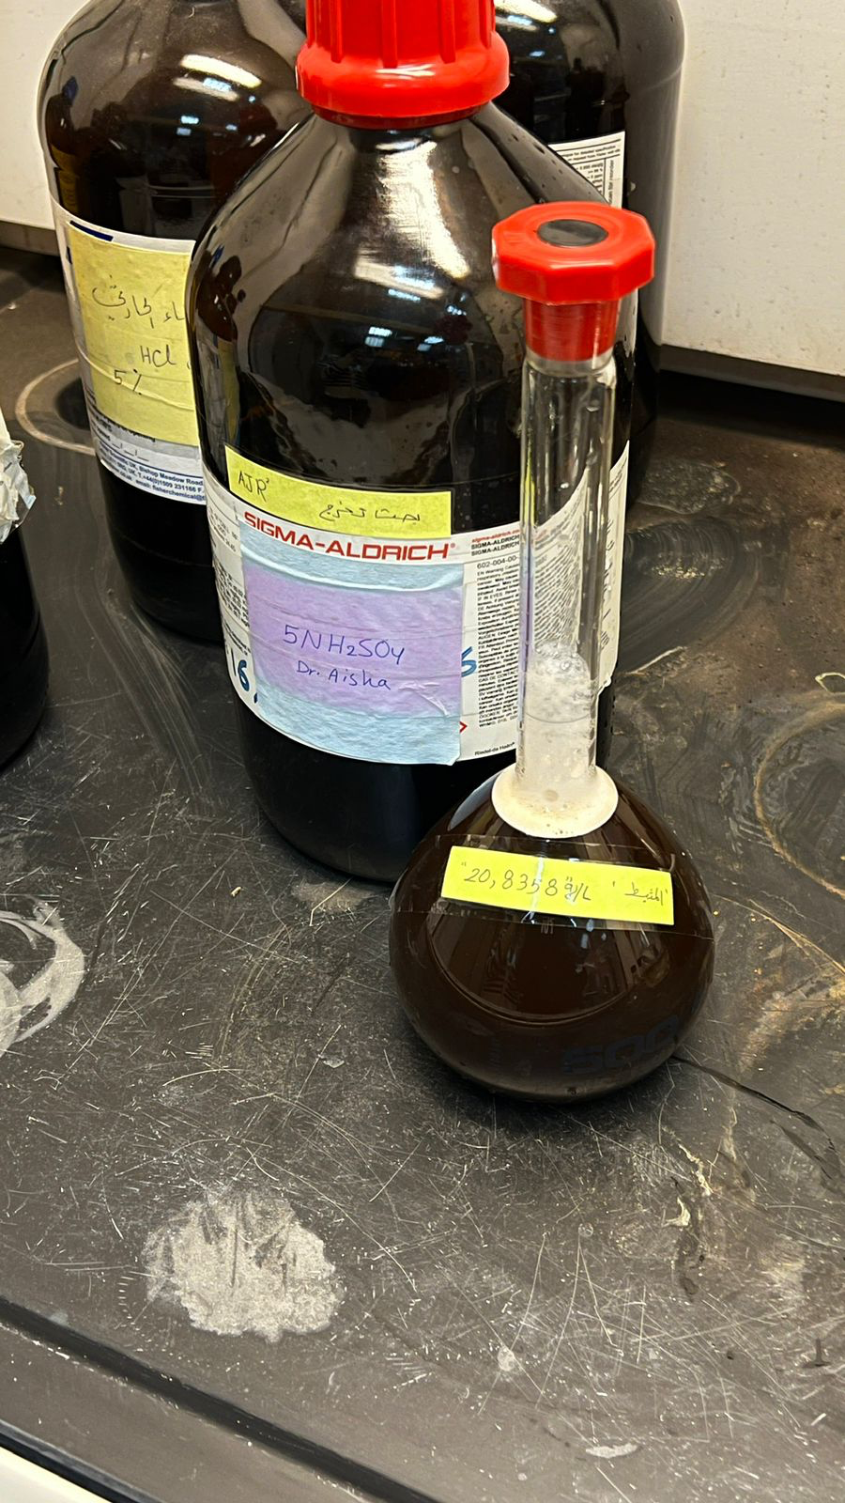
Experimental
Table 1. Chemical composition of the studied mild steel (wt%).
Material
1- Specimen and Pretreatment
Mild steel rods of 5 cm in length and 1 cm in diameter.
2- Aggressive solutions
Solutions stocks of aggressive 1 M HCl and 0.5 M H₂SO₄ .
3- Inhibitor
Washingtonia fruit extract.
Notes:
The main objective of carbonate isotope to know the value of H 2, 1 and O 16, 18
Why know the source?

Slide 13
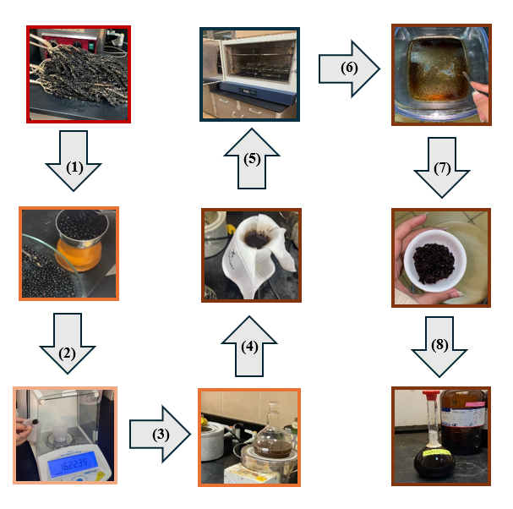
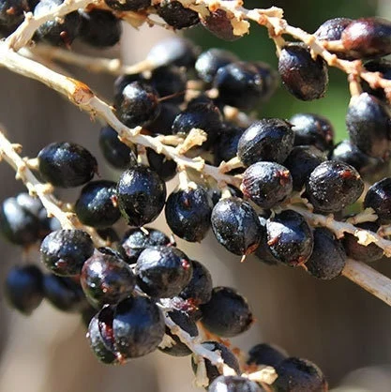
Inhibitor Preparation
(WFE)
Figure 2.The steps used to prepare the plant extract (WFE).

Slide 14
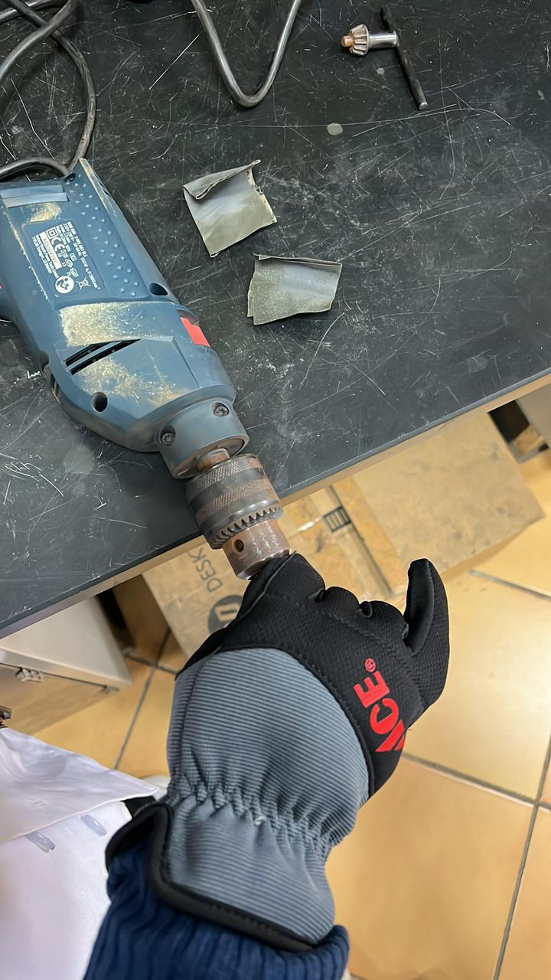
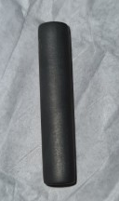
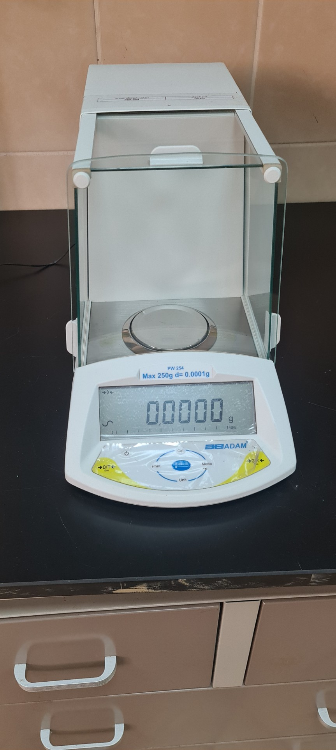
Experimental
Method
Polishing
Submerging
Washing
Washing
Weighing
Weighing
Notes:
The main objective of carbonate isotope to know the value of H 2, 1 and O 16, 18
Why know the source?

Slide 15
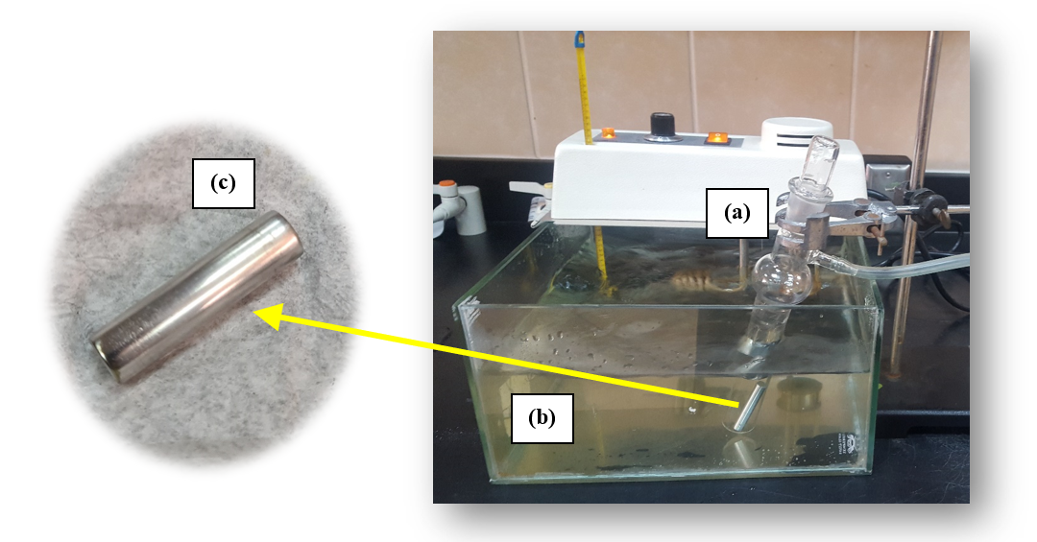
Experimental
Methods
(1)-Weight Loss (WL) Measurements
One of the simplest and most common ways to discover the inhibitory impact is through the chemical approach (weight loss).
Figure 3. The system that is used for weight loss experiments. (a) Mylius cell, (b) thermostat water bath , and (c) mild steel sample.
Notes:
The main objective of carbonate isotope to know the value of H 2, 1 and O 16, 18
Why know the source?

Slide 16
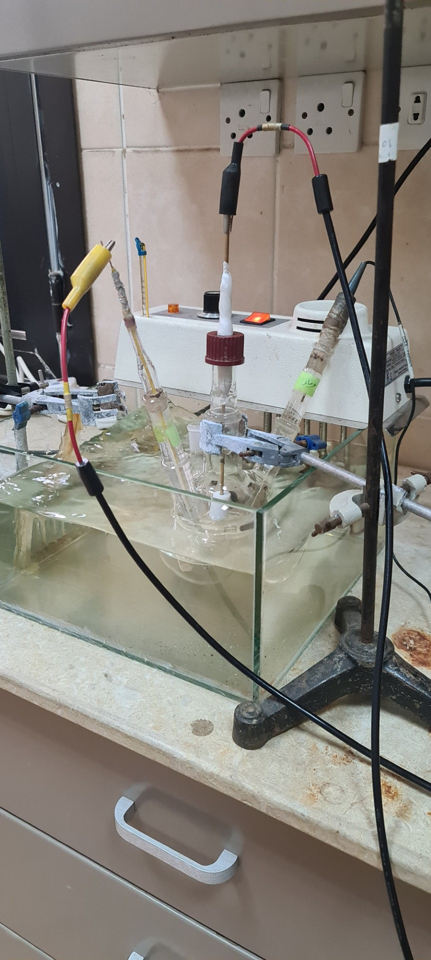
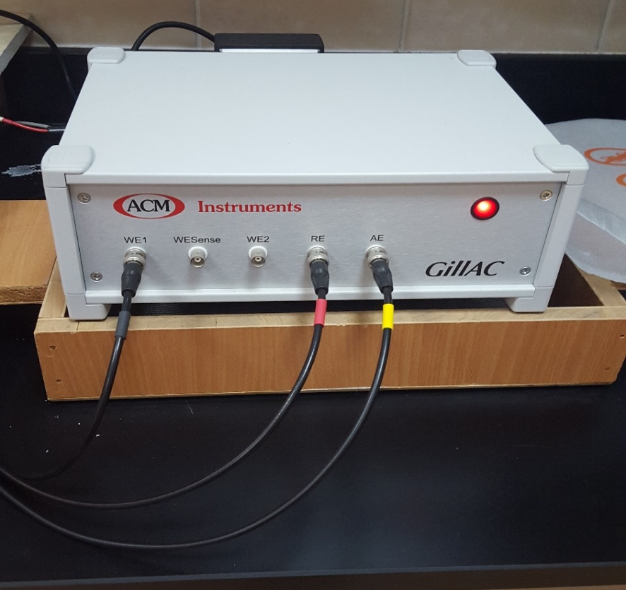
Experimental
(2)-Electrochemical (EIS & PDP) Measurements
Three different types of electrodes were used during electrochemical measurements.
The working electrode was made of mild steel rod.
The reference electrode was silver/silver chloride (Ag/ AgCl/KCl ) electrode.
The auxiliary electrode was in the form of a platinum (pt) wire .
Electrochemical measurements were run by connecting the electrochemical cell to ACM Gill AC instruments model 1649 which in turn is connected to a computer.
EIS: The covered frequency range was 30 KHz to 0.1 Hz.
PDP: the potential range from −700 mV to −200 mV

Slide 17
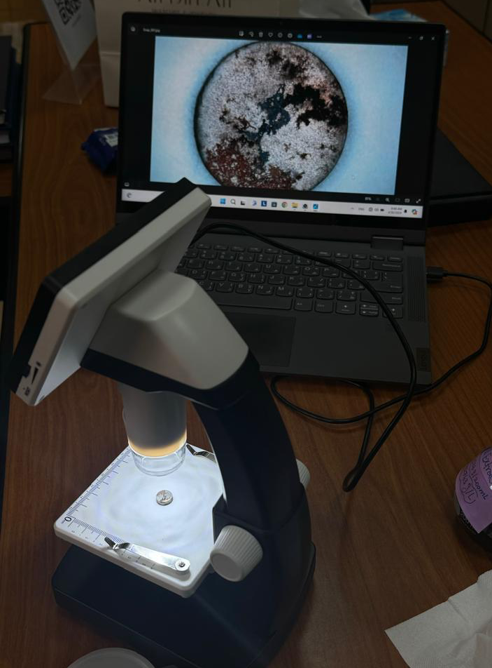
Experimental
(3) Microscopic Observations
The morphology of mild steel samples was investigated before and after immersing in 0.5 M H₂SO₄ and 1 M HCl acid solutions for 90 minutes in the absence and presence of 3.5 g/L of WFE using BRESSER LCD Microscope.
Notes:
The main objective of carbonate isotope to know the value of H 2, 1 and O 16, 18
Why know the source?

Slide 18
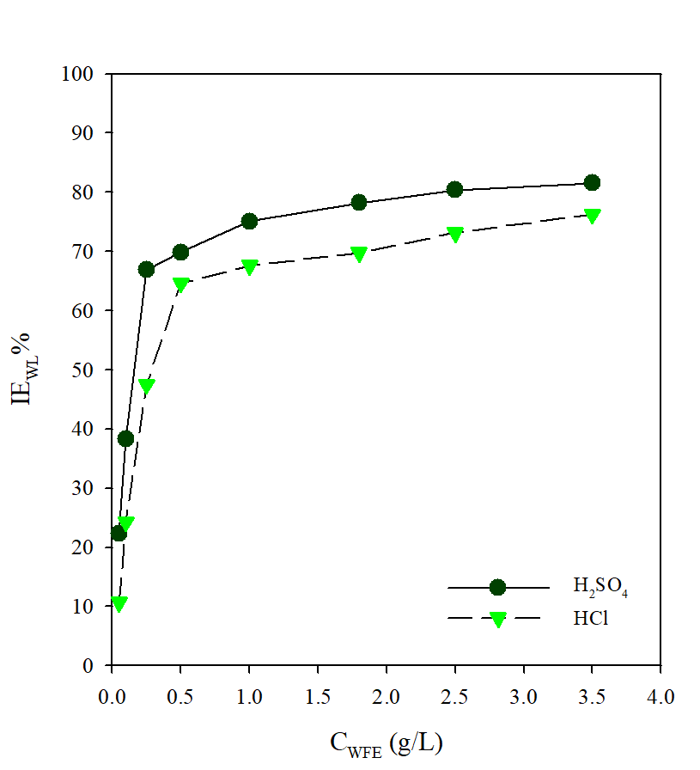

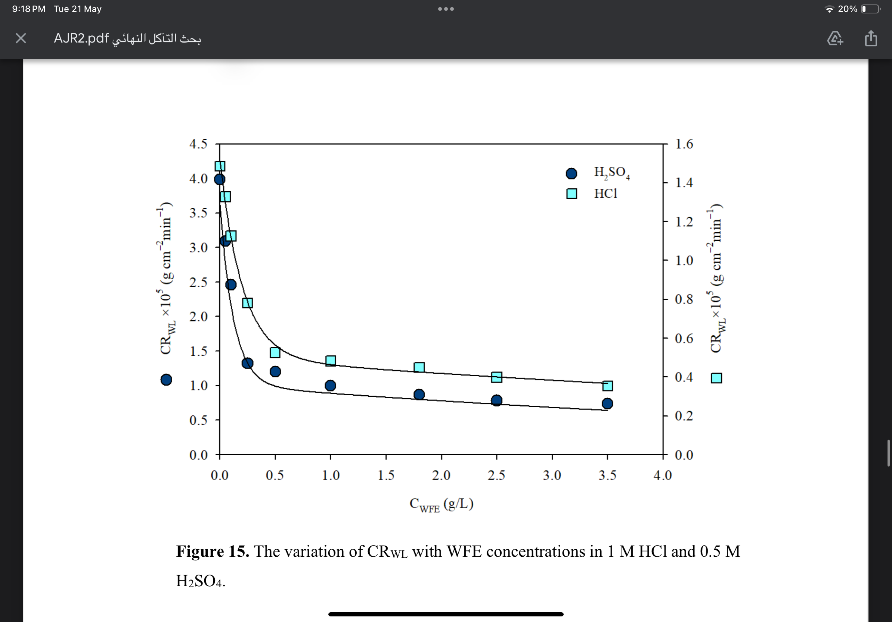

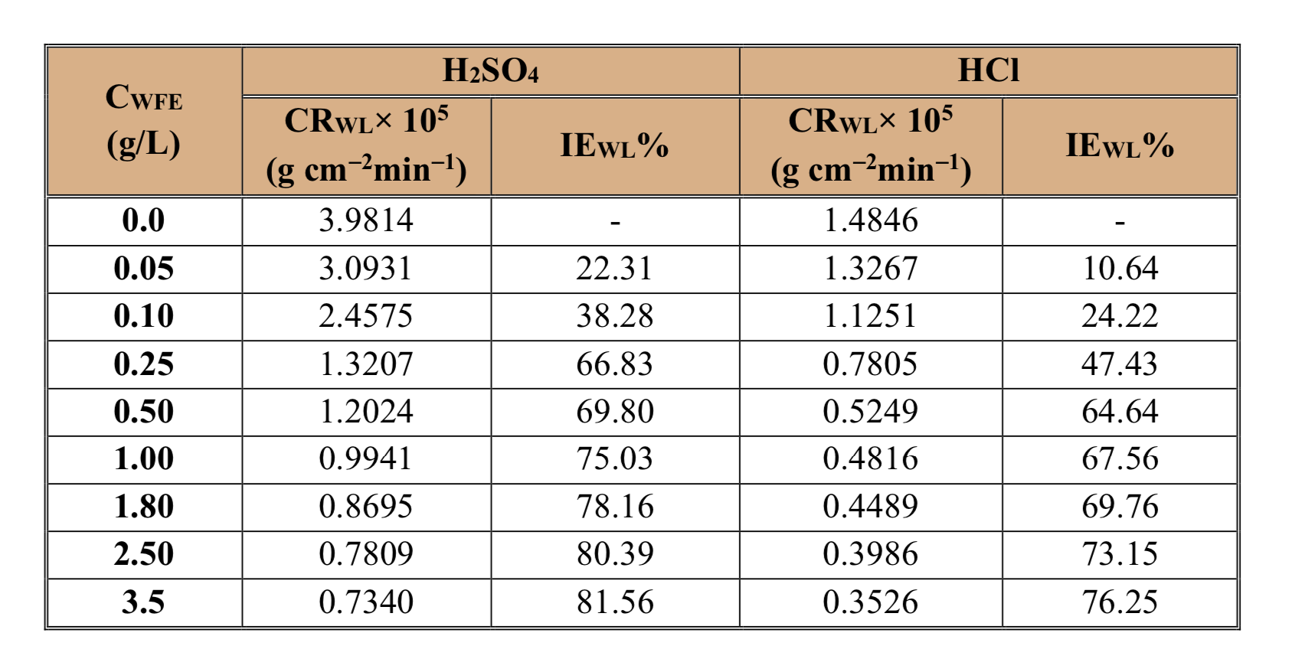
Results & Discussion
Effect of WFE Concentration on Corrosion Rate and Inhibition Efficiency
Table 2. Corrosion rates and inhibition efficiencies of mild steel corrosion in 0.5 M H₂SO₄ and 1 M HCl without and with different concentrations of WFE at 30ºC.
Figure 5. The variation of IE_{WL}% with WFE concentrations in 1 M HCl and 0.5 M H₂SO₄.
Figure 4. The variation of CR_{WL} with WFE concentrations in 1 M HCl and 0.5 M H₂SO₄.
Notes:
The main objective of carbonate isotope to know the value of H 2, 1 and O 16, 18
Why know the source?

Slide 19
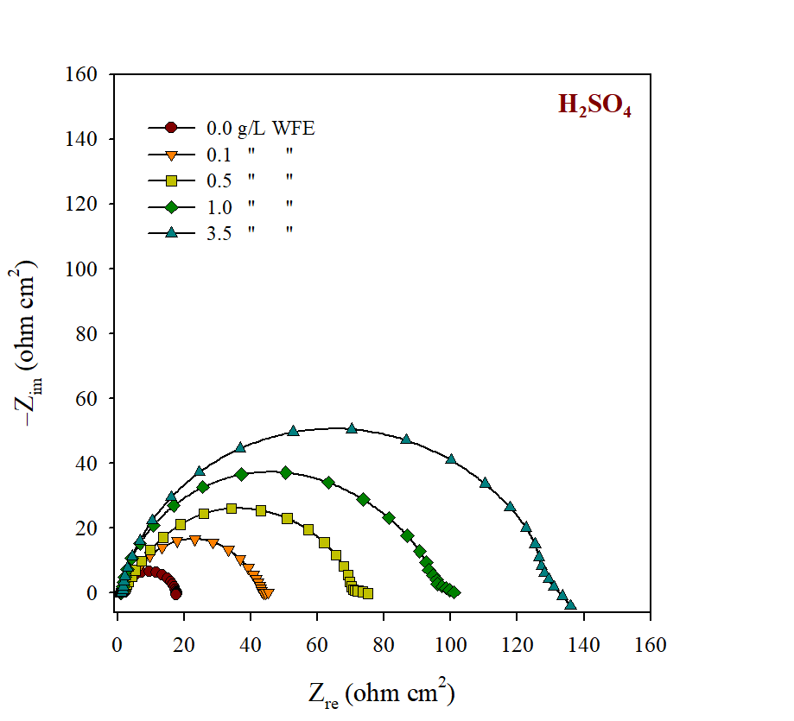
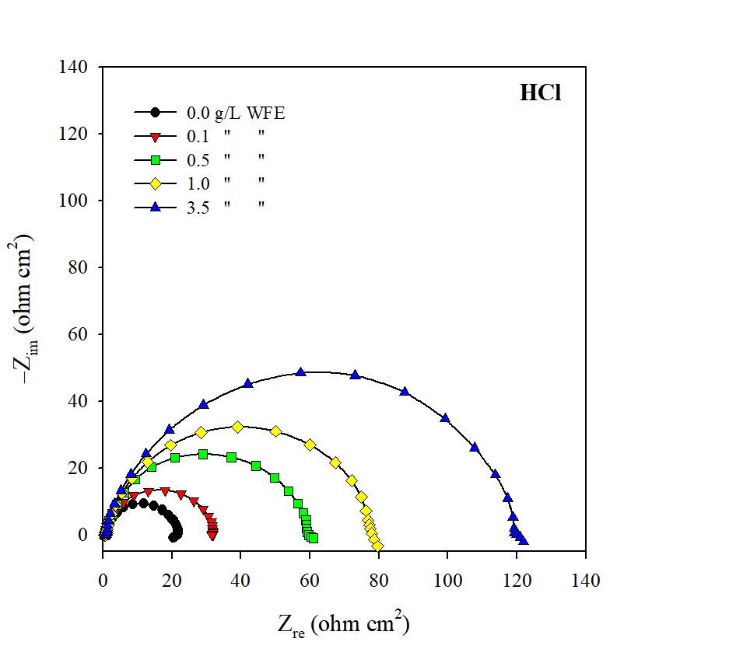
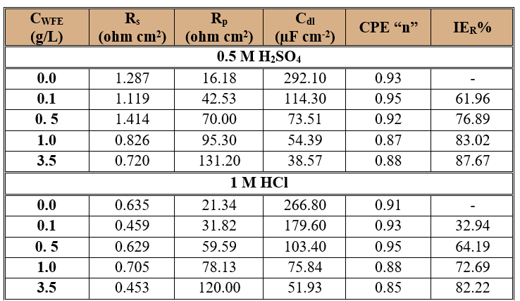
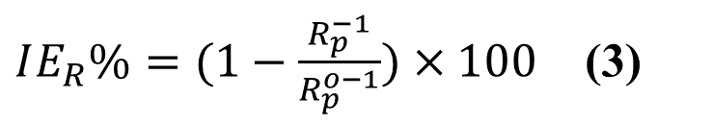
Results & Discussion
$IE_{R}\%=(1−\frac{R_{p}^{−1}}{R_{p}^{o−1}})×100$ (3)
Table 3. Electrochemical impedance parameters for mild steel corrosion in 0.5 M H₂SO₄ and 1 M HCl acids without and with different concentrations of WFE at 30ºC.
Figure 6. Nyquist plots for mild steel corrosion in 0.5 M H₂SO₄ and 1 M HCl without and with different concentrations of WFE at 30ºC.

Slide 20
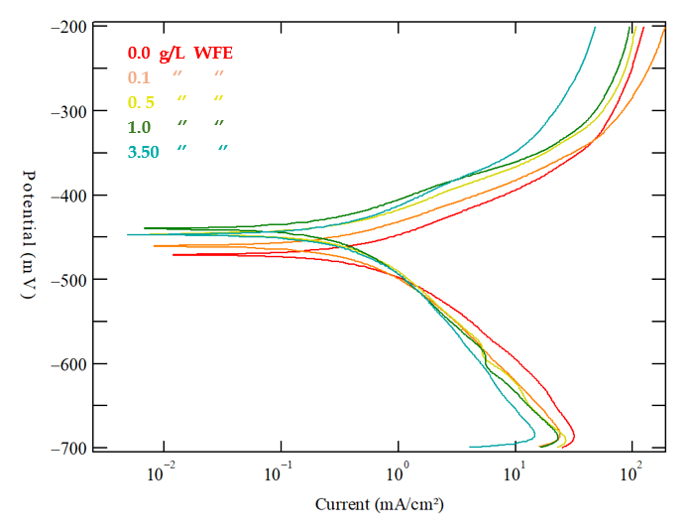
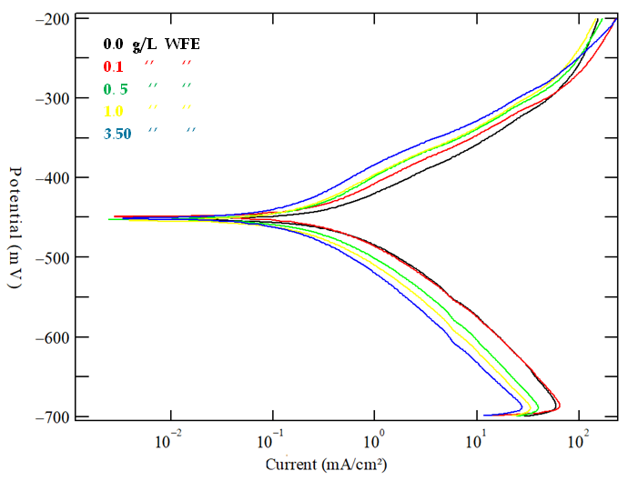
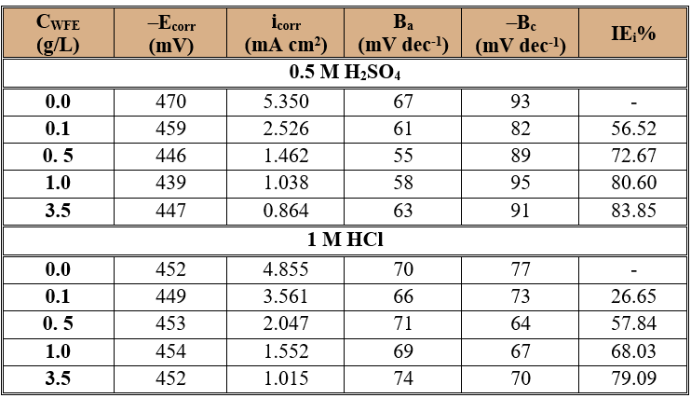
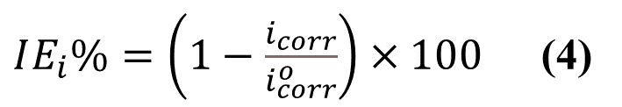
Results & Discussion
HCl
$IE_{i}\%=\left(1−\frac{i_{corr}}{i_{corr}^{o}}\right)×100$ (4)
H₂SO₄
Table 4. Electrochemical potentiodynamic parameters for mild steel corrosion in 0.5 M H₂SO₄ and 1 M HCl acids without and with different concentrations of WFE at 30ºC.
Figure 7. PDP plots for mild steel corrosion in 0.5 M H₂SO₄ and 1 M HCl without and with different concentrations of WFE at 30ºC.

Slide 21
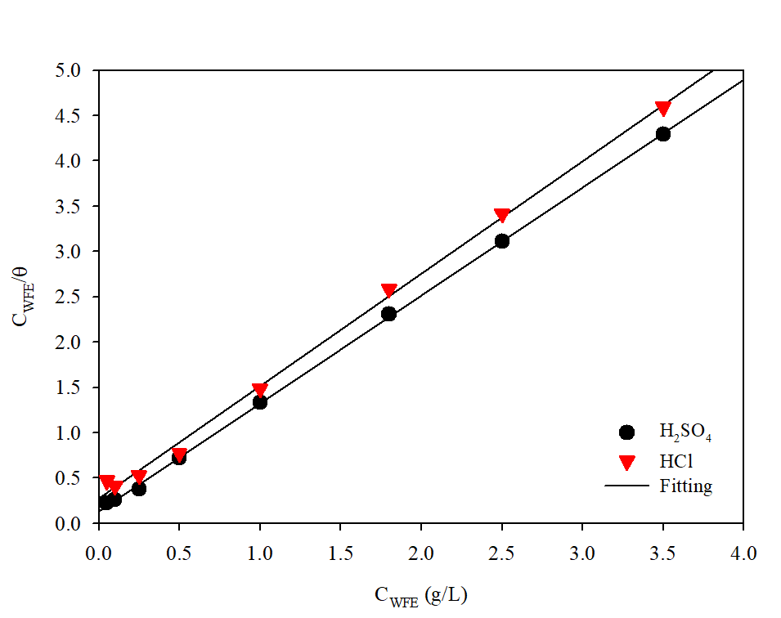
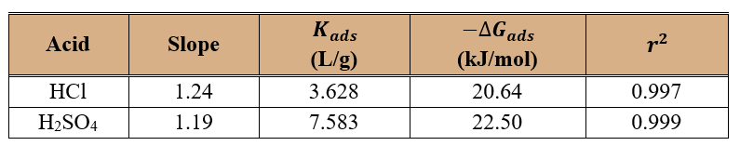
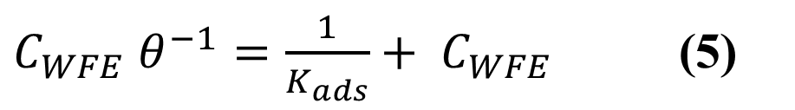
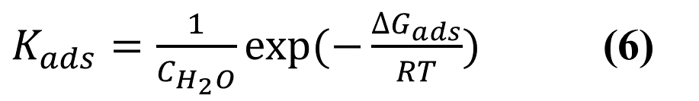
Results & Discussion
Adsorption Isotherms
$C_{WFE} θ^{−1}=\frac{1}{K_{ads}}+ C_{WFE}$ (5)
$K_{ads}=\frac{1}{C_{H_{2}O}}exp⁡(−\frac{{∆G}_{ads}}{RT})$ (6)
Table 3. Adsorption parameters from Langmuir isotherm for mild steel in 1 M HCl and 0.5 M H₂SO₄ with different concentration of WFE at 30 ᵒC.
Figure 8. Langmuir adsorption isotherm for WFE inhibitor on mild steel in 1 M HCl and 0.5 M H₂SO₄.

Slide 22
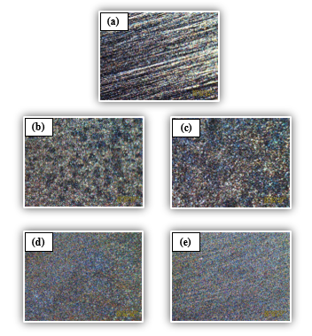
Results & Discussion
Microscopic Observations
Pits
Pits
Figure 9. Microscopic images of mild steel (a) only surface polishing, (b) and (c) after immersion in 0.5 M H₂SO₄ and 1 M HCl, respectively without WFE inhibitor, (d) and (e) with 3.5 g/L of WFE in 0.5 M H₂SO₄ and 1 M HC, respectively

Slide 23
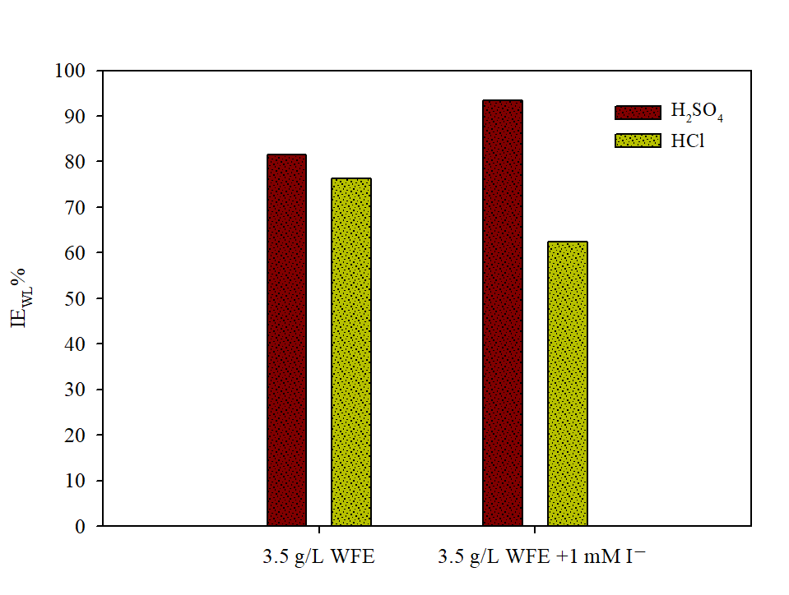
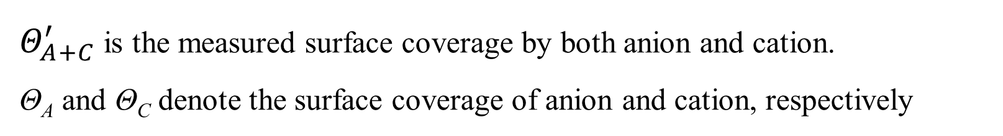
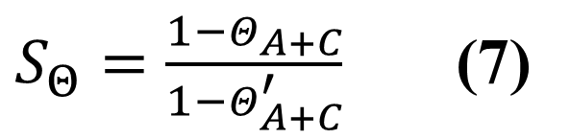
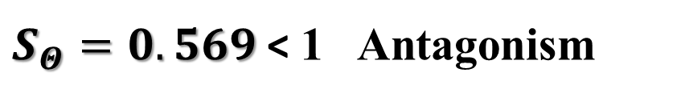

Results & Discussion
Synergistic and Antagonistic Effect
$S_{Θ}=\frac{1−Θ_{A+C}}{1−Θ_{A+C}^{′}}$ (7)
Θ_{A+C} = (Θ_{A} + Θ_{C})-(Θ_{A}Θ_{C})
$Θ_{A+C}^{′}$ is the measured surface coverage by both anion and cation.
Θ_{A} and Θ_{C} denote the surface coverage of anion and cation, respectively
in 0.5 M H₂SO₄
$S_{Θ}=1.883$ > 1 Synergism
in 1 M HCl
Figure 10. Variation of IE% of WFE inhibitor without and with addition of 1mM of iodide ions in 0.5 M H₂SO₄ and 1 M HCl.
$S_{Θ}=0.569$< 1 Antagonism

Slide 24


Results & Discussion
Explanation for Inhibition
Mild steel surface
Figure 11. Bioactive Compounds of Washingtonia filifera fruit.

Slide 25



In light of the present experimental investigations, WFE has the potential to act as an environment-friendly natural corrosion inhibitor. WFE was tested in 0.5 M H₂SO₄ and 1 M HC, respectively, to evaluate its efficiency as a green corrosion inhibitor. Based on all experiments, the following conclusions can be drawn:
According to the WL and electrochemical data, mild steel corrosion in both the 0.5 M H₂SO₄ and 1 M HCl was successfully inhibited by WFE. However, it does so more effectively in H₂SO₄ than in HCl.
As WFE concentration increased its inhibition efficiency increased as well due to the formation a protective film by the adsorbed inhibitor molecules on the metal surface.
Conclusion
Green Corrosion Inhibitor and sustainability
Notes:
-In conclusion, during my assignment, I have worked in three different labs carbonate isotopes, water isotopes and pyrolysis.
-the assignment offered me a huge opportunity to engage with real work environment and to contact many people from different technical background.

Slide 26

The adsorption of WFE molecules on the mild steel surface was found to follow Langmuir adsorption isotherm in both acids.
The results of optical microscope investigations further verified that the development of a protective layer of WFE components is responsible for delaying mild steel corrosion.
A WFE would make an ideal greener alternative for developing corrosion-resistant materials that are safe to use.
In H₂SO₄, but not in HCl, the addition of KI to the corrosive solutions increases the efficiency of corrosion inhibition when combined with WFE.
Conclusion
Green Corrosion Inhibitor and sustainability

Slide 27


References

Slide 28

References

Slide 29



JUBCOR
2024
CONFERENCE & EXHIBITION
INNOVATIVE SOLUTIONS FOR CORROSION CHALLENGES
THANK YOU
Reach out.
Email: ahmobaraki@uj.edu.sa
ahm13988@hotmail.com

