Slide 1




JUBCOR
2024
CONFERENCE & EXHIBITION
INNOVATIVE SOLUTIONS FOR CORROSION CHALLENGES
Anti-Biofouling; Using Electrochemical Process in the Cooling Circuit of Nuclear Power Industry: A Case Study
Presented By: Dr. Muhammad Saleem
AM-ASCE, M-IAAM, M-PEC,
Environmental and Water Resources Institute (EWRI)
Dept. of Civil Engineering
Jubail Industrial College, Royal Commission for Jubail & Yanbu

Slide 2




Introduction
Profile
Since 1994, involved in research related to environmental issues, water & wastewater quality, recycling & reuse, application of processes, environmental monitoring & impact assessments.
Author of more than 100 publications in peer-reviewed journals, book chapters, and national/international conferences.
Head of Nuclear & Environmental Engineering (Pakistan Atomic Energy Commission, PAEC)
Consultant & Member, Board of Advisory (NED University, Mehran UET, Quaid-e-Awam Univ, University of Manchester, Env. Management, UK).
Faculty & Coordinator, Environmental Engineering Research & Teaching Labs, KFUPM
Academics:
PhD (Water Resources & Environmental Engineering)
MSc (Environmental Engineering, Environmental Biochemistry & Microbiology)
MSc (Nuclear Engineering)
BS (Civil Engineering)
Positions:
Head of Nuclear & Environmental Engineering (Pakistan Atomic Energy Commission, PAEC)
Consultant & Member, Board of Advisory (NED University, Mehran UET, Quaid-e-Awam Univ, University of Manchester, Env. Management).
Faculty & Coordinator, Environmental Engineering Research & Teaching Labs, KFUPM.

Slide 3


Introduction
Editor for Journals
Editor, BMC Research Notes, SPRINGER NATURE.
Editor, American Journal of Civil Engineering (AJCE R&D), USA.
Editor, International Journal of Environmental Monitoring and Analysis, Science Publishing Group, USA.
Editor, Environment and Pollution’ Canadian Centre of Science and Education, Environment and Pollution (EP), Canada.
Editor, Journal of Advanced Biotechnology and Bioengineering, Synergy Publishers, UK.
Associate Editor, Academic Journal of Material Sciences (AJMS), International Association of Scientists and Researchers (IASR).
Technical Reviewer
Technical Reviewers of More than 45 Journals,
World Water Association,
WHO,
Environment & Pollution, Canadian Centre of Science & Education,
Higher Education Commission, Pakistan,
Deanship of Research at KFUPM
Who is in Collaborative Group:
Consist of more than 20 universities in 11 different countries
Persons involved: Professors, senior researchers and students

Slide 4

Discussion Topics
Introduction
Problem Statement
Solution to the Problem
Case Study
  Material & Methods
  Results & Discussion
Conclusions
References

Slide 5

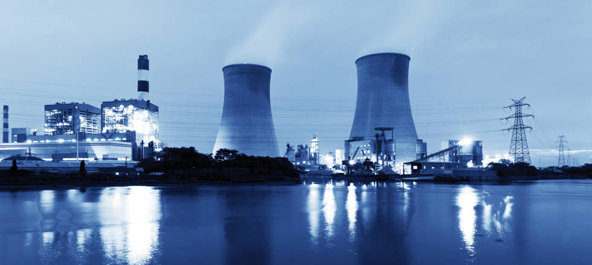
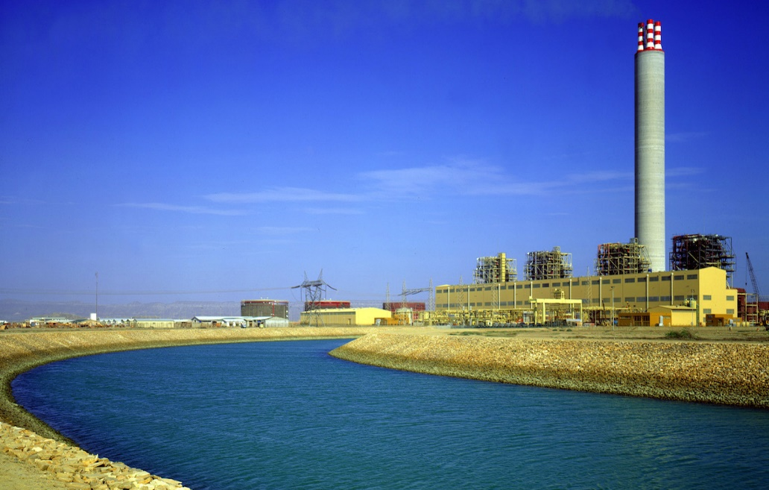
Introduction
Generally, power industries are located at coastal areas
Purpose is to use seawater to fulfill cooling and process water requirements.
Significant cost in transportation and maintenance could be saved

Slide 6
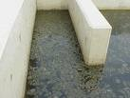
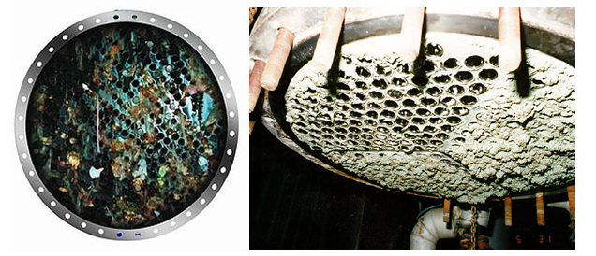
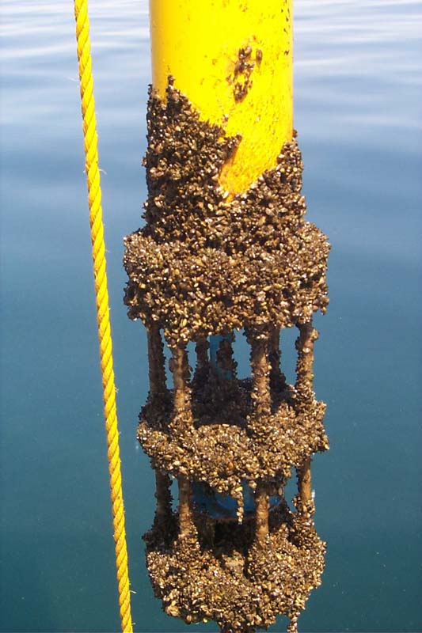
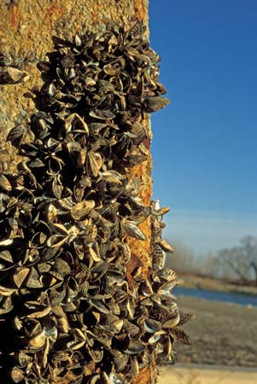
Introduction
However, the saline seawater contains biological organisms such as bacteria and algae which may cause biological fouling in the seawater inlet structure and relevant equipment of the industry.
This may further damage and obstruct the piping system and equipment due to the biological slime formation.

Slide 7

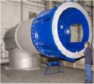
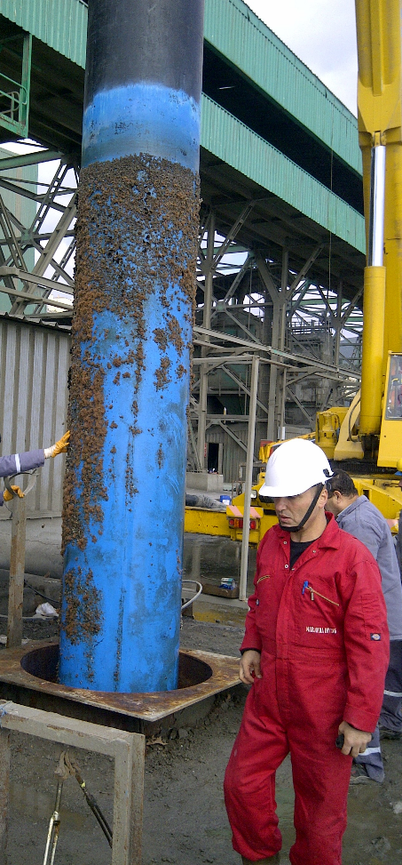
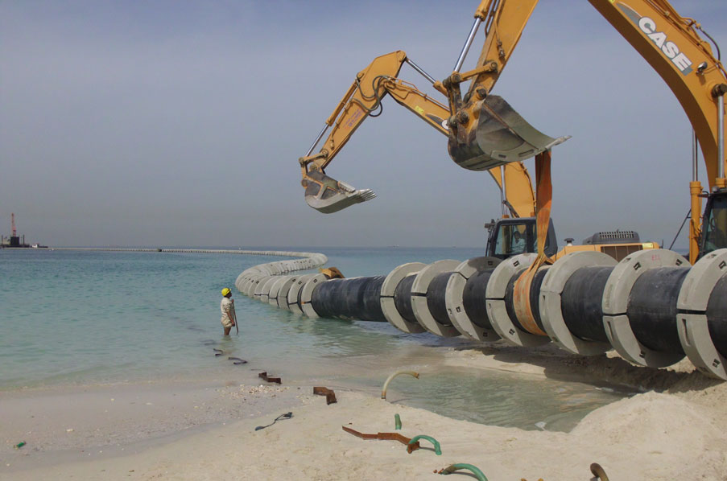

Introduction to the Problem
This results in unexpected plant downtime.
Frequent maintenance of seawater intake systems, condenser tubes, tube sheets, and piping systems are required.
Increase in maintenance and operation cost.

Slide 8
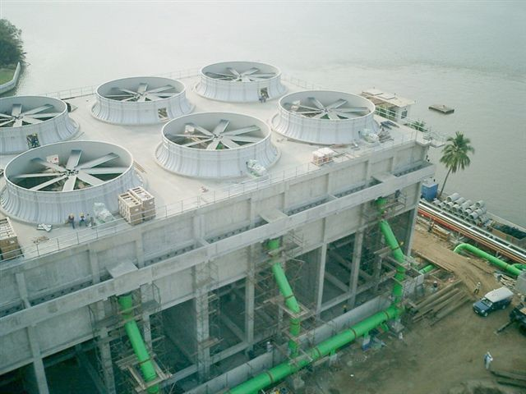
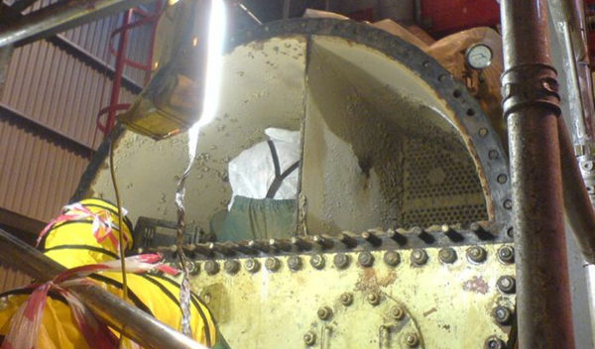
Introduction to the Problem
Generally, biofouling can affect the condenser performance in a number of ways:
  Reduction in the internal diameter of the condenser tubes and intake pipes.
  Increase in the fluid resistance that requires pumping system/operation to be modified; in some cases high pumping heads may be required.
  Reduction in the thermal conductivity.

Slide 9

Solution to the Problem
What is the Solution ?

Slide 10
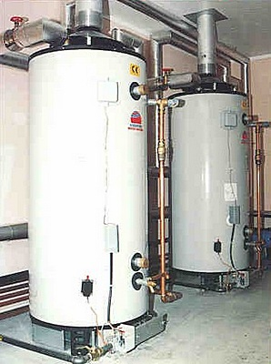
Solution to the Problem
The most economical solution to biological fouling is disinfection (Zazouli, & Kalankesh, 2017).
Disinfection can be accomplished through chlorination, ultra-violet (UV) sterilization, ozone or biocide.
Chlorine is an effective and well understood disinfectant (Asfer, 2005; Joseph et al., 2001).
Chlorine
is Available
Gas
Liquid

Slide 11
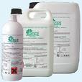
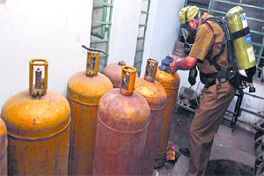
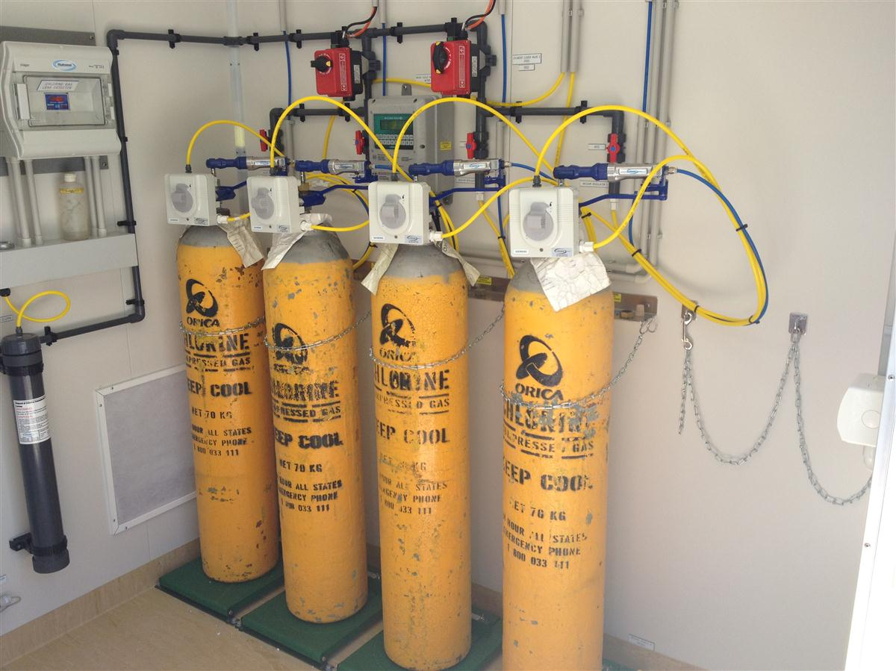
Gaseous Chlorine is not Recommended
However, gaseous chlorine handling could be hazardous and requires strict regulatory compliance.
Specific safety devices need to be provided to personnel handling and transporting chlorine gas tanks and cylinders.

Slide 12
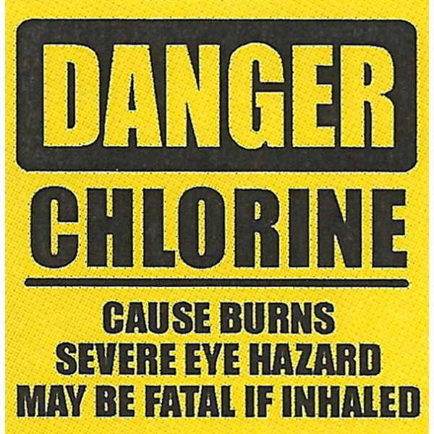
Gaseous Chlorine is not Recommended
Chlorine gas has severe health effects.
Inhalation of chlorine vapor at concentration as low as 5 ppm can provokes breathing problems.
Concentration of 1000 ppm (vol.) may cause death in few minutes.

Slide 13
Solution to the Problem
However, an economical approach is the use of electrolysis to generate sodium hypochlorite from seawater at the site since the main components, electricity and salt water, are readily available in costal operations.
Electrochemical process is preferred because it provides sodium hypochlorite as and when required in the required concentration.

Slide 14
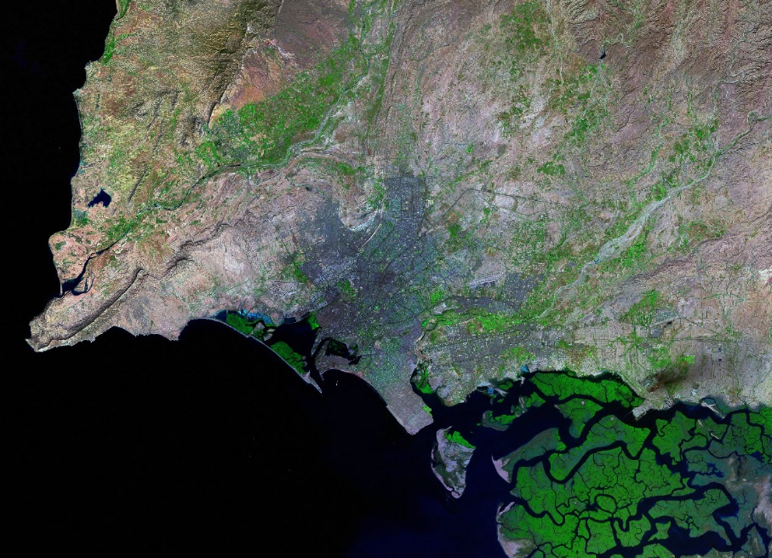
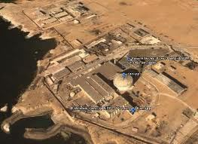
Case Study
KANUPP is the first Nuclear Power plant of Pakistan (137MWe) located at the costal area of Karachi city.
Costal City Karachi
A traditional chlorination system has been provided at Karachi Nuclear Power Plant to control biological growth in the seawater cooling system.

Slide 15
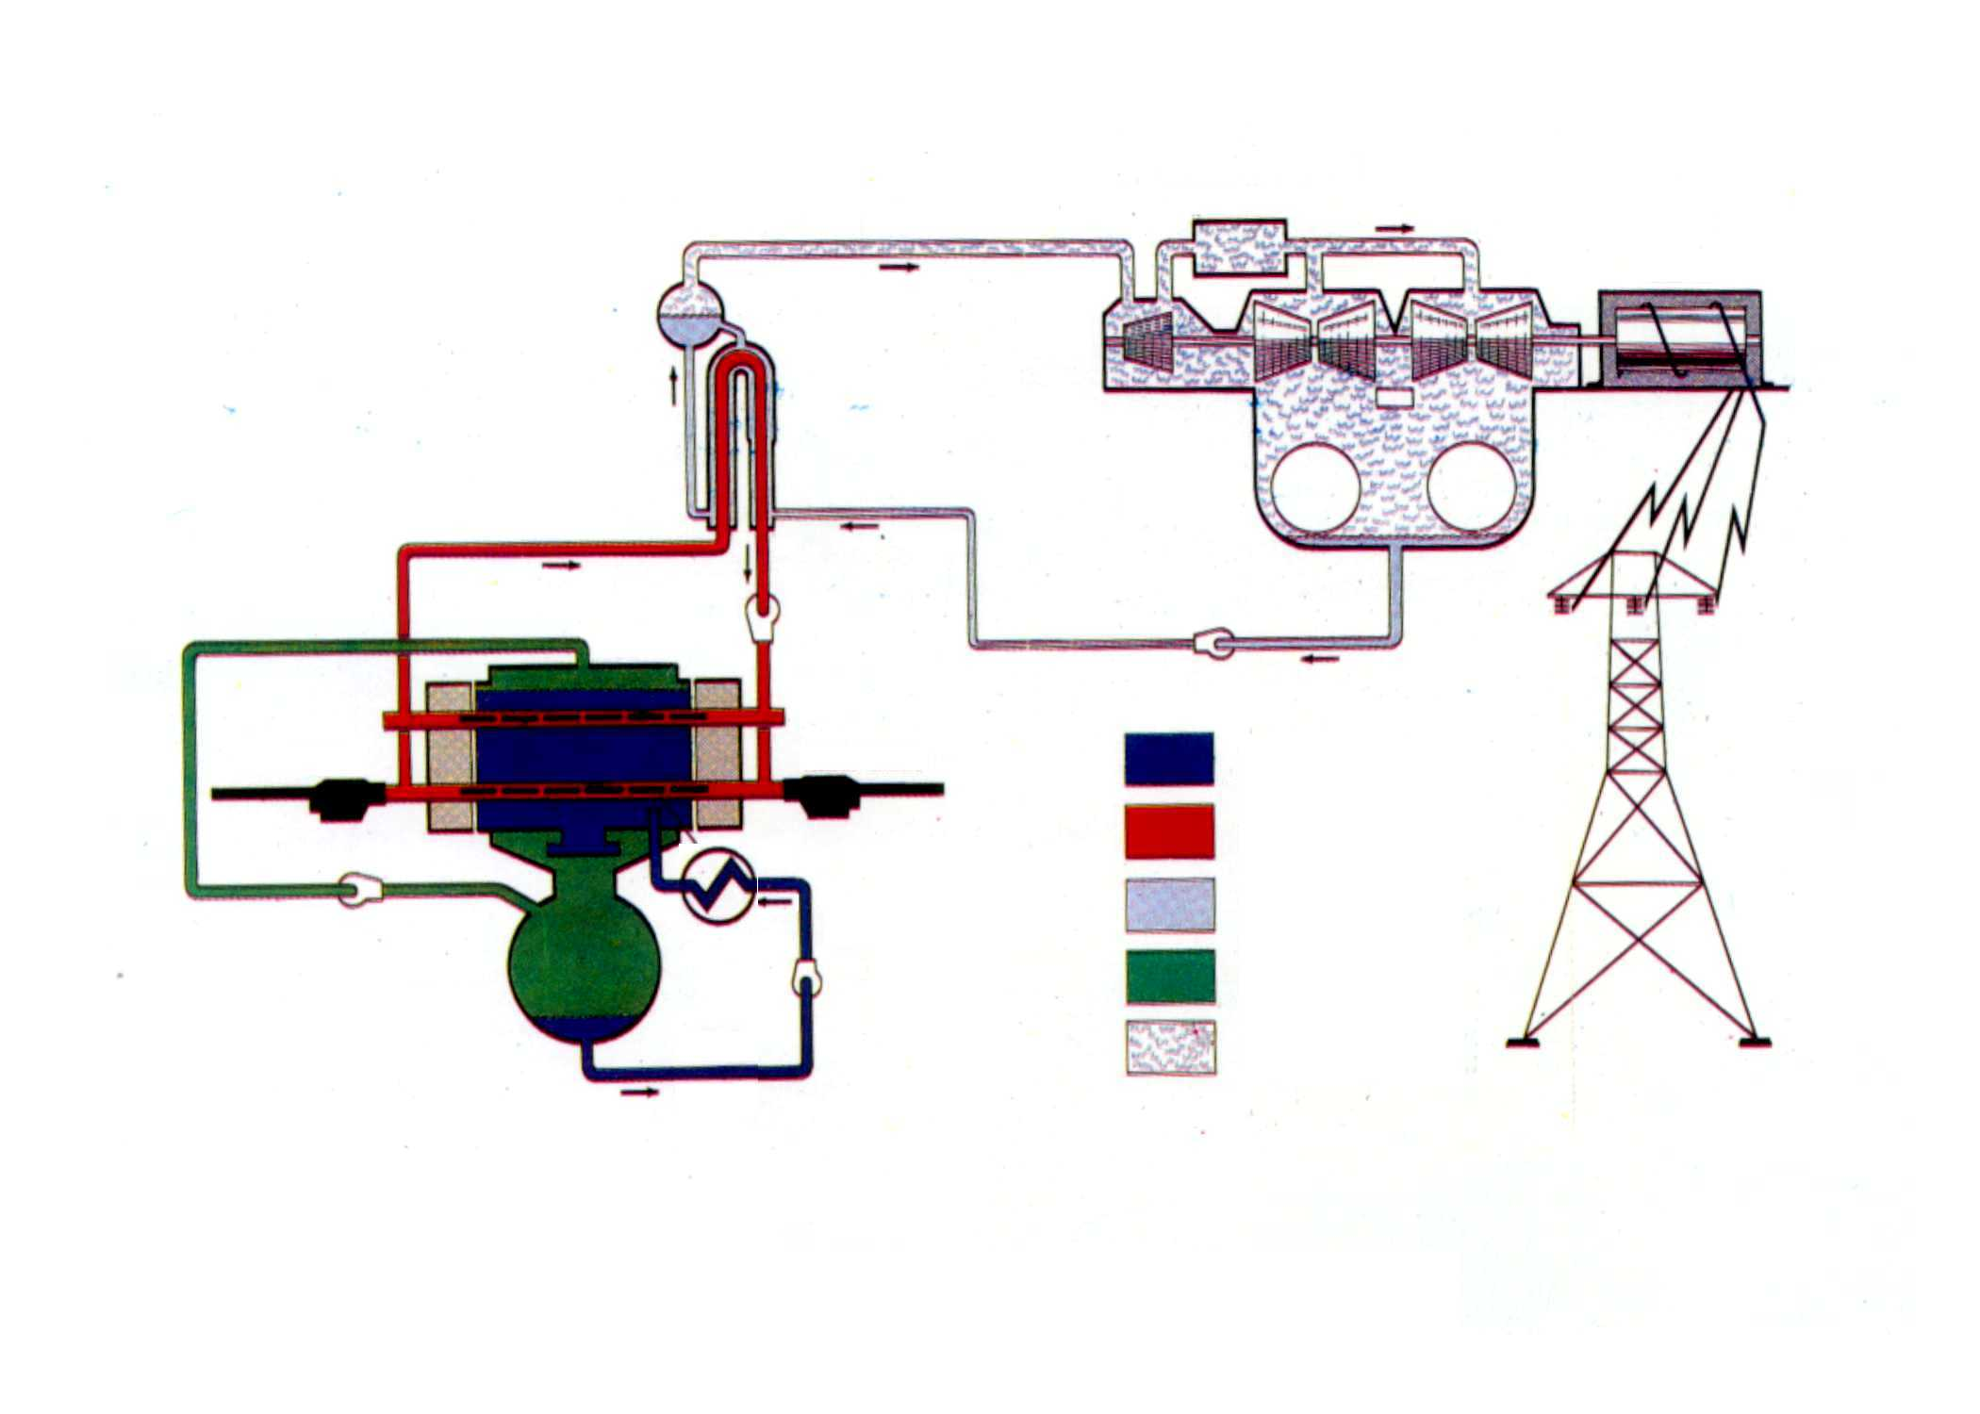
KANUPP Simplified Working Principal ( Flow Diagram )
REACTOR - BOILER
MOISTER SEPARATOR
TURBINE - GENERATOR
STEAM LINE
TURBINE
GENERATOR
STEAM GENERATOR
CONDENSER
PRIMARY CIRCUIT
CALANDRIA
PUMP
FUELING MACHINE
FUELING MACHINE
HEAVY WATER MODERATOR
HEAVY WATER COOLANT
FUEL BUNDLES
HULIUM CIRCUIT
ORDINARY WATER
COOLER
HELIUM
DUMP TANK
MODERATOR CIRCUIT
STEAM

Slide 16
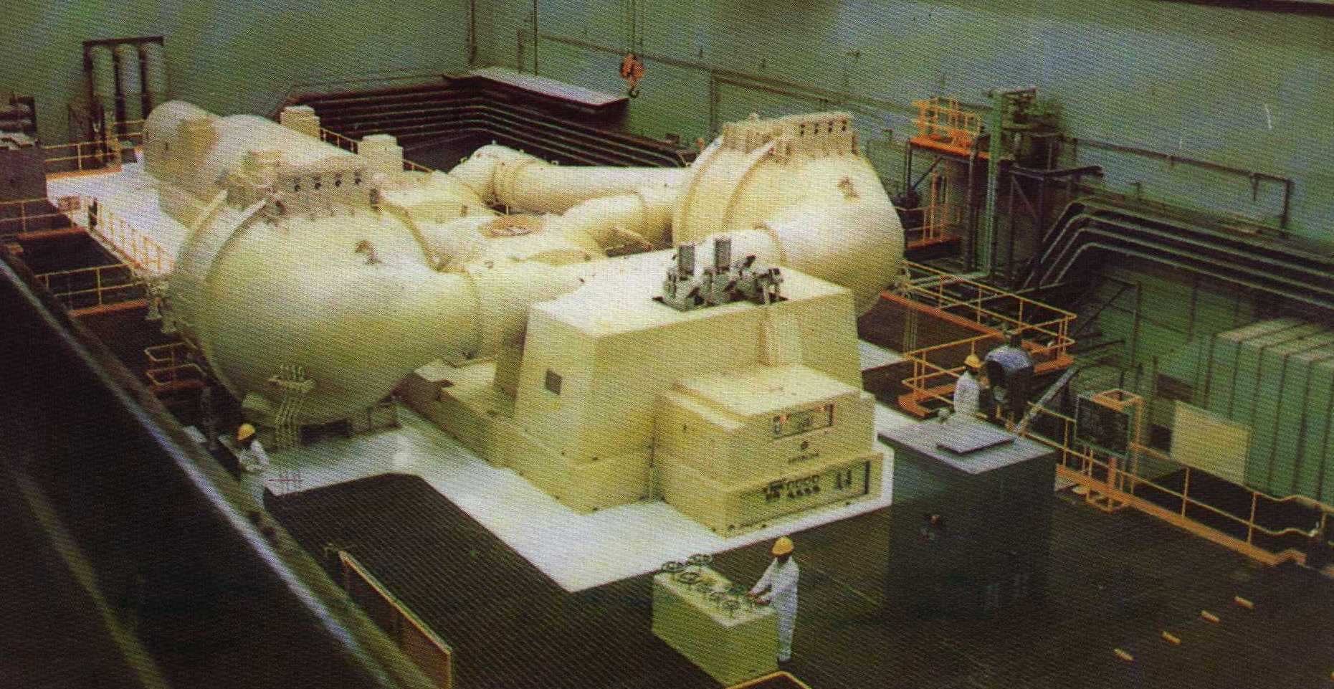
Turbine Hall

Slide 17
Seawater Supply Arrangement
DMW-TK1
KDA
De -
Salination
KW-TK4
KW-TK3
KW-TK2
KW-TK1
DMW-P
Pump House
Sea Water
WTP
FW-P
850 igpm
AUTO
Make-up
VCW-TK1
CBW-TK1
MW-TK3
MW-TK4
BYW
MW-P
(50 igpm)
FIJW-TK1
(EWT-TK1)
Spray Cooling
FIJW-P
(360 igpm)
DSW-P
(800 igpm)
PHT Headers
Core
landria vault
Vault
Boiler Room

Slide 18

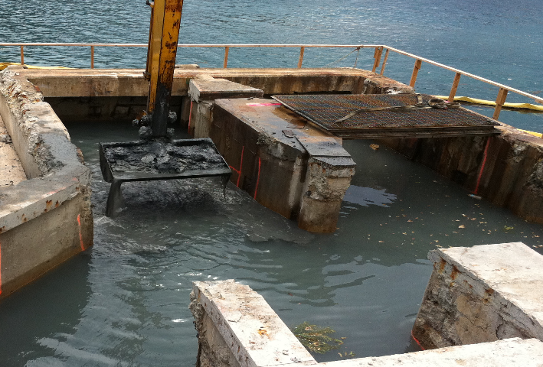
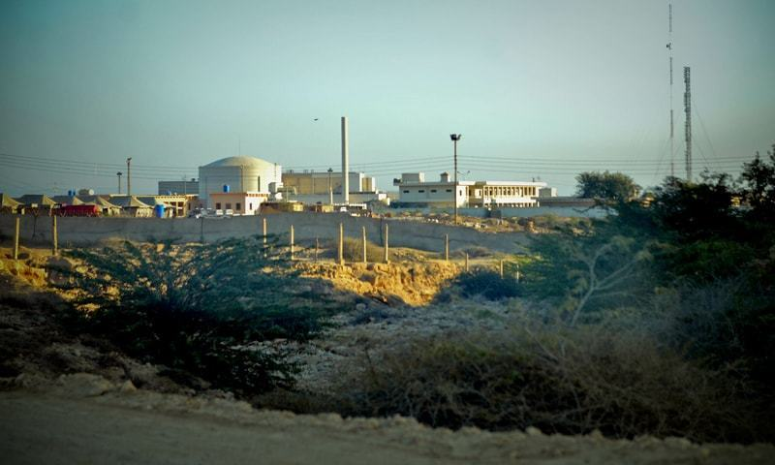
Case Study
With the extensive use of the system and corrosive nature of seawater, various components of the chlorination system became deteriorated and required replacements such as electrodes.
A study was required to provide an electrochemical cell
configuration for the production of Sodium Hypochlorite

Slide 19
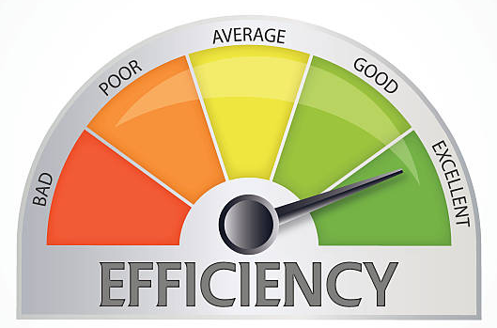
Objectives of Present Study
Study was a part of IAEA (International Atomic Energy Agency) sponsored CRP series of research. Main objectives of the present study were:
Selection of an electrode material to be used in the electrochemical process having a high efficiency and durability as compared to the previous material.
Determination of the effects of critical operational parameters on the process efficiency such as applied current density, applied voltage, surface area of electrode and inter-electrode spacing.
Process efficiency was an important consideration in the study.

Slide 20
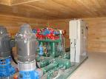
Experimental Protocol
Materials & Methods
  In order to simulate the sodium hypochlorite production cell using seawater a batch experimental setup using plexiglass (having dimensions of 200 mm × 125 mm × 125 mm) was fabricated
  Experimental Data Catalogue:
  Inter-electrode spacing was kept at 10 cm in each run except during studies of inter-electrode spacing.
  The volume of the seawater to be electrolyzed was 2.5L.

Slide 21
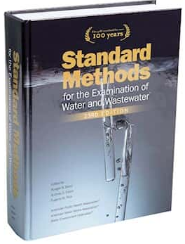
Experimental Protocol
Materials & Methods
  Temperature = 16- 31 °C and pH = 8-9.5
  Each experimental run lasted for at least 2 hours.
  Sampling & Analysis
  Samples were collected at predefined time intervals.
  Analyzed for sodium hypochlorite concentration following the procedures outlined in “Standards methods for the examination of water and wastewater” (Standard Methods, 2000).

Slide 22

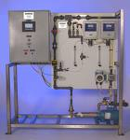



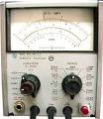
Plexiglass Cell
Rheostat
Electrodes
D.C. Power Supply
Magnetic Bar Stirrer
Magnetic Stirrer Plate
Multimeter
A
Figure 1. Schematic of electrochemical Set-up

Slide 23
Results & Discussion

Slide 24
Results & Discussion
Table 2: Characteristics of seawater at the study site
Parameter | Units | Minimum | Maximum | Mean
Temperature | °C | 16 | 31 | 28
pH at 25 °C |  | 8.0 | 8.3 | 8.2
Turbidity | NTU | -- | 30 | 16
Conductivity | mS/cm | -- | -- | 52.0
Total Hardness as CaCO₃ | mg/l | 6,350 | 7,580 | 6,800
Total Dissolved Solids (TDS) | mg/l | 35,000 | 41,500 | 39,500
Total Solids (TS) | mg/l | -- | -- | 46,200
Calcium as Ca²⁺ | mg/l | 400 | 610 | 615
Magnesium as Mg²⁺ | mg/l | 1,300 | 1,470 | 1,200
Sodium as Na⁺ | mg/l | 10,800 | 15,800 | 14,660
Potassium as K⁺ | mg/l | 380 | 480 | 450
Chloride as Cl⁻ | mg/l | 19,360 | 25,000 | 24,000
Sulfate as SO₄²⁻ | mg/l | 2,700 | 3,300 | 3,000
Oil | mg/l | Nil | Nil | Nil

Slide 25
Results of Electrode Material
Criteria for the selection of material
  NaOCl production efficiency
  Durability
  Cost
Electrode materials tested were
  stainless steel
  lead
  zinc
  copper
  aluminum and
  titanium
  However, titanium with DSA coat was selected due to its better performance.
Reagents | Amount
RuCl₃ | 1 g
36% HCl | 0.5 ml
n-butanol | 17 ml
Iso-propanol | 10 ml
Ti(OC₄H₉) | 3 ml
Ti:Ru | 1:3.46

Slide 26
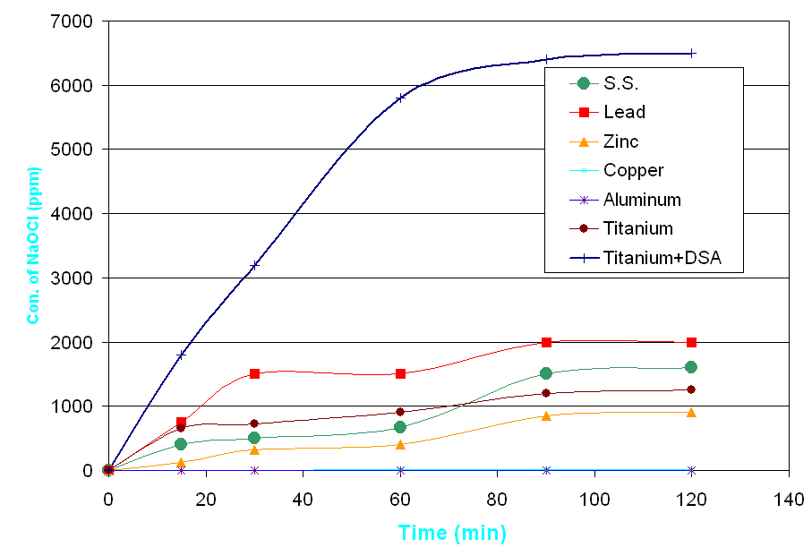
Results of Electrode Material
Titanium+DSA
Life (Years)
0.5
<0.5
1.0
<1.0
0.5
2
20
Temporal variation in the Production of NaOCl using Various Electrode Materials

Slide 27
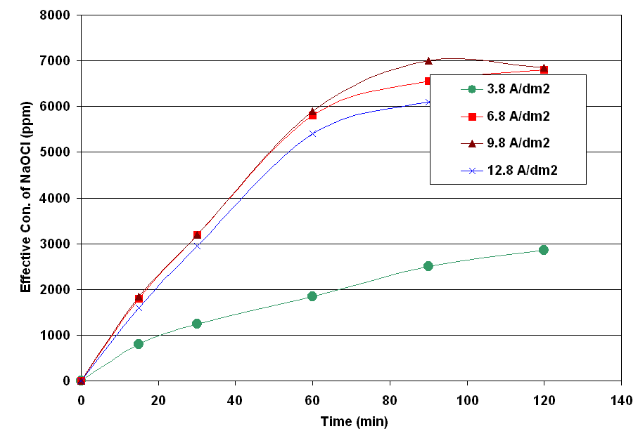
Effect of Current Density on Process Efficiency
9.8 A/dm²
Temporal variation in NaOCl production at different current densities

Slide 28
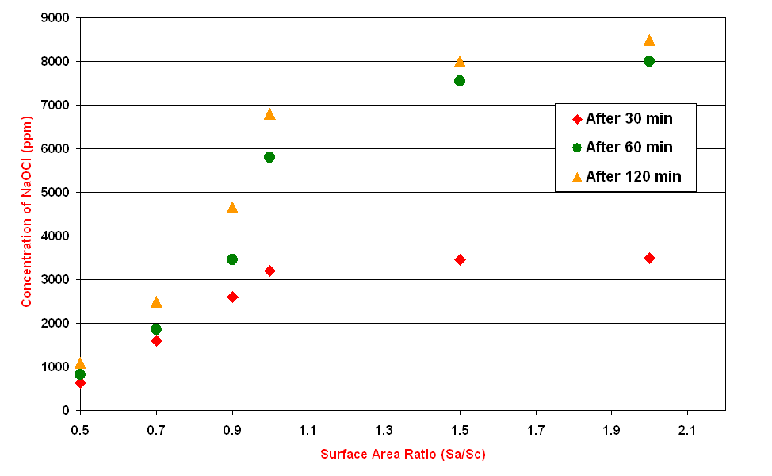
Effect of Surface Area Ratio on Process Efficiency
Unity
Effect of surface area ratio on NaOCl production efficiency

Slide 29
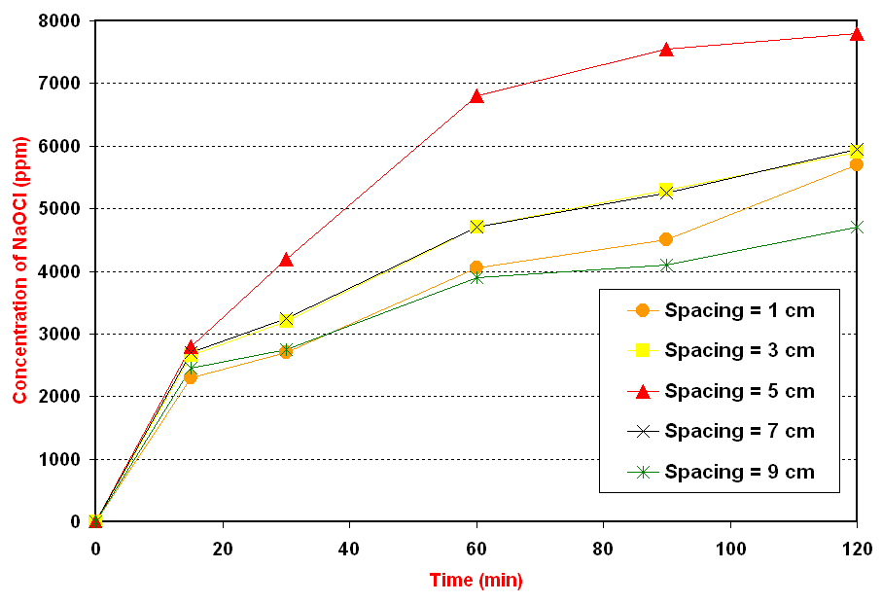
Effect of Inter-electrode Spacing
on Process Efficiency
5 cm
Effect of inter-electrode spacing on NaOCl production

Slide 30
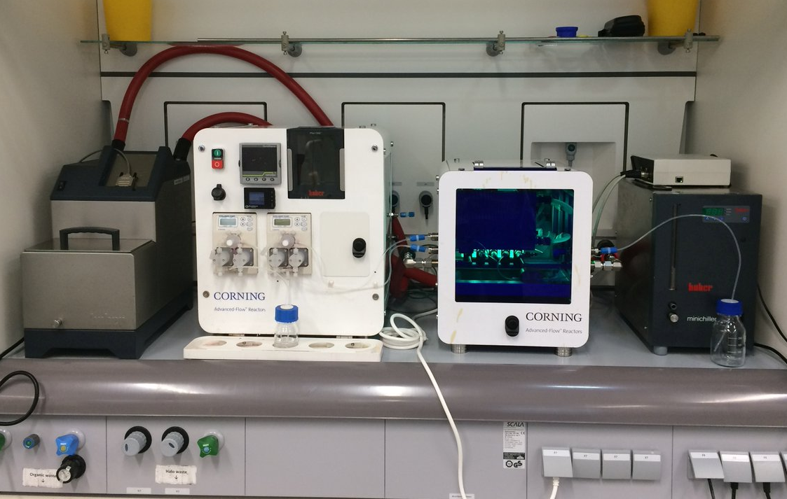
Results & Discussions
Further Study was done (based on continues system)
at pilot scale and online electrochemical setup
was installed

Slide 31


Results & Discussions
Rheostat
Electrodes
D.C. Power Supply
To Effluent Collection
Inlet
Pump
Pretreatment
Unit
Continues Flow
Electrochemical Unit
Multimeter
A

Slide 32
Summary & Conclusions

Slide 33
Summary & Conclusions
An electrochemical setup was arranged to investigate the influence of some operating parameters for the production of sodium hypochlorite disinfectant on site.
Following are the conclusions made based on results and discussion.
  Titanium + DSA electrode showed excellent stability in comparison to other electrode materials and production of sodium hypochlorite reached to an optimum of about 6000 ppm.
  A current density of 9.8 A/dm² was found to be a reasonable value for an efficient production of sodium hypochlorite.

Slide 34
Summary & Conclusions
  An anode to cathode surface area of unity was found to more efficient for the production of sodium hypochlorite.
  An inter-electrode spacing of 5 cm was found to be optimum for the production of sodium hypochlorite disinfectant.
  Based on batch study a pilot scale continues system utilizing online electrochemical system was studied.
  Results obtained were well comparable with the previous initial study.

Slide 35
References:
Saleem, M, Chakrabarti, M.H., Diya’uddeen, B. H., Islam,M.S., Hajimolana, S.A., Hussain, M.A., Yusoff, R., Khan, G.M.A. and Ali, B.S. (2012). On site Electrochemical Production of Sodium Hypochlorite Disinfectant for a Power Plant utilizing Seawater. International Journal of Electrochemical Science. 7(2012), pp. 3929-3928.
Saleem, M. (2011). Biofouling Management in the Cooling Circuit of a Power Industry Using Electrochemical Process. Journal of The Chemical Society of Pakistan, 33(3), pp. 295-304.
Saleem, M., Chakrabarti, M. H. and Diya’uddeen, B. H. (2011). Electrochemical removal of nitrite in simulated aquaculture wastewater. African J. Biotechnology, 10(73), pp. 16566-16576.
Chakrabarti, M. H., Saleem, M., Irfan, M.F., Raza, S., Hasan, D.B. and Daud, W.M.A.W., (2011). Application of waste derived activated carbon felt electrodes in minimizing NaCl use for electrochemical disinfection of water. Int. J. Electrochem. Sci., 6(10), pp. 4470-4480.
Saleem, M. Design of an electrochemical setup for the production of sodium hypochlorite required at KINPOE for the bay-water treatment to stop growth of bacterial slime and seaweeds. KINPOE, Karachi, Pakistan, 2006.
Saleem, M. Electrochemical treatment of aquaculture wastewater for the removal of nitrite. KINPOE, Karachi, Pakistan, 2006
Saleem, M. Application of Electrochemical Treatment technology for the removal of Nitrate from industrial wastewater. KINPOE, Karachi, Pakistan, 2007
Saptiama, I., Marlina, M., Sarmini, E., Herlina, H., Sriyono, S., Abidin, A., ... & Mutalib, A. (2015). The Use of Sodium Hypochlorite Solution for (n, γ) 99 Mo/99m Tc Generator Based on Zirconium-Based Material (ZBM). Atom Indonesia, 41(2), 103-109.
Zazouli, M. A., & Kalankesh, L. R. (2017). Removal of precursors and disinfection by-products (DBPs) by membrane filtration from water; a review. Journal of Environmental Health Science and Engineering, 15(1), 25.

Slide 36



JUBCOR
2024
CONFERENCE & EXHIBITION
INNOVATIVE SOLUTIONS FOR CORROSION CHALLENGES
THANK YOU
Reach out.
Calle Cualquiera 123, Cualquier Lugar
+966-599556154
saleemm@rcjy.edu.sa

