Slide 1





JUBCOR
2024
CONFERENCE & EXHIBITION
INNOVATIVE SOLUTIONS FOR CORROSION CHALLENGES
Presented By: Abdulaziz Alsaleh & Dr. Ihsan Ul haq Toor
Jubcor Presentation
King Fahd University of Petroleum and Minerals

Slide 2

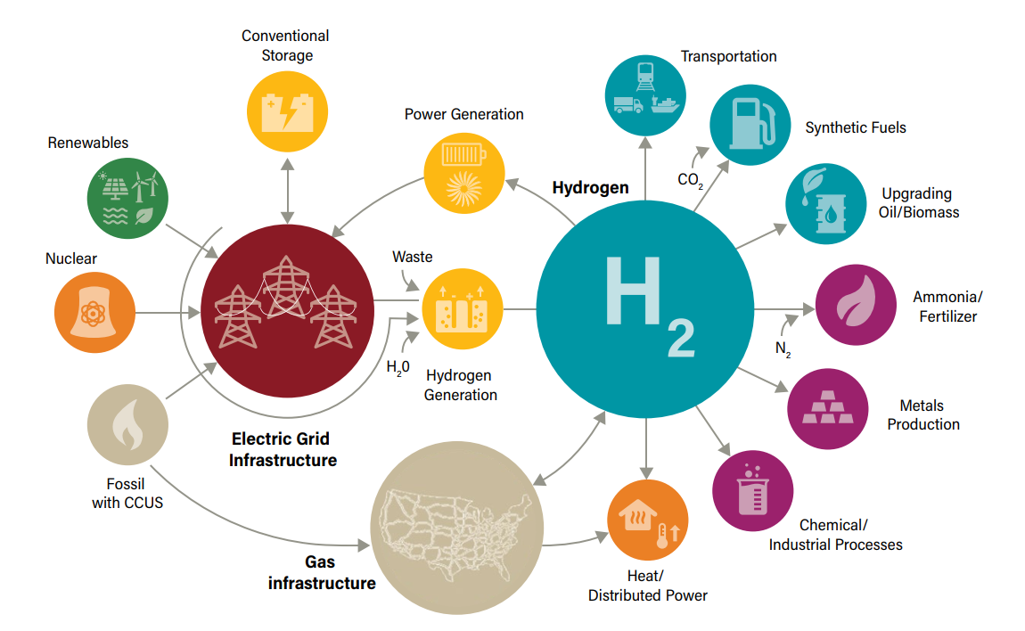
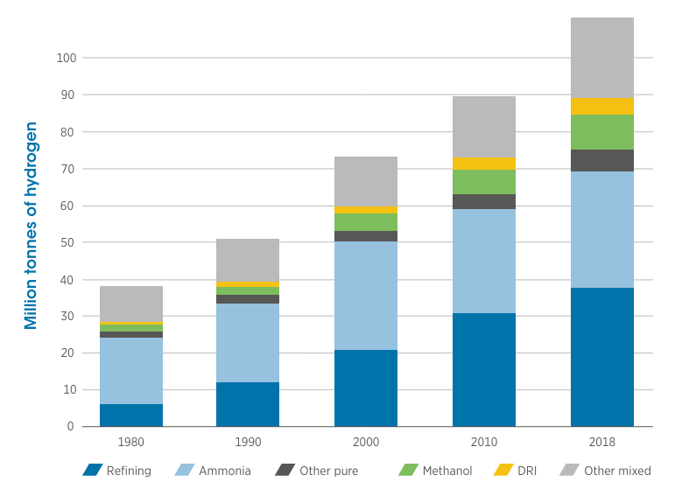

Hydrogen Economy
Hydrogen Economy
Demand of Energy in different industries over the year

Slide 3

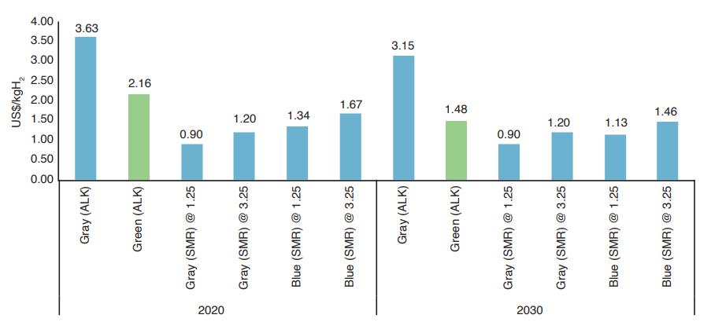
Saudi Arabia & Hydrogen
Current and projected hydrogen production costs in Saudi Arabia

Slide 4
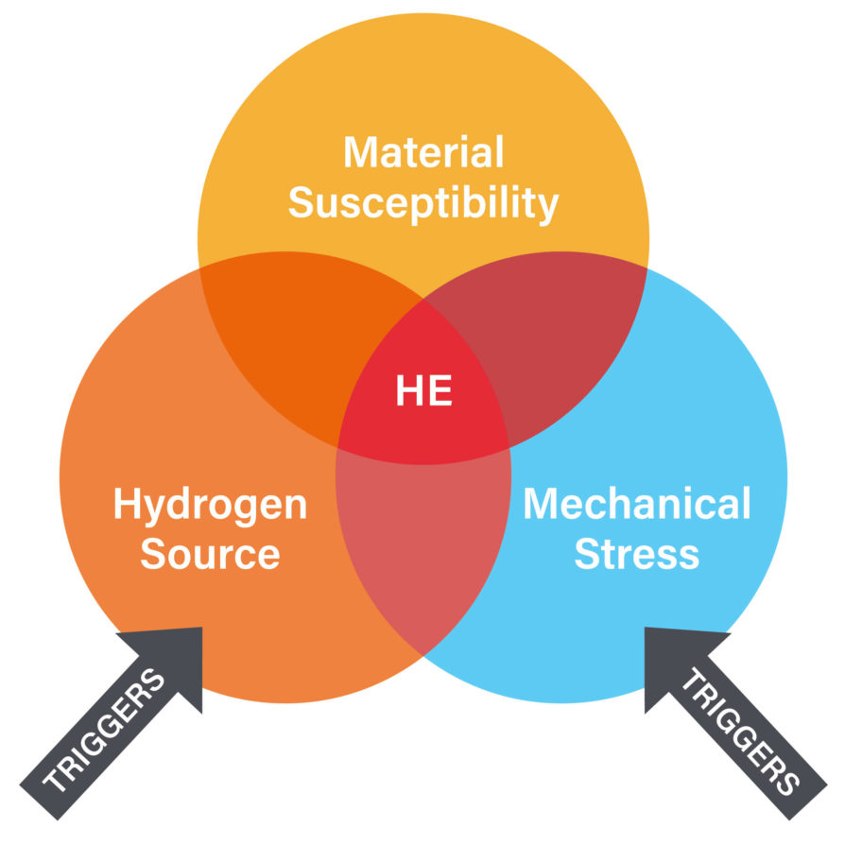
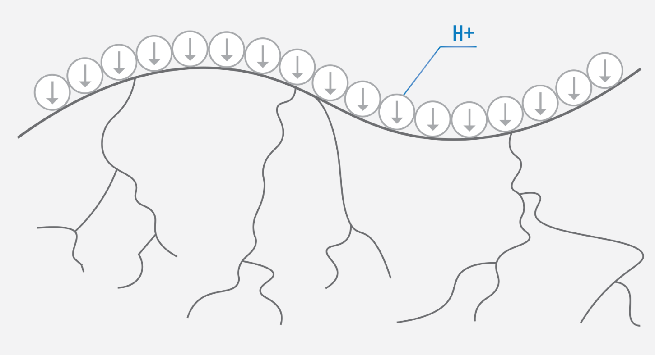
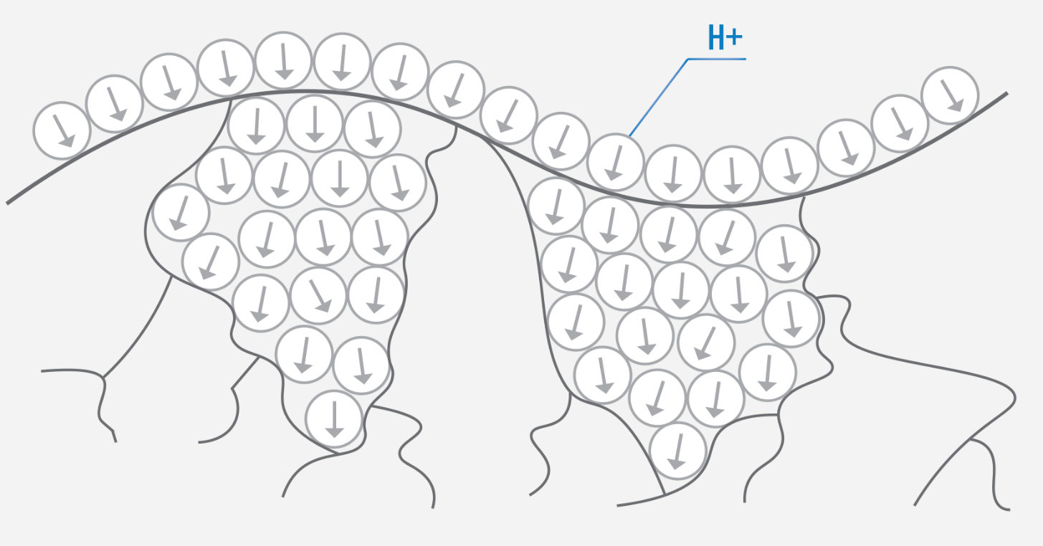
What is Embrittlement?
Embrittlement, where materials become brittle from reduced ductility, which leads to cracking or failure.
Types of Embrittlement
Hydrogen embrittlement, 3. Temper embrittlement
2. Liquid metal embrittlement, 4. Sulfide Stress Cracking (SSC)
Hydrogen molecules diffuse through metals and create pressure inside the cavities
Hydrogen molecules accumulate and create pressure and cause carking

Slide 5
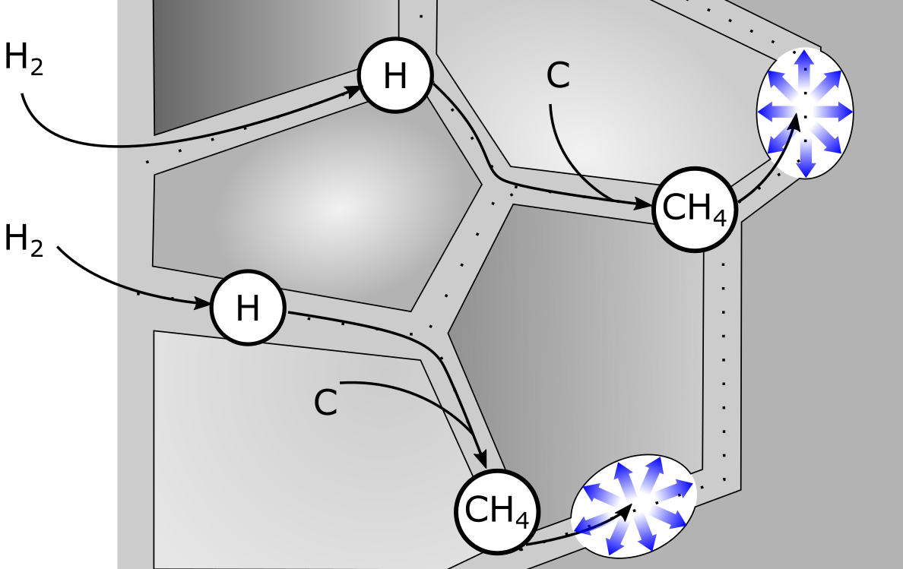
Stages of Embrittlement
H-Ion generation
Adsorption
Absorption
Diffusion
Trapping
Cracking

Slide 6
Experiment Scenario
Sample Number | Heat Treatment Temperature (°C) | Hydrogen Charging Duration (hours)
1 | 550 | 12
2 |  | 24
3 |  | No Exposure
4 | 600 | 12
5 |  | 24
6 |  | No Exposure
7 | 650 | 12
8 |  | 24
9 |  | No Exposure
10 | As-Received | 12
11 |  | 24
12 |  | No Exposure

Slide 7
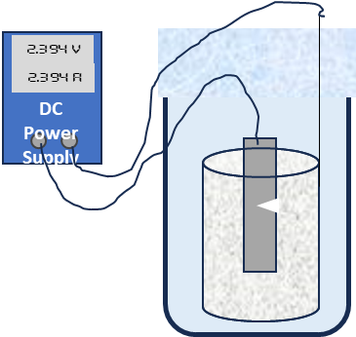
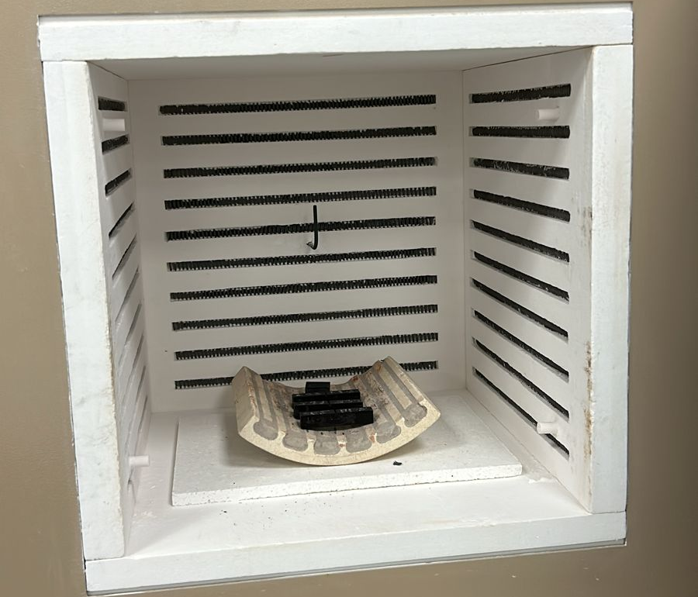
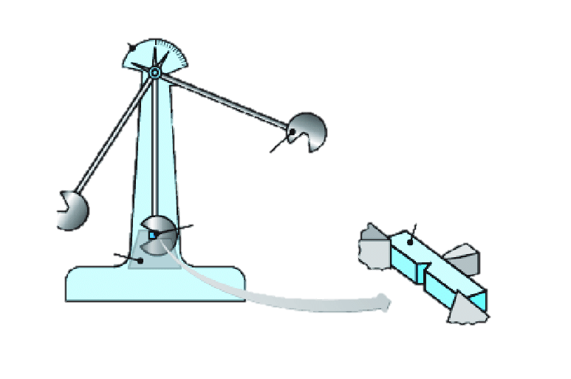
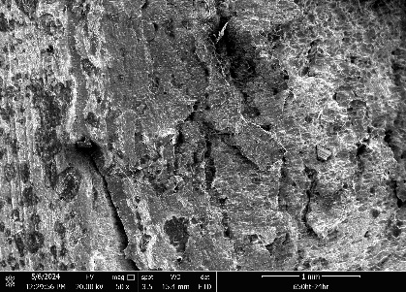
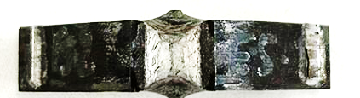
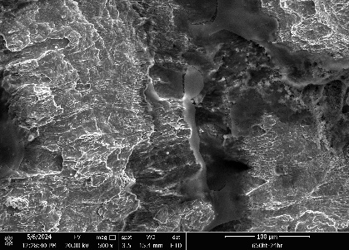
Methodology
Table 1, X65 API 5L Chemical Composition
Elements | C | Mn | Si | Ti | P | S | V | Nb | Fe
Chemical Composition (%Mass) | 0.16 | 1.65 | 0.45 | 0.06 | 0.02 | 0.01 | 0.07 | 0.05 | ~97.53
Heat Treatment
550, 600 & 650ºC
Hydrogen Charging
Impact Testing
Fractography
Room Temperature
Atmospheric Pressure
Solution:
H₂SO₄
NH₄SCN
H₂O

Slide 8
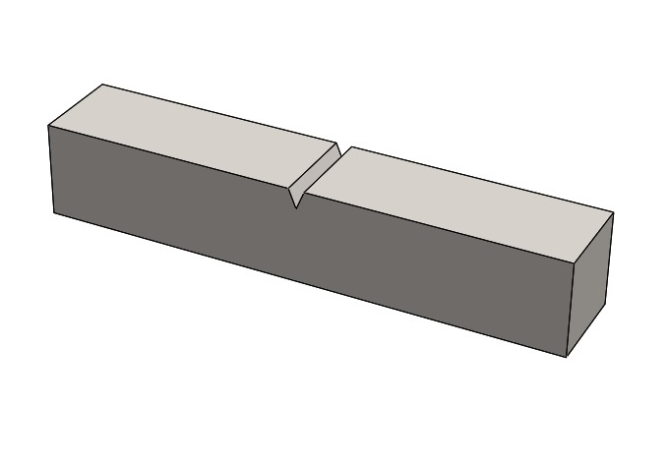
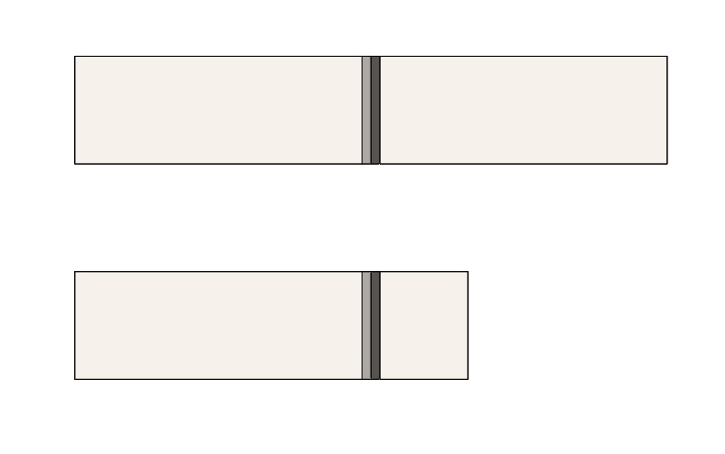
Sample Preparation
$I\left(A\right)=i(\frac{A}{{cm}^{2}})×Area({cm}^{2})$ x 4 = 14.60 ${cm}^{2}$ $I\left(A\right)=0.02×14.60=0.292$A
Exposed Area
Insulated by Tape
The standard Charpy impact test specimen is of dimension 55 mm × 10 mm × 10 mm
Exposed Area of specimen 36.5 mm × 10 mm × 10 mm

Slide 9
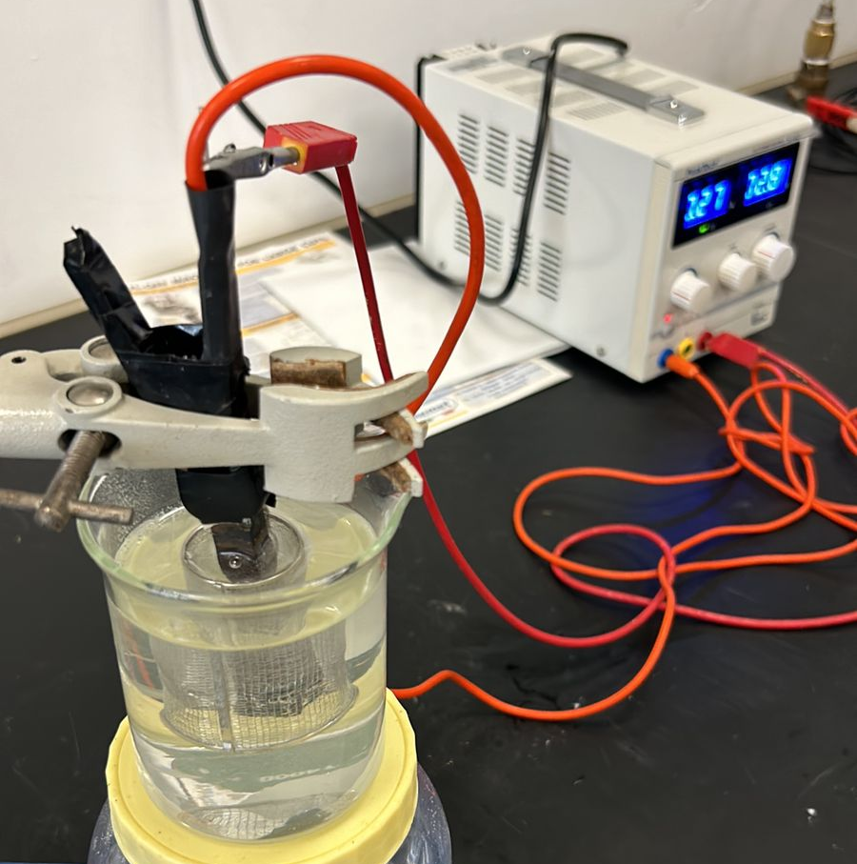
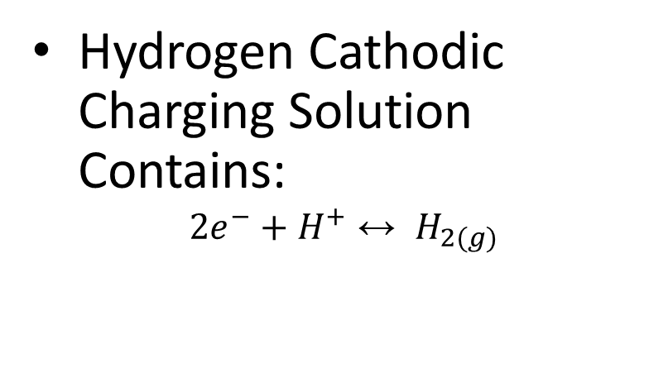
Solution Preparation
Component | Concentration | Volume Added
Sulfuric Acid (H2SO4) | 0.2 M | 10.93 mL
Ammonium Thiocyanate (NH4SCN) | 3 g/L | Calculated to make 1 L
H2O | - | 899 mL
Hydrogen Cathodic Charging Solution Contains:
$$2e^{−}+H^{+}↔ H_{2(g)}$$
Sulfuric Acid:
  Density of H₂SO₄: 1860 g/cm³.
  Mass of H₂SO₄ in Stock Solution:0.966×1860=1796.76 g/L
  Molar Mass of H₂SO₄: 98 g/mol.
  1796.76 g/L x 98 g/mol=18.3
  𝐶1 x 𝑉1=𝐶2 x 𝑉2 ⟹ 18.3×𝑉1=0.2×1000 ⟹ 𝑉1=10.93 mL

Slide 10
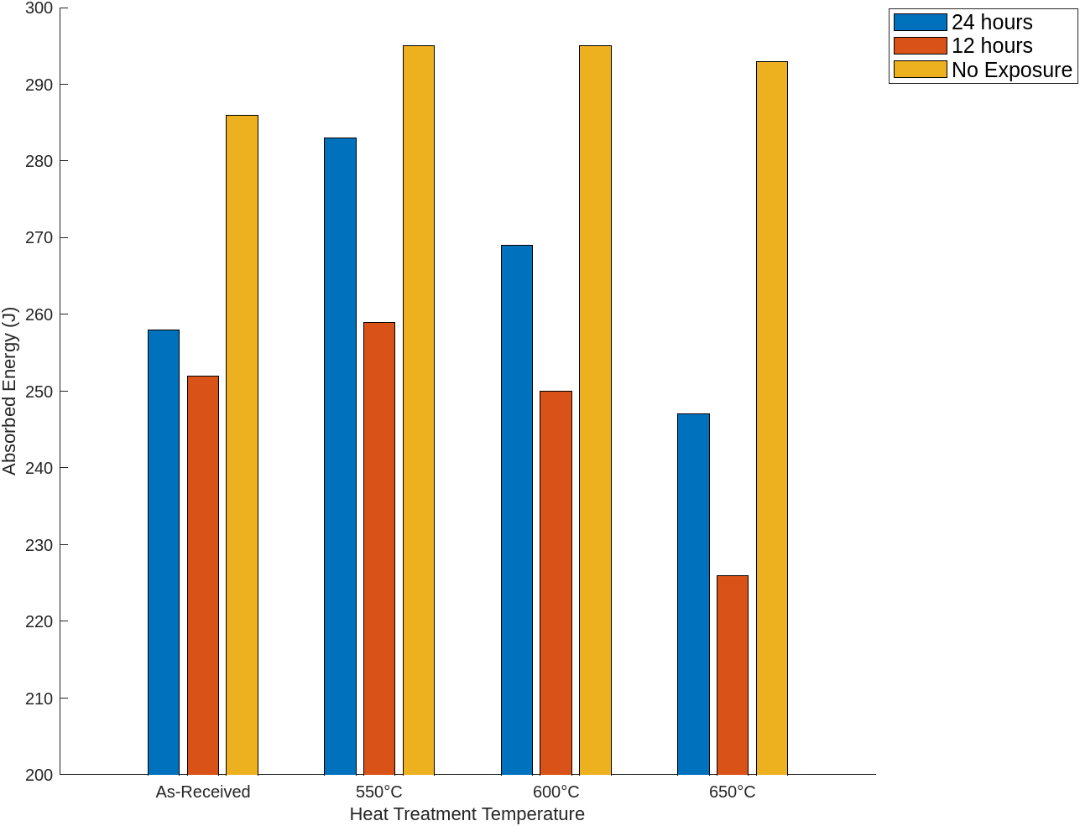
Results & Discussion
Hydrogen charging decreased the impact energy of X65 alloy irrespective of the heat treatment temperature.
Heat Treatment was effective in reducing the impact of hydrogen charging on X65 alloy.
Stress releasing heat treatment at 550ºC produce the best performance to mitigate the effect of hydrogen charging.
The impact energy of X65 alloy was not affected by heat treatment when not subjected to hydrogen charging.
The fracture surface is characterized with the presence of micro cracks and dimples
Effect of Hydrogen Charging and heat Treatment on the Impact Energy of X65 alloy

Slide 11
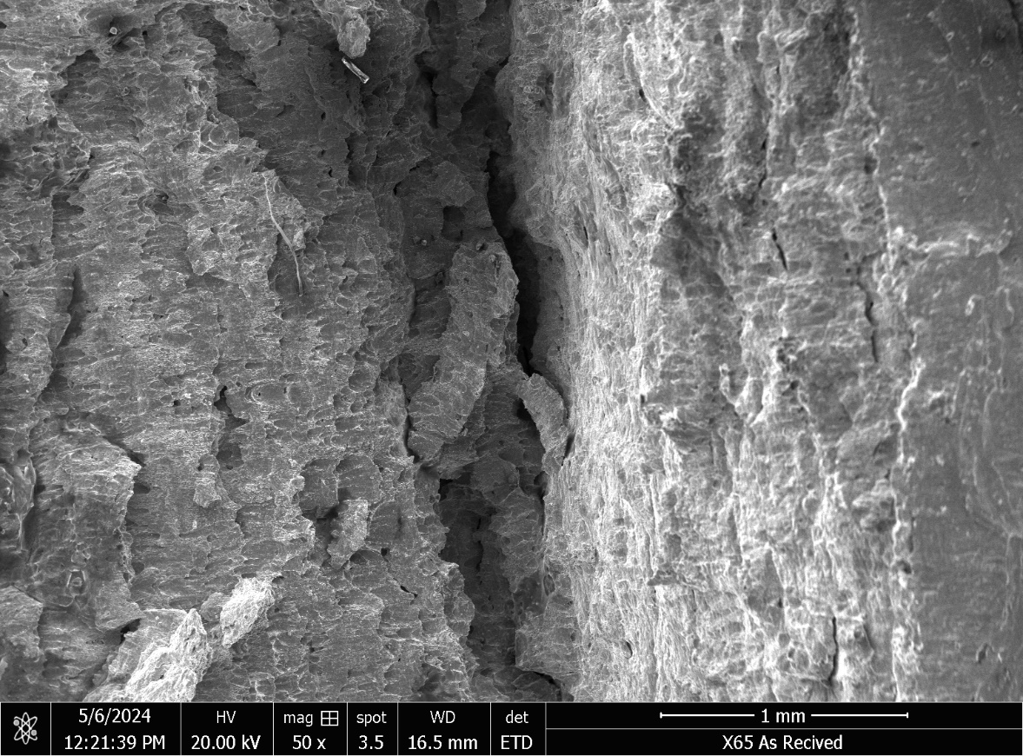
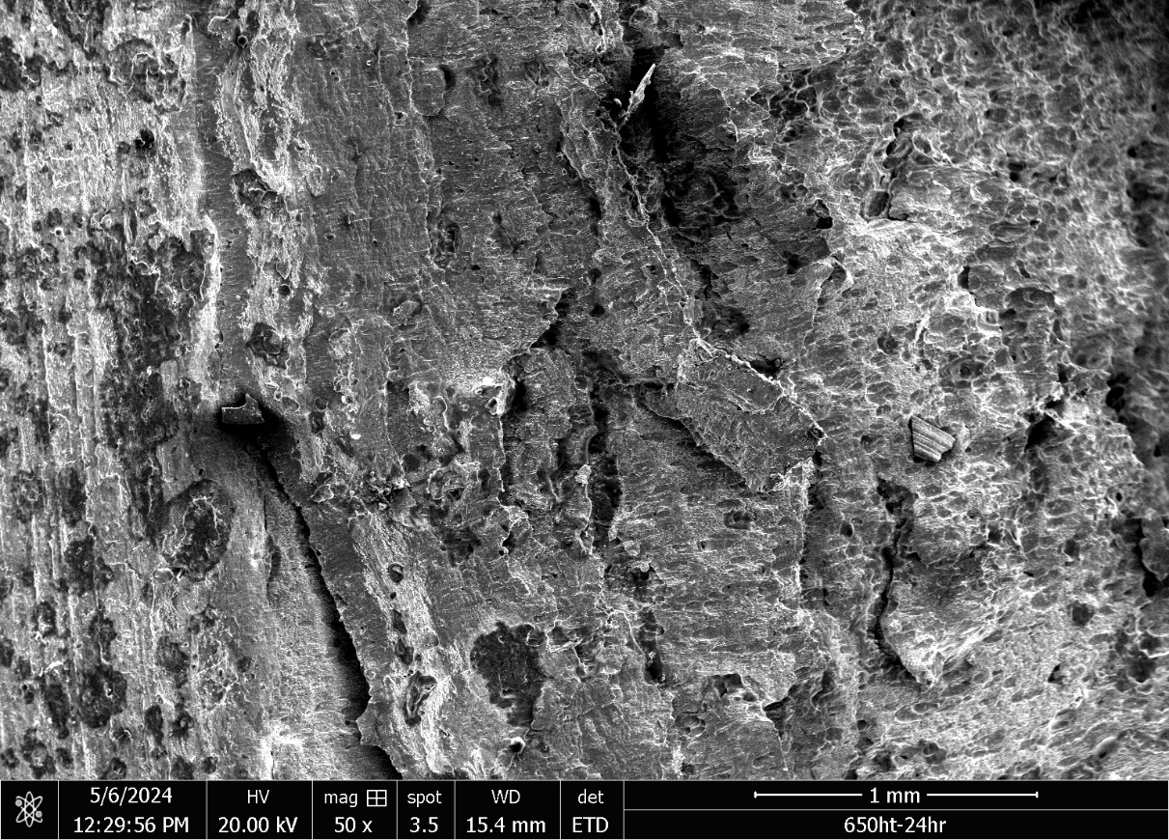
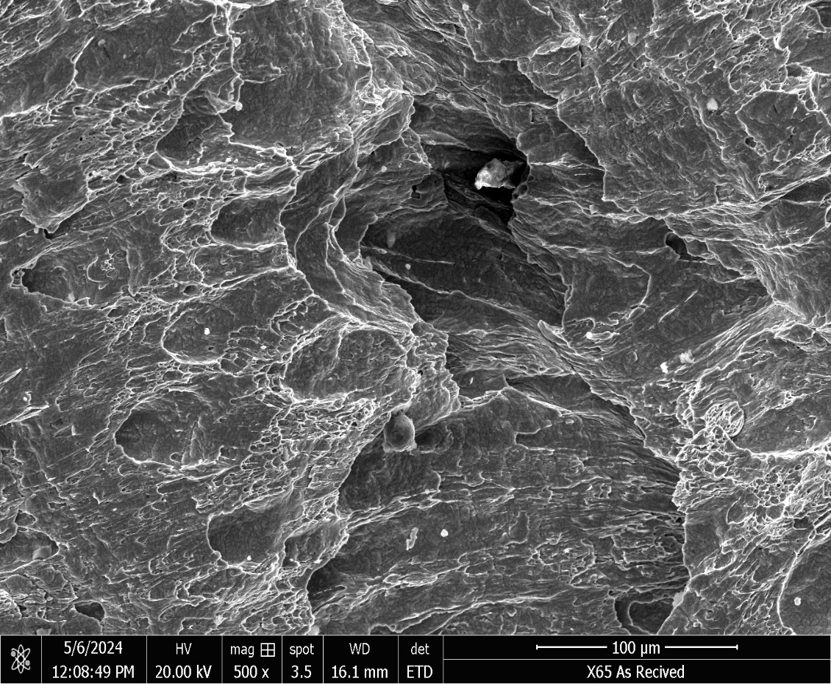

Fractography
As - Received
Heat Treated 650
Micro cracks
dimples

Slide 12
References
Hydrogen: A Renewable Energy Perspective. September 2019. Report prepared for the 2nd Hydrogen Energy Ministerial Meeting, Tokyo, Japan.
Take Early Action to Avoid Hydrogen Embrittlement. MagnaPlate Blog. Available at: magnaplate.com. This blog discusses preventive measures against hydrogen embrittlement in materials.
Hasan, S., & Shabaneh, R. (2021). The Economics and Resource Potential of Hydrogen Production in Saudi Arabia. DOI: 10.30573/KS--2021-DP24. November 2021. This study discusses the economic viability and resource potential of hydrogen production in Saudi Arabia.
Department of Energy. (2024). Hydrogen Program Plan. U.S. Department of Energy. Retrieved from https://www.energy.gov/hydrogen-program-plan

Slide 13


Acknowledgment
Acknowledgement: The authors acknowledge the support provided by King Fahd University of Petroleum and Minerals (KFUPM),Dhahran, Saudi Arabia, under the research grant# INAM 2406 for conducting this research work.

Slide 14




JUBCOR
2024
CONFERENCE & EXHIBITION
YOUR LOGO
INNOVATIVE SOLUTIONS FOR CORROSION CHALLENGES
THANK YOU
Reach out.
Calle Cualquiera 123, Cualquier Lugar
+966508092568
Azizalsaleh-98@hotmail.com

