Slide 1
Anodic protection system for Sulfuric Acid Tank
Case Study
Saad Al-Maaesab
Lead Engineer

Slide 2

Anodic Protection System
Anodic Protection of Metals - A Technique Whose Time Has Come
Electrochemical Corrosion Protection
Anodic Protection
Cathodic Protection
Storage Vessels
pH <3, >9
Underground Structures,
pH > 3
Many Protective Methods Are Used
In appropriate environments and conditions, electrochemical methods-anodic or cathodic protection-are applied, often with dramatic benefits and economics.
Anodic Protection Used Effectively
For more than 25 years anodic protection has been effectively used to control corrosion by sulfuric acid

Slide 3
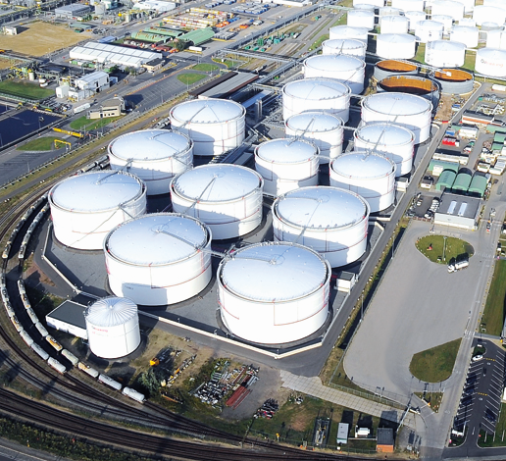
Anodic Protection System
Anodic Protection of Industrial Equipment
Sulfuric Acid Applications
Applications to control corrosion by sulfuric acid have been the most common uses of anodic protection and have been the mainstay of its commercial success.
Protection of Sulfuric Acid Storage Equipment
There are approximately 100 tanks now under protection in the United States which are protected by anodic protection system

Slide 4
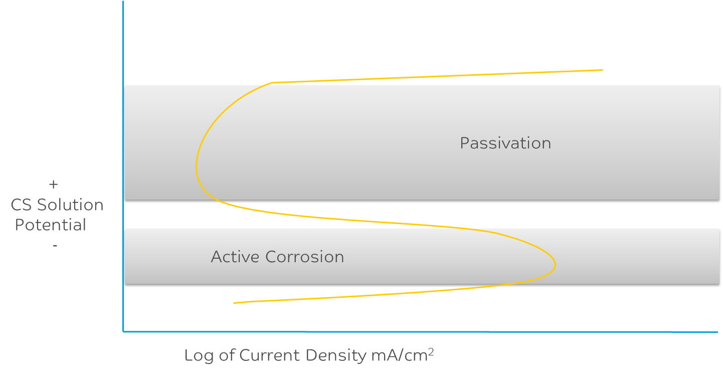
Anodic Protection System
Theory of Anodic Protection
Theory of AP
Anodic protection (AP) is a technique to control the corrosion of a metal surface by making it the anode of an electrochemical cell and controlling the potential in a range where the metal is passive.
Passivation Range
AP is used to protect metals that exhibit passivation in environments where the current density in the freely corroding state is significantly higher than the current density in the passive state over a wide range of potentials. This is shown in the figure below.

Slide 5
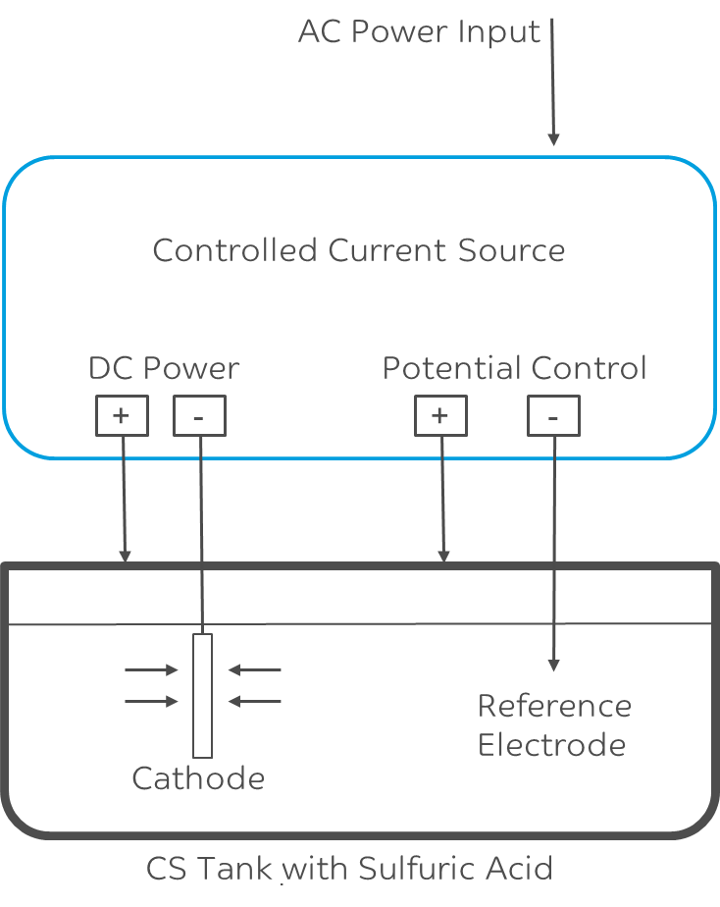
Anodic Protection System
Anodic Protection for Sulfuric Acid Tanks
layout of AP
The passive film formed on a metallic surface, due anodic polarization as a result of direct current potential applied to it, is responsible for the protection of the metal from corrosion damage.
Passivation Range
To create the anodic layer on the surface of the metal, AP Experts apply controlled electric current to charge the protective film with the use of an anode. The current can increase or decrease the thickness of the protective layer through the use of an external power supply.

Slide 6
Anodic Protection System
Advantages of Anodic Protection
AP System features
Continuous corrosion protection for all immersed steel surfaces.
Low operating costs. After initial passivation, dc power requirement is nominally less than 60W.
Cost effective when compared to coatings and linings. Internal maintenance is nil; system is automatic and does not require operator intervention.

Slide 7
Anodic Protection System
AP System Components
Potential Controlled DC Current Source
Converts AC input power to controlled Direct Current.
Functions as a single loop controller providing the necessary current to achieve and maintain a SET solution potential.
DC current source is contained within a single enclosure with digital metering for:
  DC voltage and current output
  Feedback solution potential
  SET or target solution potential

Slide 8
Anodic Protection System
AP System Components
Cathodes
Two (2) 3/8" diameter composite cathode rods are mounted through hardware in the roof of each vessel in this case. The arrangement of the cathodes is designed to provide a uniform current density on the wall of the vessel.
Each cathode rod is connected to the DC negative terminal or busbar of the DC current source, completing the current path from the vessel wall through the acid. The cathode is electrically isolated from the vessel by Teflon inserts in the entry gland.

Slide 9
Anodic Protection System
AP System Components
Reference Electrodes
Each tank system has two (2) reference electrodes for the measurement of solution potential. One is used for control in concert with the DC current source and the others
used to validate the controlling reference electrode potential.

Slide 10
Anodic Protection System
AP System Components
Spark Prevention System
Explosive gas mixtures may exist in a storage tank. The possibility of sparking (arcing) is avoided through the use of spark preventers and an auto-shutdown system which uses the process level sensor for feedback.
The electronic shutdown system prevents current output at low acid levels before acid/cathode contact is lost. When the level rises back to an acceptable height, current output resumes.

Slide 11
Anodic Protection System
SABIC Tank History
Tank History
Parameter | Tank
Acid Tank Diameter | 4.0 m
Acid Tank Height: | 4.2 m
Acid temperature (°C): | 25.8 °C
H2SO4 Concentration: | 98%
H2SO4 Acid Level During Passivation (%) | 57.5 %
A highly concentrated sulphuric acid tank in Saudi Kayan is made up of carbon steel and is internally coated with specialty coating for concentrated sulphuric acid. During internal inspections of multiple shutdowns, damages were found in the specialty coating. In addition, it was observed pitting on shell and reduction in thickness due to corrosion.

Slide 12
Anodic Protection System
AP System Pre-Energization
System Readiness
Parameter | Tank
Shunt Rating A / mV | 100 A / 100 mV
Reference # 1 Potential (mV) | -830 mV
Reference # 2 Potential (mV) | -669 mV
Resistance between +/- Terminals | 1.35 MΩ
Structure Resistance S1→S2 (Ω) | 0.2 Ω
Prior to energizing, the rectifier and field wiring for the AC power, reference electrodes, cathodes, and tank grounding were verified.
Potential readings are expected pre-energization values. The high resistance between the rectifier positive (structure) and negative (cathode) terminals demonstrate there are no electrical shorts between the electrodes. The low resistance measured between the two reference structure connections indicate strong connection to the tank.

Slide 13
Anodic Protection System
AP System Energization
System commissioning
Parameter | Tank
Set Potential | +400 mV
Controlled TR | Potential
Control Reference | Ref #1
Current Limit | 50 A
Manual Override Limit | 500 A
After all pre-energization checks were completed on the rectifier, the anodic protection was activated.
After Energization, Potential values were fluctuating approximately +/- 10%.This is due to the low acid volume which results in very low resistivity in this tank, It will
require a few days before stability is fully achieved.

Slide 14
Anodic Protection System
AP System Passivation
Passivation achieved
The passivation of the tank to the set target potential of +400 mV was achieved rapidly due to the small size of the tank. The AP system was commissioned successfully and is operating normally to protect the acid tank.
Following the successful initial passivation of the tank, the AP operating values should be verified regularly to ensure reference #1 and #2 values are within +/- 50mV of set potential with a current output under 10 A.
Parameter | Tank
DC Current | 0 to 1 A
DC Voltage | 0.8 to 1.4 V
Reference 1 (Control) | +395 to +408 mV
Reference 2 | +377 to +386 mV

Slide 15
Anodic Protection System
Recommendation
For long term successful operation
The reference potentials should be verified on a regular basis and ensure that reference #1 and #2 measured potentials are within +/- 50mV of set potential with a current output under 10 A during stable acid level.
Schedule a site visit annually to inspect and verify the AP System operating efficiency for continued effective tank protection.
Both the system alarm signal and remote rectifier interrupt wiring should be connected to
the control room.

Slide 16
Anodic Protection System
Recommendation
For long term successful operation
Replace one reference electrode every 2-3 years and rotate such that each probe is replaced every 4-6 years. This will decrease the likelihood of contaminated reference sensing tip and ensure the tank receives adequate protection.
Periodically analyse the iron PPM content in the acid to verify it meets within acid specification and as a check to confirm the anodic protection system is operating effectively.
Ensure the anodic protection system is powered off when acid level in the tank falls below the cathode level. The system should be turned back on only after the acid level rises above the cathode tip.

Slide 17
Thank you
Notes:
To select different Thank You options, go to HOME tab and click Layout button.

