Slide 1
Rehabilitation of Business- Critical Seawater Cooling Tower
Wasim Idris Baig
Abdulrahman Al-Shahrani
Projects Engineering Department -Cathodic Protection
Syed Shams Shiraz,
SABIC Agri-Nutrients
confidential

Slide 2
contents
Introduction
Background
Condition Assessment
Installation of Scaffolding
CP System Design and Installation
CP System Performance Assessment
Significance of Cathodically Protecting Critical Assets
confidential

Slide 3
introduction

Slide 4
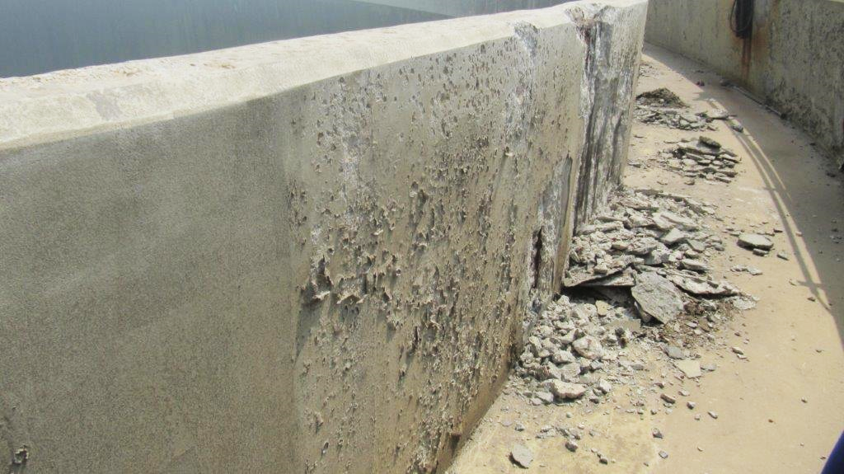
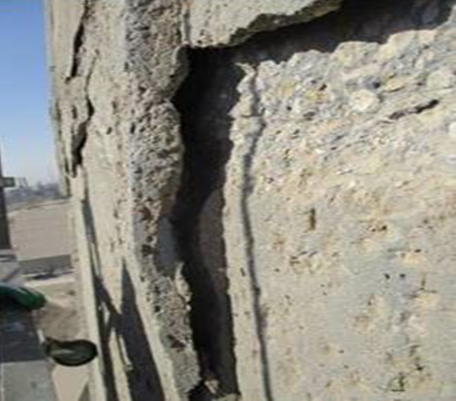
introduction
Cylindrical/ conical shape Reinforced Concrete Seawater Cooling Towers (CT) operate in very harsh environments that can cause severe corrosion, deterioration and spalling of concrete.
The spalling of concrete pieces from above pose an EHSS concern for personnel working around the CT.
If the structure loses it integrity due to the severe damages it can pose as business risk if the CT underwent shutdown.
Carrying out repair of these structures is very challenging and expensive due to its height, geometry and getting an access on the structure during operations.
confidential

Slide 5
background
Rehabilitation of EHSS/ Business Critical Seawater Cooling Tower

Slide 6
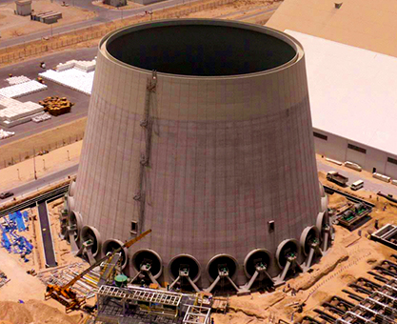
background
The Cooling Tower (CT) was built in 2006
Cylindrical/ conical in shape and consists of 24 fans around the circumference used for cooling the hot seawater.
The height of the CT is 52m, the diameters at the bottom and top are 72.6m and 53.3m respectively.
The thicknesses of the CT shell at the bottom and top are 600mm and 200 mm respectively.
Cathodic Protection (CP) system was provided up to 14m of shell portion for the internal reinforcement only.
Top 10 meters of external surface of the CT were coated with epoxy-based coating.
confidential

Slide 7
Condition assessment

Slide 8
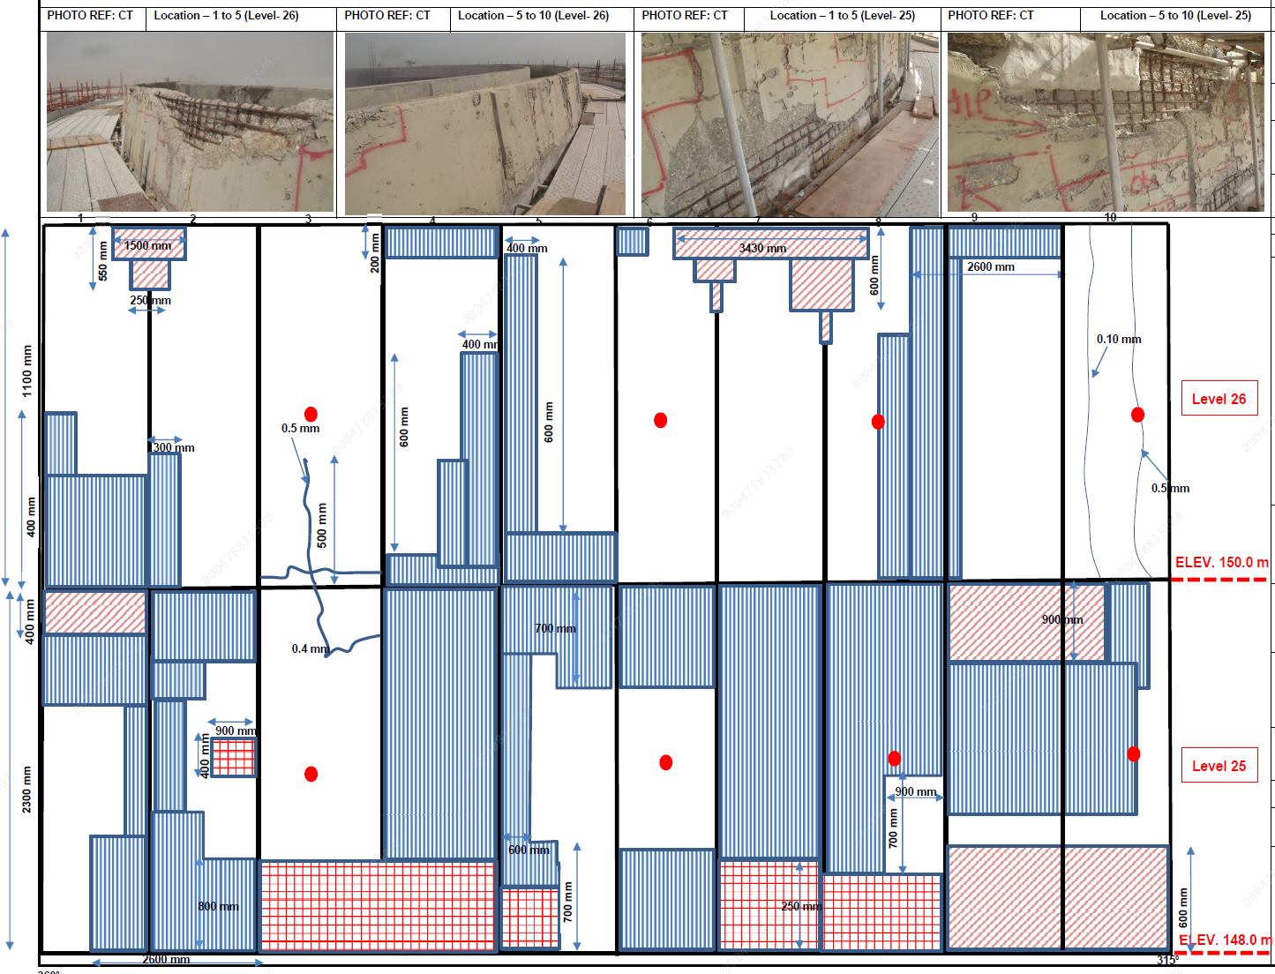
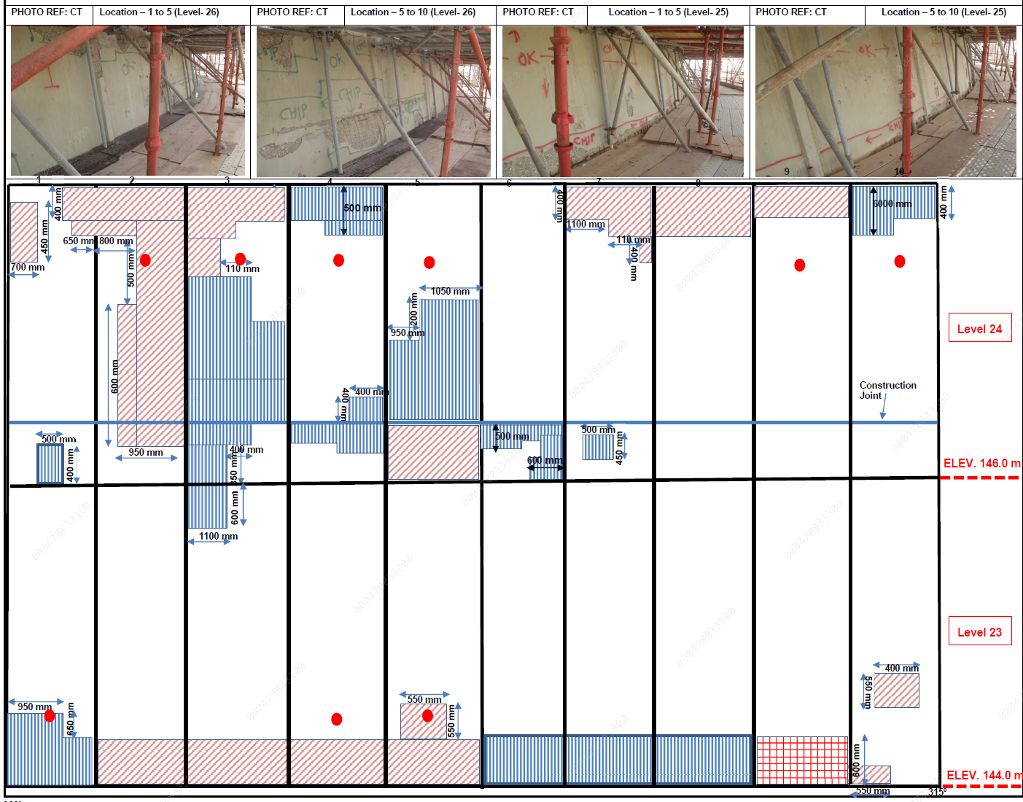
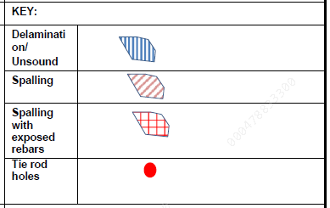
Visual assessment

Slide 9
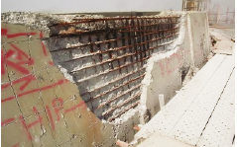
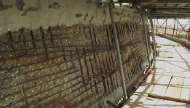
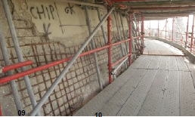
SEVERE CORROSION OF STEEL REINFORCEMENT AND DELAMINATION OF CONCRETE

Slide 10
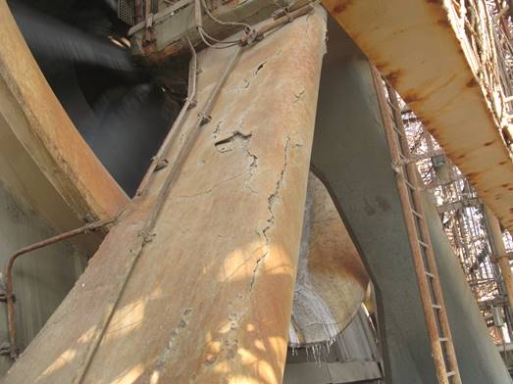
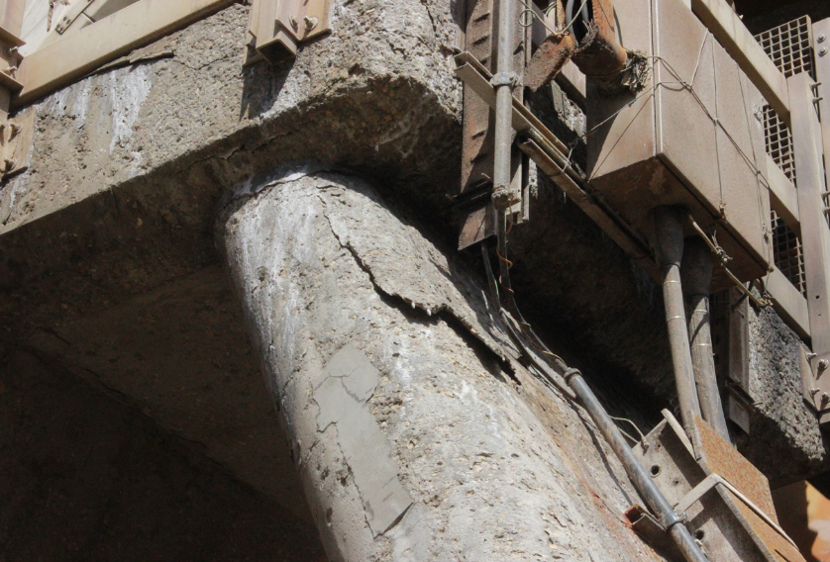
Fan supports

Slide 11
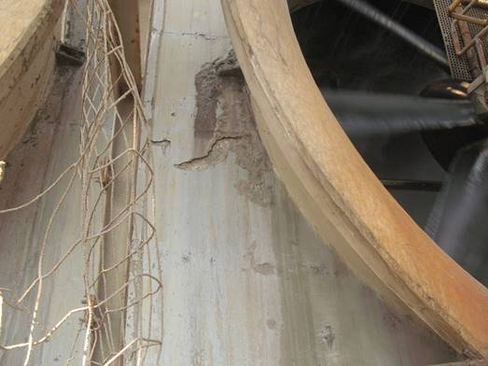
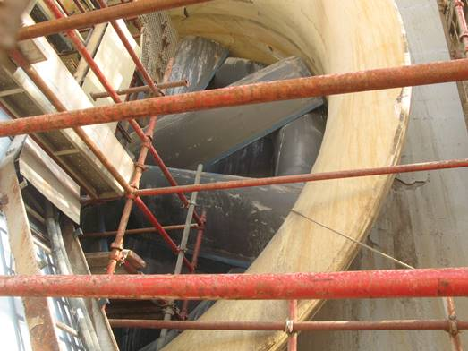
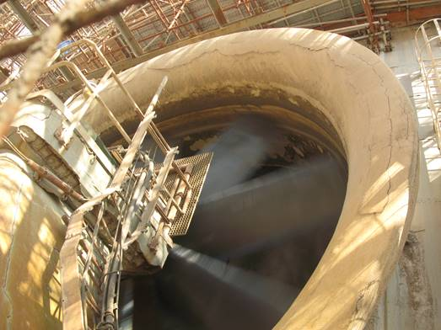
External Fan rings

Slide 12
Scaffolding installation

Slide 13
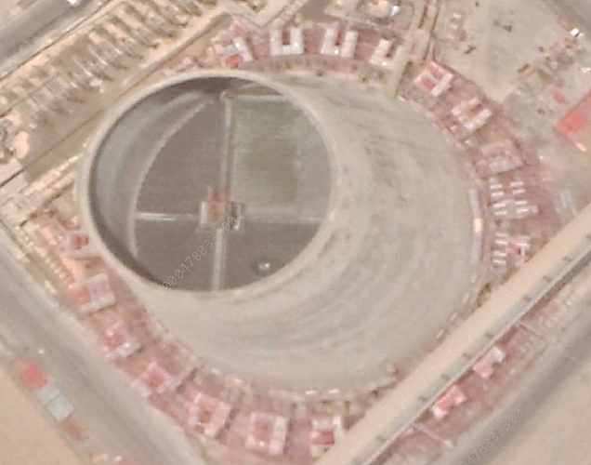
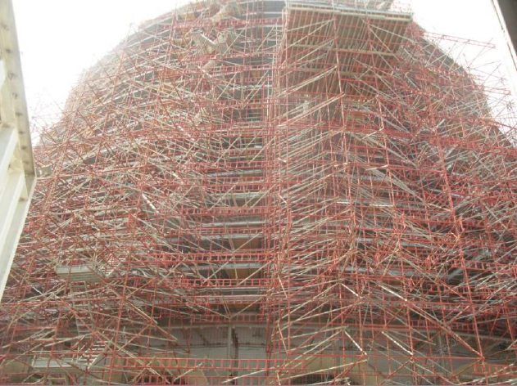
Scaffolding installation

Slide 14
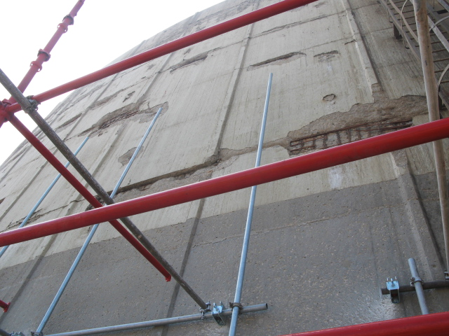
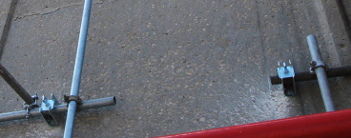
SCAFFOLDING PLAN WITH ONE ANCHOR BOLT

Slide 15
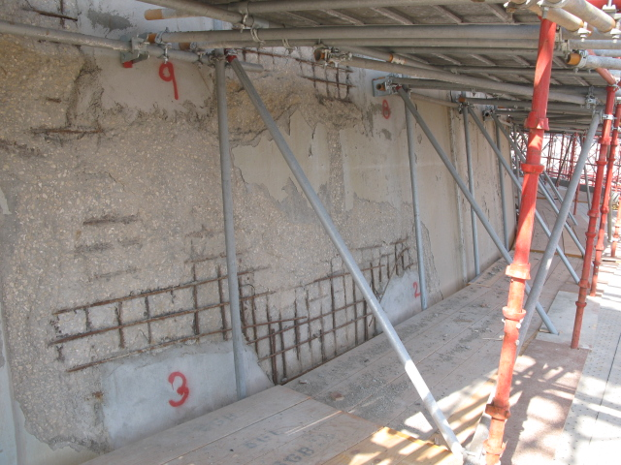
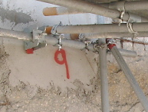
Temporary repair carried out at severe damaged areas to fix scaffolding

Slide 16
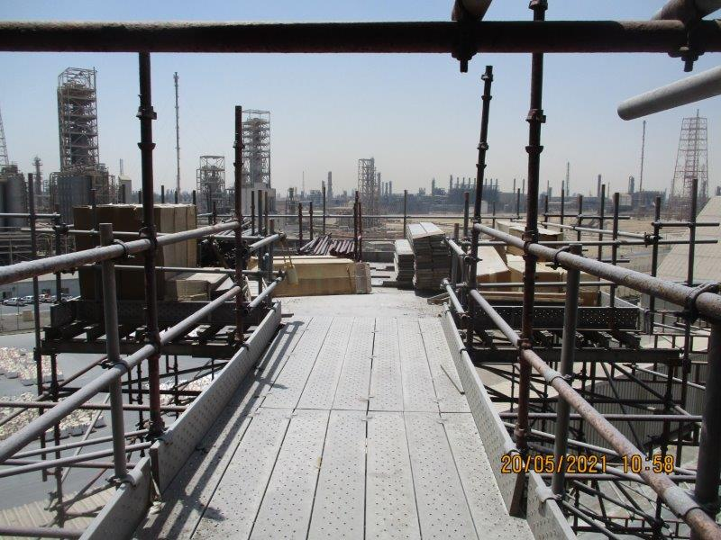
Scaffolding platform

Slide 17
CP System design
Cp design

Slide 18
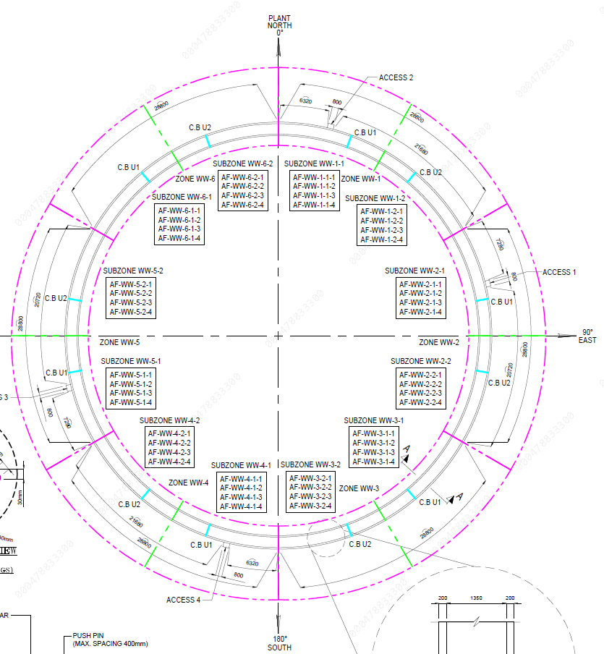
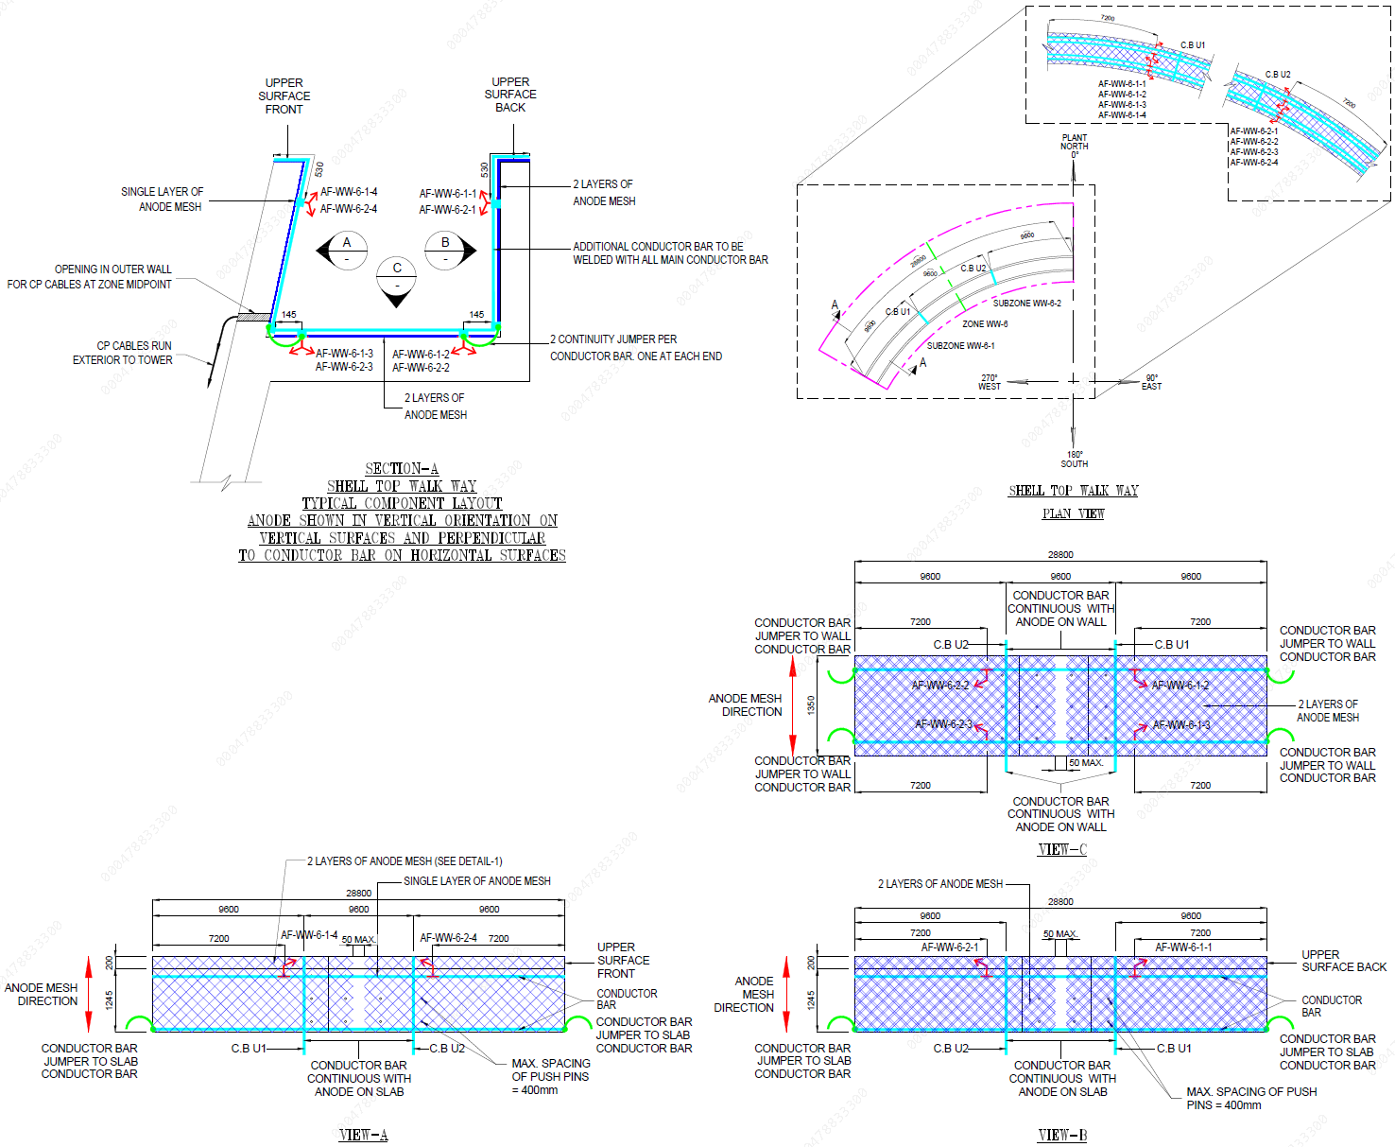
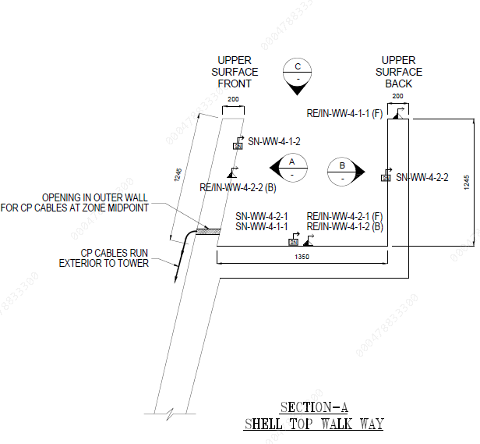
Cp design- walkway

Slide 19
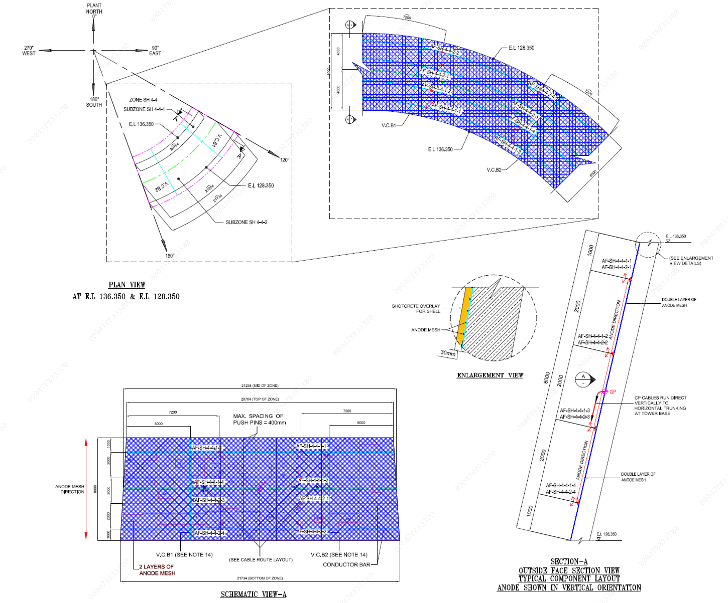
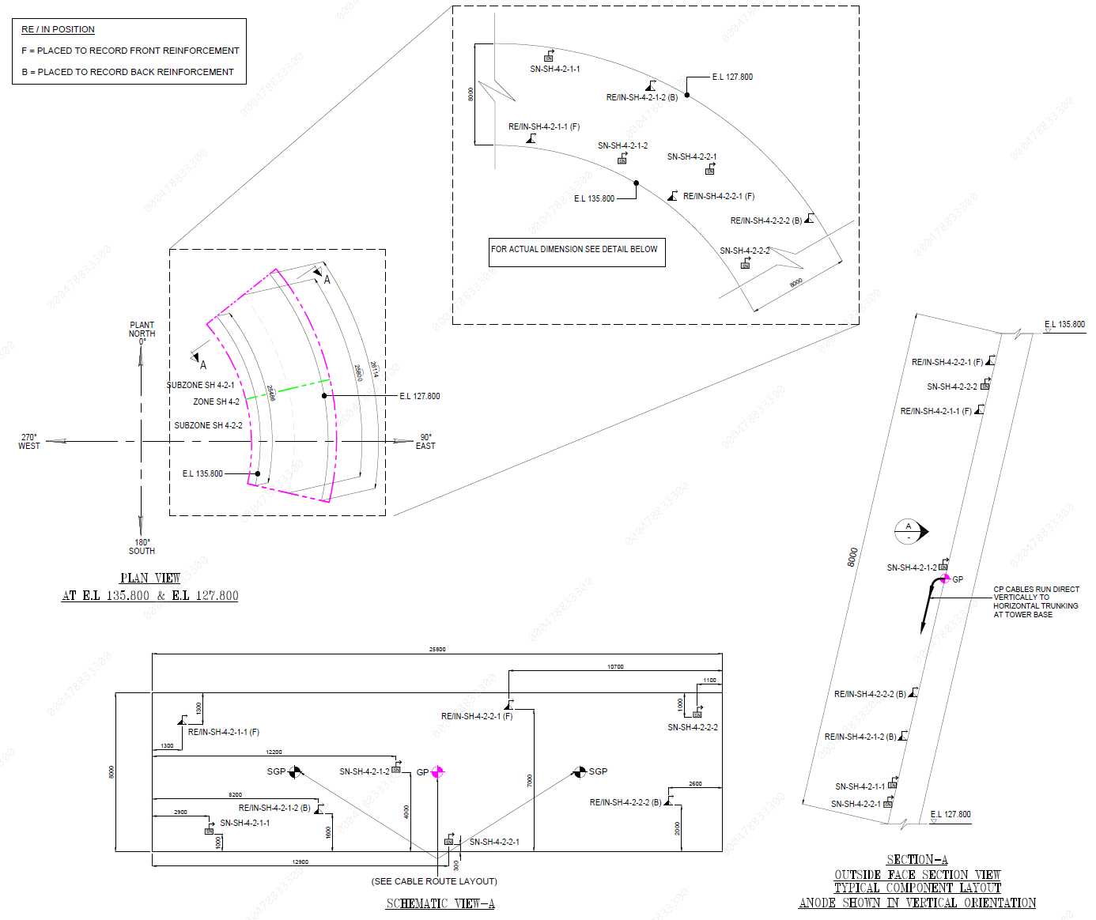
Cp design- ct shell

Slide 20
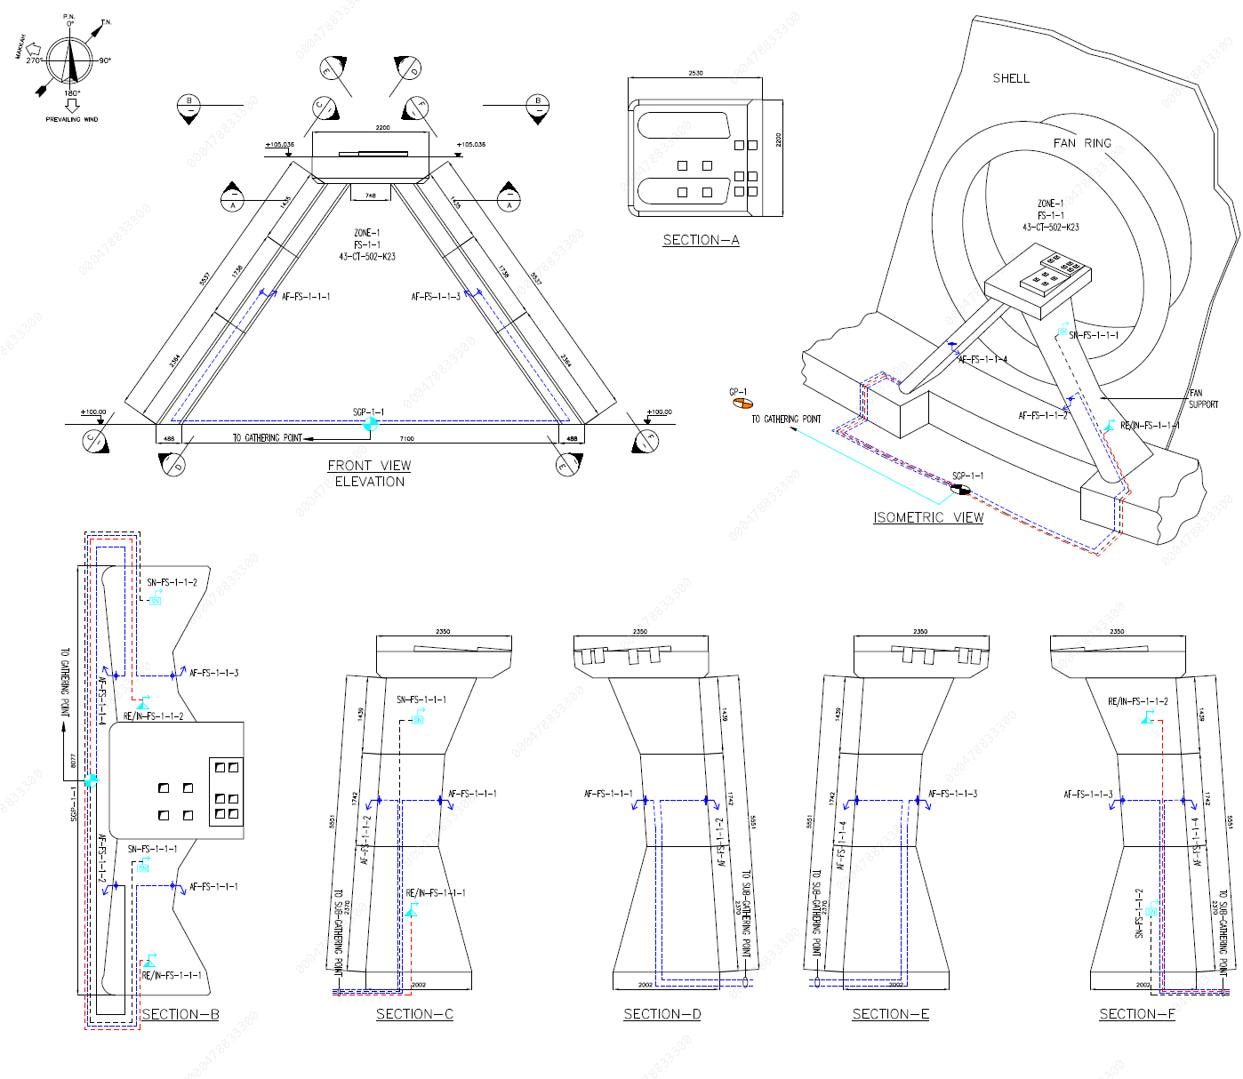
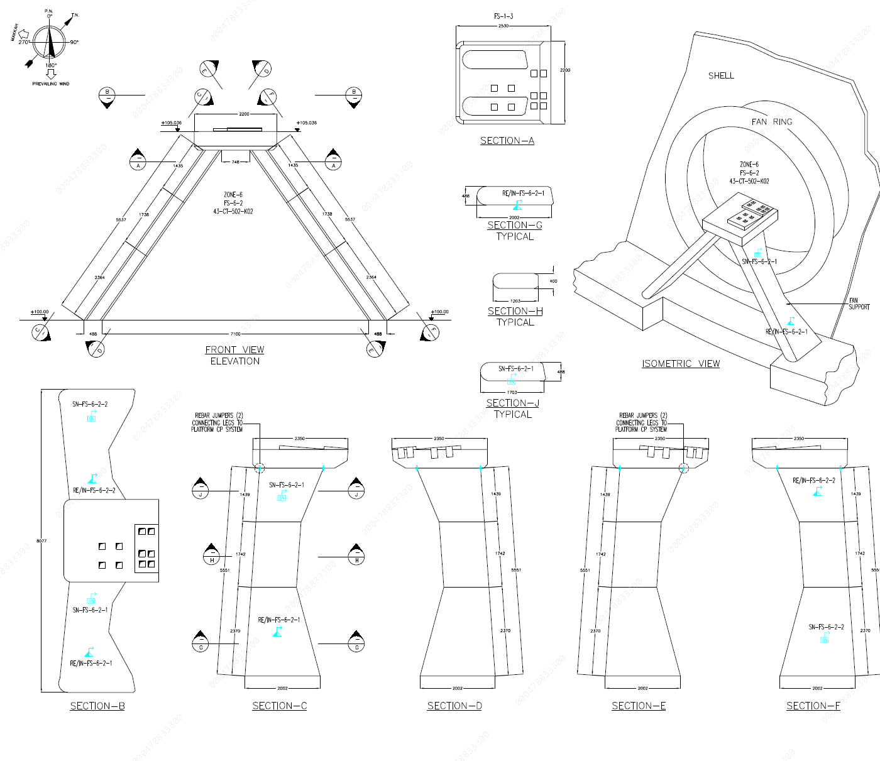
CP design Fan supports

Slide 21
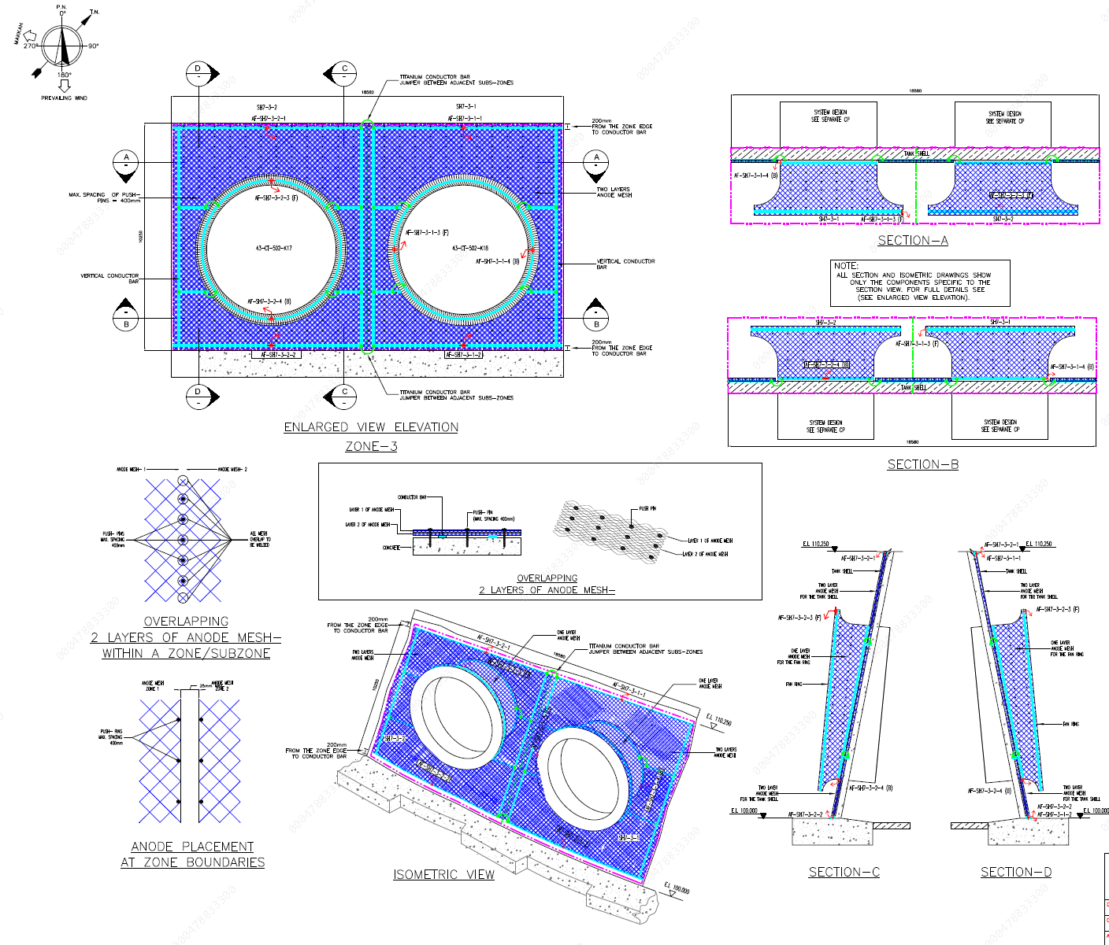
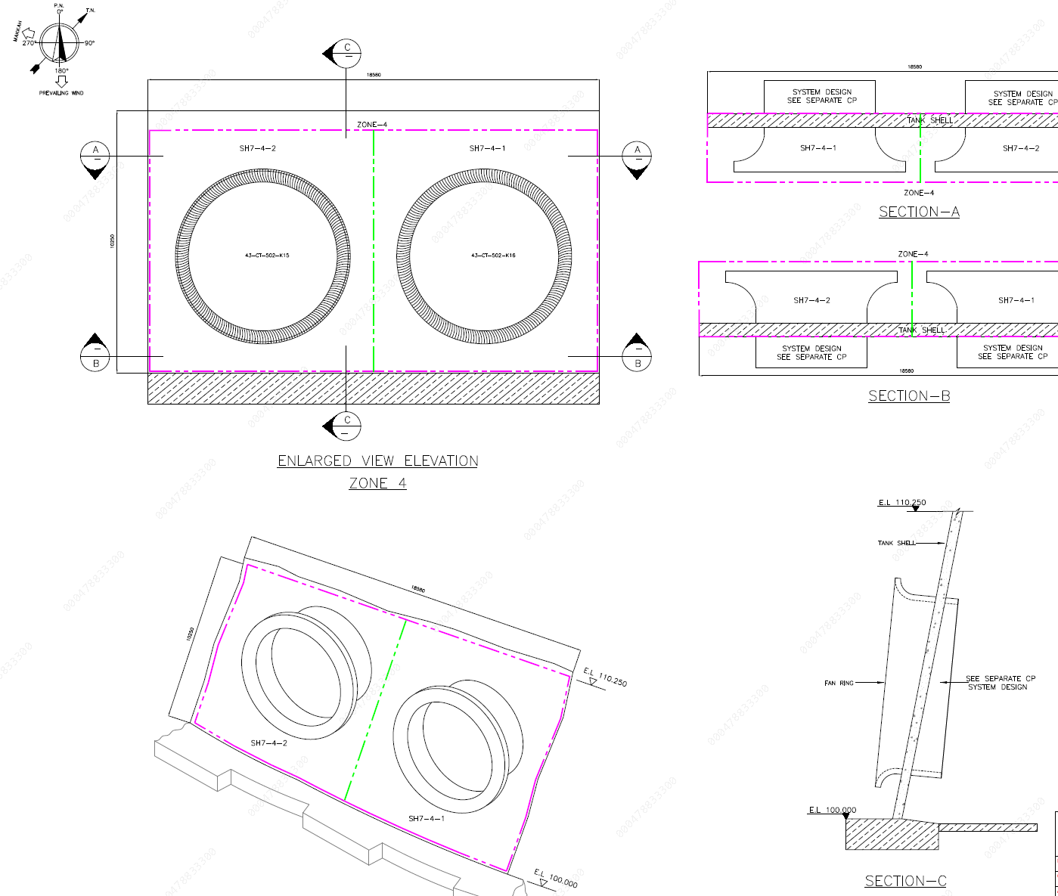
cP design Shell lower level and fan rings

Slide 22
Cp system installation

Slide 23
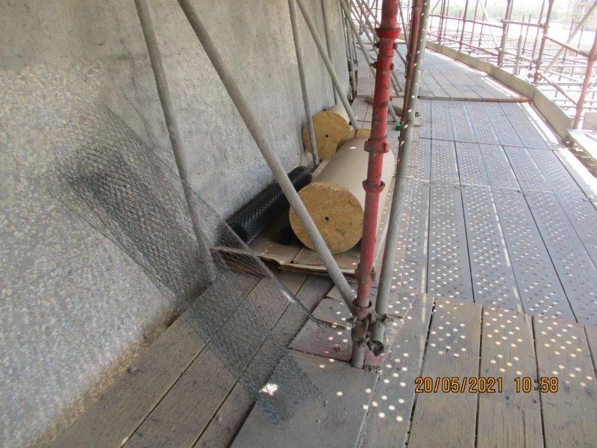
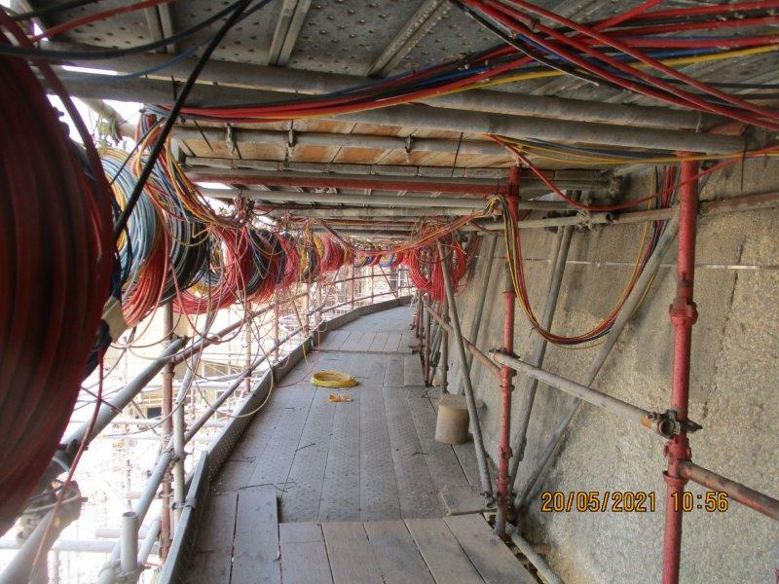
Surface preparation

Slide 24
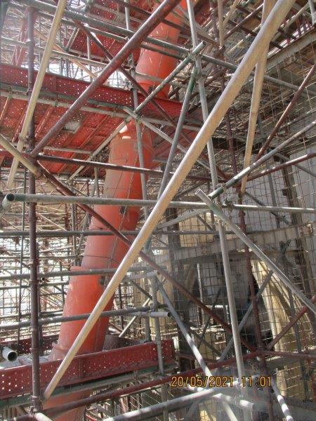
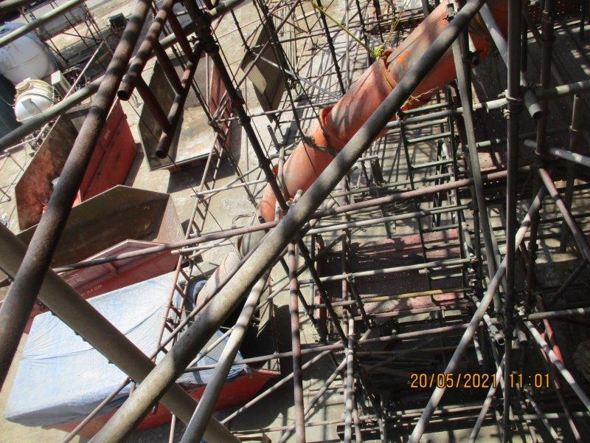
Debris management

Slide 25
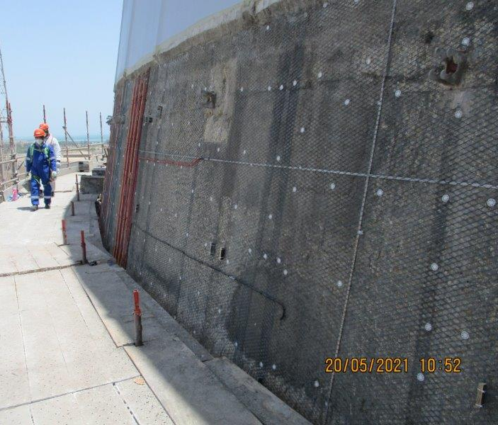
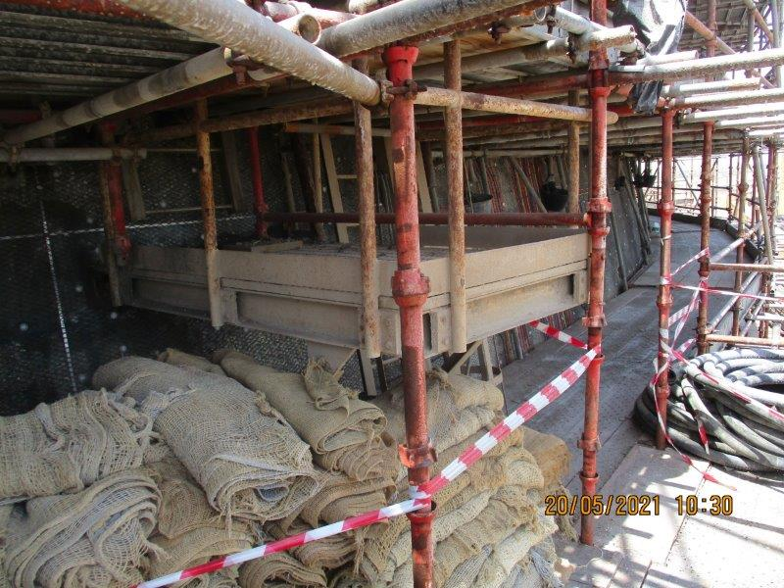
Anode installation

Slide 26
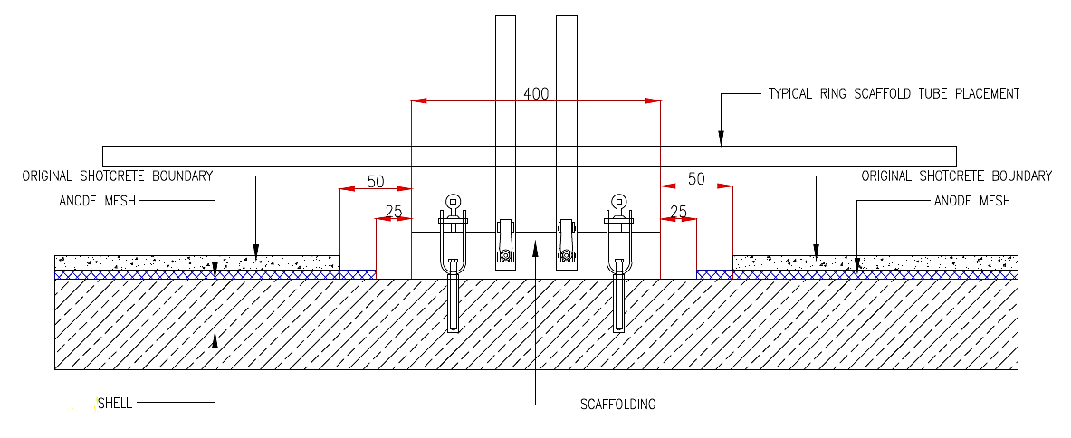
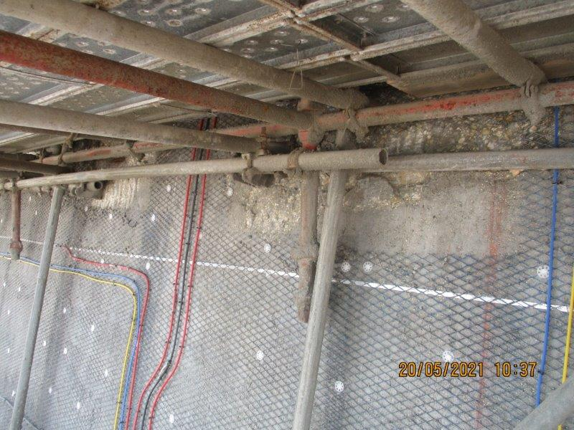
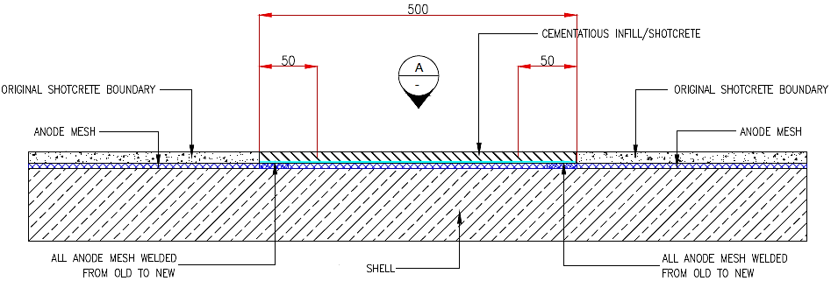
Typical CP system installation with scaffolding supports in place
Knowledge
Skills
Competencies

Slide 27
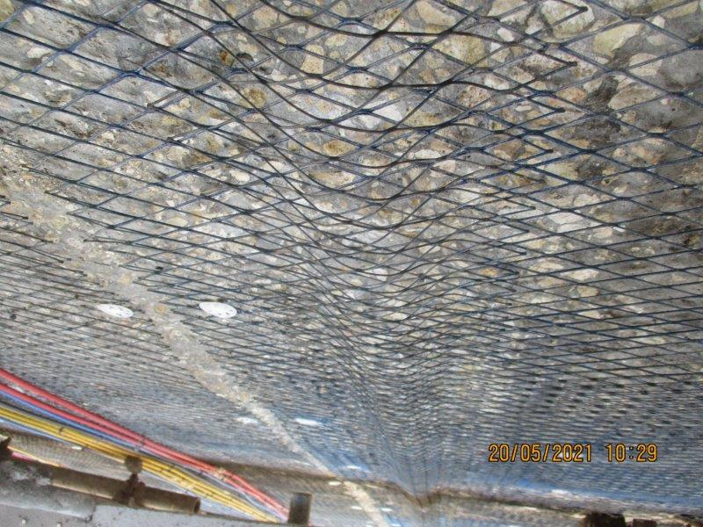
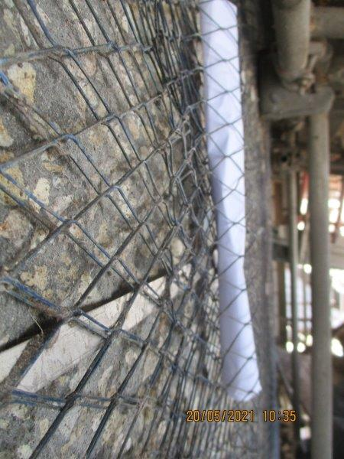
Mmo Anode mesh installation arrangement for wind ribs

Slide 28
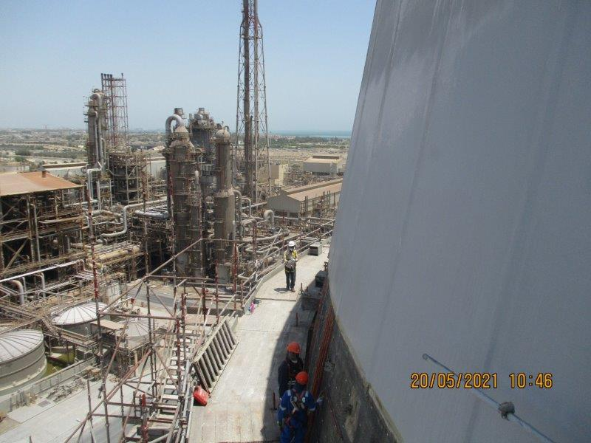
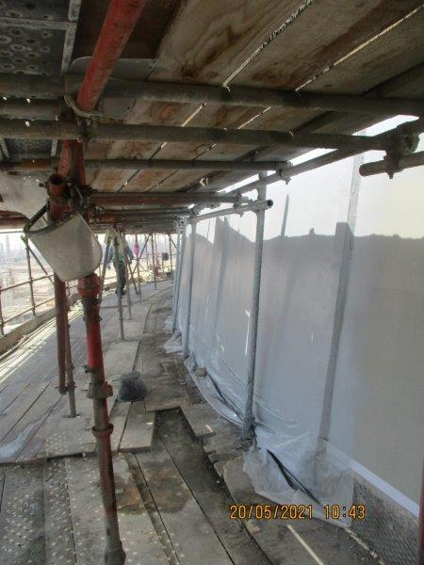
CP system installation, shotcrete and coating

Slide 29
Significance of Cathodically Protecting Critical Assets
Section divider subtitle

Slide 30
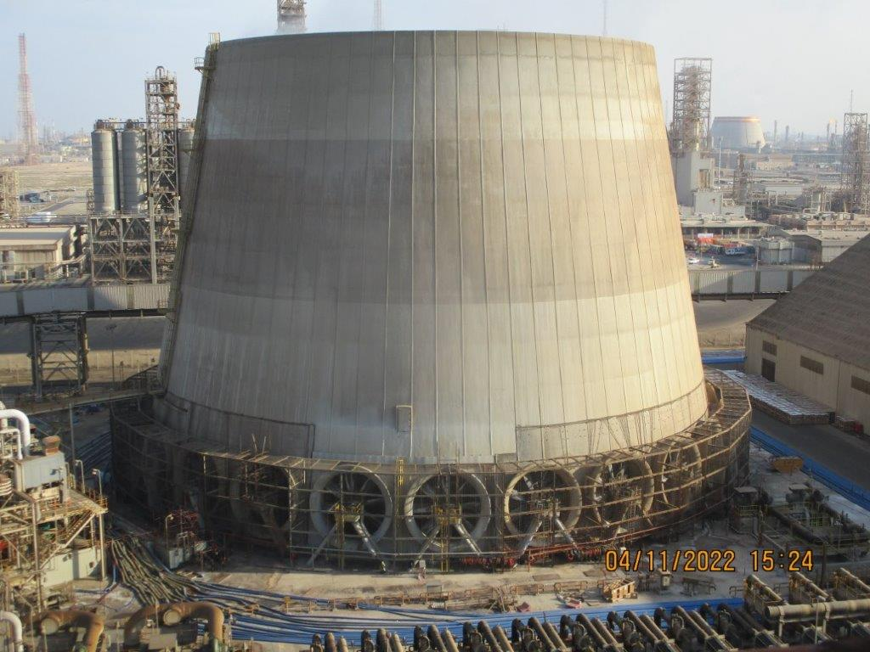
Significance of Cathodically Protecting Critical Assets
Corrosion of steel in concrete is critical, and if left unaddressed it can lead to catastrophic failures and safety risk to living beings.
Plants have large reinforced concrete seawater reservoirs which provide cooling system to the plants. Hence, integrity of these structures is very critical to the plant operations.
Complete shutdown of the complex can happen if the cooling tower goes out of service due to structural integrity.
Difficult to repair damaged Concrete structures in congested areas.
The corrosion of reinforcing steel is considered one of the major cause of deterioration of steel reinforced concrete structures. Applying Cathodic Protection from initial stages can prevent expensive mitigation measures, prevent unplanned turnarounds and save huge costs.

Slide 31
Rust is must
Mighty ships upon the ocean Suffer from severe corrosion,
Even those that stay at dockside Are rapidly becoming oxide
Alas that piling in the sea is mostly Fe₂O₃,
And where the ocean meets the shore You’ll find there’s Fe₃O₄,
Because when the wind is salt and gusty
Things are getting awful rusty.
We can measure we can test it,
We can halt it or arrest it,
We can gather it and weigh it,
We can coat it, we can spray it,
We examine and dissect it,
We Cathodically protect it,
We can pick it up and drop it,
So here’s to rust, no doubt about it,
Most of us would starve without it.
T.R.B Watson, June 1974

Slide 32

Thank you
Notes:
To select different Thank You options, go to HOME tab and click Layout button.

