Slide 1



JUBCOR
2024
CONFERENCE & EXHIBITION
INNOVATIVE SOLUTIONS FOR CORROSION CHALLENGES
Active protection of concrete structures, when, where and how.
Presented By: Dr Kevin Kendell

Slide 2


Active protection of concrete structures, when, where and how.

Slide 3
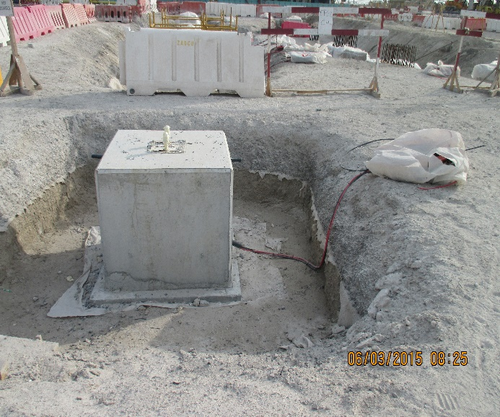

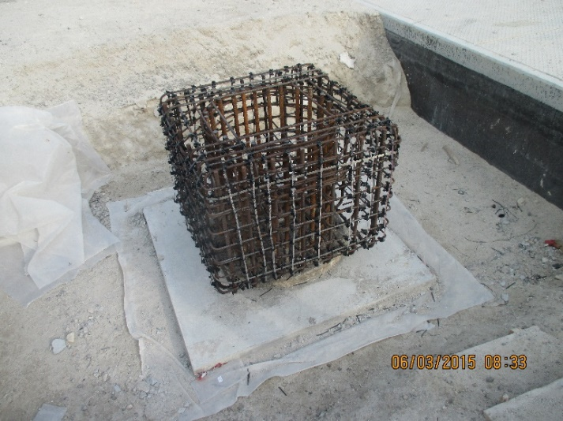
CONCRETE STRUCTURES – PERCEPTION AND REALITY
What Does the Outside of Concrete Look Like?
What is Seen is Apparently an Inert Non-Conducting Medium
What Does the Inside of Concrete Look Like?
Out of View is a Mass of Metal Which is Part of the Overall Cathode Circuit

Slide 4
WHEN

Slide 5
THE FOLLOWING TIME PERIODS ARE AVAILABLE FOR THE INSTALLATION OF AN ACTIVE CORROSION PROTECTION SYSTEM
NOW
THIS IS AT TIME OF CONSTRUCTION AND REQUIRES A DEMAND FROM THE STRUCTURE OWNER THAT SUCH PROTECTION IS REQUIRED.
LATER
THIS INVARIABLY MEANS BY INSTALLING CORROSION MONITORING AND INTRODUCING A “PROVISION FOR FUTURE CP”
TOO LATE
THIS IS WHEN THE STRUCTURE THAT WAS INSTALLED WITHOUT ACTIVE PROTECTION, STARTS TO FAIL BY CORROSION

Slide 6
NOW
THIS IS WHEN CATHODIC PROTECTION IS APPLIED DURING CONSTRUCTION
(PREVENTION IS BETTER THAN CURE)

Slide 7
LATER
THIS ALWAYS TAKES THE FORM OF “PROVISION FOR CATHODIC PROTECTION” IN VARIOUS SPECIFICATIONS.
HOWEVER WHEN SPECIFIED, IT CAN ONLY PRACTICALLY BE ADOPTED BY USING SOIL OR SEAWATER BASED REMOTE ANODES TO PROVIDE THE CATHODIC PROTECTION.

Slide 8
TOO LATE
TOO LATE REFERS TO WHEN A STRUCTURE, OR PART OF A STRUCTURE, WAS INITIALLY SELECTED AS NOT NEEDING CATHODIC PROTECTION DURING CONSTRUCTION, BUT SUBSEQUENTLY WAS FOUND TO HAVE CORRODED TO THE POINT OF CAUSING DAMAGE TO THE CONCRETE.

Slide 9
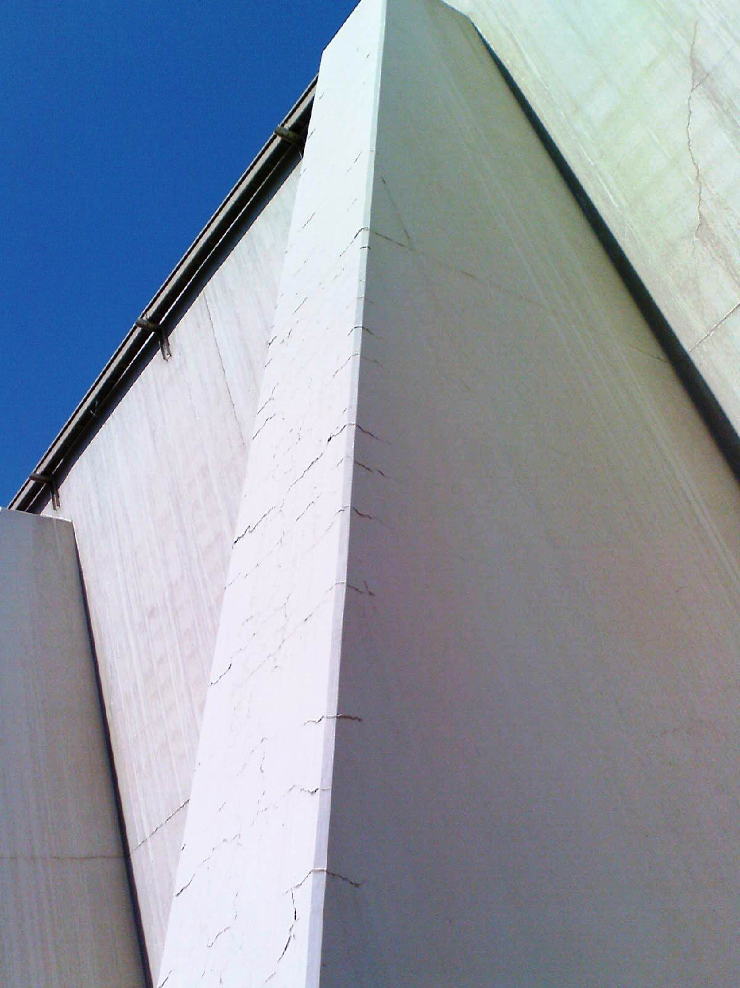
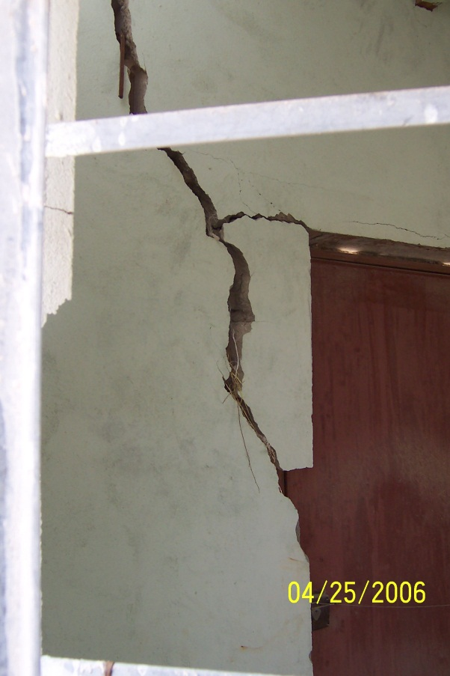
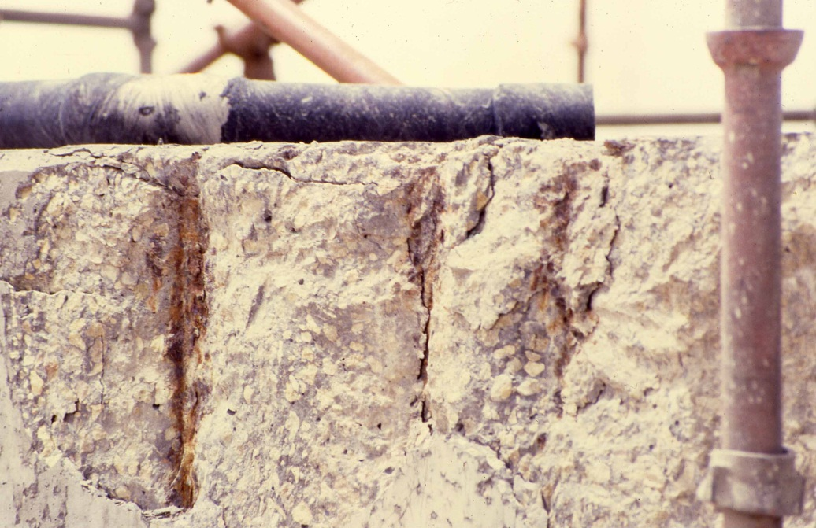
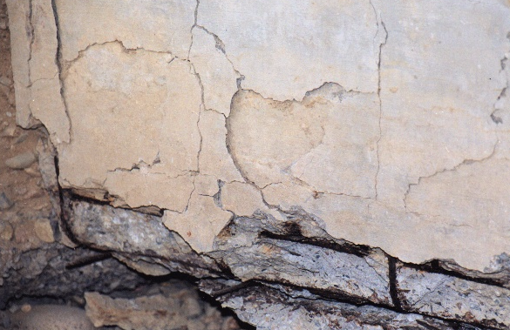
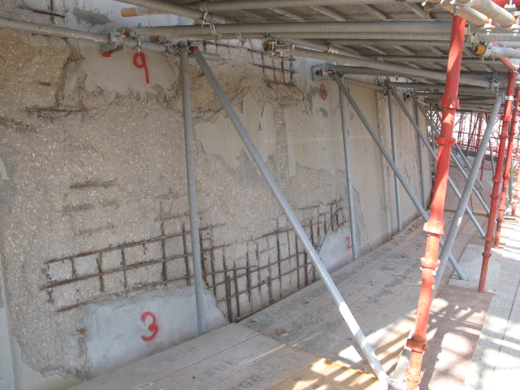
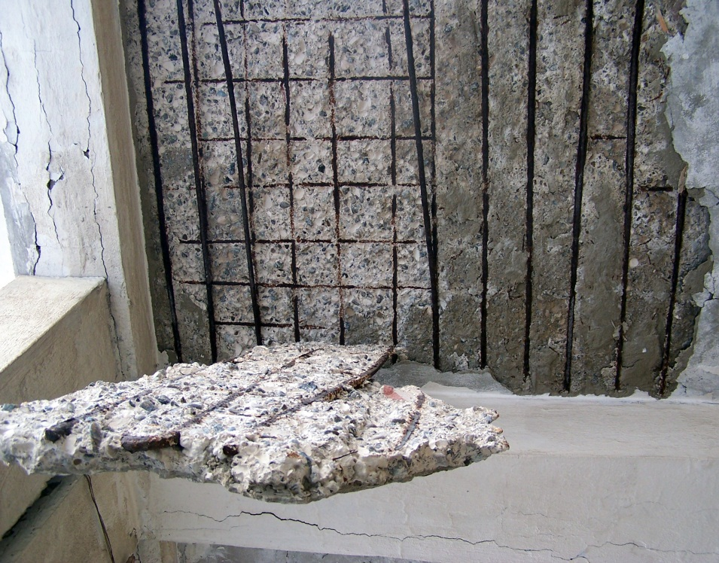
THE CONSEQUENCES OF “TOO LATE” (EXAMPLES FROM 4 DIFFERENT COUNTRIES)

Slide 10
WHERE
THIS SECTION DEFINES THE AREAS THAT DO AND DO NOT NEED TO BE CONSIDERED FOR ACTIVE CORROSION PROTECTION
TWO SEPARATE CRITERIA FOR DETERMINING WHERE CATHODIC PROTECTION IS TO BE APPLIED, SHOULD ALWAYS BE CONSIDERED IN EACH CASE.
THESE CRITERIA ARE THE STRUCTURE CRITICALITY AND CORROSION RISK.

Slide 11
Simplistic Model of a Substation Used for Determining Structure Criticality Based on the Concrete Element Access Conditions
Moderately Difficult Access
Easy
Access
Difficult Access
1m
Difficult
Access
Very Difficult Access
Access Impossible
IF ACCESS AFTER CONSTRUCTION IS NOT POSSIBLE, THEN THE CORROSION PREVENTION SCENARIO MUST BE FOR THE FULL DESIGN LIFETIME

Slide 12
Corrosion Risk Illustrated by Distribution of Chemical Species for a Concrete Element Spanning Different Environments and Causing Macro-cell Conditions
Total Oxygen Availability
[O₂] High, [H₂O] Almost Non-existent
O²⁻ Predominant
Natural Potential –100mV
G.L.
200mV Macro-Cell
Medium Oxygen Availability
[O₂] High, [H₂O] Low
O²⁻ Predominant
Natural Potential –300mV
Corrosion Cell Potential Increases
Moisture Table
Optimum Corrosion Cell Conditions
400mV Macro-Cell
[O₂] and [H₂O] Medium
O²⁻ & OH⁻ In Balance
Natural Potential –500mV
Low Oxygen Availability
Water Table
Corrosion Cell Resistance Increases
[O₂] Low, [H₂O] High
OH⁻ Predominant
Natural Potential –800mV
700mV Macro-Cell
Very Low Oxygen Availability
The Macro-Cell Conditions Produce the Maximum Corrosion Deterioration Out of Sight Below Grade

Slide 13
SCOPE OF PROTECTION
SEVERAL END USERS IN THE GCC COUNTRIES NOW HAVE COMPANY WIDE SPECIFICATIONS THAT STATE CATEGORICALLY WHICH STRUCTURES MUST BE PROTECTED AND WHICH SURFACES OF THESE STRUCTURES MUST BE INCLUDED.
THESE HAVE UNIVERSALLY BEEN CREATED TO DEAL WITH THE PROBLEMS THAT DIRECT EXPERIENCE HAS DEMONSTRATED ARISE IF ACTIVE PROTECTION WAS NOT APPLIED.
WITHOUT EXCEPTION THESE SPECIFICATIONS ARE CORRECT, BUT PROJECT EXPERIENCE HAS SHOWN THAT IN MANY CASES THE CONTRACTOR HAS PERSUADED THE CLIENT THAT THIS IS NOT NECESSARY AND THE SPECIFICATIONS DISREGARDED.
(MY CONCRETE IS GOOD!)

Slide 14
HOW

Slide 15
TECHNIQUES AND EFFICIENCIES
HAVING DETERMINED WHEN AND WHERE TO APPLY CATHODIC PROTECTION THE SELECTION OF TECHNIQUE TO BE USED BECOMES CRITICAL
THESE TECHNIQUES VARY BOTH WITH THE STRUCTURE ACCESS CONSIDERATION AND THE TIMING OF APPLICATION. THE VARIOUS OPTIONS ARE DISCUSSED BELOW.

Slide 16
ICCP DURING CONSTRUCTION

Slide 17
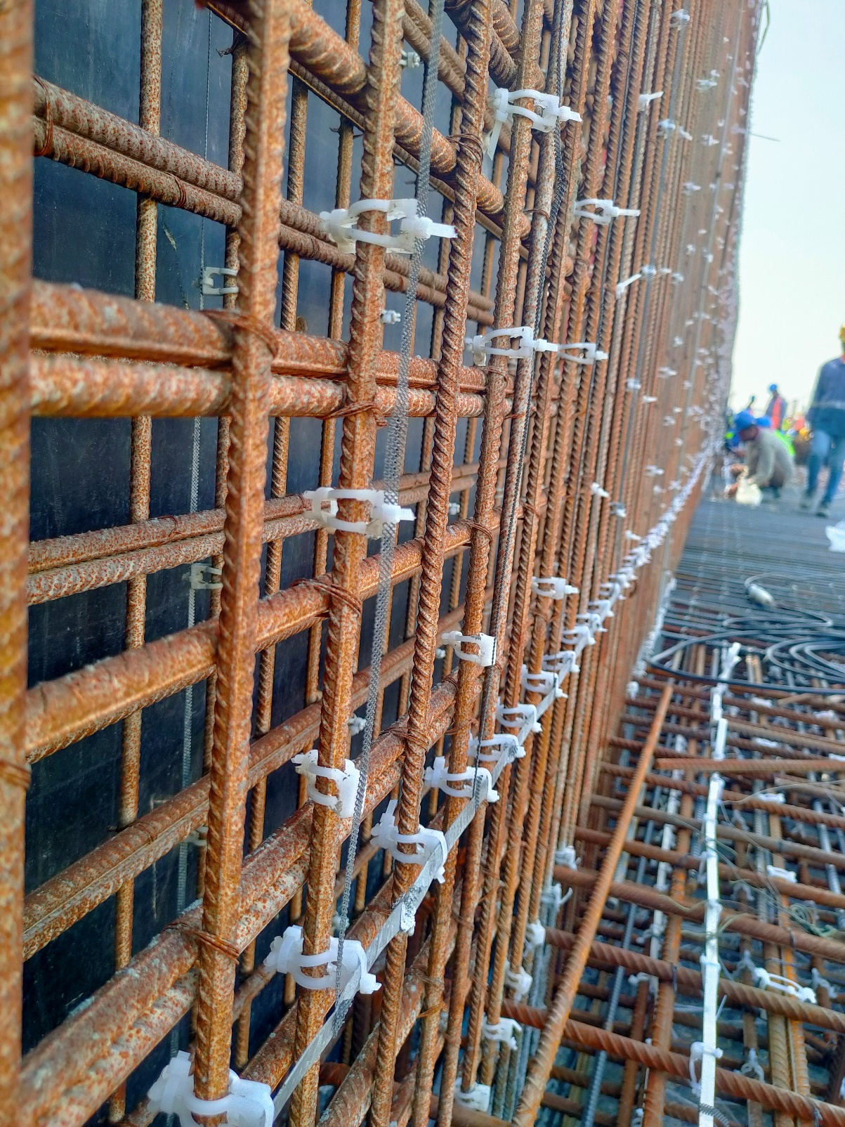
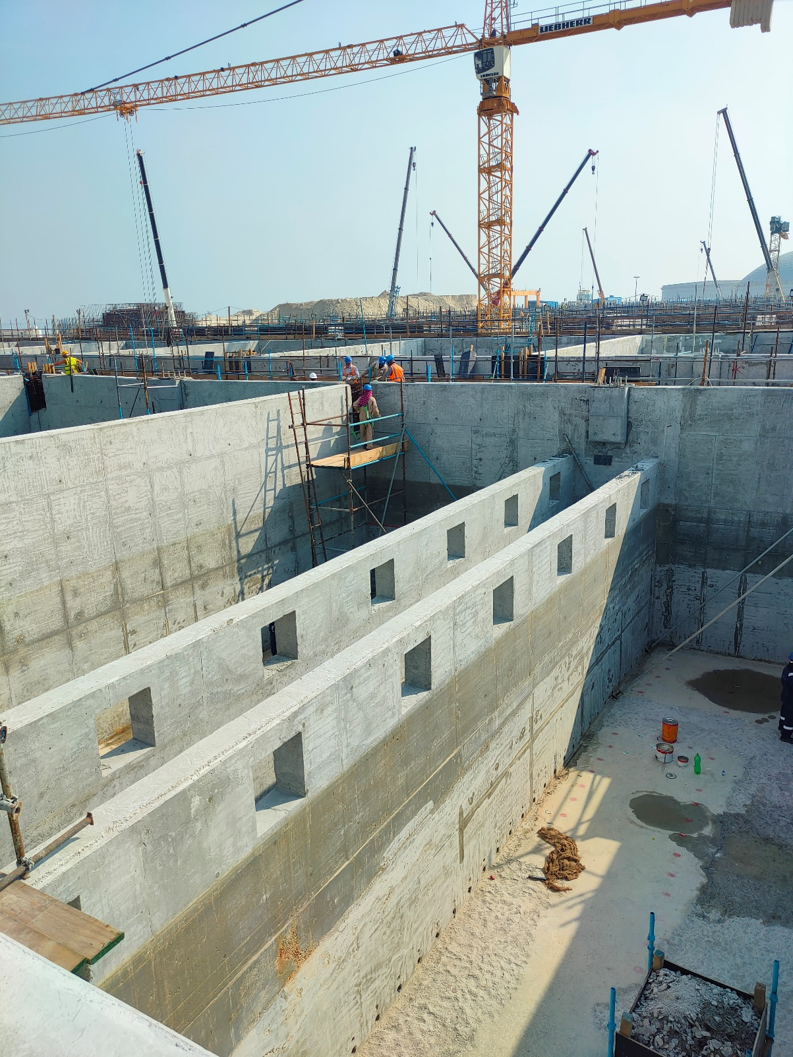
EMBEDDED ANODE IMPRESSED CURRENT CATHODIC PROTECTION FOR REINFORCED CONCRETE STRUCTURES INSTALLED DURING INITIAL CONSTRUCTION
THIS TECHNOLOGY IS WELL KNOWN IN THE MIDDLE EAST WITH A TRACK RECORD IN EXCESS OF OVER 35 YEARS AND MORE THAN 4,000,000m².
BEFORE CASTING CONCRETE
AFTER CASTING CONCRETE

Slide 18
SACP DURING CONSTRUCTION

Slide 19
ZINC ANODE SACRIFICIAL CATHODIC PROTECTION FOR REINFORCED CONCRETE STRUCTURES DURING INITIAL CONSTRUCTION
Zinc Anode | Potential Loss (mV)
1 | 95
2 | 88
3 | 71
4 | 86
5 | 82
6 | 80
7 | 70
All Zinc Anodes depolarise in the same manner and to the same degree and none of them had an initial (unconnected) potential anywhere close to the expected value of -1,100mV (Ag/Ag.Cl)

Slide 20
CORROSION MONITORING AS A MEANS OF DETERMINING THE REQUIREMENT FOR ANY FUTURE ACTIVE PROTECTION

Slide 21
CORROSION MONITORING
CORROSION MONITORING IS OFTEN USED TO JUSTIFY NOT INSTALLING ICCP WHILE CLAIMING TO BE “ADDRESSING CORROSION RISKS”.
THESE DEVICES ARE GENERALLY INSTALLED ON A STRUCTURE BY STRUCTURE BASIS, i.e. 1 PER STRUCTURE WHETHER THE STRUCTURE IS 100m² OR 10,000m².
DUE TO THE POOR ELECTROLYTE CONDUCTIVITY THESE MONITORS ONLY CONSIDER AN AREA OF APPROXIMATELY 400mm DIAMETER (0.125m²) WHICH MEANS BETWEEN 0.01% TO 0.001% OF THE STRUCTURE IS ACTUIALLY MONITORED.
SOME SPECIFICATIONS ALSO REQUIRE THESE DEVICES TO BE “INSTALLED ABOVE GRADE FOR EASE OF MONITORING”, WHICH AUTOMATICALLY MEANS THEY ARE IN THE LEAST CORROSIVE AREA AND SO GIVE A FALSE POSITIVE IN TERMS OF THE STRUCTURE CORROSION ASSESSMENT.
THERE ARE NO STANDARDS AVAILABLE FOR INTERPRETING THE DATA RECEIVED FROM SUCH DEVICES.
EVEN IF A DEFINED CORROSION RATE IS ACCURATELY MEASURED THERE IS NO WAY TO KNOW WHEN IT STARTED, WHAT THE RATE WILL BE AT ANY TIME IN THE FUTURE AND HOW MUCH CORROSION CAN BE ACCEPTED BEFORE A STRUCTURE IS CONSIDERED TO BE “AT RISK”.

Slide 22
“PROVISION FOR ICCP” TO BE INSTALLED AFTER CONSTRUCTION

Slide 23
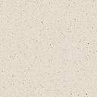
THE USE OF SOIL BASED ANODES TO PROTECT REINFORCED CONCRETE STRUCTURES - 1
Major reinforced concrete structures invariably span two or more different environmental conditions. As an example to illustrate this, the below sketch of a water containing pit shows how these are situated.
Atmospheric Exposure
Humid Exposure
Other smaller structures like pile caps span just two environments, buried and atmospheric, although depending on the position of the water table this can also include submerged and humid as well.
It is often believed that as concrete is an electrolyte that current flow ( ) can flow up through the structure from the below grade surfaces into the above grade areas. This issue is addressed in the following slides.
Submerged Exposure
Buried Exposure

Slide 24
THE USE OF SOIL BASED ANODES TO PROTECT REINFORCED CONCRETE STRUCTURES - 2
An evaluation was made at 201 Reference Electrodes across a variety of structures ranging from small pile caps to large basins. Studies were conducted when both the local soil-based anodes and remote marine anodes are energised at a combined output of 1,600 Amps, of which 70% is from the local anodes (<10m) and 30% from remote seabed anodes. The results can be summarised as under.
In all cases the shift recorded is for the ON potential, not the Instant OFF potential, and not only shows very little polarisation in the correct negative direction (less than 30mV) but even sometimes shows positive polarisation, i.e. interference.

Slide 25
THE USE OF SOIL BASED ANODES TO PROTECT REINFORCED CONCRETE STRUCTURES - 3
The concrete structures being studied for any beneficial effects from soil/seawater based anodes all had reference electrodes installed in multiple positions. The graphical analysis of potentials in different pile cap locations before and after these anodes were energised is given below.
This latter graph shows that even in a localised cluster of pile caps the effects are not consistent with good CP distribution and it is clear that where current is picked up at the ends of the module it is equally discharged in the mid point.

Slide 26
THE USE OF SOIL BASED ANODES TO PROTECT REINFORCED CONCRETE STRUCTURES - 4
These results are for large concrete structures being studied for any beneficial effects of soil/seawater based anodes. Again all of them had reference electrodes installed in multiple areas of different environments. The graphical analysis of potentials before and after these anodes were energised is given below.
As can be seen there is zero effect outside the buried surfaces (points 1-5 on the small structure) and what little effect is seen on the larger structure is mostly in the opposite direction to CP current flow.

Slide 27
THE USE OF SOIL BASED ANODES TO PROTECT REINFORCED CONCRETE STRUCTURES - 5
This final analysis is a large concrete structures in a congested area. Again there were reference electrodes installed in multiple areas of different environments. The graphical analysis of potentials before and after these anodes were energised is given below.
The effects are again very small but we were able to show that while a very small amount of CP effect occurred on soil contact surfaces (B=Buried) and penetrated through to the seawater saturated faces (S=Submerged) there was no effect or sometimes the opposite effect on surfaces relying on current flow through the concrete matrix (H=Humid & A= Atmospheric)

Slide 28
DETERMINING THE REASONS WHY RETROFIT CP SYSTEMS ARE INEFFECTIVE

Slide 29

SCHEMATIC ILLUSTRATION OF RESISTANCE BALANCE IN CONGESTED SITE LOCATIONS
Resistance to Earth of 2 Pile Caps (2m x 2m x 1.5m) = 0.94 Ohms
Resistance to Earth of 800mm Diameter Pipeline with 10% holidays = 10 Ohms
Resistance to Earth of Large Cable Duct (12m x 2m) = 0.16 Ohms
By Calculation of Resistance Balance, the Resulting Current Distribution from a Remote Anode System Would be as Under.
Pipeline 0.6%
Pile Caps 6.3%
Small Cable Duct 24.7%
Piles 31.3%
Large Cable Duct 37.1%
If we assume the cable ducts are not designed to be intentionally protected, then 61.8% of current is lost as a current drain.
Resistance to Earth of Small Cable Duct (6m x 1.5m) = 0.24 Ohms
Resistance to Earth of 4 Piles (0.6m Diameter x 25m Long) = 0.19 Ohms
Taking the standard formula for resistance and assuming a universal 75mm cover and 50,000 Ohm-cm concrete resistivity we have a fixed value of 37.5/Area for the resistance of each structure. With the dimensions shown and assuming a unit cell of 15m between pile cap lines, we have a result as shown above.
THE CURRENT DISTRIBUTION FROM REMOTE OR SEMI-REMOTE ANODES EXACTLY FOLLOWS THIS RESISTANCE DISTRIBUTION PATTERN.

Slide 30
GENERALLY UNCONSIDERED COMPLICATIONS WHEN INSTALLING CATHODIC PROTECTION TO REINFORCED CONCRETE STRUCTURES BEFORE OR AFTER CONSTRUCTION - EARTHING
When using soil or seawater based anodes to protect concrete structures on a retrofit basis there is the issue of interconnected earthing to consider as below. Both NEC and IEEE changed their earthing codes in 2005 as shown.
In NEC Sec. 250.50, it is required that all grounding electrodes present be bonded together to form the grounding electrode system. The types of grounding electrodes that must be bonded together, if present, are listed in 250.52(A)(1) through (A)(6). They include: 1) metal underground water pipe, 2) metal frames of buildings or structures, 3) concrete-encased electrodes (usually rebar), 4) ground rings, 5) rod or pipe electrodes, and 6) plate electrodes.
In IEEE Std 142 “The Green Book,” Sec. 4.2.3 discusses the use of rebar as a grounding electrode. Corrosion is discussed in Sec. 4.4.5. This section states: “The basic objectives of a sound electrical grounding system are safety of personnel, reliability of equipment operation, fault current return and to limit transient over voltages. After these objectives have been satisfied, the effect of the grounding installation on corrosion must be considered.
EN14505 – COMPLEX STRUCTURES - EXTRACT
NOTE The connection of copper or cathodic earthing systems to buried steel not only increases cathodic protection current demand but, if cathodic protection is not applied, it will increase the corrosion risk to the buried steel.

Slide 31
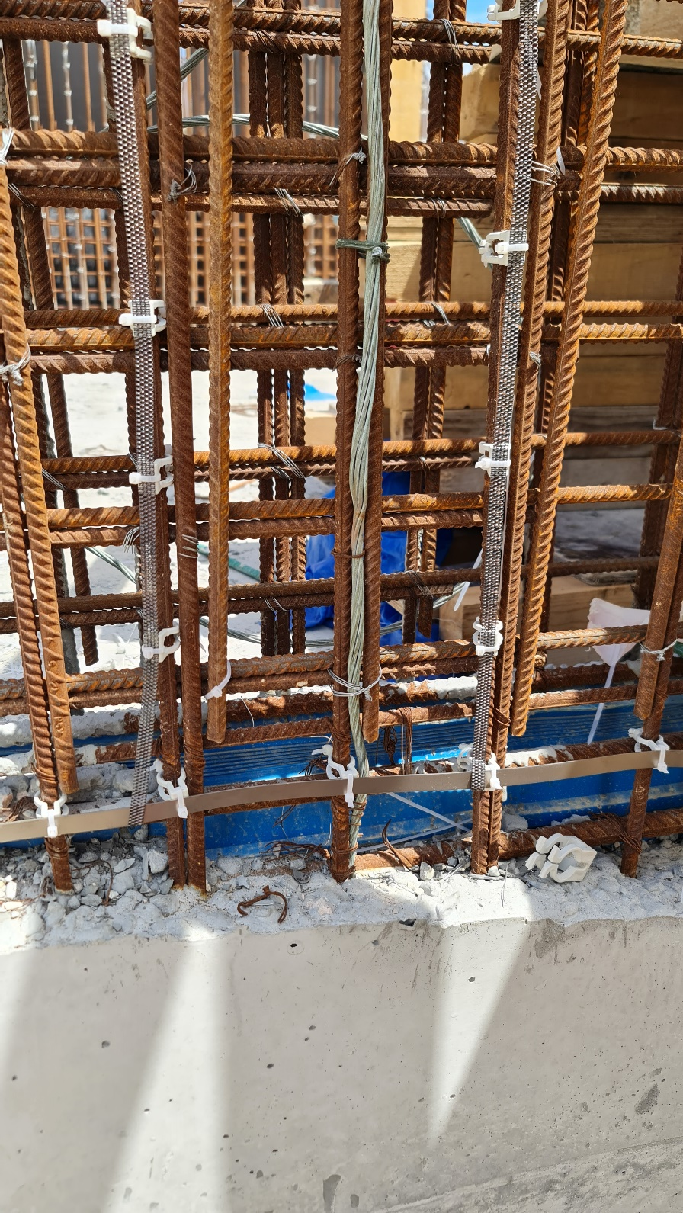
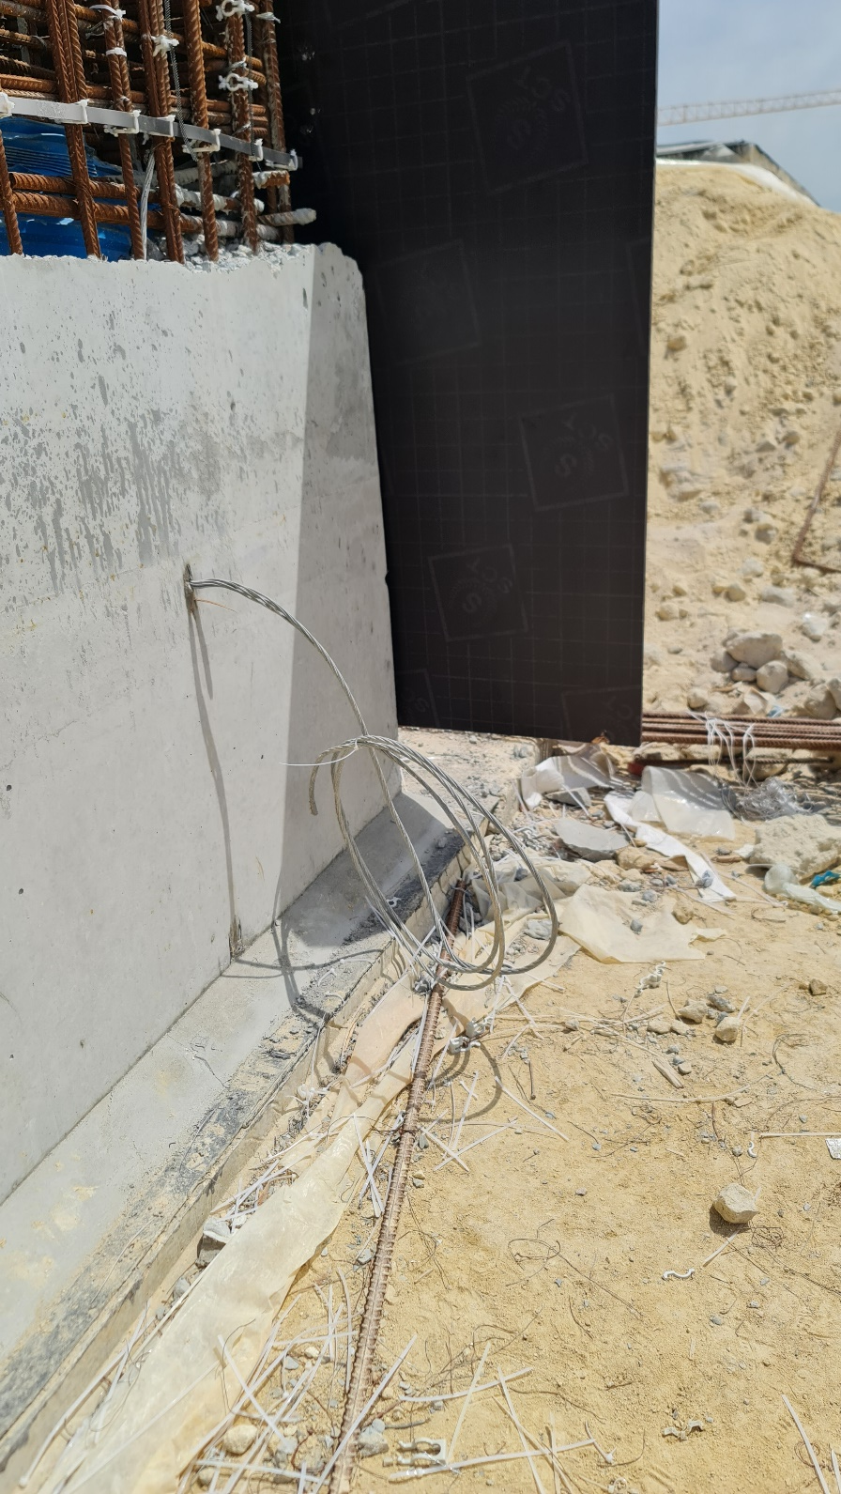
INCLUSION OF BARE EARTHING CABLES WITHIN AND AROUND CONCRETE STRUCTURES AFFECTING CATHODIC PROTECTION DESIGN

Slide 32
NO CATHODIC PROTECTION DESIGN CAN DETERMINE ELECTRON FLOW PATTERNS. THIS IS 100% CONTROLLED BY OHM’S LAW
NO ENTRY FOR ELECTRONS
NO ENTRY FOR ELECTRONS

Slide 33
ICCP DURING REPAIR

Slide 34
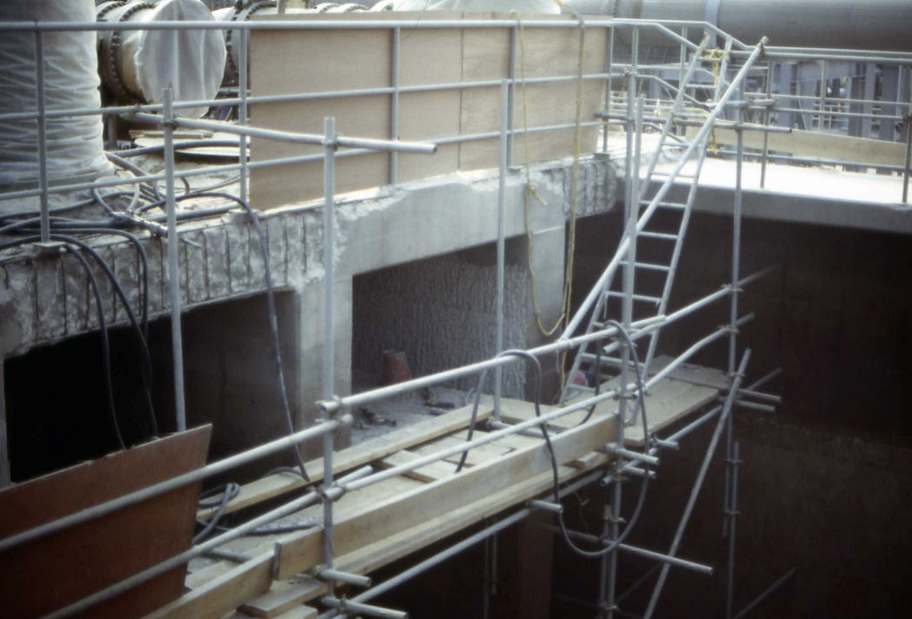
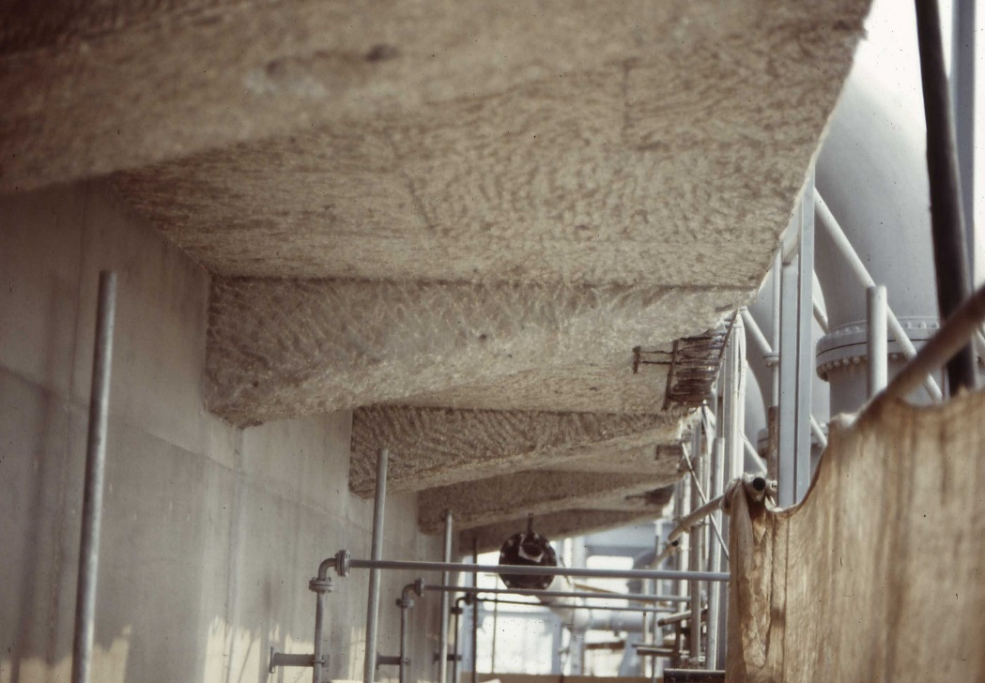
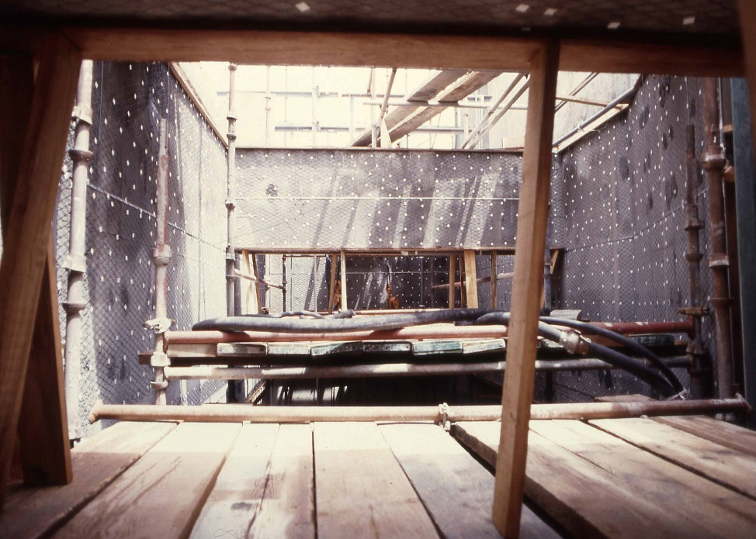
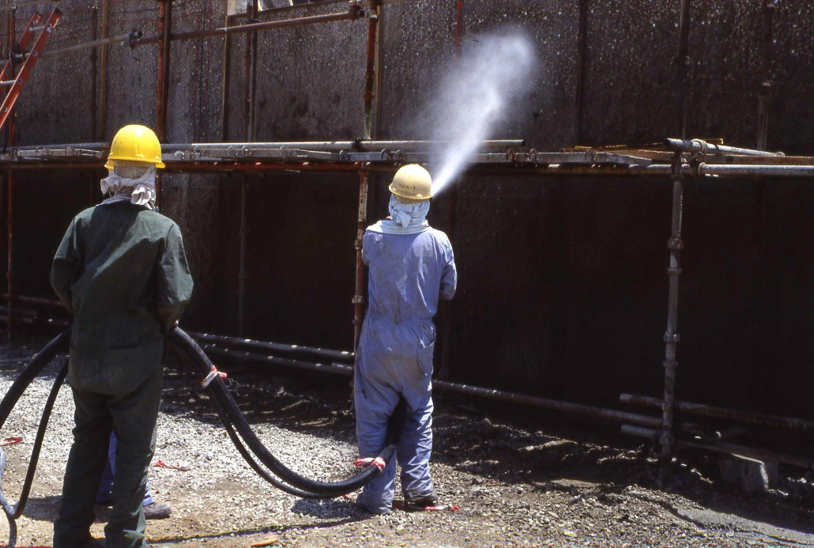
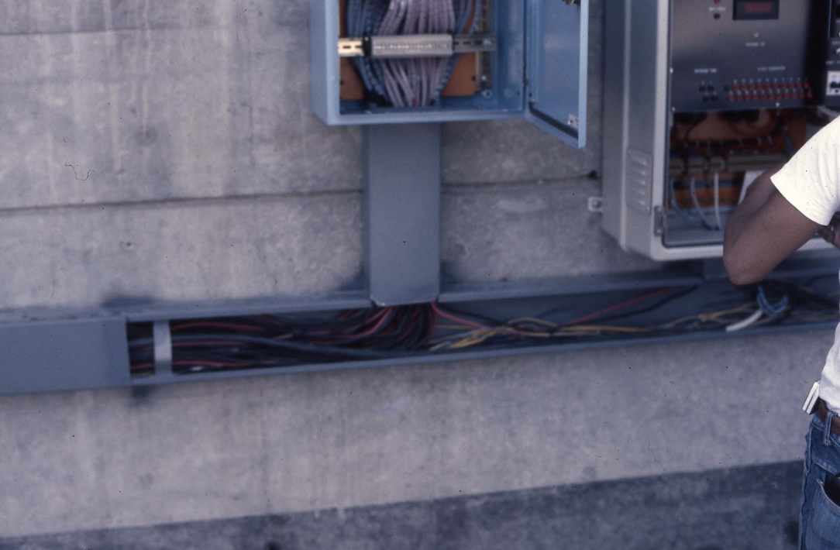
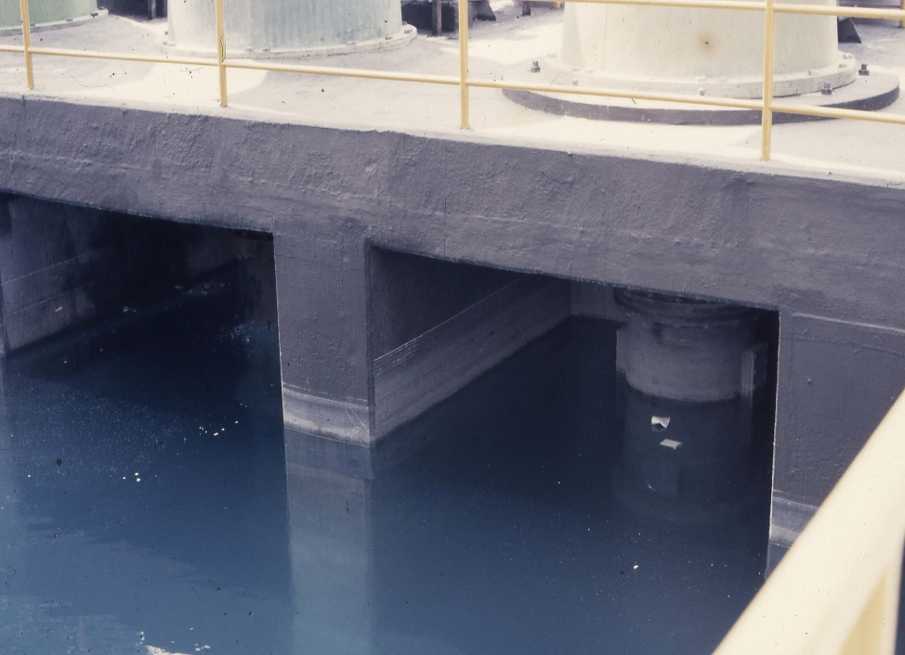
INSTALLING CATHODIC PROTECTION TO DETERIORATED REINFORCED CONCRETE SEAWATER INTAKE STRUCTURE

Slide 35
SACP AS PART OF A REPAIR
SOMETIMES SACRIFICIAL ANODE CATHODIC PROTECTION IS INSTALLED AS PART OF THE REPAIR PROGRAMME IN THE HOPE OF PRODUCING A LOW COST SOLUTION.
AN EXAMPLE IS GIVEN BELOW WHERE THIS HAS OCCURRED. THESE STRUCTURES HAD 31,374 ZINC ANODES INSTALLED IN 407 ZONES ACROSS 6 SEPARATE STRUCTURES. AS THESE WERE ALL INTERCONNECTED EXTERNALLY, AND NOT DIRECTLY TO THE REBAR, ACCURATE DATA AS TO ANODE CURRENT, ON AND OFF POTENTIALS FOR BOTH ANODES AND REBAR WAS ABLE TO BE COLLECTED.

Slide 36
ZINC ANODE SACRIFICIAL CATHODIC PROTECTION FOR REINFORCED CONCRETE STRUCTURES AS PART OF A REPAIR STRATEGY – DATA AFTER 1 YEAR - 1
CURRENT DENSITY FOR REPAIR OF CONCRETE – 20mA/m²
EXPECTED DRIVING POTENTIAL OF ZINC ANODES – 600mV
STATUS | ANODE OUTPUT | DRIVING POTENTIAL
MINIMUM | 0.01 | -528
AVERAGE | 0.18 | -97
MAXIMUM | 2.45 | -7

Slide 37
ZINC ANODE SACRIFICIAL CATHODIC PROTECTION FOR REINFORCED CONCRETE STRUCTURES AS PART OF A REPAIR STRATEGY – DATA AFTER 1 YEAR - 2
CONCLUSION - After 1 year of operation there is no protection effect from the Zinc anodes and they were replaced with an ICCP system.
(BUY CHEAP = BUY TWICE)

Slide 38
Summary of the Techniques Considered and their Application Issues
Timing | Technique | Advantages | Disadvantages
During Construction | ICCP Using Embedded Ribbon Mesh | 100% Effective for 50+ years. Can be proven effective by direct measurement at any time. Recommended by Client and International Standards. | Requires Skilled Designer and Contractor. Requires ongoing monitoring commitment for the system life, but this can be supplied via remote monitoring and control systems (RMCS).
During Construction | SACP | Cheap | Does not Achieve Standard Acceptance Criteria
Post Construction | ICCP Using Remote Soil or Seawater Anodes | Defers Capital Cost | No Standard Criteria for Initiating the deferred ICCP. Spreads Current Uncontrollably to All Surrounding Structures with Possible Stray Current Corrosion Risk
During Repair | ICCP Using Slotted Ribbon Mesh or Surface Mesh and Overlay | 100% Effective for 50+ years. Can be proven effective by direct measurement at any time. Recommended by Client and International Standards. | Requires Significant Civil Input in Terms of Access, Repair, Concrete Slotting and/or Overlays Significantly More Expensive than New Installation.
During Repair | SACP | Cheaper than ICCP | Does not Achieve Standard Acceptance Criteria

Slide 39
Summary of the Costs of Installing ICCP for Major New Industrial Structures On Projects From 1996 to 2021 in Date Order
Country | Size (m²) | Project Type | ICCP COST | ICCP as % of Total Budget
KSA | 550,000 | Power Plant | 6m$ | 0.48%
Qatar | 350,000 | Cooling System | 18M$ | 0.51%
Qatar | 205,000 | LNG/LPB Port | 14M$ | 0.52%
UAE | 175,000 | Petrochemical Complex | 12M$ | 0.50%
The Costs of Installing ICCP for Major New Industrial Structures as a Percentage of Overall Project Cost has Remained Relatively Constant Over the Last 25 Years

Slide 40
CONCLUSIONS
Sacrificial Anode CP systems for concrete structures either installed during construction or as part of a repair do not achieve protection of the structures.
Provision for future CP systems are simply a way to defer initial payment and ultimately end up with structures that cannot be adequately protected by retro-fit CP systems.
The use of corrosion monitoring to determine when a CP system should be installed and energised, cannot be adopted simply because the number of monitoring points is so low, they only give extremely localised data and there is no accepted standard for interpreting the data.
Impressed Current Cathodic Protection has already established a successful track record in GCC countries for over 35 years.

Slide 41
RECOMMENDATIONS
Impressed Current Cathodic Protection for all structures and specific surfaces of structures that cannot be re-accessed for repair should be treated to a full lifetime protection system during construction.
Client specifications which state when and where to apply active protection systems should be rigorously enforced.

Slide 42



JUBCOR
2024
CONFERENCE & EXHIBITION
INNOVATIVE SOLUTIONS FOR CORROSION CHALLENGES
THANK YOU
Reach out.
Calle Cualquiera 123, Cualquier Lugar
+966 13 342 0660
bsstech@bsstechnologies.com

