Slide 1
JUBCOR
2024
CONFERENCE & EXHIBITION
INNOVATIVE SOLUTIONS FOR CORROSION CHALLENGES
Presented By:
Mohammad Al-Shaikh
Industry Technical Consultant,
IMEA Region
Closed Cooling on TRACK Innovation
Increasing reliability and reducing environmental impact

Slide 2
Create Maintain Value: innovation part of our process Saudi vision 2030 requires water management excellence and minimal footprint
Royal Commission review of environmental regulations: global trends for stricter limits
Key
Business Drivers
System
Assurance
Continuous
Improvement
Innovation
ENGAGE
ENGAGE
Metrics
(Measure/Audits)
DO
Value
Communication

Slide 3
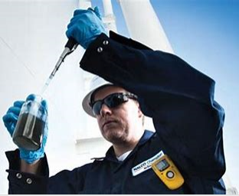
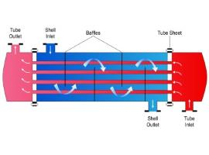
Closed Cooling: controlling your process
Closed Cooling System controlling the process temperatures
High efficiency heat exchange for operational reliability
High water quality make-up eliminates scale under high stress conditions
Current practice: Molybdate Or Nitrite with borate buffer for corrosion control at high pH
Treatment control is essential to maintain corrosion inhibition performance
Nitrite is oxidized to nitrate e.g. by bleach in make-up water
Nitrite is readily reduced to N₂ gas by bacteria when biodegradable organics enter the loop
Process leaks promote biofilm growth and nitrite reduction, control can be challenging
SDS of Nitrite has several hazard symbols; direct disposal of treated loop no option
Molybdate in the wastewater is regulated by RC. Discharge level is very low < 0.01 mg/L
Nalco Water R&D developing the next generation of treatment
Responsible Care: Looking for more sustainable solution
Laboratory testing successful: static and dynamic pilot tests show excellent corrosion protection
Industry technical trials show excellent performance during hydrocarbon leak into cooling system
New biostatic technology minimizes water footprint by lowering blowdown needs
Shell and Tube
Heat Exchanger

Slide 4
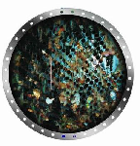
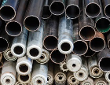
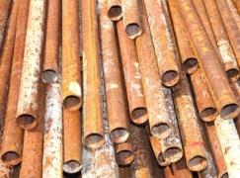
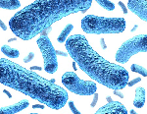
Cooling Treatment Challenges
Scale
formation occurs when impurities form hard, dense crystals.
Corrosion
is the oxidation of metals, supported by water.
Fouling
is the accumulation of dispersed solids in water.
Microscopic organisms
in water can cause system and health problems.
Process leaks pose biofouling challenges & high operational costs
High purity water as make-up, discharge not allowed due to treatment chemistry
Cooling system leaks drain the closed loop, treatment residual control critical

Slide 5
Holistic treatment program development
Advanced corrosion and biofouling control
Cost effective and safe treatment
Chlorine & non-oxidizing biocide compatible
Mild Steel and yellow metal corrosion inhibition
Easy monitoring and control
Additional Program improvements
Biostatic treatment
Very high buffer capacity
Direct water disposal depending on local regulation
Aim to safeguard production:
Debottleneck closed cooling

Slide 6
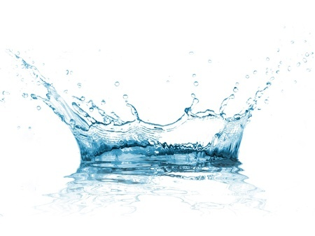
TRAC400: Closed Cooling Treatment innovation
Sustainable Technology
Non-P
Non-NO₂
Non-Boron
Non-Molybdate
High buffer capacity
Compatible with Nitrite and Molybdate
Chloride and sulfate tolerant
Biostatic, (bio)chemically stable actives
Robust Closed Cooling Treatment
6

Slide 7
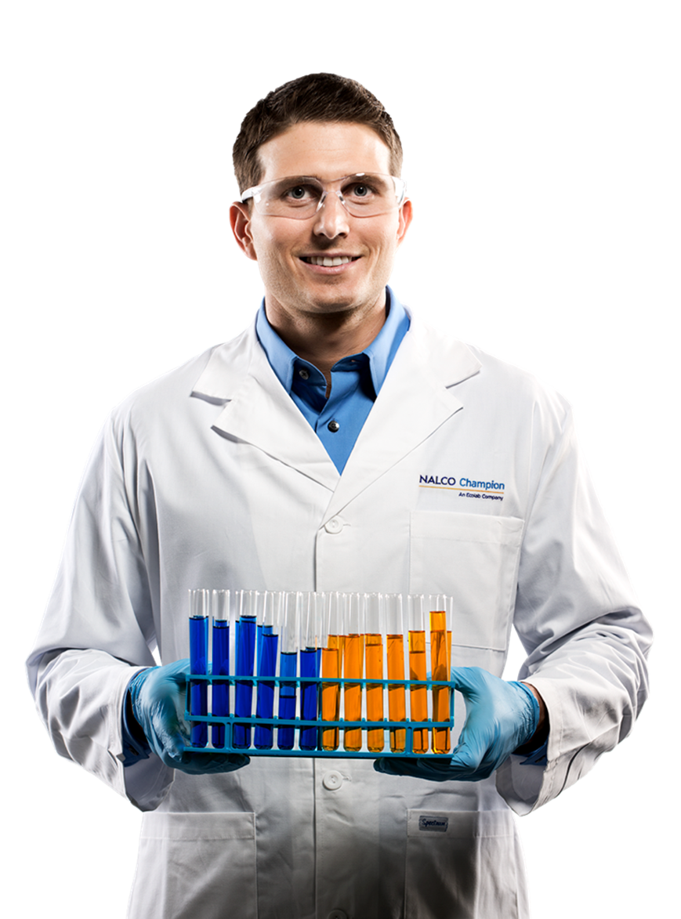
TRAC400 Development process
Nalco Water Global R&D developed and tested
Robust program performance shown
Extensive bench flow loop (stress) testing
Best performer identified, patent protection pending
Pilot plant production successful for industrial trial
Regional trials at KAUST
Marafiq service water used for closed loops
Hydrocarbon contaminated water from local closed loops
Ammonia and Microbio contaminated real water samples
Industrial application proven concept
High Temperature, challenging cooling system
150 m³ loop VDU (hydrocarbon leaks during stress)
Excellent corrosion control and very low iron values

Slide 8
Comparative performance superior performance with non-toxic, innovative chemistry
TRAC400
Incumbent Treatments
Competitor Offering
Triple-P Inhibition
Nitrite/ Borate
Molybdate/ Borate
Filming/buffering Amines
KPIs
Delivering Performance
Cost
Robust corrosion Protection
non-Toxic inhibitor
No-Borate or amines
High buffer capacity
Biostatic treatment
Robust performance tolerant to operational variability
Toxicity profile
Buffering capacity
Biostability
Nitrite overlay compatibility
N/A

Slide 9
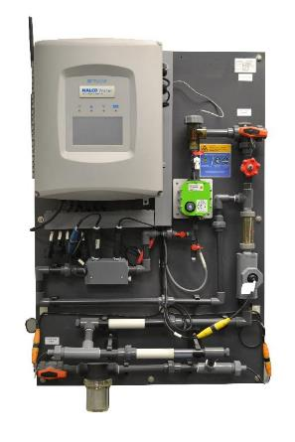
Monitoring and control
Large or critical loops: 3D TRASAR online control
Corrosion, conductivity, pH, TRASAR in real time
Web based 24/7 system assurance
Spot checks on water quality, actives and microbio
Other loops: TRASAR Pen Fluorometer
Spot checks on treatment dosed, pH, Conductivity
Spot checks on water quality, actives and microbio
All uploaded for digital reference and trending
Change management to TRAC400
Target dose rate selected based on chloride levels
TRASAR measures inhibitor dosed, actives target linked
Lower conductivity band (less mS/cm per ppm), similar pH
TOC contribution 150-200 ppm, biostatic & HC leak tolerant
Data digitally-enabled in the cloud with SAC analyses and reports performance, manage alarms and provide recommendations 24/7 to deliver performance.
State of the art controller (Intuitive color touch-screen, multiple language platform)
Smart sensors to determine corrosion, scaling tendency, and critical water and treatment parameters
Enhanced monitoring and control options

Slide 10
CASE STUDY
Refinery makes step change in closed cooling treatment sustainability
System Details
Refinery high temperature closed cooling system
Demi Water make-up due to >100C operating temperatures
Treated with ~3000 ppm TRAC109
pH=11,2, no CO2 ingress due to nitrogen blanketing.
Periodic water leaks out of the system periodic top-up
System conductivity 2000-5000 µS/cm (average 3175 µS/cm)
Mild Steel Corrosion under good control 0,03 mpy (<1 mpy target)
INNOVATION
TRAC400, new nitrogen, borate and molybdate free product for sustainable closed loop treatment:
Corrosion Coupons spotless, at 0,02 mpy well below target
Rapid protection, stable actives level one week after first fill
System conductivity 2000 µS/cm (slowly dropping to 1700 µS/cm
Actives follow slow conductivity drift, pH stable at 11,2
Meeting customer targets in discharge water quality
No biological growth recorded, despite hydrocarbon leak detected
ANNUAL SAVINGS
1 and 3 month coupons
both confirm mild steel
corrosion control to
0,02 mpy
Well below 1 mpy limit
No Iron dissolution: constantly below detection limit of
0,02 ppm
Eliminated 2 hazard symbols from the SDS
Eliminating
Nitrite and Borate
From treatment
Under high temperature conditions
SOLUTIONS
TRAC400, Novel non-toxic closed loop treatment program
3D TRASAR® Technology for Cooling
10
10

Slide 11
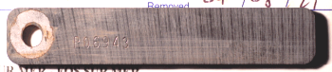
SUCCESS STORY
Steel Mill reduces corrosion by 95% using Nalco Water’s new, high-performing, green closed loop chemistry TRAC400
APPLICATION
Steel mill struggling with corrosion in the closed loops of the blast furnace
System Volume: 90 m³
Make-up: Lime softened + Basic Ion-exchanged, inherently corrosive water [50 ppm Cl, 110 ppm SO₄]
ISSUES
Significant localized & general corrosion (2-18 mpy) exceeding site KPI of <0.8 mpy
Total iron levels as high as 16 ppm despite sockets & magnetic filters in place (Site KPI < 5ppm)
Molybdate based treatment currently in place
INNOVATION
TRAC400, a new borate, nitrite and molybdate free product for sustainable closed loop treatment:
Excellent mild steel corrosion coupon results: <0.2 mpy, well below target
No localized corrosion at optimized dosing
Total iron of 4-6 ppm achieved with low blow down rates
RESULTS
Period | Corrosion Rate (mpy) | N# Days | Description
Historical Data | 1.5 | 71 | Localized (3 mils)
 | 1.7 | 55 | Localized (7 mils)
 | 18.3 | 45 | General
 | 4.0 | 98 | Localized (17 mils)
Product Introduction | 0.3 | *30 average | Localized (2-4 mils)
Coupon 1 | 0.2 | *29 average | General
Coupon 2 | 0.2 | 20 | General
Coupon 3 | 0.1 | 77 | None
Excellent Mild Steel and Yellow Metal corrosion control
<0,2 mpy
Well below site KPI (<0.8 mpy)
Total Iron levels 4-6 ppm achieved with
low blow down rates
Historical Results
TRAC400 Application
18.3 mpy (45 days)
0.2 mpy (20 days)
4.0 mpy (98 days)
0.1 mpy (77 days)
SOLUTION
TRAC400, Novel non-toxic, borate, nitrite and molybdate-free closed loop treatment program 3D TRASAR® Technology for Cooling
11
11

Slide 12
JUBCOR
2024
CONFERENCE & EXHIBITION
INNOVATIVE SOLUTIONS FOR CORROSION CHALLENGES
THANK YOU
Reach out.
Calle Cualquiera 123, Cualquier Lugar
+966 5005 88 232
malshikh@ecolab.com

