Slide 1




JUBCOR
2024
CONFERENCE & EXHIBITION
INNOVATIVE SOLUTIONS FOR CORROSION CHALLENGES
Microstructural Investigation of Damaged PSV Disk Holder
Abdulaziz Alharbi, Saeed Kadasah, Akeem Adesina, and Anis Ziani
Presented By: Abdulaziz Alharbi
Sept. 2024

Slide 2

Contents
Background
Process Description
Technical Evaluation
Methodology
Laboratory Failure Analysis
Conclusion
Recommendations
References
Q&A

Slide 3
Background
At one of the SABIC Affiliates. Pressure Safety Valve (PSV) was found stuck due to suspected internal corrosion of the disk holder that caused heavy accumulation of corrosion products.
The PSV is mounted on the process water line going to cation beds of the deionization unit.
The PSV downstream line discharge water into the wastewater common header, which is connected to neutralization sump.
The header contains HCl and other contaminants where acid vapors are assumed to reach the PSV parts which are made of stainless steel 420 and result in its corrosion.

Slide 4
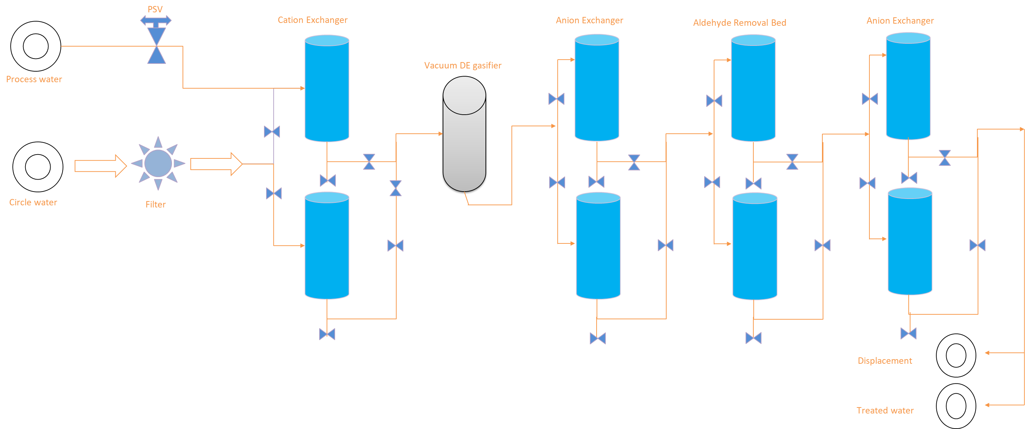
  Process Description
  Schematics of the Process Description

Slide 5
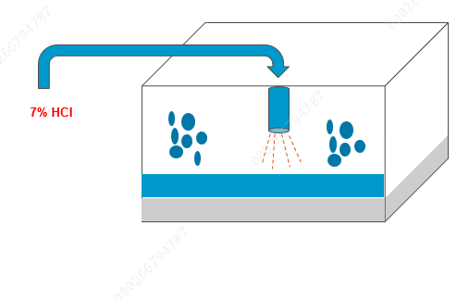
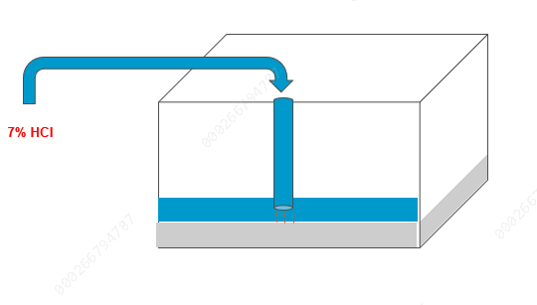
Technical Evaluation
    Condition of the Connected Piping
The history indicated that the PSVs discharge lines made of austenitic stainless steel 304 were subject to internal localized corrosion in the form of isolated pitting that sometimes led to leakage.
Corrosion is expected to occur because of corrosive gases that are generated from the neutralization sump and present in the wastewater header.
To prevent this, the plant has modified the line going to the sump by increasing its length until the liquid level.
Before
Before Modification
Parameters | Values | Unit
pH | 4 | -
Temperature | 23 | ºC
Total dissolved solids (TDS) | 799 | ppm
Total Organic carbon (TOC) | 682 | ppm
Total suspended solids (TSS) | 24 | ppm
After
Parameters | Values | Unit
pH | 12 | -
Temperature | 22 | ºC
Total dissolved solids (TDS) | 6249.10 | ppm
Total Organic carbon (TOC) | 1355 | ppm
Total suspended solids (TSS) | 6.0 | ppm
After Modification

Slide 6
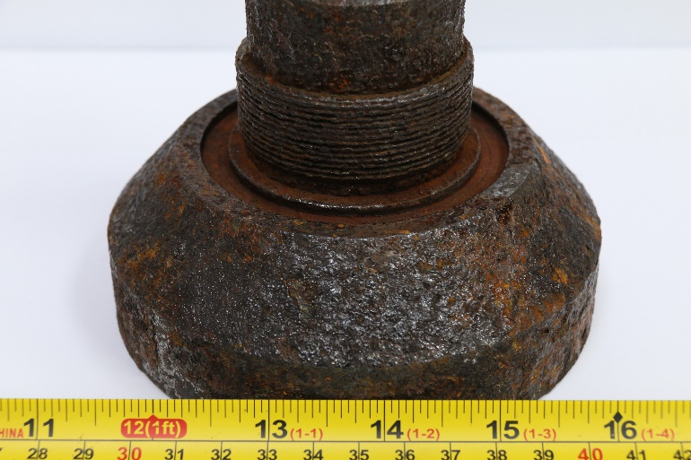
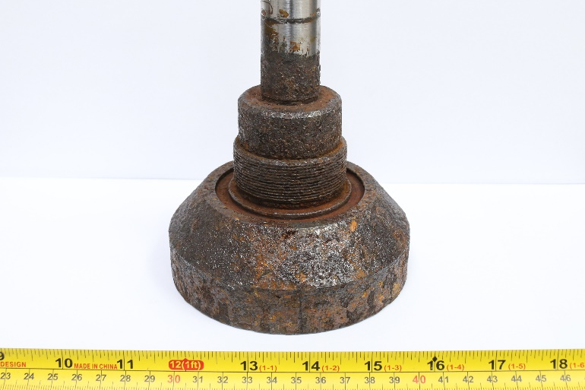
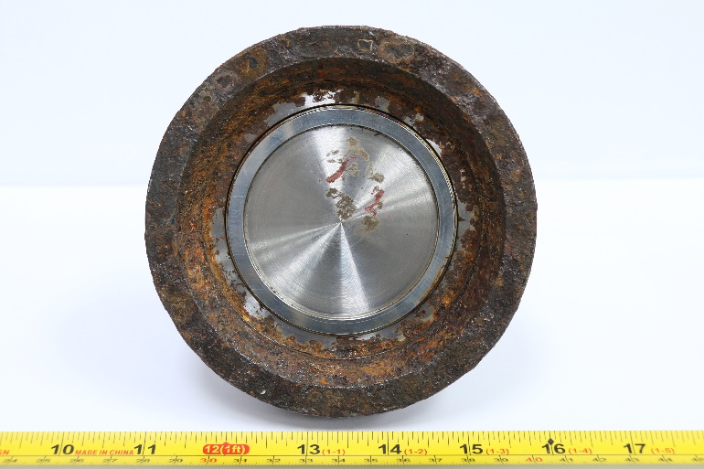
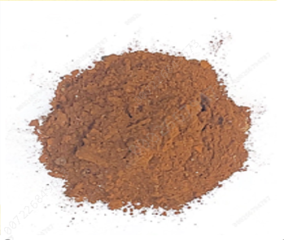
Laboratory Failure Analysis
    Methodology
Optical microscope, Stereoscopy, X-ray florescence spectroscopy (XRF), Carbon-sulphur (CS) analyzer, X-ray diffractometer (XRD), scanning electron microscope (SEM) as well as energy dispersive spectroscopy (EDS) were employed for this investigation.
Scanning Electron Microscopy (SEM) and Energy Dispersive Spectroscopy (EDS) analysis were performed on the as polished condition of the tube in order to identify presence of phases, precipitates and creep voids.
    Visual Inspection
Internal condition of the PSV as found during the testing in the workshop is shown in the photos. PSV parts that are made of 2Cr13 (420 SS) were found more affected by corrosion. Components made of SS 304 show less degradation.
The lower portion has a rough surface with a scale of corrosion products which prevented the PSV from opening during the planned testing.
Figure: Condition of the PSV parts as found during test and calibration at workshop.

Slide 7
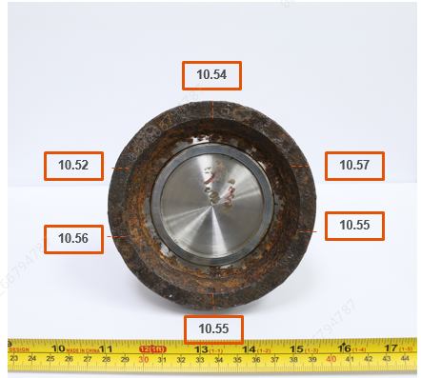
    Dimensional Measurement
    Materials Chemical Composition
Disk Holder
Elements | Conc % | ASTM A240 SS420
Fe | 85.27 | --
Cr | 12.95 | 12-14 %
Si | 0.47 | 1 max
Mn | 0.46 | 1 max
Ni | 0.32 | 0.75 max
C | 0.21 | 0.15 min
Cu | 0.09 | --
V | 0.08 | --
Mo | 0.05 | 0.5 max
Al | 0.04 | --
P | 0.04 | 0.04 max
S | 0.01 | 0.03 max
Corrosion products
Formula | Conc %
Fe₂O₃ | 63.73
Cr₂O₃ | 16.53
NiO | 6.01
S | 4.11
C | 3.04
SiO₂ | 1.84
Al₂O₃ | 0.945
CaO | 0.927
Na₂O | 0.72
MgO | 0.42
P₂O₅ | 0.362
Cl | 0.33
ZnO | 0.288
CuO | 0.241
Thickness profile of the PSV holder
Semi Quant | Ref. Code | Compound Name | Chemical Formula
Major phase | 03-065-1388 | Chromium Oxide | Cr O₃
 | 01-075-0611 | Pentlandite | Fe Ni S₂
Major phase | 01-079-0416 | Magnetite | Fe₃ O₄

Slide 8
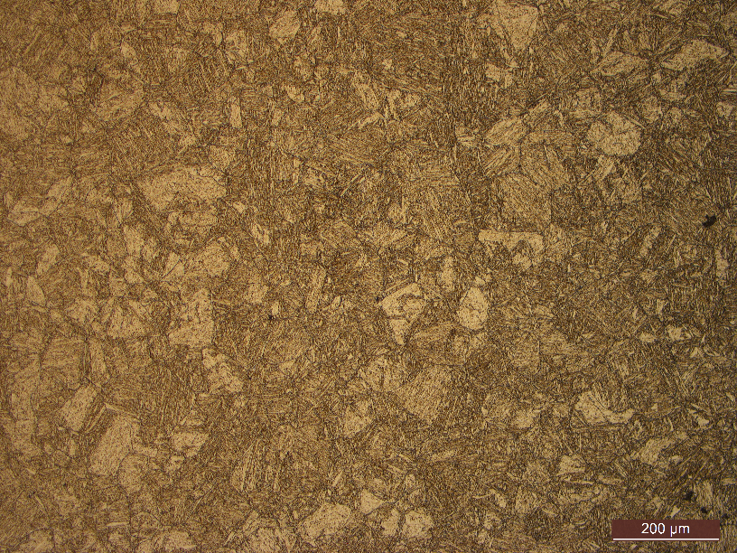
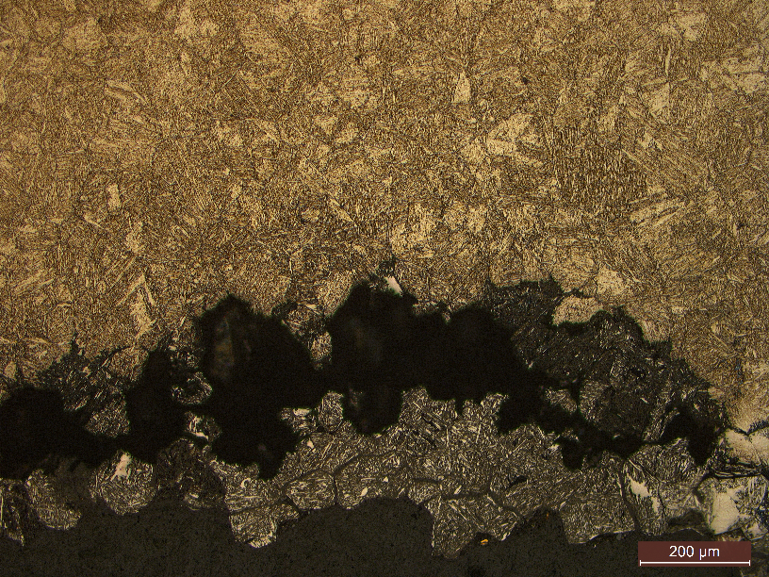
    Microstructure Examination
The microstructure which is mainly martensitic with bright islands which are possibly retained austenite
Microsture of the sample after etching at a magnification of 100x and 500x
Microstructure of the corroded areas observed under optical microscope

Slide 9
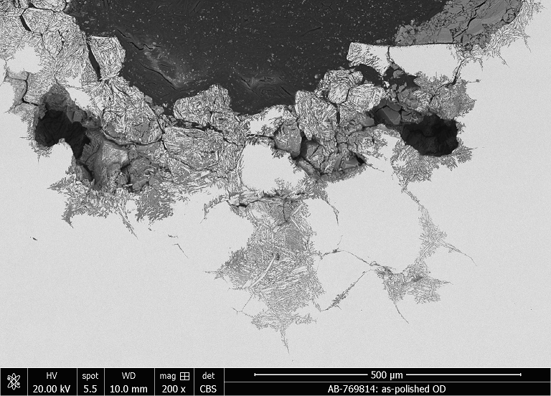
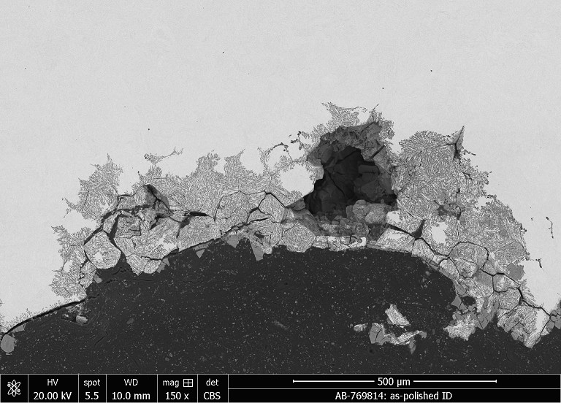
    SEM/EDS Examination
    Examination as polished
SEM analysis shows several intergranular cracks and pitting
Also observed is the degradation of the grains
Intergranular cracks
Pits
Pits
Pits
Grain degradation
Figure: Images showing the corrosion morphology of disc holder under SEM

Slide 10
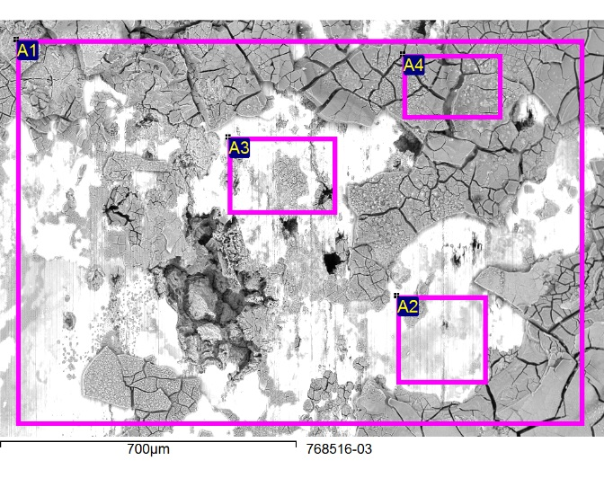
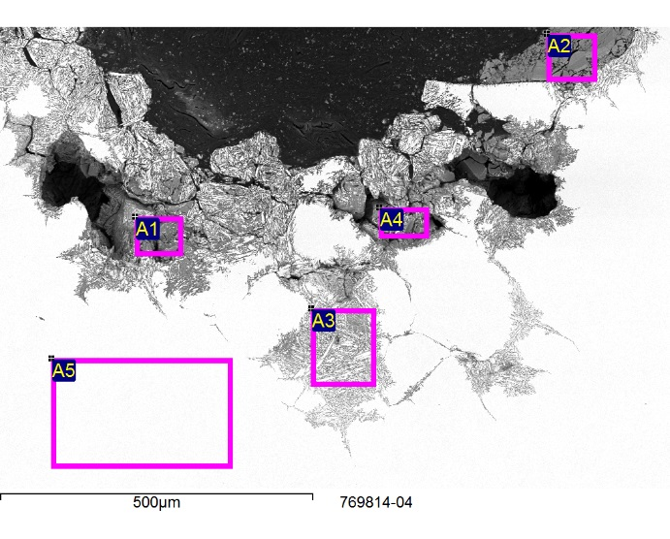
    As Received Condition
    As polished
The elemental composition of the deposits found on the disc holder surface indicate similar results with those found when analysing the corrosion products recovered inside the PSV by XRF/XRD. Scales are mainly composed of Iron, Oxygen, Chromium and Carbon with presence of considerable amount of Sulphur.
Chemical analysis of the corroded surface after preparation indicated presence of multiple pits filled with iron and chromium oxides. High amount of Sulphur was found inside the pits and between the grain boundaries where a form of intergranular corrosion and cracking causing grains dissociation was noticed. High carbon and chromium content was observed at the OD surface.
Spect. | C | O | Si | S | Cr | Mn | Fe | Ni
A1 | 5.63 | 38.09 | 0.77 | 3.21 | 16.46 |  | 35.39 | 0.44
A2 | 5.98 | 31.10 | 0.51 | 1.46 | 10.18 | 0.37 | 49.88 | 0.52
A3 | 6.33 | 27.92 | 0.59 | 2.34 | 15.50 |  | 47.03 | 0.28
A4 | 5.97 | 54.99 | 1.34 | 5.11 | 15.36 |  | 16.30 | 0.95
Spect. | C | O | Na | Si | S | Ca | V | Cr | Mn | Fe | Cu
A1 | 8.17 | 36.21 | 0.37 | 2.03 | 3.56 |  |  | 26.12 |  | 23.54
A2 | 20.80 | 49.34 |  | 0.46 | 5.05 |  | 0.15 | 20.29 |  | 3.66 | 0.25
A3 | 8.34 | 20.55 |  | 0.55 | 2.11 | 0.19 |  | 18.18 | 0.52 | 49.58
A4 | 8.59 | 36.24 | 0.30 | 2.84 | 4.24 |  |  | 24.03 |  | 23.77
A5 | 6.43 |  |  | 0.51 |  |  |  | 12.29 | 0.52 | 80.25

Slide 11
    Conclusions
The PSV disc holder, made of 2Cr13, meets the Chinese standard (GB-T-1220) and AISI 420 SS specifications.
The construction material of the internal parts of PSVs (2Cr13) is deemed unsuitable due to its potential exposure to corrosive environments containing sulfur and chlorides.
The construction of PSVs downstream piping using stainless steel 304 is insufficient due to the presence of acid gases, which can cause pitting and stress corrosion cracking.
PSVs at some plants discharge clean process water into the wastewater header, a loss, while similar plants return water to the process water tank.
PSV blockage is caused by corrosion products containing iron and chromium oxides, which result from the internal parts' corrosion mechanism.
The microstructure which is mainly martensitic with some retained austenite.
SEM analysis shows several intergranular cracks and pitting, Also observed is the degradation of the grains

Slide 12
Recommendations
To prevent corrosion of the internal parts of the PSV and avoid similar blockage scenario, one of the following recommendations should be implemented:
Upgrade the PSVs body and internal parts material of construction to ASTM 904L (UNS: N08904) which is a low carbon high-alloy austenitic stainless steel intended for use under severe corrosive conditions (attacks in acidic environments). The downstream piping must be upgraded to more resistant carbon steel as well as the wastewater header.
Install a non-metallic (example: graphite) rupture disc directly downstream PSVs A and PSVs B to prevent the acid gases to reach the PSV internal parts. The downstream piping should be upgraded to higher specification as it will be still subject to corrosion.
Re-direct the PSVs discharge piping to the process water tank instead of the wastewater header similarly to other EG plants. This option will avoid upgrading the PSVs and the downstream piping to higher resistant alloy. This will save considerable volume of clean water which could have been discharged to the waste steam in case of PSV opening.

Slide 13
References
API 571: Damage Mechanisms Affecting Fixed Equipment in the Refining Industry
GB-T-1220: Stainless Steel Bars (Chinese Standard)
ASTM A0276/A0276M-23 Standard Specification for Stainless Steel Bars and Shapes
BS EN 10088-3:2005 Stainless steels Part 3: Technical delivery conditions for semi-finished products, bars, rods, wire, sections and bright products of corrosion resisting steels for general purposes
ASM Handbook Volume 13 - Corrosion
ASM Handbook Volume 11 - Failure Analysis and Prevention
ASM Metals Handbook Volume 12 - Fractography
SABIC Manual _ Static Equipment Failure Prevention and Avoidance_V1

Slide 14


JUBCOR
2024
CONFERENCE & EXHIBITION
INNOVATIVE SOLUTIONS FOR CORROSION CHALLENGES
THANK YOU
Reach out.
Phone
+966554612515
Email
Alharbiaaa@SABIC.com

