Slide 1
JUBCOR
2024
CONFERENCE & EXHIBITION
INNOVATIVE SOLUTIONS FOR CORROSION CHALLENGES
Presented By: Muhammad Nawaz Hussian
Jubcor Presentation
Adding Value Through Chemistry

Slide 2
PTA-SCC in Pre Heater coil
POLYTHENIC ACID STRESS CORROSION CRACKING

Slide 3
TABLE OF CONTENT
Introduction to Farabi
Background of Process
Problem Statement
Investigation
Results of Inspection
Root Cause
Recommendations
Discussion

Slide 4
Farabi Petrochemicals
Farabi Petrochemicals Group, located in the Kingdom of Saudi Arabia (KSA) is a global major in Linear Alkyl Benzene (LAB) & N-Paraffin business.
Farabi Group Comprises of Farabi Petrochemicals company (FPC), Farabi Yanbu Petrochemicals Company (FYPC), Farabi Downstream company (FDC), HADAF International Energy Company (HADAF) and Farabi Marketing company (FMC), located at Jubail and Yanbu Industrial cities of KSA.
Farabi today operates two world scale Normal Paraffin plants, and 3 world scale LAB plants, in addition to its specialty oils and specialty chemicals plants at Yanbu & Jubail. Farabi is the largest N-Paraffin and the second largest LAB Producer in the world today.
With the Commissioning of its new complexes at Yanbu & Jubail in 2020, Farabi today has a broad portfolio of around 1 million tons per year of Petrochemical intermediates and Specialty Surfactants.

Slide 5
Background of process

Slide 6
Background of process

Slide 7
Background of Process
Furnace Design & Operating Parameter
Material: SA 312 TP 310 S
Diameter: 89 mm
Thickness: 4.5 mm
Pressure: 3 bar
Temperature: 780 C
Process Fluid: Hydrocarbons

Slide 8
Background of process

Slide 9
Background of Process
Material: SA 312 TP 310 S
Diameter: 133 mm /89 mm
Thickness: 4.5 mm
Pressure: 3 bar/ 1 bar
Temperature: 600 C/ 800
Process Fluid: Hydrocarbons

Slide 10
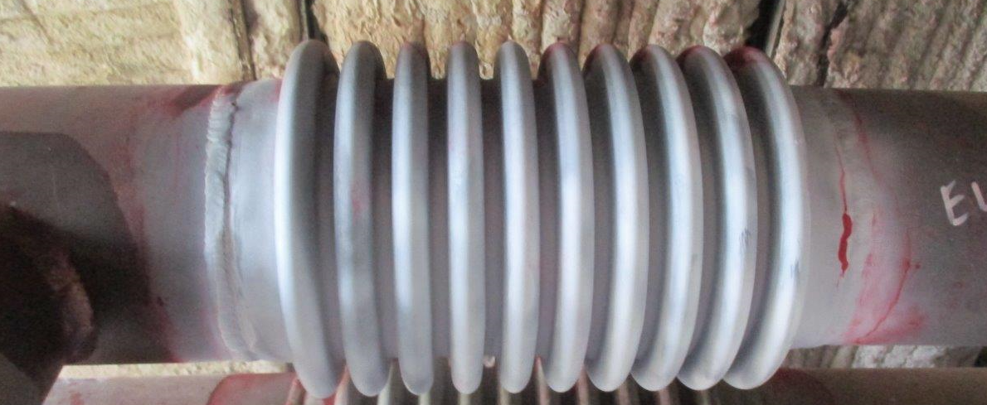
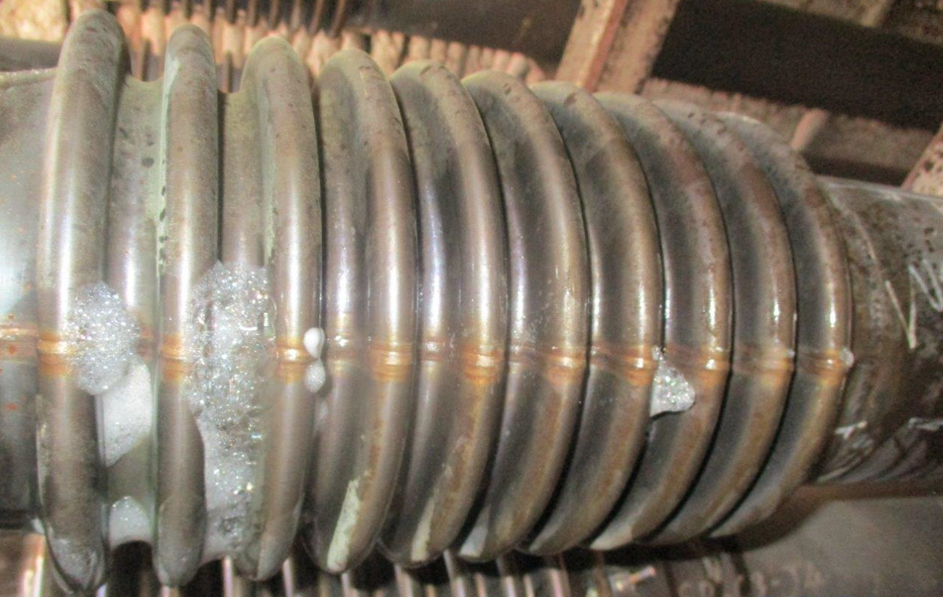
Problem Statement
Found Cracks during start up
Location of cracks: On bellow/On welds of Bellow to pipe

Slide 11
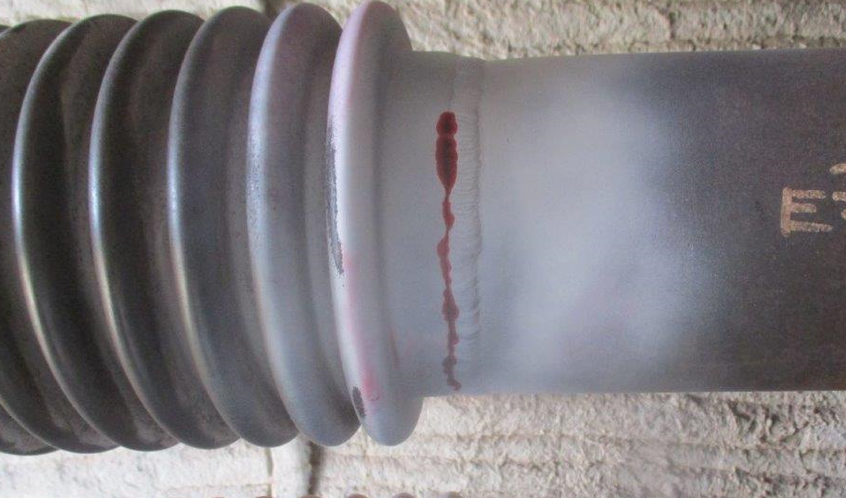
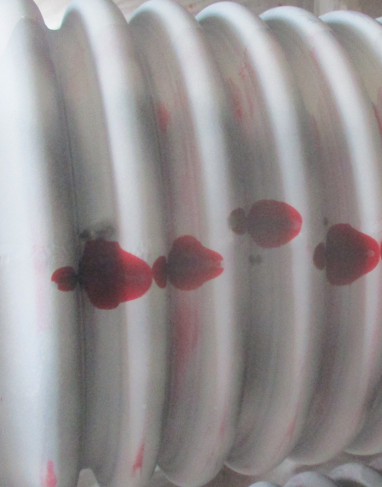
Problem Statement

Slide 12
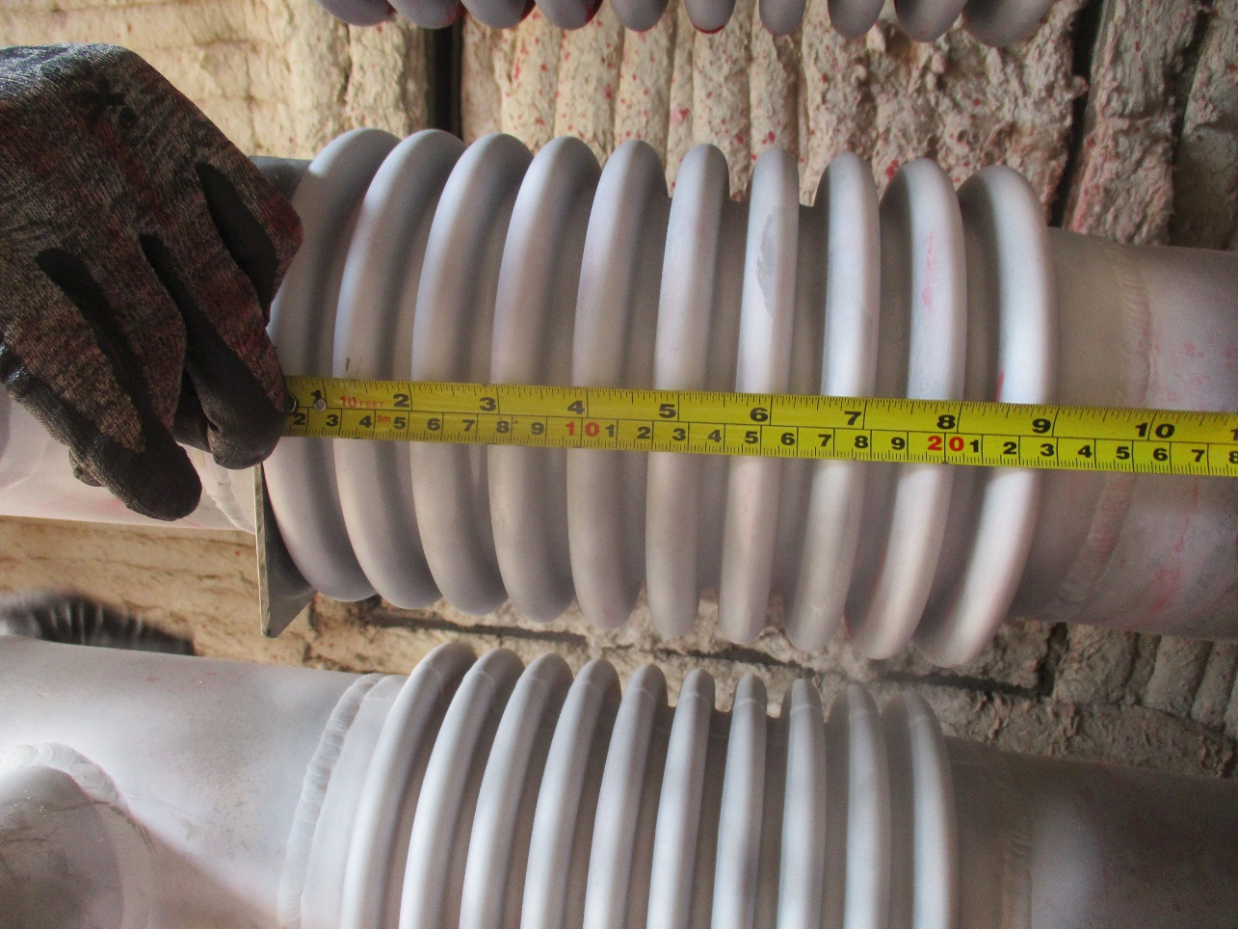
Investigation
Visual
Dimensional
Metallography
SEM and EDS analysis
Chemical Analysis
Hardness testing

Slide 13
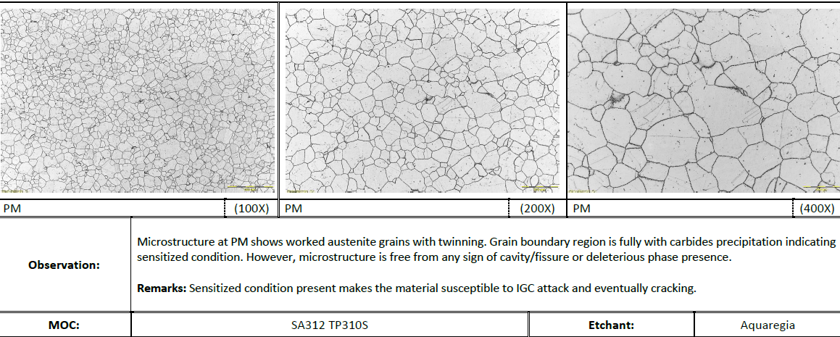
Results of Inspection
Cracking
Sensitization

Slide 14
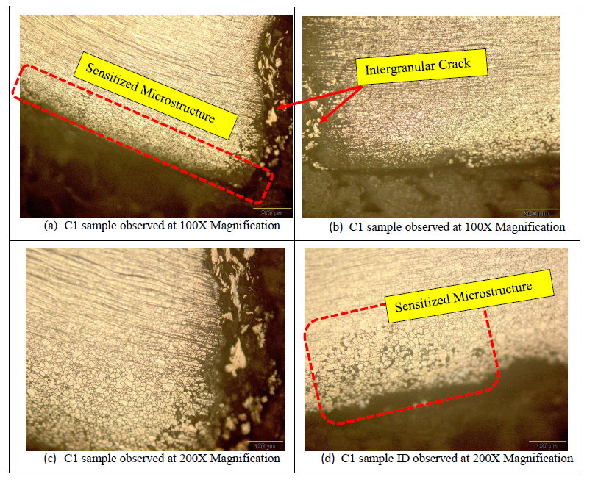
Results of Inspection

Slide 15
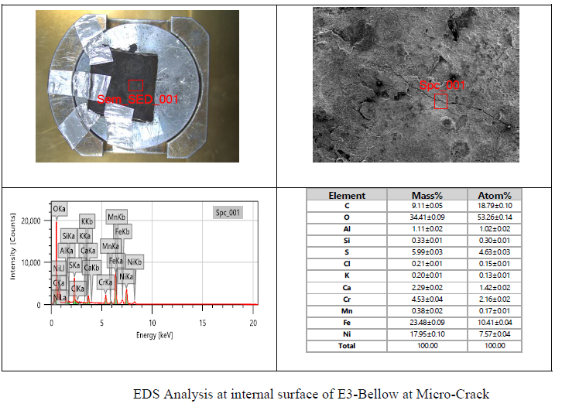
Results of Inspection

Slide 16
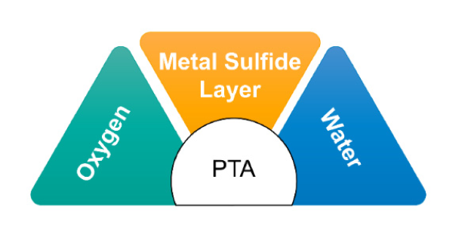
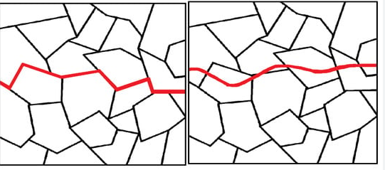
Root Cause

Slide 17
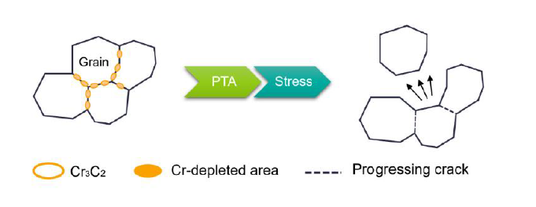
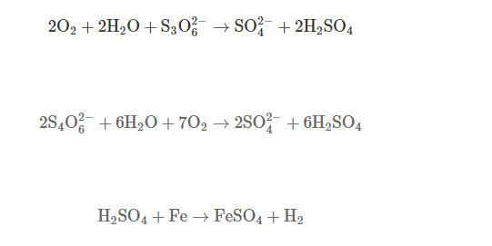
POLYTHIONOIC ACID STRESS CORROSION CRACKING

Slide 18
Mitigations and their Results???
Metallurgy
Austenitic Stainless steel
Solution Annealing
Nitrogen Purging
Mitigation
Dry Air Purging
Alkaline washing
Stabilization Heat Tretmen

Slide 19
Questions???

Slide 20
JUBCOR
2024
CONFERENCE & EXHIBITION
INNOVATIVE SOLUTIONS FOR CORROSION CHALLENGES
THANK YOU
Reach out.
Calle Cualquiera 123, Cualquier Lugar
+966133565874
hussainmn@farabipc.com

