Slide 1





JUBCOR
2024
CONFERENCE & EXHIBITION
INNOVATIVE SOLUTIONS FOR CORROSION CHALLENGES
Presented By: Dharmesh Patel
Jubcor Presentation
Tube to tubesheet joint failure in Thermal Reactor Waste Heat Recovery Boiler
SAUDI ARAMCO TOTAL Refining and Petrochemical Company, Al-Jubail, Saudi Arabia

Slide 2



Presentation Agenda
SATORP – Company Overview
Failure Introduction
Failure details and Inspection findings
Root cause analysis details
Summary

Slide 3
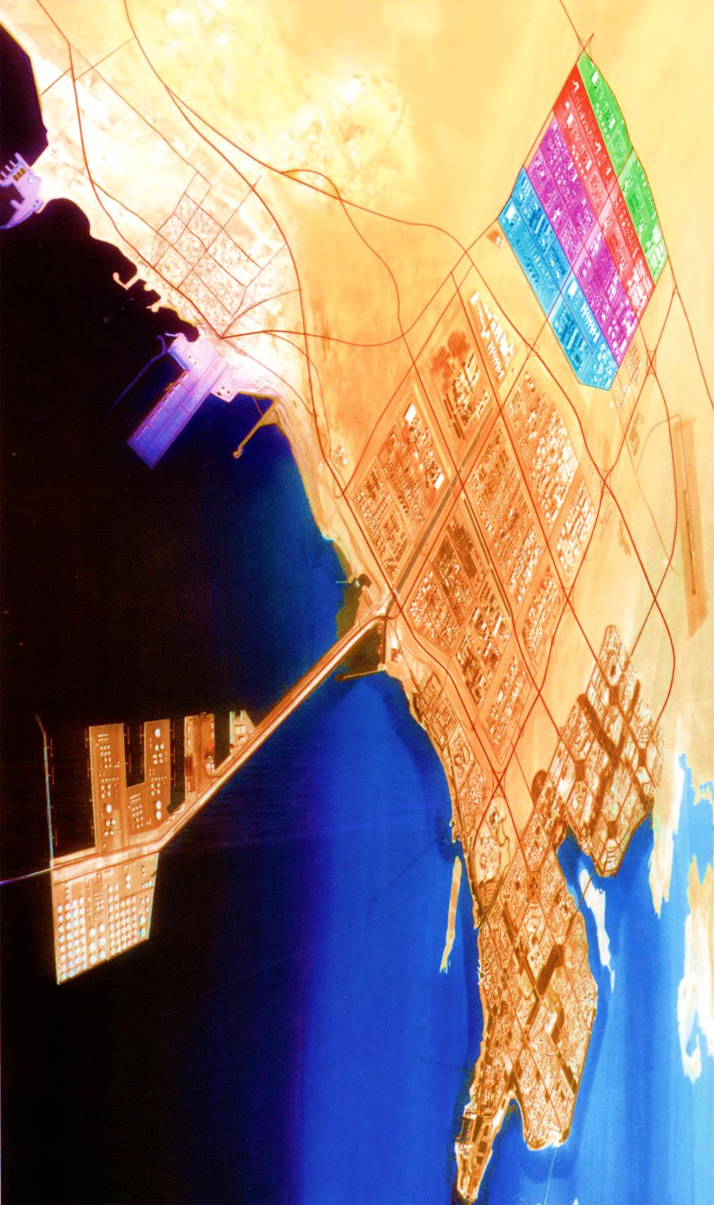
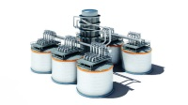



SATORP - Company Overview
SATORP – SAUDI ARAMCO TOTAL Refining and Petrochemical Company is an oil refinery and petrochemical company in Jubail Industrial Area II, Saudi Arabia.
SATORP produces refining commercial products, petrochemical commercial products, and By-products as Pet Coke and Sulphur to the local and international market. SATORP processes 440,000 BPSD of Arabian Heavy in a high conversion refinery scheme.
SATORP Refinery
Jubail II
Jubail I
Jubail Residential Area
Coke Conveyor 26km
Berry GP
Coke Handling
King Fahad Industrial Port
Refrained Product Berths

Slide 4
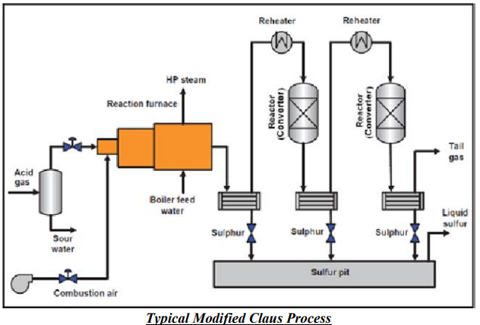
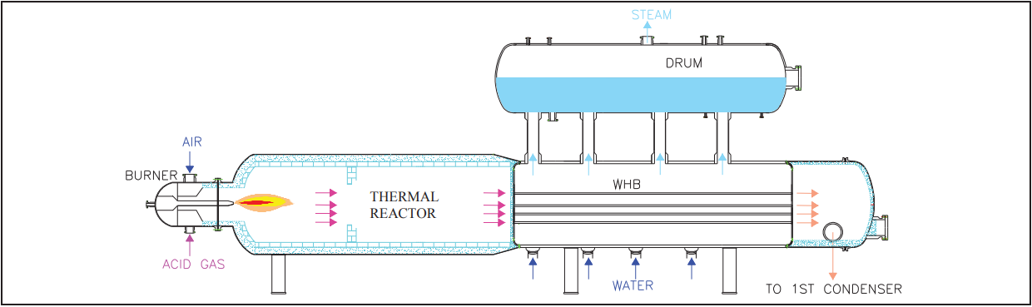
Introduction
Sulfur Recovery Unit is based on Modified Claus Process consists in sub-stoichiometric combustion of the acid gas, which is mainly constituted of H2S, H2O, CO2, CO, NH3 and hydrocarbons at high temperature in the Thermal Reactor followed by catalytic conversion in Claus Reactors.
Thermal Reactor double zone configuration, an axial-symmetric chamber internally refractory lined to prevent overheating on vessel walls. Waste Heat Boiler is directly connected with the Thermal Reactor; process gas is evenly distributed in the horizontal tubes, whereas on shell-side water is in boiling conditions. Waste Heat Boiler tube sheet is also refractory lined and provided with Ferrules and Hexagon assembly to protect tube sheet from exposure to high temperature process gas.

Slide 5
Introduction
Typically, Thermal Reactor WHB is straight tubes, fixed tube sheet and directly connected with Thermal Reactor & Steam Drum with risers and downcomers.
Leaks and failures of heat exchangers are common but such leak in WHB involves high maintenance and repair costs with other plant operation consequences.
Design Data of Thermal Reactor (Refractory lined)
Service | Process Gas
Operating Pressure | 0.66 Bar g
Operating Temperature | 1250 °C (300 °C Wall)
Design Pressure | 7 Bar g
Design Temperature | 1400 °C (350 °C Wall)
Design Data of Waste Heat Boiler
 | Shell Side | Tube Side
Service | BFW / HP Steam | Process Gas
Operating Pressure | 47 Bar g | 0.66 Bar g
Operating Temperature | 261 °C | 334 °C (Wall)
Design Pressure | 52 Bar g | 7 Bar g
Design Temperature | 275 °C | 370 °C (Wall)

Slide 6
Failure Details and Inspection findings
On 2nd September 2019, Operations and Process Engineering team members identified a mass balance discrepancy between the Boiler Feed water and the Steam generation in the WHB of Unit 221.
By 16th September 2019, the leak was confirmed and a it was decided to keep the unit running until the upcoming train 2 T&I in January 2020, with a leak progress monitoring in place.
However, on 25th November 2019, due to a power failure, the unit went to shutdown and could not be restarted. Decision was made to carry out a temporary repair until the planned T&I in January 2020. During the T&I, a major repair was performed on the tubesheet where 21 Tube to tubesheet (TTS) welds were repaired and 11 tubes were plugged after 4 Hydrotest attempts.
Unfortunately, the leak reappeared on 4th May 2020, and the unit was shutdown on 28th June 2020 for repair.

Slide 7
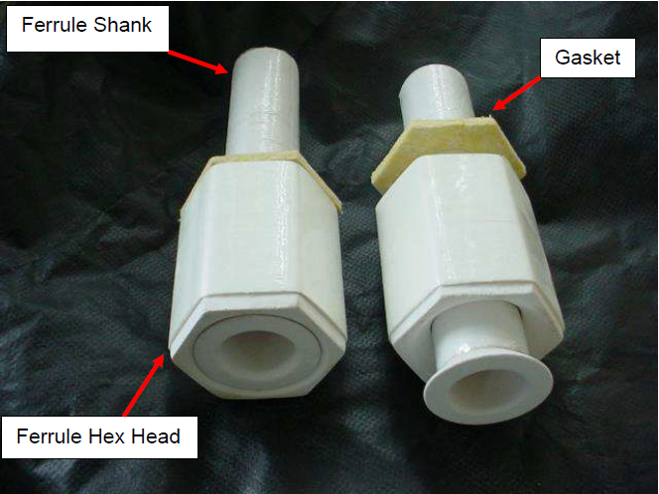
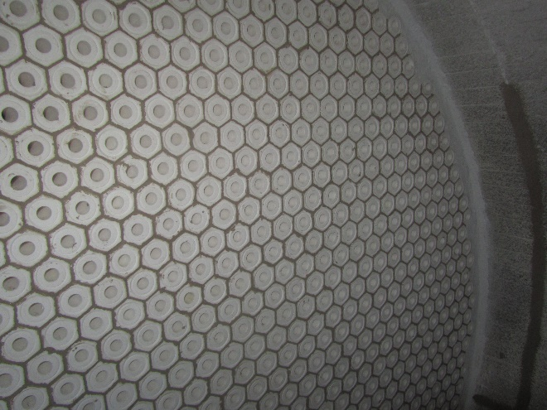
Failure Details and Inspection findings
Thermal Reactor Waste Heat Boiler tubesheet is refractory lined and provided with Ferrules and Hexagon assembly to protect tube sheet from exposure to high temperature process gas. Refer below figures.
Tube to tubesheet joints are light expanded with strength weld.
The cracks between the Hex-heads and broken ferrules can expose the tube sheet to high temperatures. The tubesheet is of CS metallurgy and can be subjected to high temperature sulfidation and mechanical damage.
Ceramic Ferrules (Typical) | Ferrules installed on Tubesheet

Slide 8
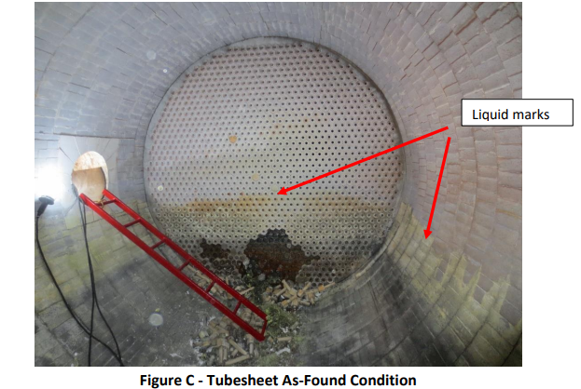
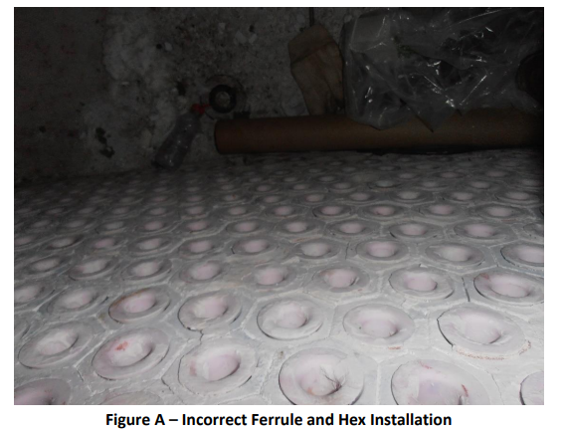
Failure Details and Inspection findings
Ceramic Ferrules were found broken/cracked in the bottom five rows of the Tube sheet. Also, multiple ferrules inserts were not inserted properly. These conditions allow the hot gas to bypass to the tubesheet resulting in sulfidation of the TTS welds and tubesheet as mentioned above.
During shell side water leak test, massive leak was observed in the bottom rows. At the leak location, Refractory Hex-Heads had fallen down and Ferrules broken.
Leaky tubes are identified and plugged followed by Refractory repair on tubesheet.

Slide 9
Root cause analysis
The causal factors:
Mistakes or failures that, if corrected, could have prevented the incident from occurring or would have significantly mitigated its consequences.
Mechanical Failure of tube to tubesheet welds
2. Tubesheet subjected to overheating
3. Incorrect installation of tubesheet refractory components
4. Incomplete inspection and repair
5. High number of unit trips and shutdowns

Slide 10
Root cause analysis
Root causes:
The most basic cause (management systems), that management has control to fix, and when fixed, will prevent (or significantly reduce the likelihood or consequences of) the problem's recurrence.
Inadequate Quality Assurance/Control
Inadequate Procedures
Repeated Failures
Inadequate Accountability
  Roles and responsibilities not clear

Slide 11
Summary
As a result of detailed RCA, various recommendations were issued in order to avoid recurrence of such failures in future. Below are the brief summary of the recommendations and corrective actions.
MOC was issued to procure a new WHB including new refractory components for the tubesheet and was replaced during Turnaround 2023.
Specific Inspection procedure was developed to establish the guidelines for WHB tubesheet refractory inspection, assembly and installation.
This procedure also includes the inspection requirement for WHB tubesheet, such as Tubesheet preparation and inspection techniques, Tubesheet repair options and Tubesheet repair test pressures.
Other operational procedures were developed

Slide 12



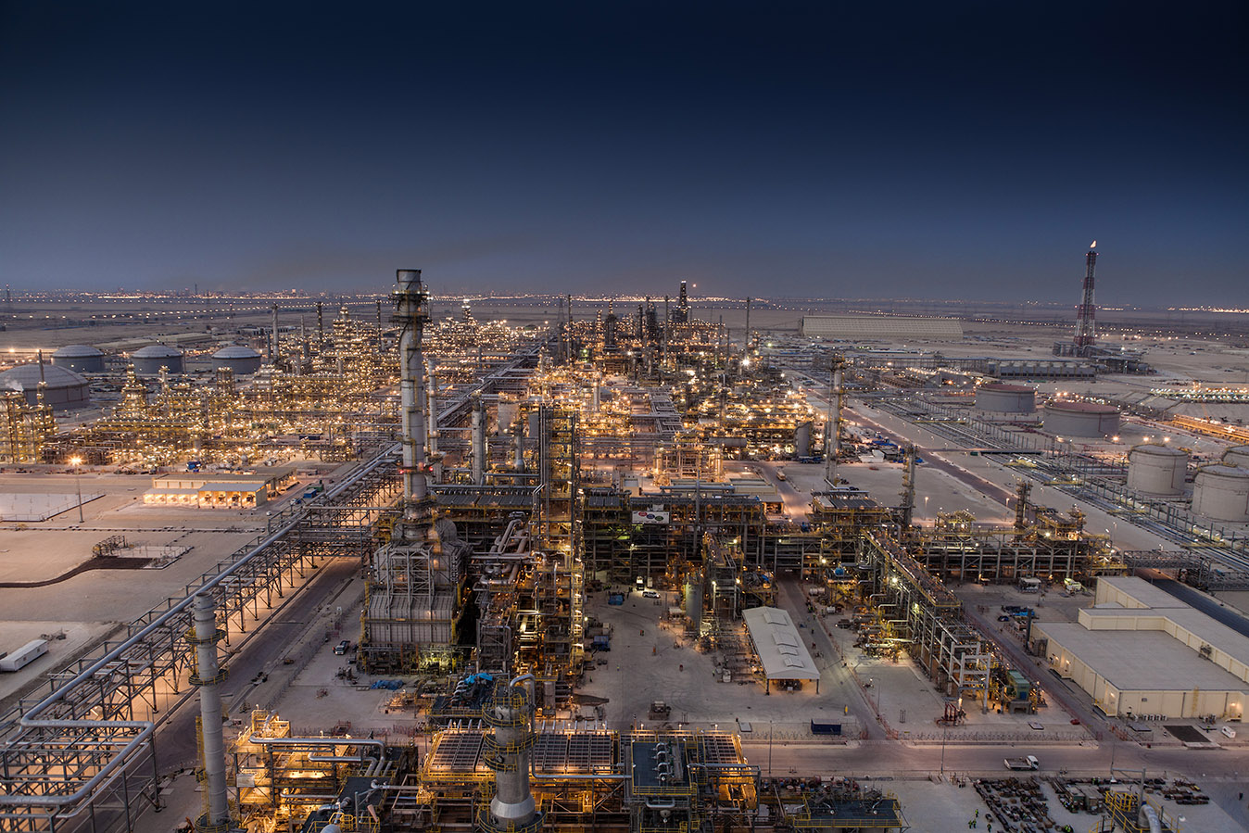
JUBCOR
2024
CONFERENCE & EXHIBITION
INNOVATIVE SOLUTIONS FOR CORROSION CHALLENGES
THANK YOU
Reach out.
+966133434507
Dharmeshkumar.patel@satorp.com

