Slide 1





JUBCOR
2024
CONFERENCE & EXHIBITION
INNOVATIVE SOLUTIONS FOR CORROSION CHALLENGES
Jubcor Presentation
Mohmmed Alnasser
Flexible Passive Fire Protection

Slide 2
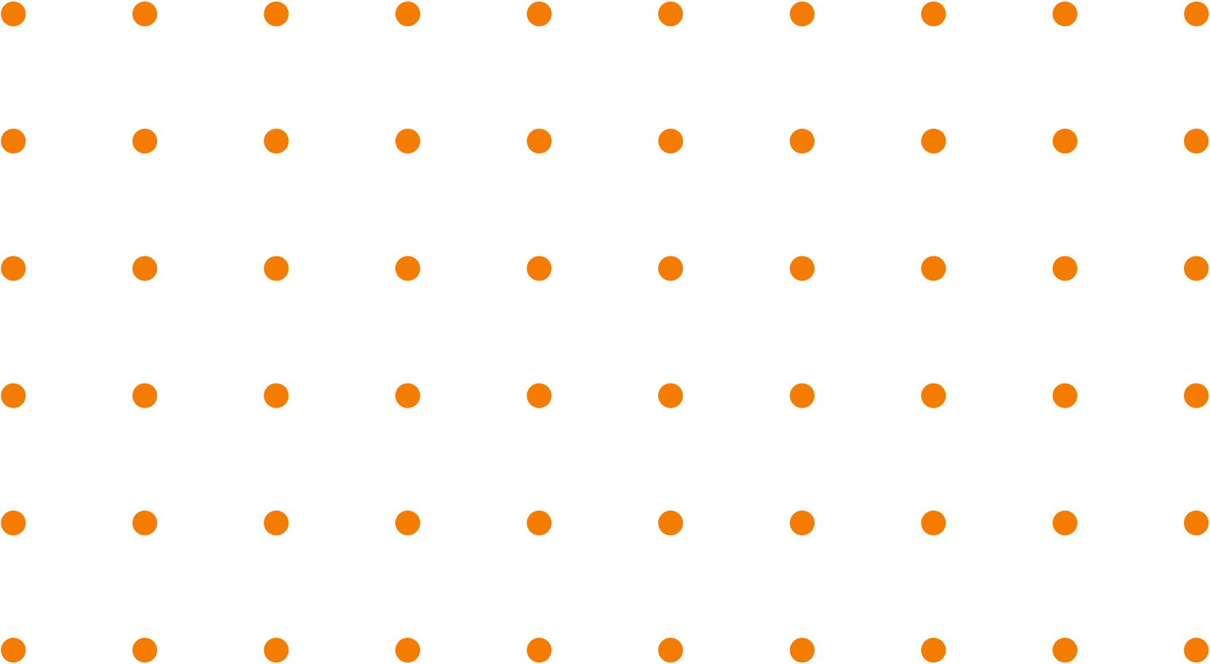
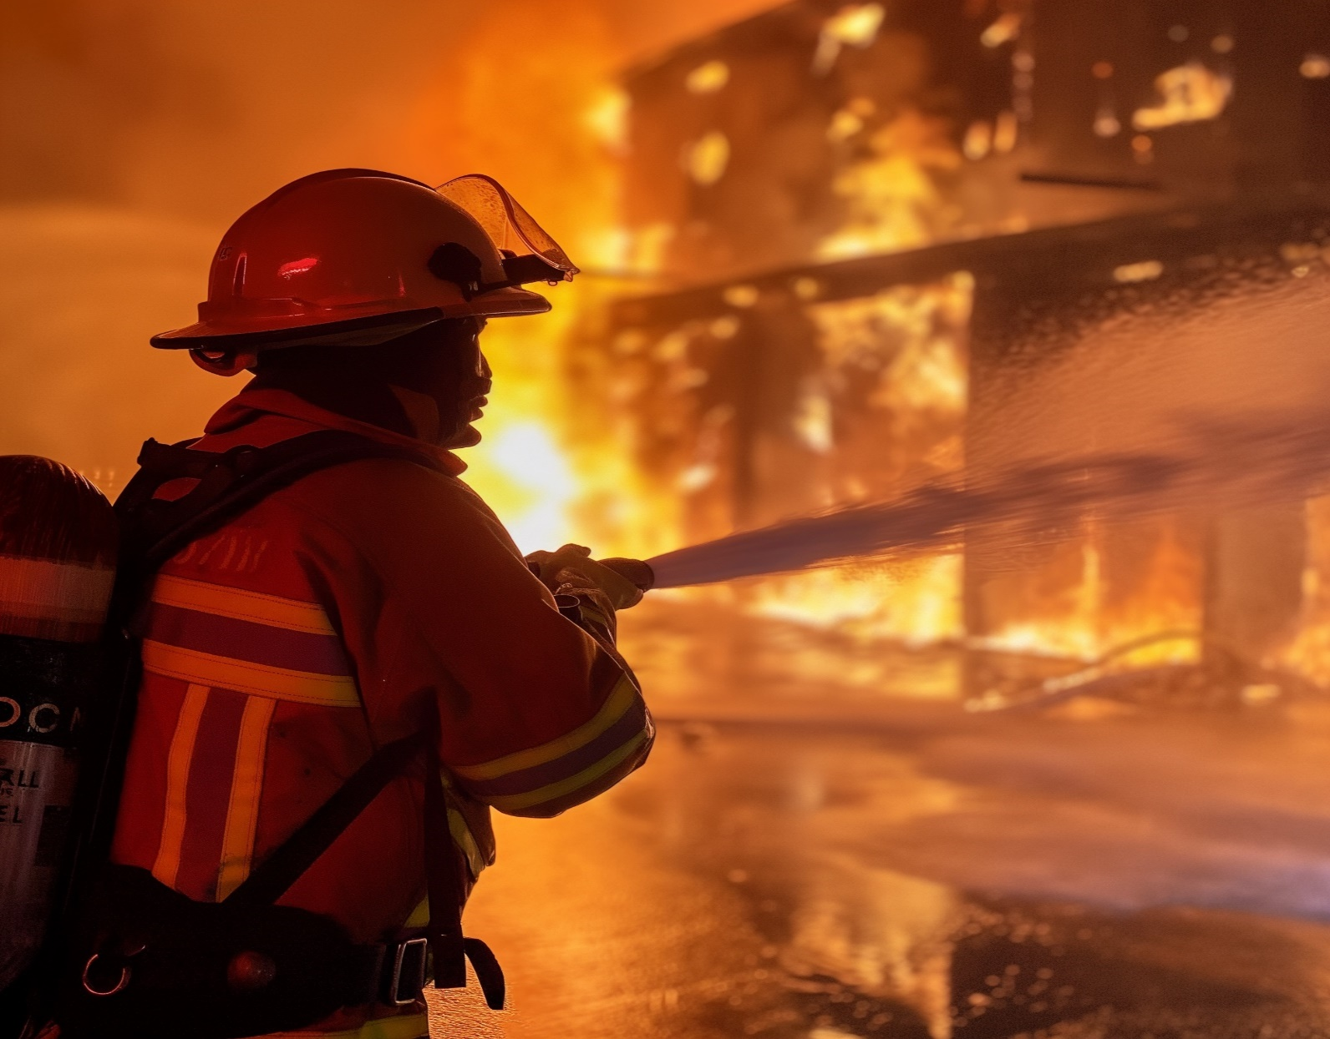
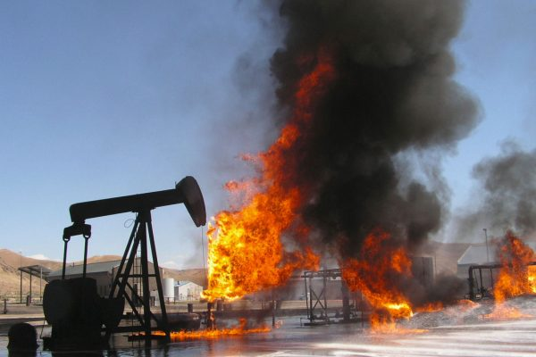

WHAT IS PFP
Passive fire protection Material (PFP) is crucial for preventing or delaying the spread of fire, thereby providing crucial time for evacuation and minimizing damage to property.
PASSIVE FIRE PROTECTION SOLUTIONS INCLUDE:
Cellulosic Fire
Hydrocarbon Fire

Slide 3



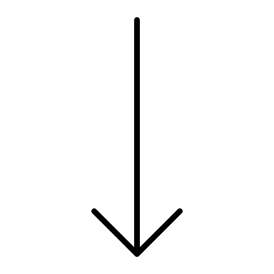
Type of Fireproofing | Cementitious Fireproofing | Waterborne Fireproofing | Solvent Based Fireproofing | Epoxy based Fireproofing
Appearance | Rough | Smooth | Smooth | Smooth
Application | Spray | Spray | Spray | Spray
Fire Resistance | Up to 3 Hrs | Up to 2 Hrs | Up to 3 Hrs | Up to 3 Hrs
Durability
Maintenance | Regular | No | No | No
Weight
Environment | Up to C5 | Up to C3 | Up to C5 | Up to C5
Flexibility
Corrosion Protection

Slide 4

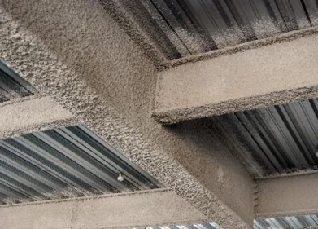
Cementitious Vs. Other PFP
Meet AESS* Finish Standard No. 3: Feature Elements in Close View – High decorative finish without sanding
Smooth surface after cured
Good appearance even without topcoat
Less weight, allowing lower transportation cost
No smoothing putty required
Approx. 20% labor/ cost saving
Cleaner, more durable aesthetic
Other PFP
Typical cementitious fire protection
*Architecturally Exposed Structural Steel
by The American Institute of Steel Construction (AISC)

Slide 5
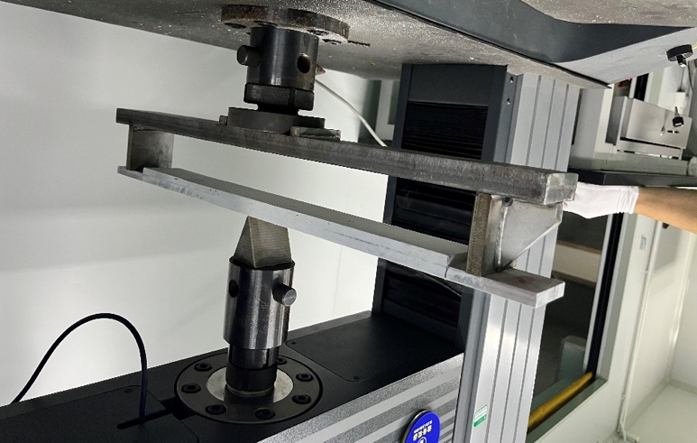
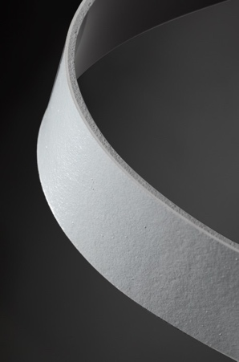
Flexibility
Provides good flexibility at harsh environment
No cracking after 30 cycles during cycle test vs. competitor (IP Interchar 212) cracked after 15 cycles
No cracking before 10.5mm displacement even at -40ºC vs. competitor (Jotun Steelmaster 1200HPE 5.0mm)
Benefits
Less damage during handling and transportation
Wider tolerance for application environment (especially at low temperature)
Save time & labor cost for repair
3-Point Bending Test

Slide 6
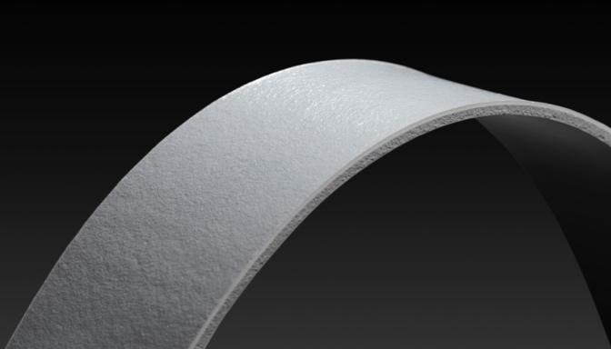
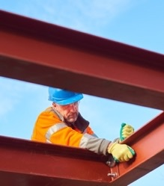
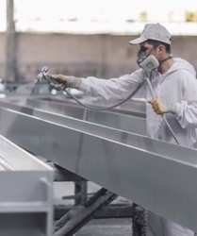
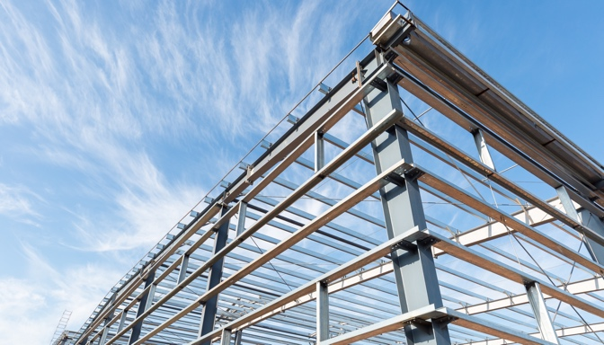



Key features – Application benefits
On-site / off-site application
Applied within 1 day / transferred to the site next day
Smooth and flexible finish
Designed for in-shop and on-site application by dry trowel, single or plural component airless spray.
Up to 3500 µm DFT in a single coat, cures rapidly for a quick and efficient building process.
Unrivalled in its outstandingly smooth, architectural finish.
More aesthetic option than
traditional cementitious products.
6

Slide 7
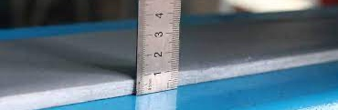
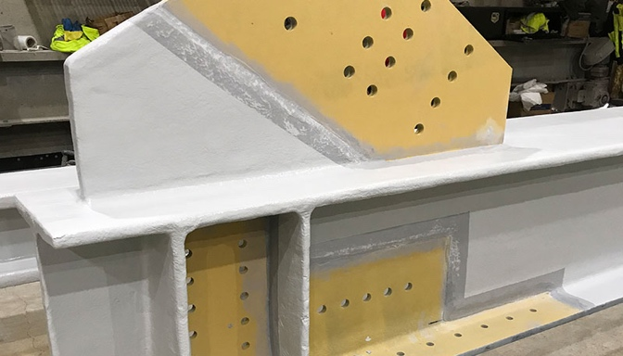
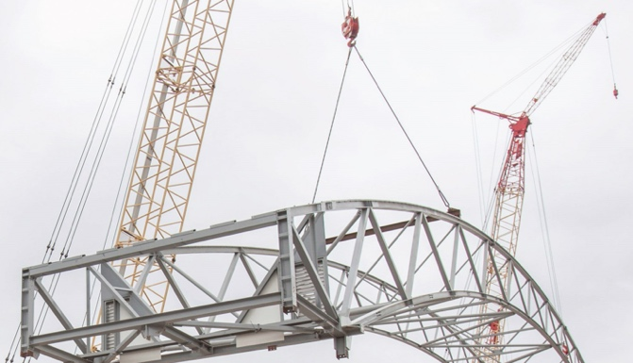
Key features – Application benefits
Best in class thicknesses in some ranges
Less conflicts on-site
Flexible surface providing excellent damage resistance
Highly competitive thicknesses, gives cost effective protection built with lower material and labour investment.
Reduced works on site, working at height, which also improves safety.
Flexible surface providing excellent damage resistance, easy for safe construction and transportation.
7

Slide 8
Key features – Benefits for applicators and installers
Best in class thicknesses in some ranges
Less conflicts on-site
Flexible surface providing excellent damage resistance
Highly competitive thicknesses, gives cost effective protection built with lower material and labour investment.
Reduced works on site, working at height, which also improves safety.
Flexible surface providing excellent damage resistance, easy for safe construction and transportation.

Slide 9



JUBCOR
2024
CONFERENCE & EXHIBITION
INNOVATIVE SOLUTIONS FOR CORROSION CHALLENGES
THANK YOU
Reach out.
phone
email

