Slide 1





JUBCOR
YOUR LOGO
2024
CONFERENCE & EXHIBITION
INNOVATIVE SOLUTIONS FOR CORROSION CHALLENGES
Presented By: Syed Shiraz Shams
Jubcor Presentation
Add a subtitle or the company tagline here

Slide 2


Contents
Introduction of Tank bottom CP System
Used of Titanium Expanded Mesh Anode
Performance Evaluation

Slide 3
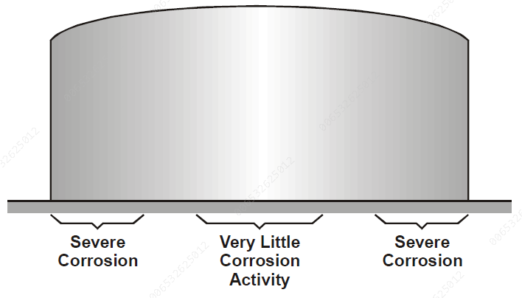
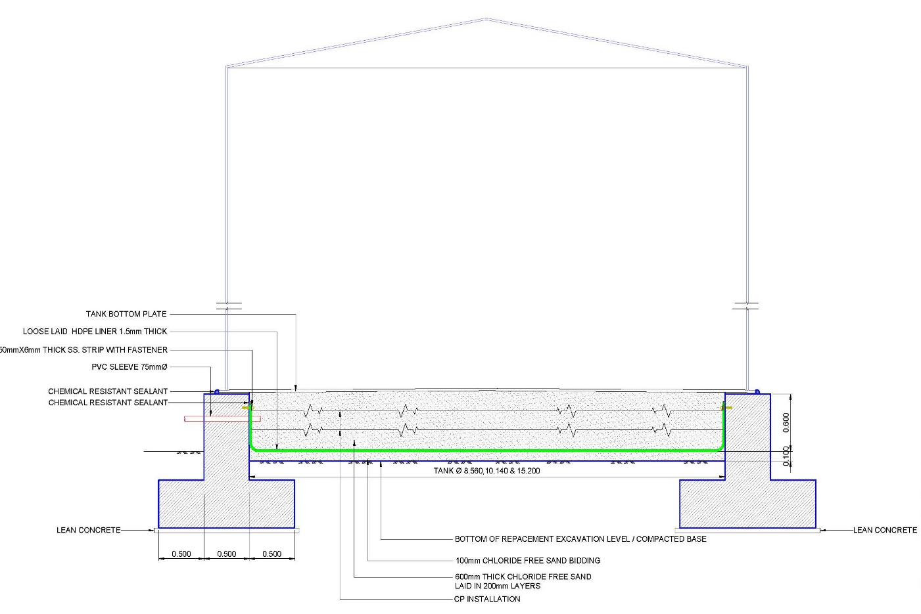
Cathodic Protection of Tanks
Cathodic Protection is one of the most effective techniques for controlling corrosion on both existing and new structures when the structures are continually in contact with soil or water.
Cathodic protection (CP) is typically applied to all above ground storage tanks built on a ring wall foundation to protect the external tank bottom in contact with the soil/sand foundation.
Cathodic protection (CP) is a cost effective technique used to eliminate soil side corrosion and hence can indefinitely extend the life of the tank bottom.
The primary objective in providing Cathodic protection for the external surface of storage tanks is to obtain uniform current distribution and hence uniform corrosion control.

Slide 4
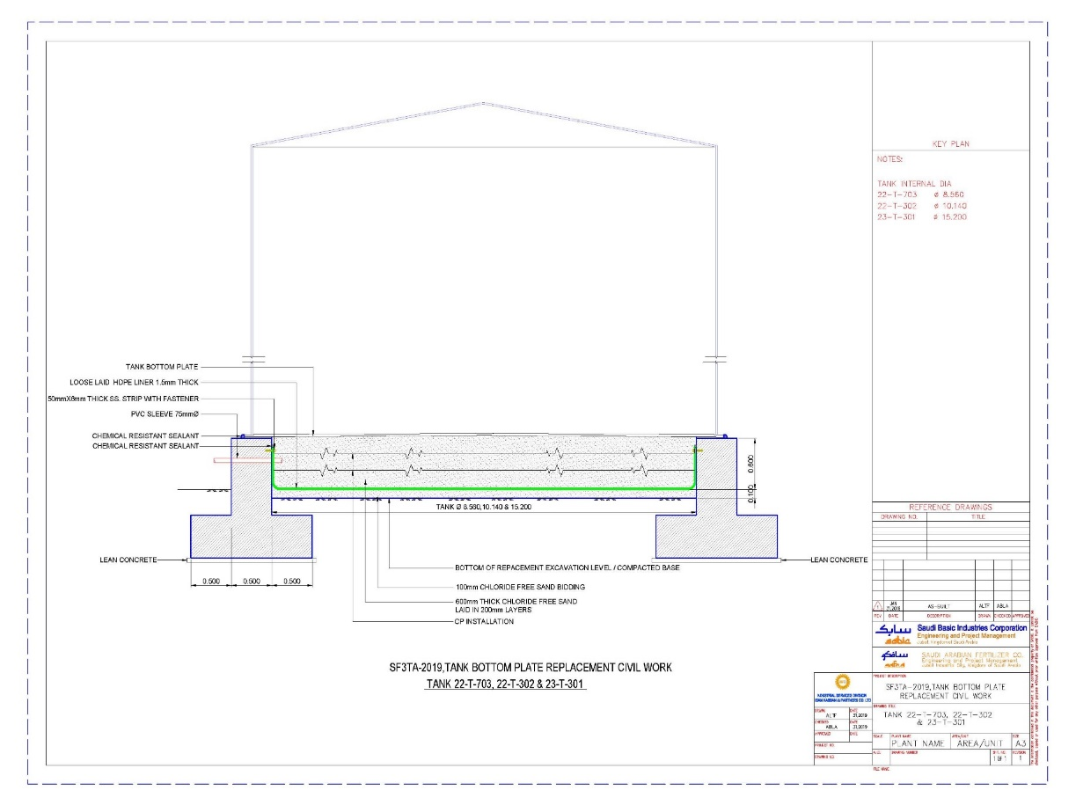
Basic design for Cathodic Protection of Tanks

Slide 5
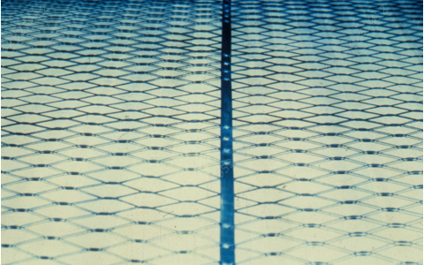
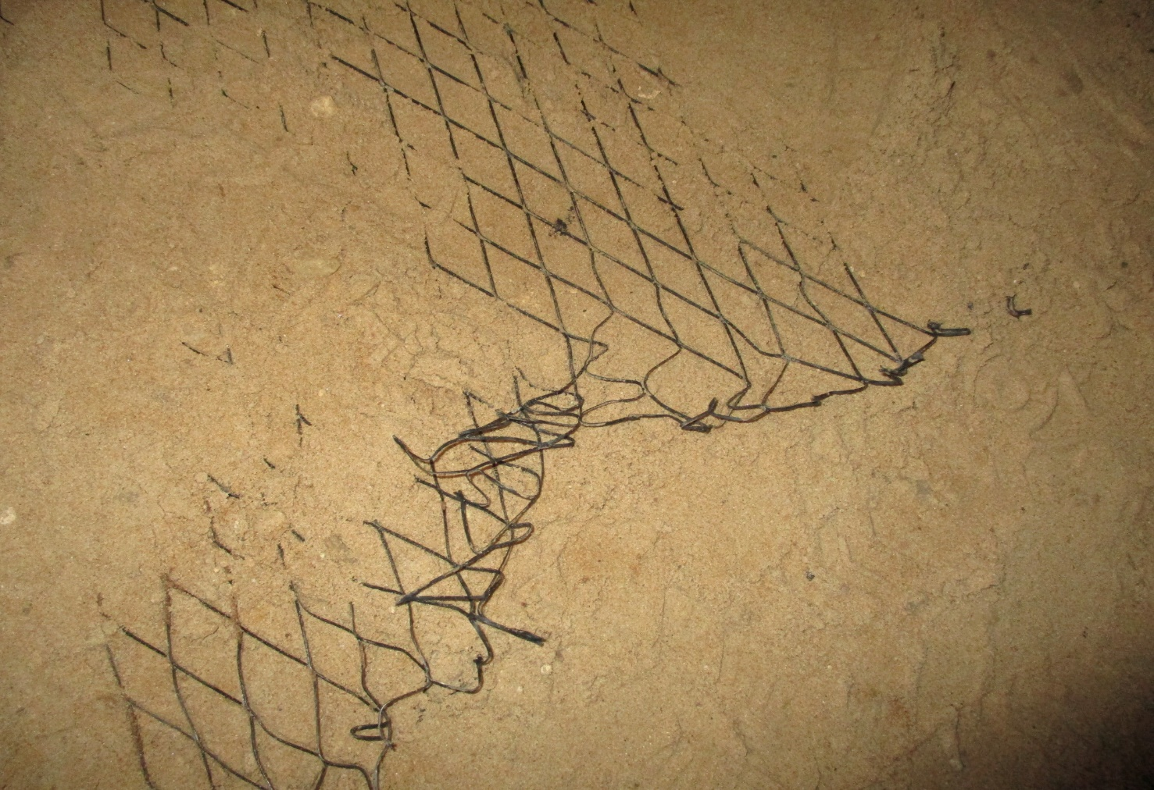
Activated Titanium Net Anodes
Tank bottom external protected with activated titanium net anodes.
Mesh/Net anodes typically installed in concrete structure due to strength, performance and current output capacity which covered maximum surface area, moreover the performance of net anode is reliable and rated design life is higher than other types of anode.
Net anodes is performing equally in dry and wet condition and it’s highly repulsive for chloride. Distribution of current is also very equal due to net and covering more area.
Moreover, recorded failure of CP system with Titanium net anodes is very less comparatively with MMO ribbon anodes due to lose connection with titanium conductor bar during installation as it has less number of connection point.
As per our assessment it Titanium anode is providing protection without any issue till 35 years.

Slide 6
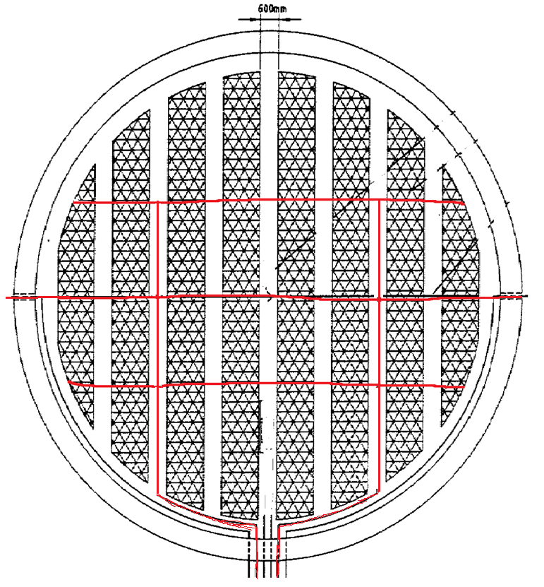
Severity vs design
Titanium Net Anode
Titanium Net Anode
Anode Feeder Box

Slide 7
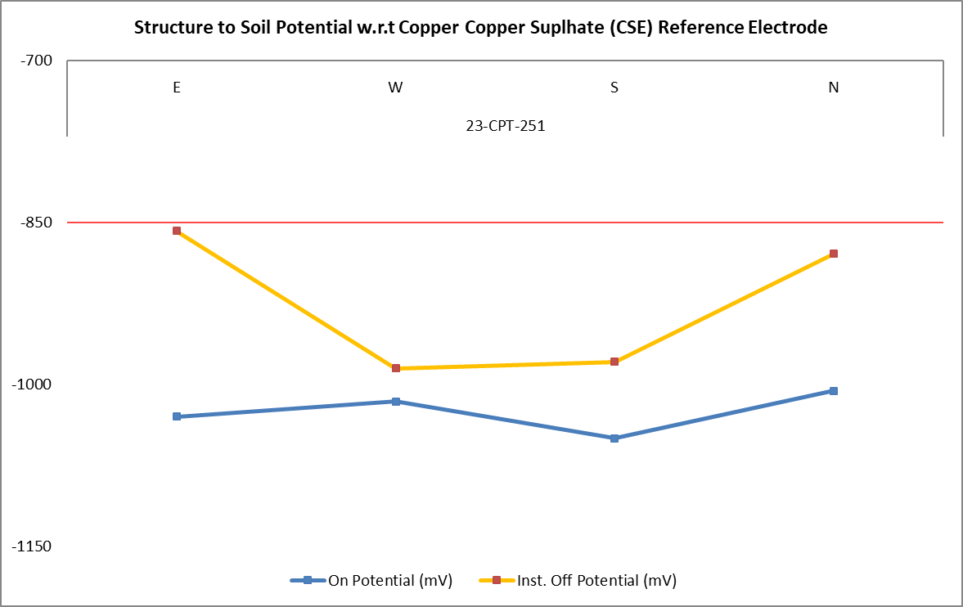
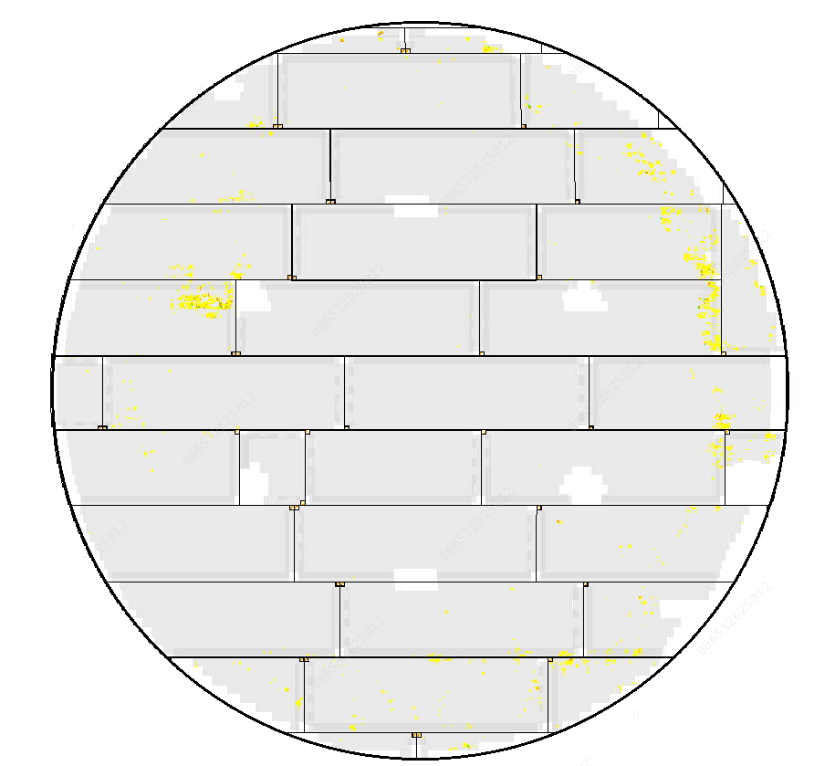
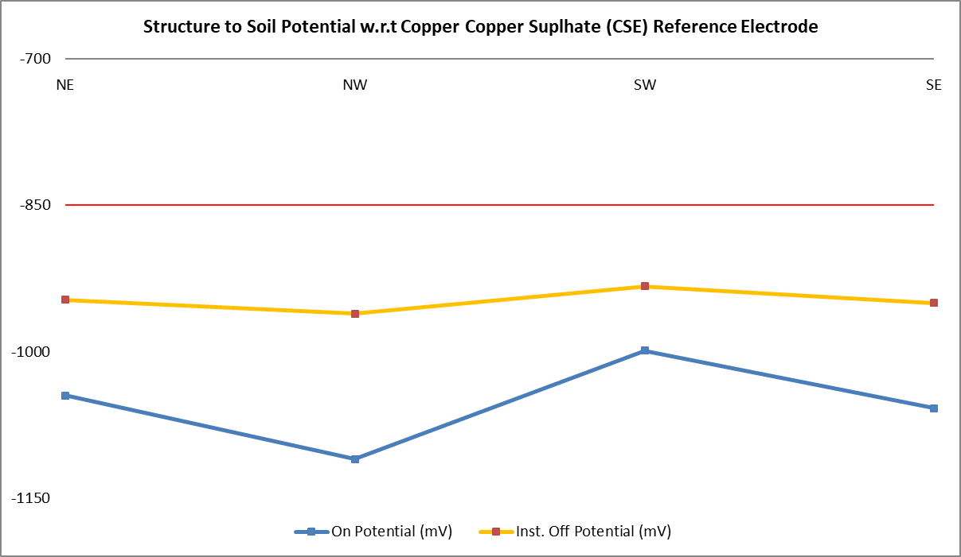
Inspection data (cp & MFL) performance evaluation
Tank # | Commissioned | Tank Dia / Bottom Surface | Operating CP Current | Bottom Plate Minimum Thickness Measured | Avg. CP Potential
Tank 1 | 1996 | 24.4 m (467.35 Sqm) | 9.3 Amp | Minimum Thickness 5.7 mm Nominal Thickness 6 mm | Inst. Off -875 mV On -1005 mV
Tank 2 | 1996 | 24.4 m (467.35 Sqm) | 7.2 Amp | Minimum Thickness 5.5 mm Nominal Thickness 6 mm | Inst. Off -950 mV On -1105 mV
Tank 3 | 1996 | 15.5 m (181.4) Sqm) | 3.1 Amp | Minimum Thickness 4.7 mm Nominal Thickness 6 mm | Inst. Off -950 mV On -1025 mV
MFL Report Tank

Slide 8



JUBCOR
2024
CONFERENCE & EXHIBITION
YOUR LOGO
INNOVATIVE SOLUTIONS FOR CORROSION CHALLENGES
THANK YOU
Reach out.
013-3422903
shams@Agri.Sabic.com

