Slide 1
JUBCOR
2024
CONFERENCE & EXHIBITION
INNOVATIVE SOLUTIONS FOR CORROSION CHALLENGES
Jubcor Presentation
Presented By:
Kumar Kolur Vadivelu
Sr. NDT Tech Specialist
Integrity and Corrosion Engineering
Sadara Chemical Company
Key Consideration for Specifying Maintenance Coating/Lining System in Operating Plants

Slide 2
Agenda
About Sadara
Coating
Lining
Purpose
Introduction
Substrate
Operating Conditions
Coating/Lining Selection
Application and Inspection Control
Examples of poor parameter determination and its effects
Conclusion

Slide 3
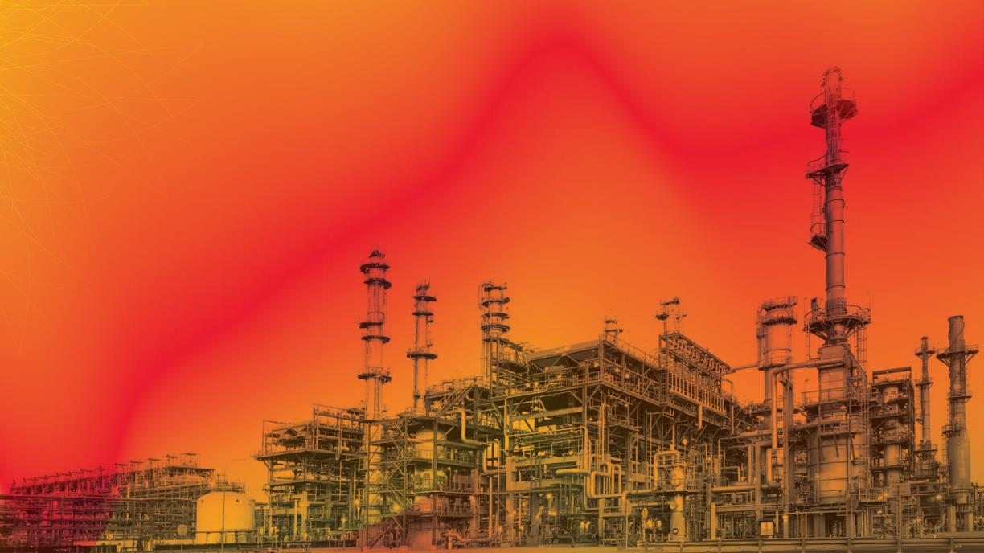
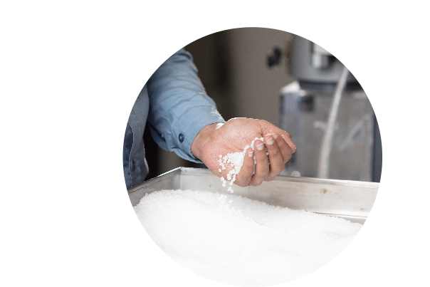
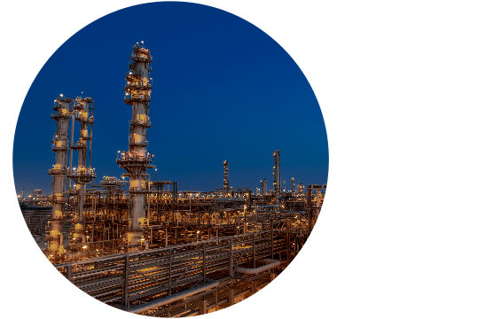
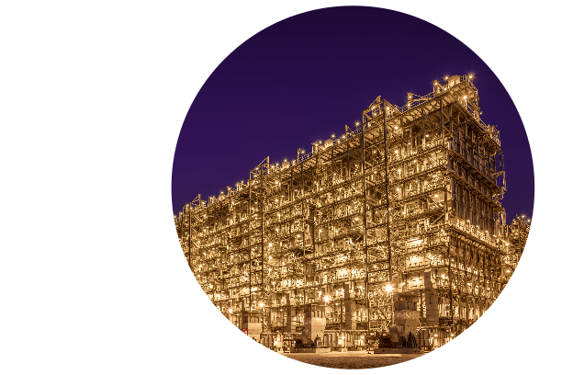
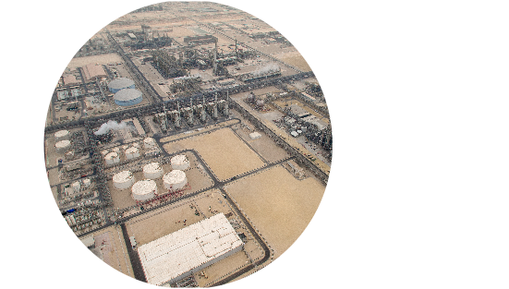
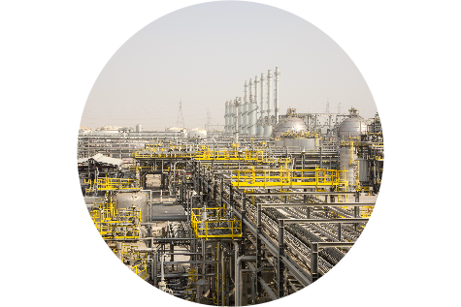
About Sadara
25+
3+
Million metric tons
value-adding chemicals and plastics annually
Billion USD investment JV between Aramco and Dow Chemical
Largest chemical complex ever built in a single phase
The only Mixed Feed Cracker (MFC) in the region (gas and liquid)
26
Manufacturing
plants
14
Plants completely
new to the Kingdom

Slide 4
Coating ………. Lining

Slide 5
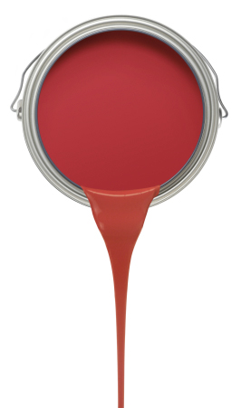
Coating
The application of a film of material to “exterior surfaces” to resist weathering, condensation, fumes, dust, splash, or spray is referred to as a resistant coating.
The coating must prevent the structure from being damaged by corrosion or disintegration due to its surrounding environment.

Slide 6
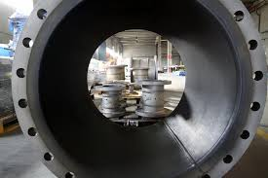
Lining
A resistant lining is a layer of material applied to the “interior surface.”
It prevents the structure from disintegration by the contained product and saves the product from contamination.

Slide 7
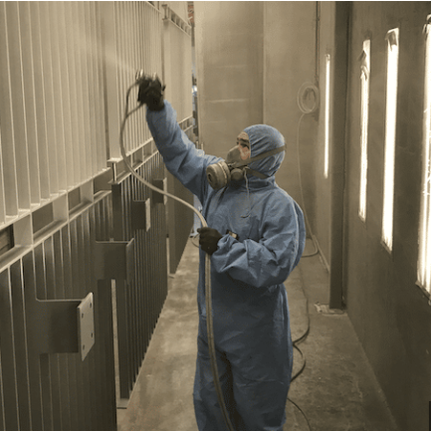
Purpose
There are multiple methods available to control corrosion. The technique that is most frequently used is applying a suitable coating/lining system.
The right coating/lining system is crucial to achieving long-term benefits.
Insufficient consideration of parameters and specifications of the coating/lining system during the maintenance phase in operating plants can lead to unnecessary stoppages and manhours spent.
This presentation will cover the important parameters that must be considered when specifying the maintenance coating/lining system in an operating plant.
In detail, we will discuss some of the early coating /lining failures that resulted from failing to consider operating parameters.

Slide 8
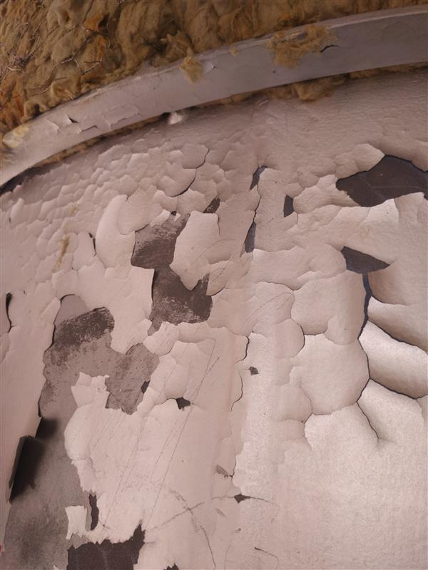
Introduction
SUBSTRATE
The nature and environmental conditions of the primary substrate.
OPERATING CONDITION
Restrictions specific to operating plants.
Surrounding environment
The maximum operating condition
COATING/ LINING SELECTION
Durability and desired property
Classification of coating/lining materials
Cost consideration of coating/lining materials
APPLICATION AND INSPECTION CONTROL
Coating/lining material Application consideration
Schedule of Inspection

Slide 9
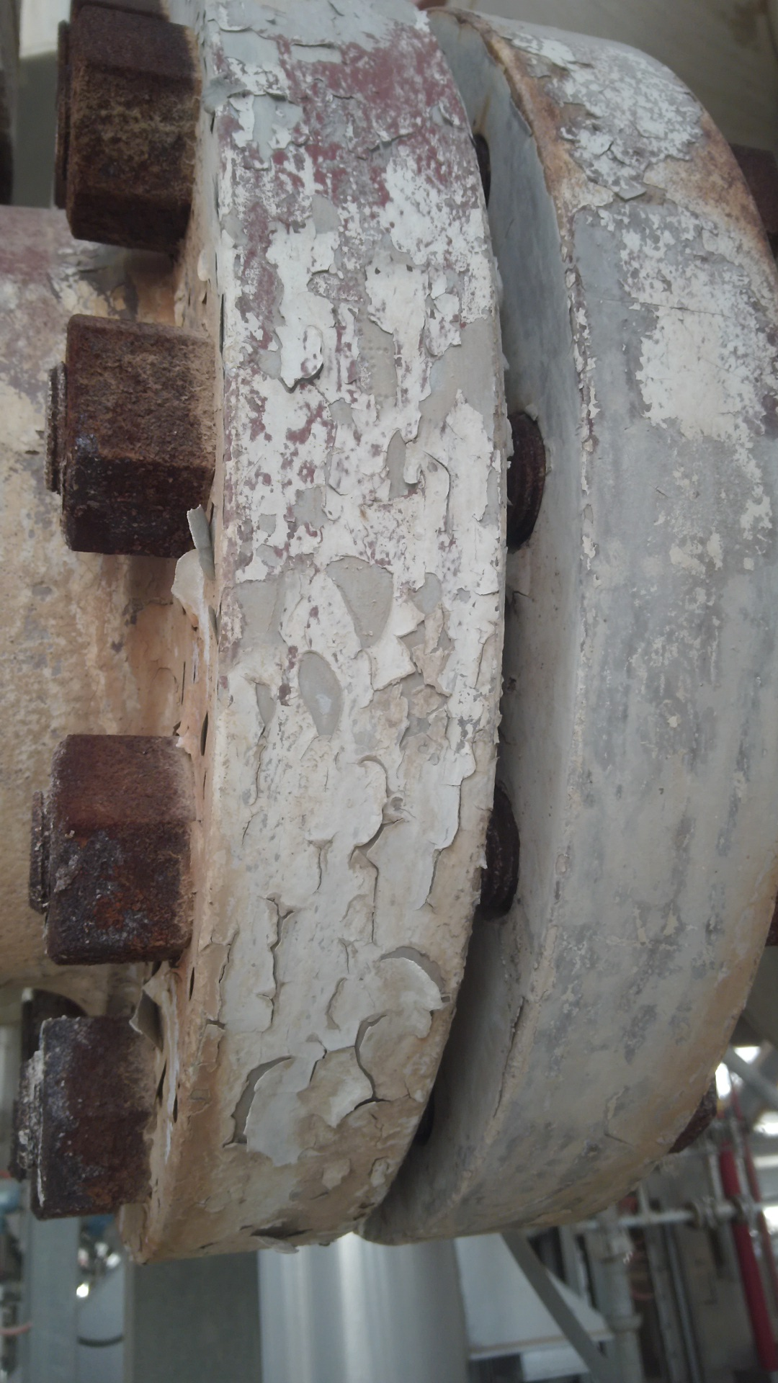
Substrate
Primary Substrate’s Nature & Environmental Conditions
The substrate can be in the form of a structure, pipe, vessel, or tank.
It can be above or underground, fixed, or mobile.
Construction of materials such as ferrous/non-ferrous/special alloy
Each substrate requires a different type of approach while preparing and applying the coating/lining system.
The environmental consideration of primary substrates is divided into three segments.
Atmospheric exposure
Immersion service
Buried service

Slide 10
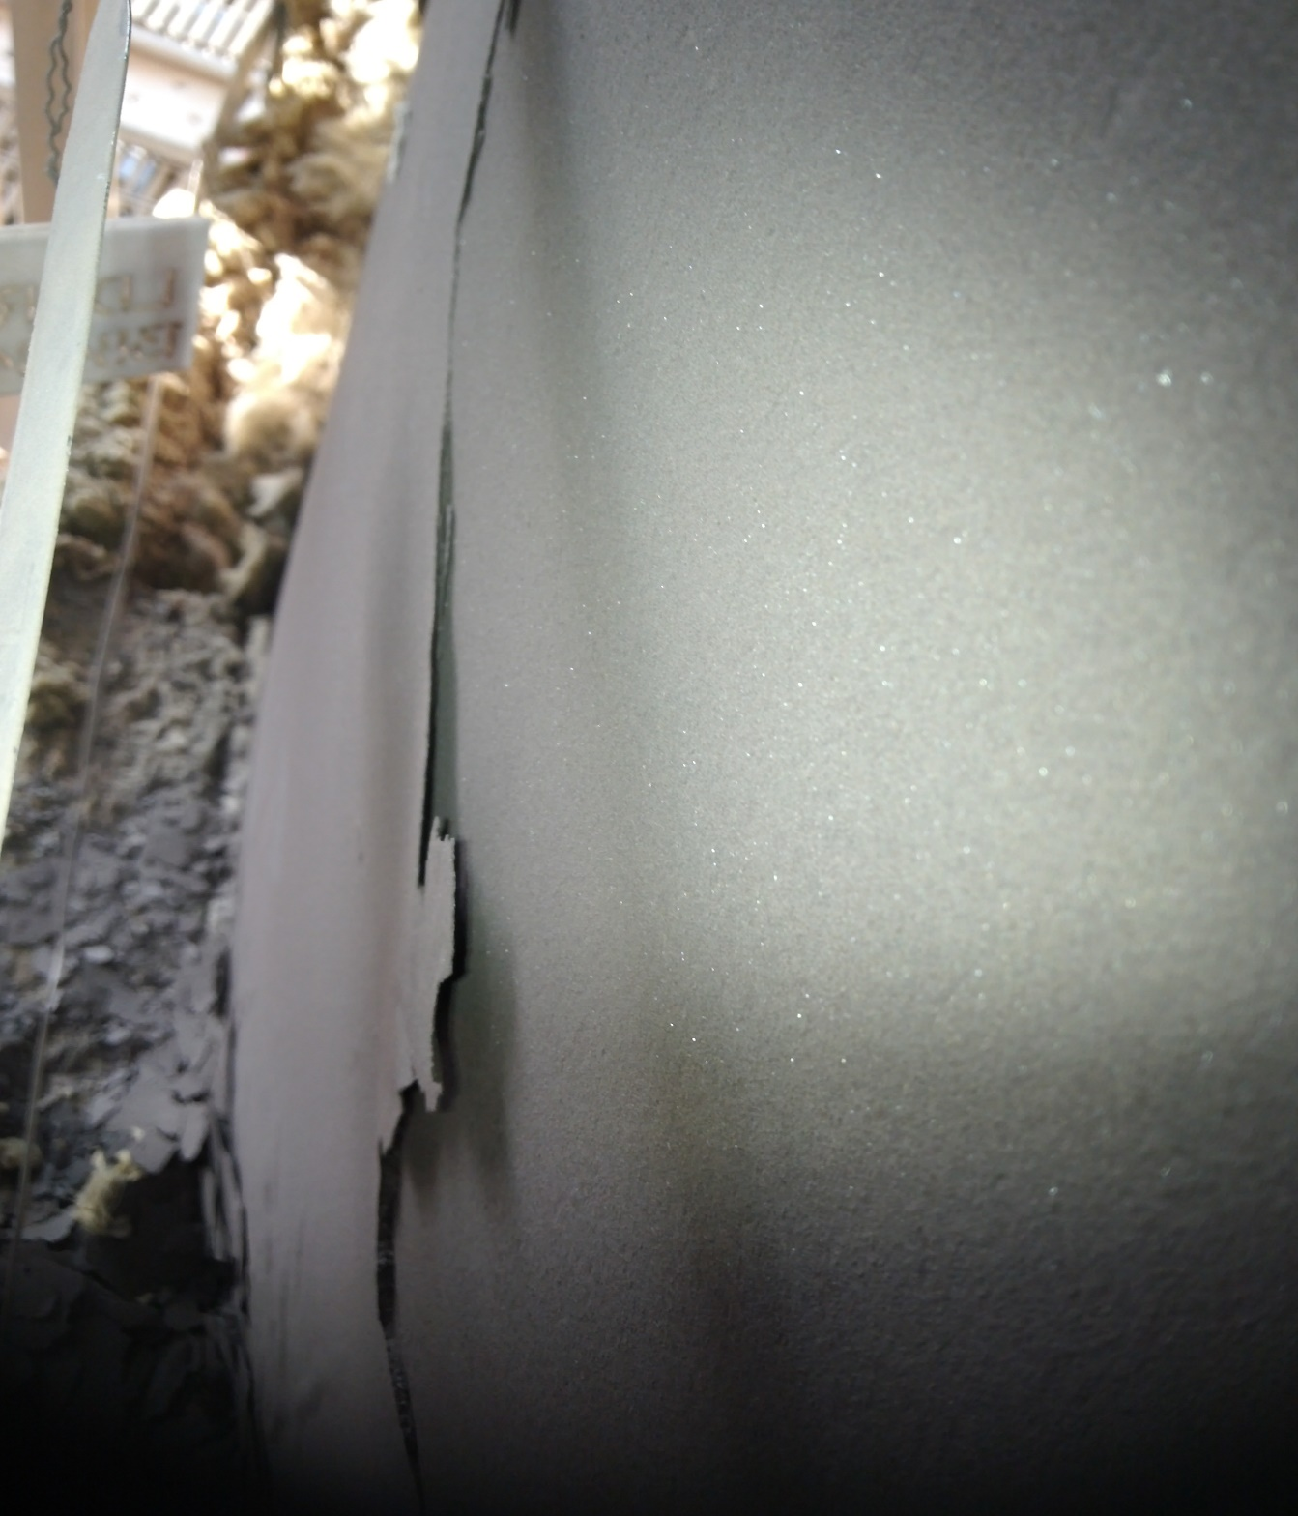
Operating Conditions
Specific Restrictions in Operating Plants
Maintenance coating/lining may face challenges due to specific restrictions in plant operation such as the following:
Plants that operate in environments with hydrocarbons and low flash points.
The system’s continued operation makes it difficult to shut it down.
The location of sensitive assets, such as critical rotating equipment, makes it difficult to cover or mask them.
Reactive chemicals.
To ensure optimal service life, it is important to choose a maintenance coating/lining that will accommodate marginally prepared surfaces.

Slide 11
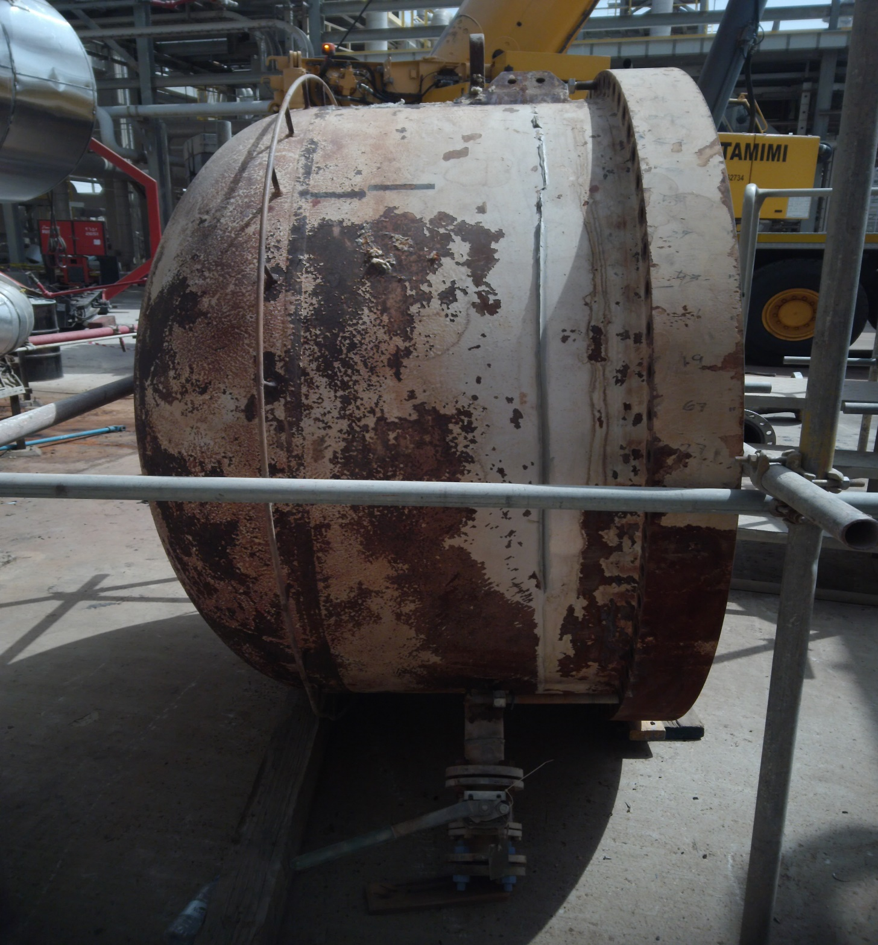
Operating Conditions
Surrounding Environment
Exposure of the substrate can be above ground, immersed, or buried.
Each exposure situation has its own set of corrosion hazards.
The environment around has an impact on the following hazards.
Wet or dry corrosion
Thermal hazards – cooling or heating effects.
Chemical contamination – spills or splash

Slide 12
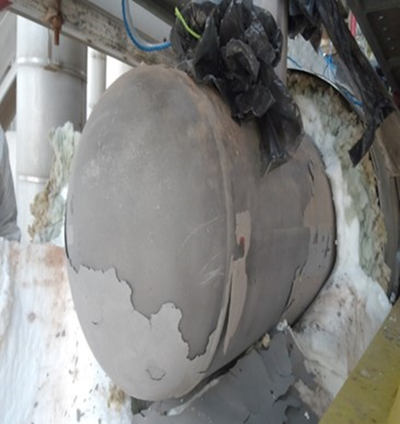
Operating Conditions
Maximum Operating Level
Operating temperatures are often used to determine coating/lining specifications, but the following parameters are not fully considered.
Upset condition of temperature and pressure.
Operations that involve frequent starts and stops, such as continuous or batch-type operations.
Operation that involves multiple phases.

Slide 13
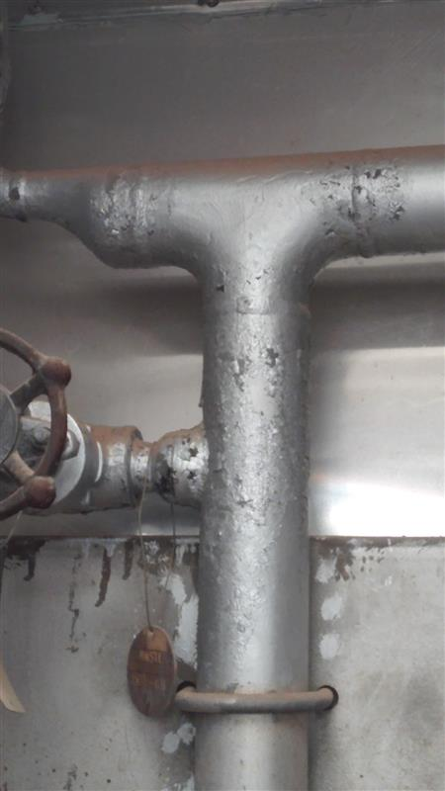
Coating/Lining Selection
Durability and Desired Property
Durability is a technical consideration that can help the owner set up a maintenance program.
As per ISO 15944, the durability of paint is divided into three categories:
Low (2 to 5 years)
Medium (5 to 15 years)
High (more than 15 years)
Desired property of coating / lining comprises the following three parameters.
Barrier: Physical barrier that prevents the contact of corrosive elements.
Inhibitive: Pigments act as active inhibitors of chemical reactions.
Galvanic: Galvanic coatings are metal particles that are not noble compared to the metal substrate.

Slide 14
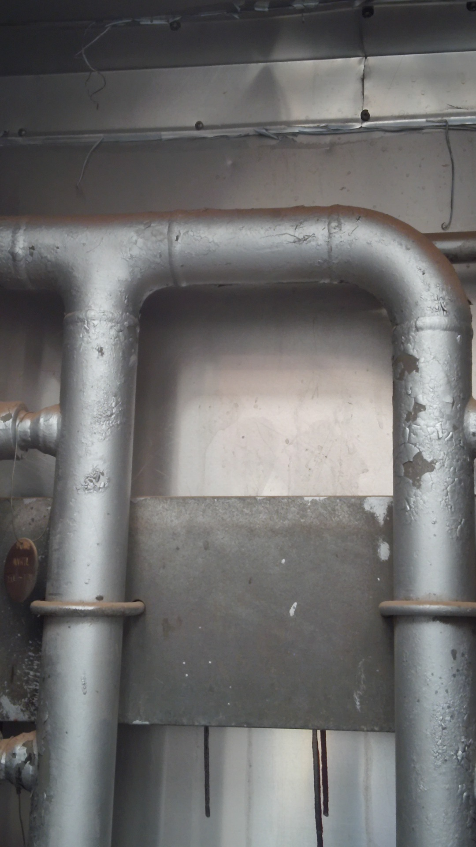
Coating/Lining Selection
Classification of Coating/Lining
Coating/lining materials are broadly classified into three categories.
Inorganic coatings are classified into the following types:
Zinc Silicate coating
Conversion coating (Anodize, Chrome plating)
Cement lining
Organic coating: Organic coating is further classified into the following types:
Thermosetting
Thermoplastic
Metallic coatings such as thermal spray, electroplating, hot dip galvanizing, and aluminizing.

Slide 15
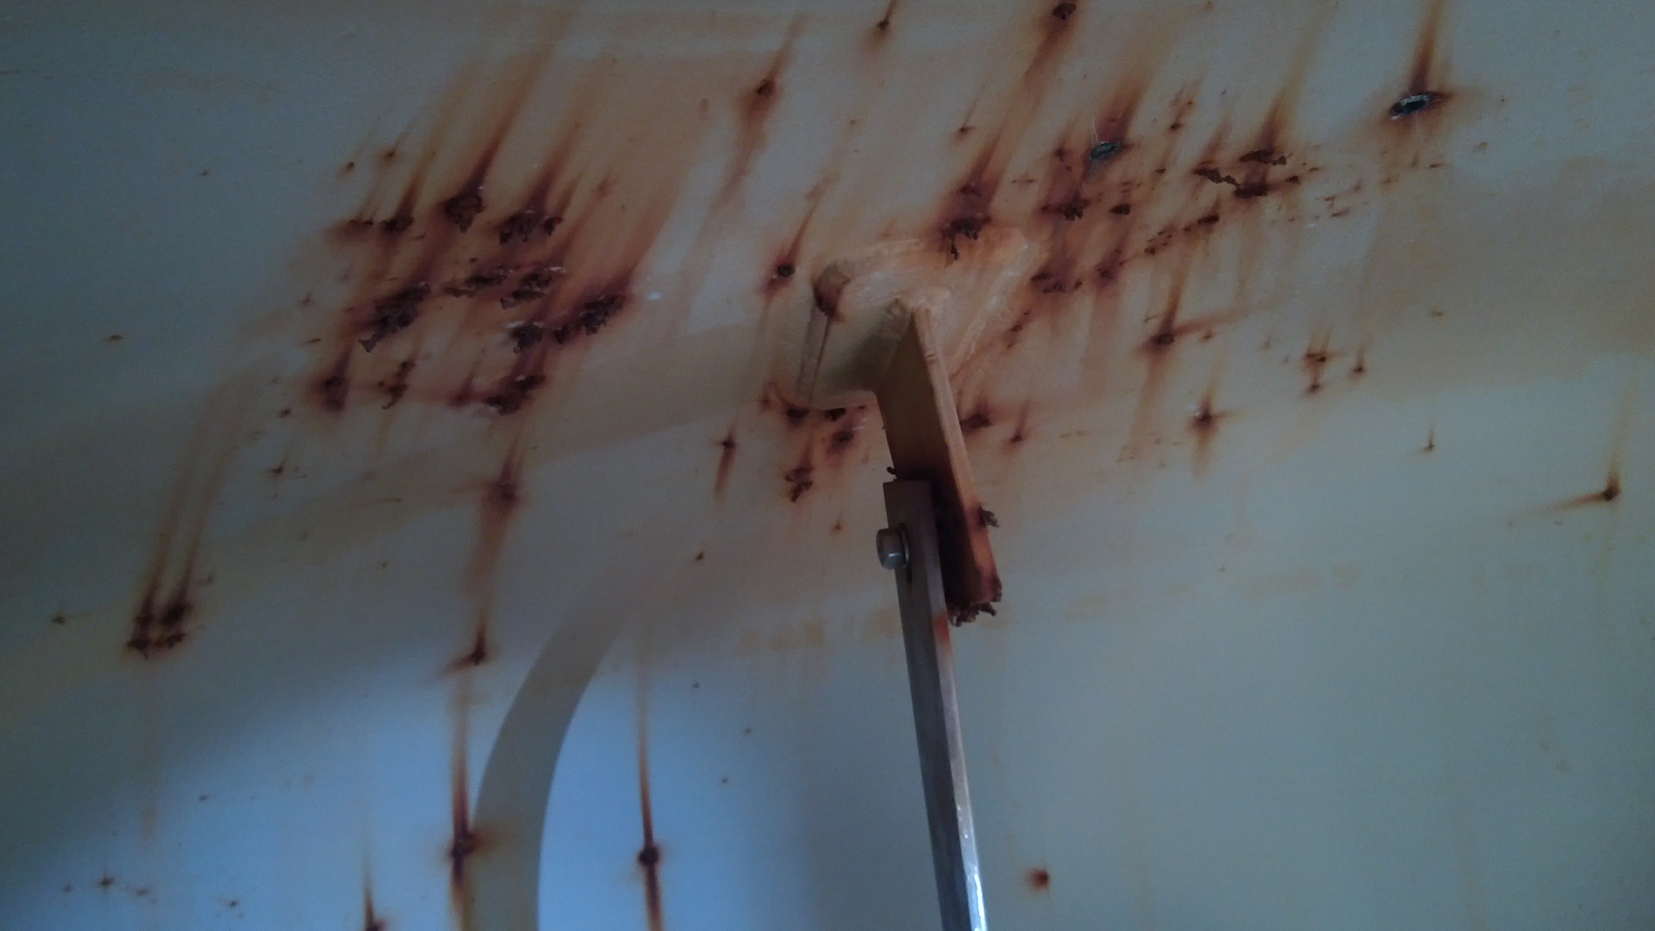
Coating/Lining Selection
Cost Consideration of Coating/ Lining
The cost of coating/lining material will vary depending on the site conditions and application requirements.
The application requires specific surface preparation, coating/lining application, and inspection control.

Slide 16
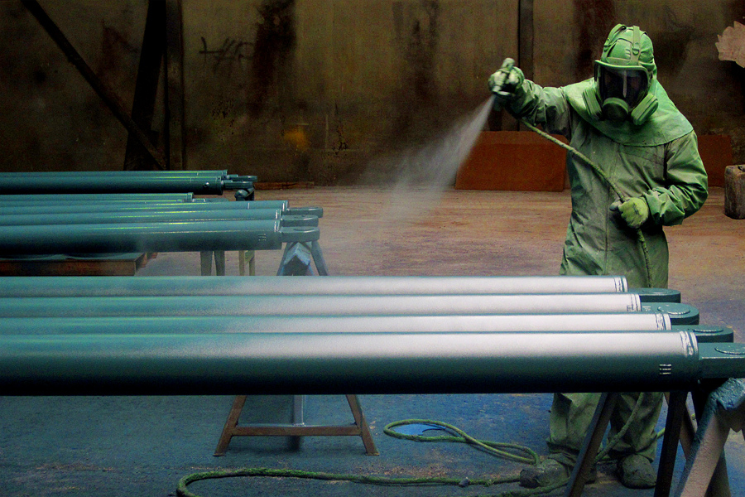
Application and Inspection Control
Coating / Lining Application Consideration
The following sub-activities are necessary for successful coating / lining applications:
The process of surface preparation begins with cleaning with hand and power tools and ends with abrasive blasting.
Coating /lining application can be achieved using roller, brush, or spray.

Slide 17
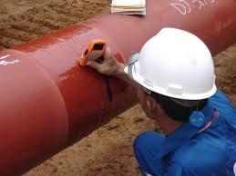
Application and Inspection Control
Inspection Schedule
The schedule of inspection covers the following stages:
Inspection before coating / lining application
Inspection during the coating / lining application
Inspection after coating / lining application
For an effective maintenance coating/lining program, the inspection schedule starts prior to surface preparation, such as verification of substrate condition, then verification of surface preparation, including confirming no foreign material presence over the substrate, such as oil and grease, and any chemical contaminants, such as the presence of any hygroscopic salts, then verification of coating/lining material and application, followed by final coating/lining verification.

Slide 18
Illustration of Poor Parameter Determination and Its Effects

Slide 19
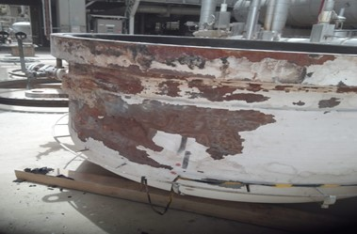
Example of Not Considering Maximum Operating Temperature
The paint system that has been applied is not suitable for the operating conditions.
Maximum operating conditions are not considered.

Slide 20
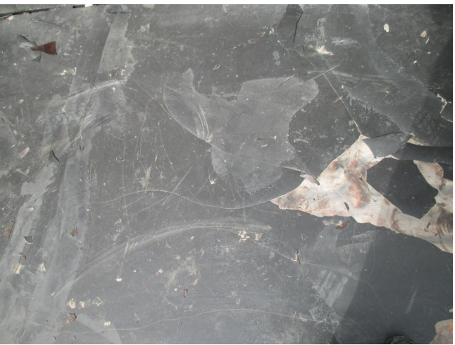
Example of Not following Specification and Coating manufacture Technical Data Sheet
Specific reason for failure:
The recommended lining has poor resistance to UV exposure, whereas during normal operating conditions, it is exposed to UV most of the time.
Surface profile requirements are not clearly determined.

Slide 21
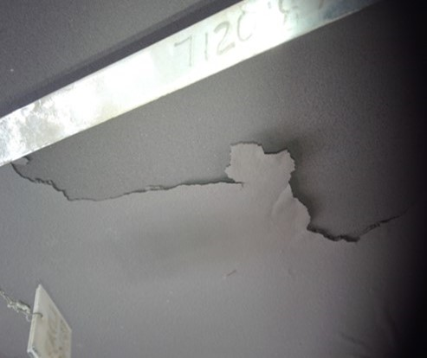
Example of Not following Specification and Coating manufacture Technical Data Sheet
Specific reason for failure:
Surface profile requirements are not clearly determined.
The coating manufacturer’s instructions in the technical data sheet, such as not following the dry film thickness per coat, were found to be higher than the recommended coating dry film thickness.

Slide 22
Conclusion
This presentation focuses on all aspects of specifying maintenance coatings/linings to enhance their effective service life. It's crucial to keeping in mind the following important points.
Before drafting a coating/lining specification, it is important to establish and review the material, coating system, application technique, and QA and QC program with qualified personnel.
Cross-functional team involvement will determine the specification of maintenance coating/lining.
When selecting a coating/lining, it is important to take into account all process conditions, including upset conditions.
In case of coating or lining failures, a systematic RCI technique should be used to revise the coating specification to meet its intended service life.
The most effective way to reduce the risk of corrosion or coating/ lining failure is to always adhere to the relevant standards.

Slide 23
JUBCOR
2024
CONFERENCE & EXHIBITION
INNOVATIVE SOLUTIONS FOR CORROSION CHALLENGES
THANK YOU
Calle Cualquiera 123, Cualquier Lugar

