Slide 1





JUBCOR
2024
CONFERENCE & EXHIBITION
INNOVATIVE SOLUTIONS FOR CORROSION CHALLENGES
Presented By: Cheolho Kang (CK)
Jubcor Presentation
Innovative Real-Time Pit Detection and Artificial Intelligence Electrical Resistance Corrosion Monitoring Systems
NEXCORR, USA

Slide 2


Outlines
Introduction
Innovative Internal Corrosion Monitoring Systems
  Artificial Intelligence Electrical Resistance (i-ER)
  Pit Detection System (PDS)
  PDS + i-ER (MFS)
Comparison Results
Conclusions

Slide 3
Importance of Corrosion Monitoring
For a safe and efficient operation of pipelines, corrosion must be monitored.
Functions of corrosion monitoring
  Detection of corrosion problems
  Control of the effectiveness of the corrosion protection (inhibition protection)
  Estimation of the inspection/maintenance requirements
  Estimation of the useful service life

Slide 4
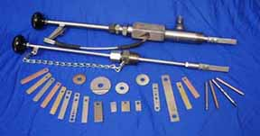
Corrosion Monitoring Techniques
Classification based on the physical principles of the technique:
  Metal Loss Techniques:
    Weight-loss Coupons, Electrical Resistance (ER)
  Electrochemical Techniques
    LPR, EIS, ECN
  Ultrasound
  FSM
Courtesy by Metal Samples

Slide 5
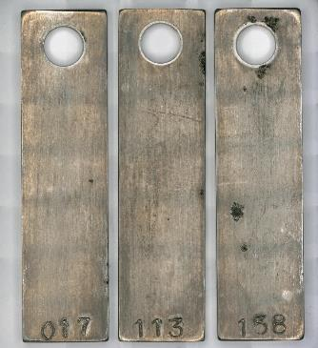
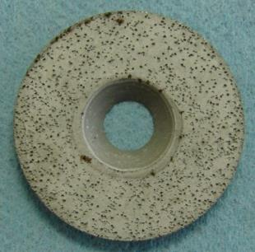
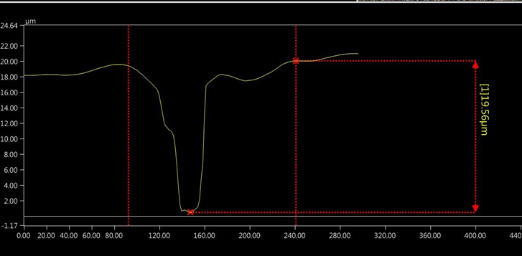
Weight-Loss Coupon Technique
ADVANTAGES
Relatively inexpensive
Simple to use
Usable in any environmental Conditions
Suitable for the detection of localized corrosion.
DISADVANTAGES
Integrates corrosion over period of exposure.
High corrosion rates for short periods of time cannot be detectable.
The effects of corrosion dynamics can not be isolated.
Cannot be used for continuous in-situ monitoring.
Measurement requires long exposure time (90 days).
Pitting Corrosion

Slide 6
Electrical Resistance (ER) Technique
ADVANTAGES
Can be used in any environment.
Changes in corrosion rate can be detected.
Continuous monitoring is possible.
Much faster response than coupons.
Uniform Corrosion
DISADVANTAGES
Element life is inversely proportional to sensitivity.
Conductive deposits (e.g. iron sulfide or carbonaceous material) on the sensor elements obviously distort the readings for corrosion rate.
Sensitive to dynamic temperature changes
Not suitable for the detection of localized corrosion.
Pitting Corrosion

Slide 7


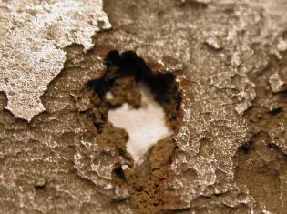
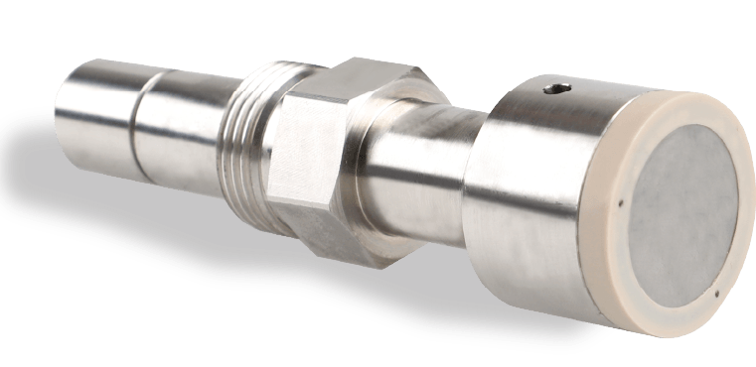
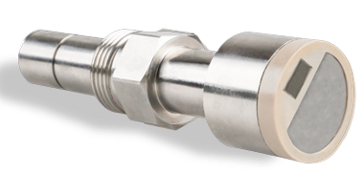
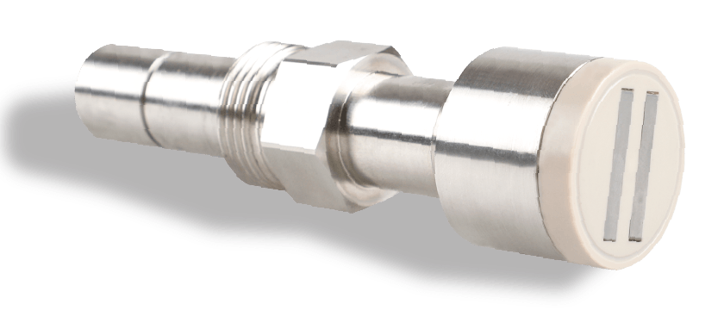
Cutting-Edge Technology:
Innovative Corrosion Monitoring Systems
Internal corrosion monitoring systems for the detection of real-time
pitting corrosion (Patented Technology).
Artificial Intelligence (AI) Electrical Resistance Corrosion
Monitoring System (i-ER)
Pit Detection Corrosion Monitoring System (PDS)
Multi-functional Corrosion Monitoring System (MFS: PDS + i-ER)
Uniform (General) Corrosion
Pitting Corrosion
I - ER
PDS
MFS

Slide 8

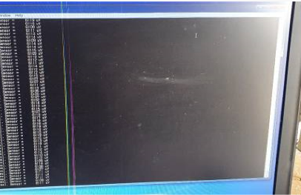
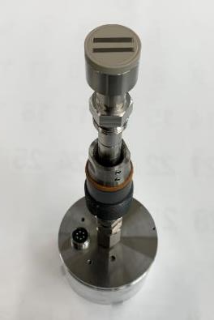
i – ER (Electrical Resistance) System
Artificial Intelligence (AI) Electrical Resistance Corrosion
Monitoring System (i-ER)
The most relevant data point for metal loss is displayed by the Linear Regression Technique after 100 data points per time interval set up for each data collection are analyzed using an AI algorithms.
The reliability of ER data was improved using the analysis technique of an artificial neural network.
i-ER system can be upgraded periodically from the data collection of oil/gas fields using Artificial Neural Network sand AI algorithms.
A high-sensitivity, flush-mounted type ER probe.

Slide 9
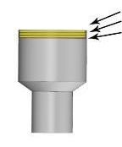
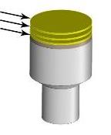
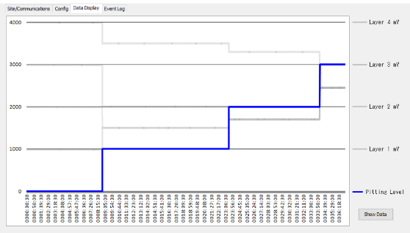
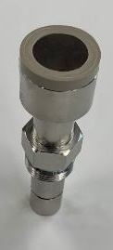
Pit Detection System (PDS): USA Patent Pending
40 µm
40 µm
The PDS has three (3) carbon steel layers of each 40 µm) thickness.
The probe has carbon steel layers.
In between each layer, there is a thin film which dissolves as soon as layer penetration occurs.
Each layer in the probe has a set voltage value, and the
voltage source is connected to a circuit in the transmitter.
Thin film is applied to each layer by semiconductor
processing-based technology.
40 µm
Third Pitting
Second Pitting
First Pitting
Advantages of PDS:
Usable in any environmental conditions
No modification of the port is necessary because the pit detection probe can be installed at the “existing port for ER or weight loss coupon”.
Real - time pit detection monitoring
Pit penetration rate can be easily calculated.
Any change of field conditions during the monitoring does not have any problem.

Slide 10
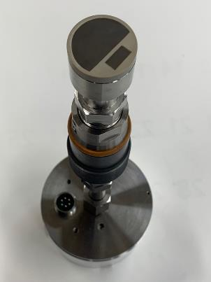
Multi-functional System (MFS): USA Patent Pending
MFS: Combination of PDS + i-ER
Advantages:
Usable in any environmental conditions
No modification of the port is necessary because MFS probe can be installed at the “existing port for ER or weight loss coupon”.
Real-time pit detection and general corrosion rate monitoring
The pit penetration rate can be easily monitored.
Any change in field conditions during the monitoring does not have any problems.
The multi-functional Probe System (MFS) can monitor pit detection using PDS (pit detection) and general corrosion rates using electrical resistance (i-ER).

Slide 11
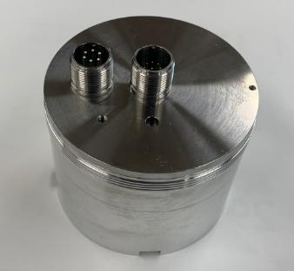
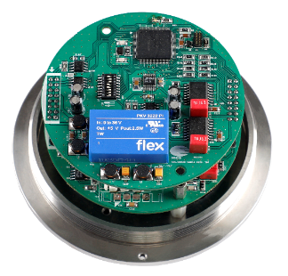
Transmitter
The all-in-one transmitter was designed to use PDS, i-ER, and MFS.
The high-resolution transmitter has a self-diagnosis function regarding abnormal voltage and temperature.
Transmitter electricity sensor: overvoltage/low-voltage detection and error signal
Transmitter temperature sensor: temperature monitoring and error signal
Transmitter temperature sensor: temperature monitoring and error signal
The software will show a reset message if the transmitter needs to reset
due to a problem. This will lead to reliable PDS, i-ER, and MFS data
collection.
Heat shield Protection: The transmitter can withstand rapid changes in external temperature up to 70C.
Transmitter

Slide 12
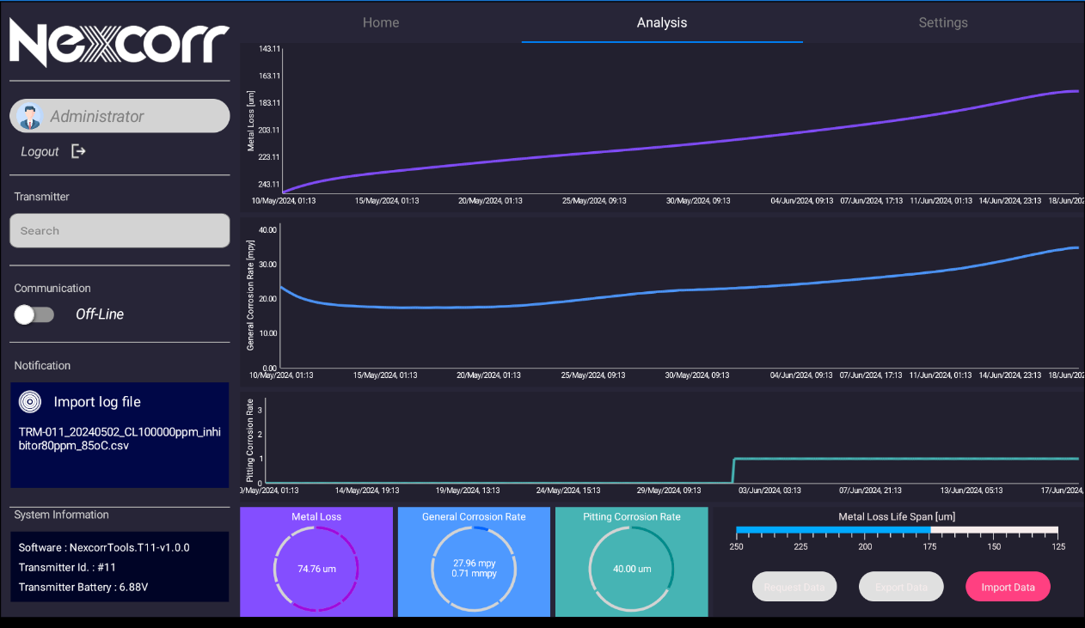
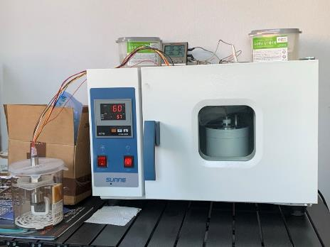
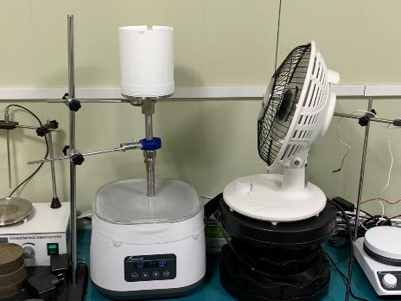
Transmitter Heat shield Protection:

Slide 13
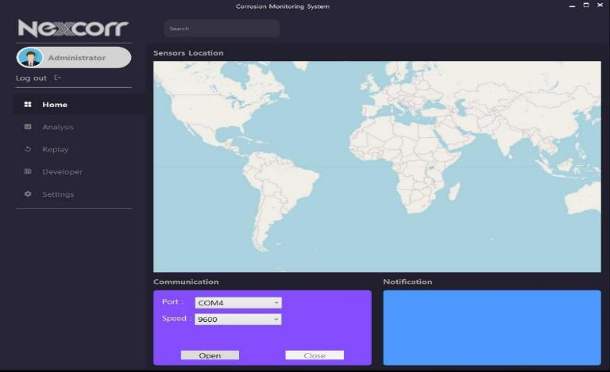
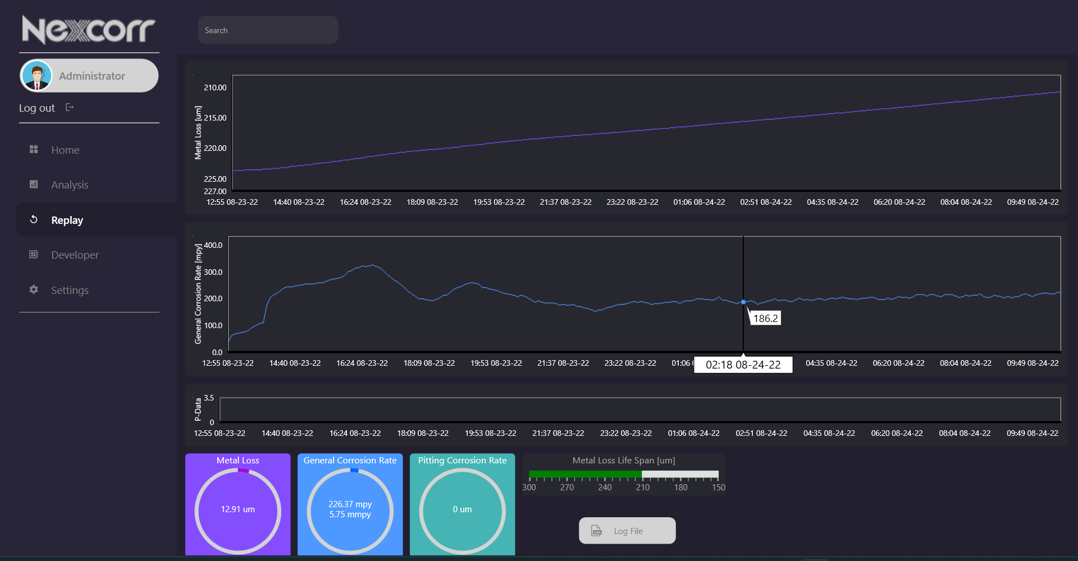
Software
User-friendly software
All-in-one software for PDS, MFS and i-ER
Software is designed to detect the type probe (PDS, i-ER and MFS) automatically. No manual input is necessary.
Warning signal with pitting corrosion
ER probe life signal
Software will be periodically upgraded using AI according to ER and weight-loss coupon data collection.

Slide 14
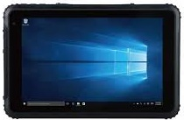
Portable Data Logger
Tablet-type portable data logger to collect data from PDS, i-ER and MFS.
Features
Firmware Tablet
Automatic data collection and stored data
Easy data transfer to PC
Display system map
Corrosion rate results and graph display on Tablet
High-resolution, rapid response
Easy to upgrade a software
Multilingual capability
Industrial Tablet

Slide 15
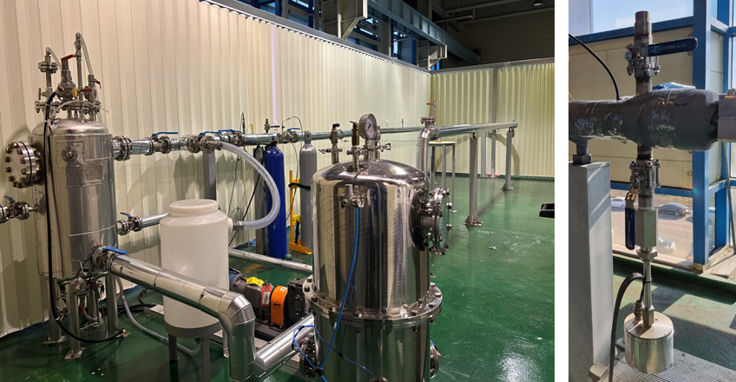
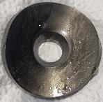
Test Results of i-ER
Parameter | Conditions
CO₂ Pressure, MPa | 0.69
Temperature, ºC | 90
Chloride Concentration, mg/L | 80,000
Liquid Velocity, m/s | 1.5
Water Cut, % | 100
Duration, hour | 9.5
i-ER
Multiphase Flow, Corrosion Loop System
(Courtesy by Unicoh Specialty Chemicals)
Weight-Loss Coupon

Slide 16
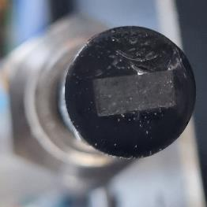
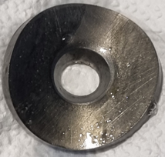
Test Results of i-ER
Comparison Results Between Weight-Loss Coupons and i-ER Probe
 | Testing Description | Corrosion Rate, mm/yr
 |  | Weight-Loss Coupon | i-ER Probe | % Difference
Test 1 | Baseline Corrosion | 6.42 | 5.75 | 10.4
Test 2 | Corrosion Inhibitor of 150 ppm | 0.093 | 0.102 | 9.7
i-ER Probe Weight-Loss Coupon
Photos of i-ER Probe and Weight-Loss Coupon After the Flow Loop Test
Liquid Velocity = 1.5 m/s, 150 ppm of corrosion inhibitor

Slide 17
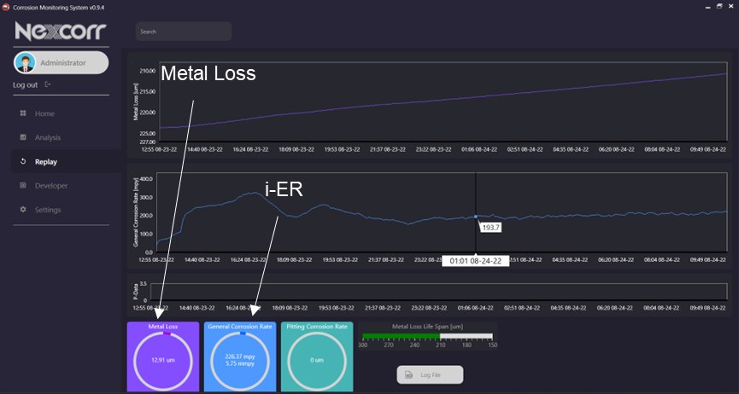
Test Results of i-ER
Corrosion Rate Variation of i-ER Probe, Liquid Velocity = 1.5 m/s Baseline (No Corrosion Inhibitor)

Slide 18
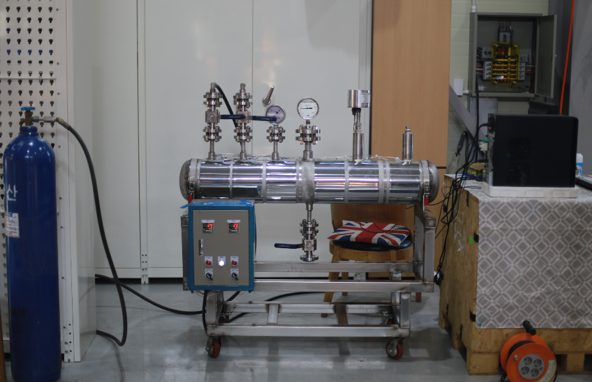
Test Results of MFS
Parameters | Test Conditions
CO₂ Pressure, MPa | 6.0
Temperature, ºC | 100
Chloride Concentration, mg/L | 160,000
Liquid Velocity, m/s | X
Water Cut, % | 100
Testing Pipe System

Slide 19
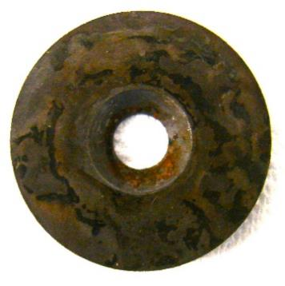
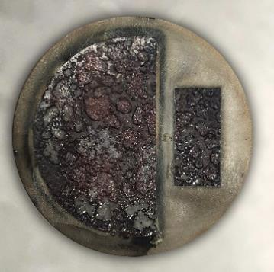
Test Results of MFS
PDS
i-ER
General Corrosion Rate
Weight-Loss Coupon | 6.58 mm/yr
MFS | 6.02 mm/yr
Weight-Loss Coupon
MFS
Photos of Weight-Loss Coupon and MFS
After the Test

Slide 20
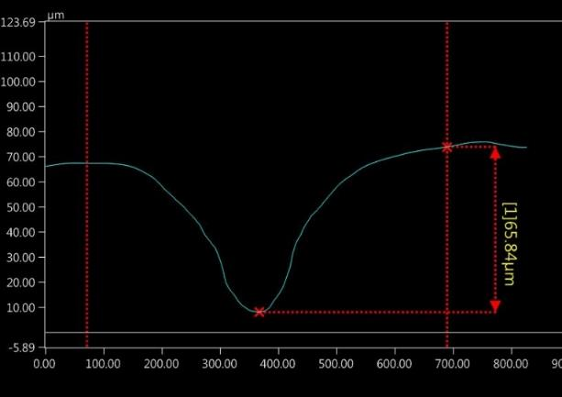
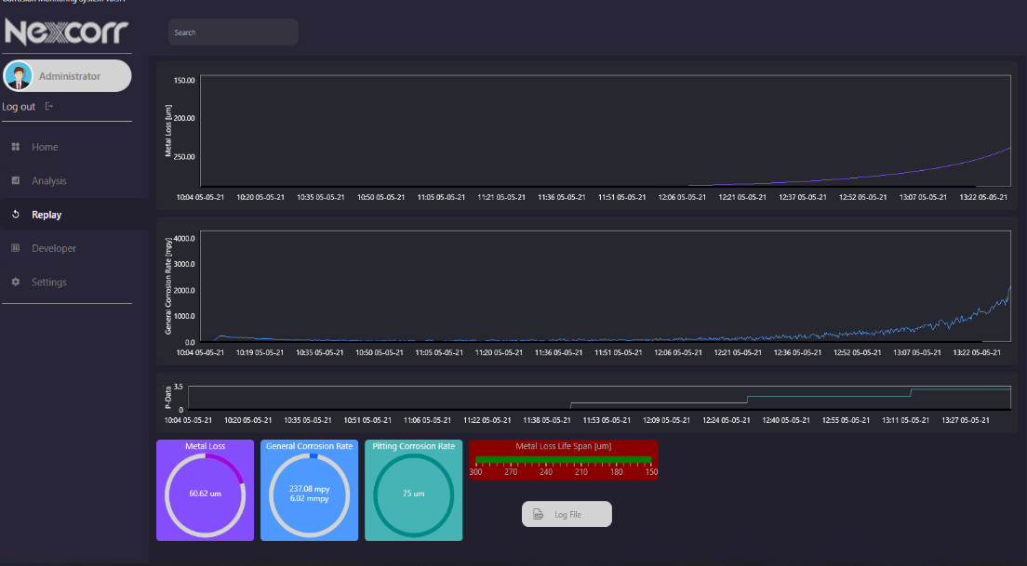
Test Results of MFS
Pit Depth of Weight-Loss Coupon
Metal Loss
i-ER
PDS
Maximum Pit Depth
Weight-Loss Coupon | 65.84 µm
MFS | 75 µm

Slide 21
Conclusions
Three corrosion monitoring systems (i-ER probe system, pit-detection probe system and multi-functional probe system) were introduced.
Multi-functional corrosion monitoring system (MFS) is the only system in the world that can measure general and pitting corrosion.
All monitoring systems are designed to be applicable to all environmental conditions in real-time, providing you with the most up-to-date information.
The MFS provides information for the general corrosion rate using i-ER and pitting corrosion using PDS in real-time.
The high-resolution transmitter has a self-diagnosis function regarding abnormal voltage and temperature.

Slide 22



JUBCOR
2024
CONFERENCE & EXHIBITION
INNOVATIVE SOLUTIONS FOR CORROSION CHALLENGES
THANK YOU
Reach out.
Calle Cualquiera 123, Cualquier Lugar
phone
email
+1-614-401-9667
ck@nexcorr.com

