Slide 1



JUBCOR
2024
CONFERENCE & EXHIBITION
INNOVATIVE SOLUTIONS FOR CORROSION CHALLENGES
Microstructural Investigation of Ruptured Dilution Steam Pipe
Presented By:
Dr. Akeem Adesina
Akeem Y. Adesina, Yousif R. Al-Dhafeery, Saud Al-Subai, Mohammad T. Akhtar, Faris S. Al-Adainan, Mohammad W. Diab

Slide 2


Outline
Background
Methodology
Results & Discussion
Conclusions & Recommendations
Objectives

Slide 3
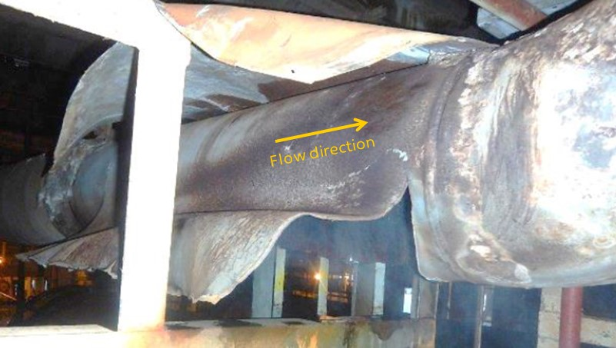
Background
In thermal C₂H₂ cracking steam from the dilution steam generator (DSG) is added to reduce the partial pressure and to increase the yield.
The system receives water via thermosiphon recirculation from the quench tower after it has been pre-treated and vaporized.
The received vaporized steam is usually at elevated temperature and pressure.
in this case study, the DSG unit supplies process water to 6 parallel heat exchangers or reboilers
The process water temperature and pressure are usually at 150-170ºC and 6-8bar, respectively.
This condition is a precursor for corrosion-related failures of DSG components
Figure 1: Ruptured pipe in the installation condition showing the direction of flow
Water chemistry, tubing material susceptibility, and mechanical loading are important factors that influence the failure [1-3]
Acid corrosion, steam erosion, and fouling resulting in the thickness reduction and overall deterioration of components are common problem in DSG [4].

Slide 4
Problem description & objectives
The dilution steam/quench oil reboilers had experienced several failures/leaks in the past especially at the downstream – More than 2 decades in service.
Historical report revealed that the DSG received the highest operational load up to 85-95% during the ruptured period.
The ruptured pipe is the downstream outlet transition line from horizontal to vertical header, 35-40 cm in diameter and with a nominal thickness of about 10-13 mm.
Figure 1: Ruptured pipe in the installation condition showing the direction of flow
The objective of the study is to investigate the root cause of the rupture failure of the dilution steam pipe supplying six parallel exchangers/reboilers.
Also, to recommend suitable corrective and preventive measures against reoccurrence.

Slide 5
Methodology
Methodology
Optical Microscopy
Stereoscopy Analysis
X-ray florescence spectroscopy & CS Analyzer
Scanning Electron Microscope (SEM)
Energy dispersive spectroscopy (EDS)

Slide 6
Results & Discussion

Slide 7
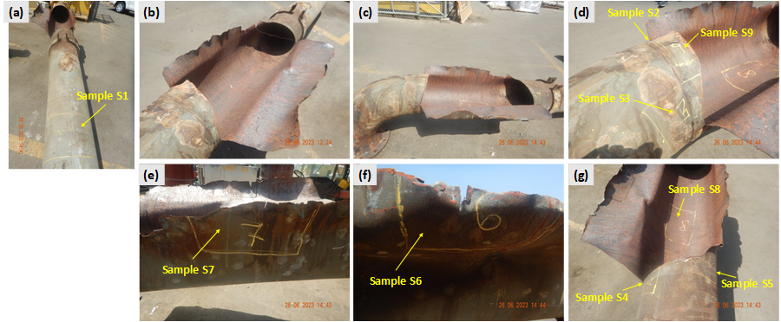
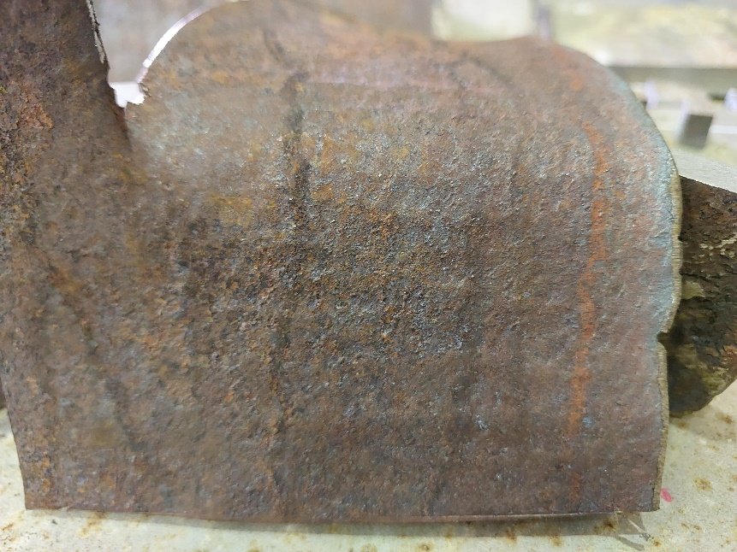
Results & Discussion
  Visual Inspection & Dimension
The ruptured occurred in the downstream at 0600 O’clock location just before the elbow
Ruptured resulted in the splitting of an area of about 0.5 m long and more than half the pipe diameter wide
Figure 2a: Photos of the ruptured pipes showing specific areas from which metallurgical analysis samples were cut from.
  MOC verification
Table 1: Elemental composition of the carbon steel
Composition (wt. %)
Elements | Carbon steel | API 5L Gr B
Fe | 98.31 | Balance
Cr | 0.037 | 0.5 max
Si | 0.33 | 0.4 max
Mn | 1.04 | 1.2 max
C | 0.201 | 0.28 max
S | 0.010 | 0.03 max
Figure 3 revealed more than 50 % reduction in the thickness in the ruptured areas
This large difference signifies accelerated and localized thinning at the ruptured area
Figure 2b: Flow pattern showing turbulence in the flow in the ruptured zone

Slide 8
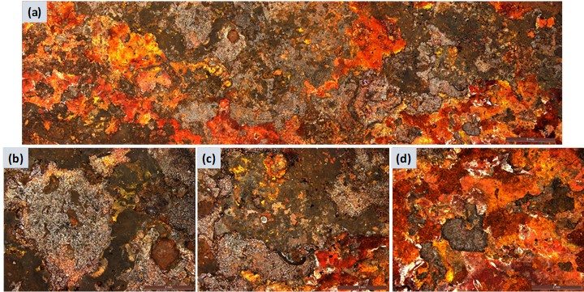
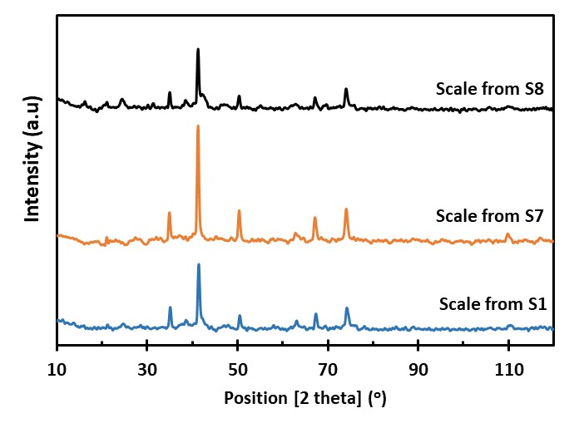
Results & Discussion
  Stereoscopic & Scale Analysis
Rupture zone (S7 & S8) composed more hematite than magnetite
Hematite is relatively less dense and less protective in comparison to magnetite, for this reason, the considerable hematite in the scales shows the high vulnerability of the steels and thus corresponds to the consequent thinning of the dilution pipe steam
Figure 4: Photos of scales collected from the ID of samples (a) S1, (b) S7, and (c) S8.
Scale composition (wt. %)
Elements | S1 | S7 | S8
Fe | 66.09 | 65.36 | 66.09
O* | 29 | 30 | 30
C | 2.90 | 1.67 | 2.68
Mn | 0.532 | 0.59 | 0.45
S | 0.224 | 0.504 | 0.361
Si | 0.236 | 0.439 | 0.216
Zn | 0.141 | 0.423 | 0.089
Figure 3: Typical stereoscopic images showing the scales on the IS
*Oxygen is chemically bonded
It is evident from the images that the dilution steam pipe went through significant rusting as huge brownish scale deposit can be observed on the surfaces.
The color ranges between dark brown and reddish orange

Slide 9
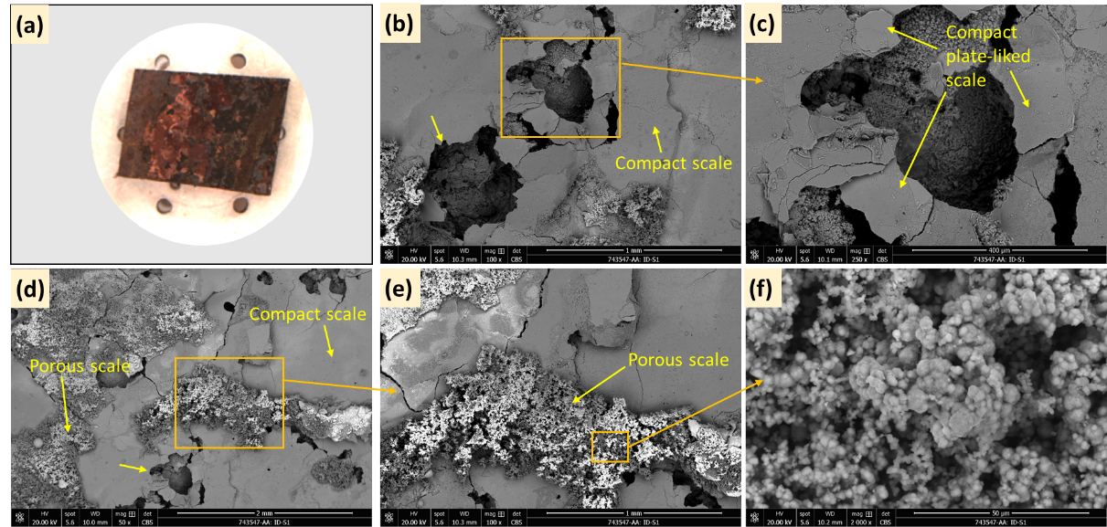
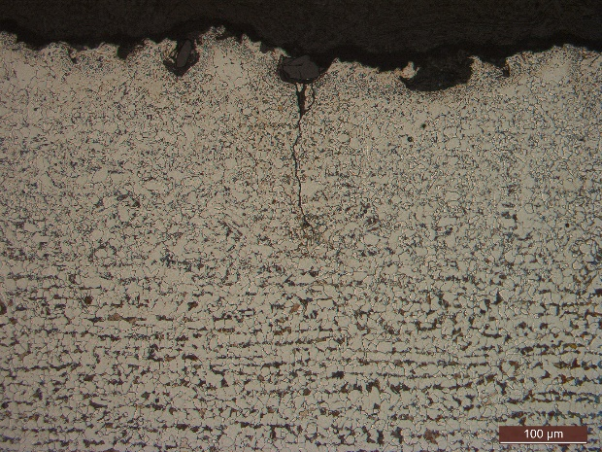
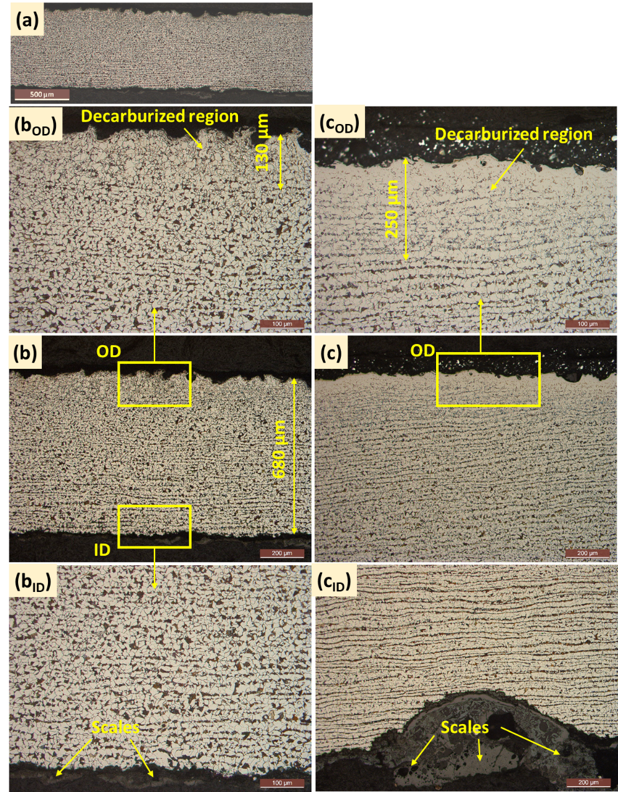
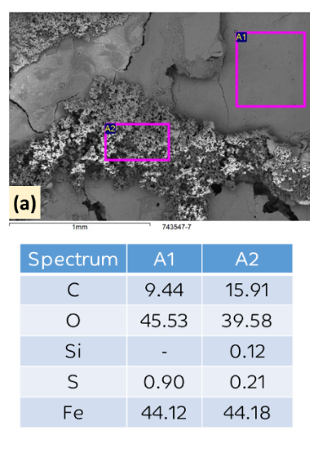
Results & Discussion
  Metallurgical & SEM Analysis
Significant decarburization was observed on ODs and scales on IDs
Decarburization leads to reduced strength, decrease in the fatigue resistance, increases crack growth and wear [11, 12].
At higher temperatures, the diffusion rate of carbon is increased such that longer annealing times lead to decarburization [8, 9].
Reduced mechanical properties due to carbide phase loss can cause the crack initiation at OD [9, 11, 12]
Crack in carburized region
Figure 5: Optical micrograph showing the microstructure of (a-b) sample S7 and (c) Sample S8
Scales consisted of porous and compact plate-liked scales
The porous scales may stem from the compact scale
EDS analysis shows similar composition for both scales
This substantiate the XRD findings of the presence of both hematite (porous and less protective) and magnetite (more protective)
Figure 5: Optical micrograph showing the microstructure of (a-b) sample S7 and (c) Sample S8

Slide 10
Conclusions & Recommendations

Slide 11
Conclusions & Recommendations
  Conclusions
Metallurgical and optical microscopic examination showed that a layer of about 150-250 µm on the OD was decarburized. Thus, cracks initiated from the decarburized layer.
Microscopic and SEM/EDS analysis of the ID surface shows significant scaling influenced thinning of the dilution steam pipe with the 0600 o’clock being the most affected areas. The SEM morphological assessment shows both porous and compact scales characterized with network of cracks.
Dissolution removal of oxide layers due relatively high turbulence area influenced by two phase flow will lead to accelerated corrosion at bottom side of piping (liquid phase)
Additionally, potential stagnation of corrosive contaminated water at low point area (i.e. rupture area) during prolonged shutdown/turn around caused huge localized corrosion scaling.
Damage mechanism is mainly organic acid corrosion (low pH downstream reboiler due to cross contamination of heavy hydrocarbons leading to removal of protective oxide layers accelerated due relatively high contaminated fluid

Slide 12
Conclusions & Recommendations
  Recommendations
Proper water chemistry treatment to avoid the late formation of protective magnetite, which causes the formation of relatively high and undesired hematite oxide scales for DSG system.
Control flow to avoid relatively high turbulence area that can influence two-phase flow and leads to dissolution of oxide layers and flow accelerated corrosion.
Conduct periodic thickness survey along reboilers piping circuits.
Enhance water chemistry control & corrosion monitoring of reboilers by monitoring pH, conductivity, alkalinity, TOC, iron content, & organic compounds.

Slide 13
References
[1] R.K. Hosseini, Root Cause Failure Analysis of Superheated Steam Tube at a Petrochemical Plant, Procedia Structural Integrity 13 (2018) 232–237
[2] D. Reza, A. Jamal, B. Shaghayegh, A Look at the Industrial Production of Olefins Based on Naptha Feed: A Process Study of a Petroleum Unit, Alkenes - Recent Advances, New Perspectives and Applications, IntechOpen2021.
[3] K. Karl, D.N. Charles, M. Zainudin, Improve the Reliability of High Flux Reboilers A Treatment Approach for Dilution Steam Generator (DSG) Reboilers in Ethylene Plants, Engineering (2003) 1-7.
[4] L.S. Hua, P.C. Sim, K. Kolmetz, Challenges in a Dilution Steam Genertor System.
[5] R.W. Staehle, J.A. Gorman, Quantitative Assessment of Submodes of Stress Corrosion Cracking on the Secondary Side of Steam Generator Tubing in Pressurized Water Reactors: Part 2, CORROSION 60(1) (2004) 5-63.
[6] R.W. Staehle, J.A. Gorman, Quantitative Assessment of Submodes of Stress Corrosion Cracking on the Secondary Side of Steam Generator Tubing in Pressurized Water Reactors: Part 1, CORROSION 59(11) (2003) NACE-03110931.
[7] A.P. Institute, API Specification 5L - Line Pipe, Line Pipe, API American Petroleum Institute, 46th Edition, 2018.
[8] B. Edenhofer, D. Joritz, M. Rink, K. Voges, 13 - Carburizing of steels, in: E.J. Mittemeijer, M.A.J. Somers (Eds.), Thermochemical Surface Engineering of Steels, Woodhead Publishing, Oxford, 2015, pp. 485-553.
[9] M. Zorc, A. Nagode, J. Burja, B. Kosec, B. Zorc, Surface Decarburization of the Hypo-Eutectoid Carbon Steel C45 during Annealing in Steady Air at Temperatures T &gt; AC1, Metals 8(6) (2018) 425.
[10] A. International, Standard Test Methods for Estimating the Depth of Decarburization of Steel Specimens, E1077 − 14, ASTM International, 2021.
[11] J. Chen, G. Feng, Y. Zheng, J. Ma, P. Lin, N. Wang, H. Ma, J. Zheng, Characterization of surface decarburization and oxidation behavior of Cr–Mo cold heading steel, High Temperature Materials and Processes 41(1) (2022) 531-541.
[12] H. Wang, F. Su, Z. Wen, A. Riveiro, Study on Decarburization Mechanism and Law of GCr15 Bearing Steel during Heat Treatment, Advances in Materials Science and Engineering 2022 (2022) 1-11.

Slide 14



JUBCOR
2024
CONFERENCE & EXHIBITION
INNOVATIVE SOLUTIONS FOR CORROSION CHALLENGES
THANK YOU
Reach out.
+966 13 359 9180
AdesinaAY@Sabic.com

