Slide 1




Division
JUBCOR
2024
CONFERENCE & EXHIBITION
INNOVATIVE SOLUTIONS FOR CORROSION CHALLENGES
Presented By:
MSc. Omar Obaid
CORROSION & TANK BOTTOM CORROSION, SOIL FACING SIDE
SOLVED!

Slide 2

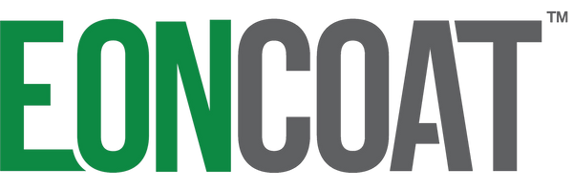

PERMENANT SINGLE COAT SYSTEM
CORROSION & TANK BOTTOM CORROSION, SOIL FACING SIDE
SOLVED

Slide 3
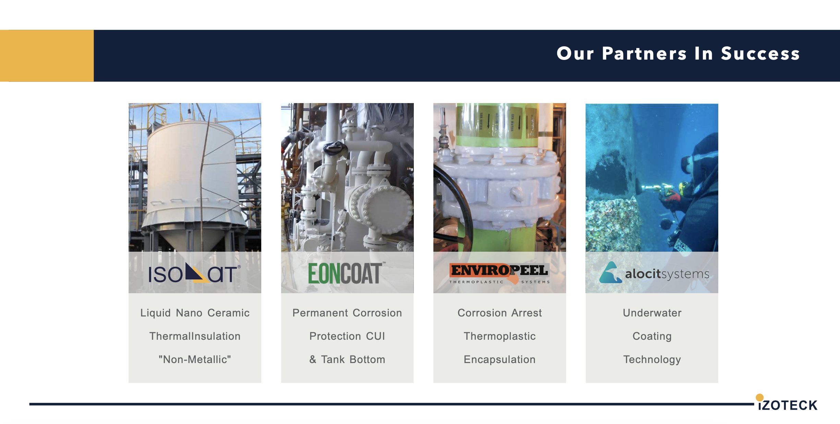

Slide 4
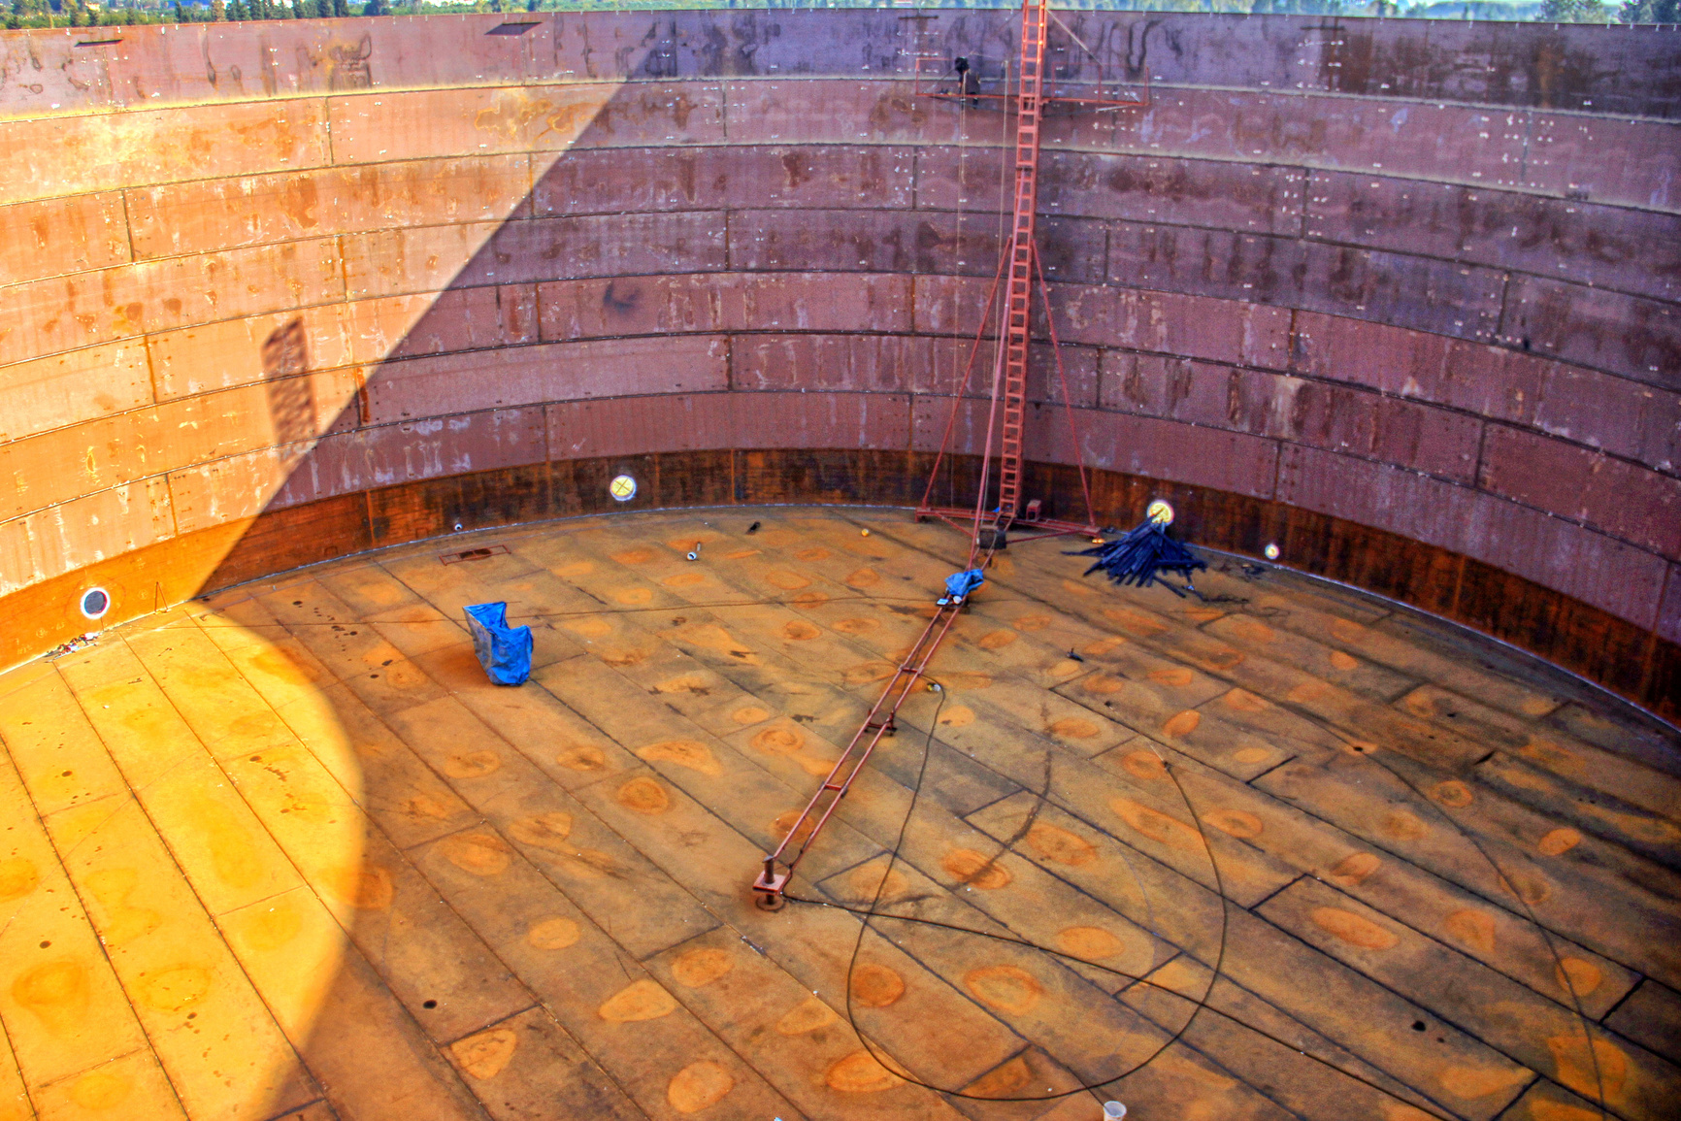

What we are Going to Discuss
02
  Why tank bottoms rust out from the soil facing side.
  Corrosion fundamentals
  Chemically Bonded Phosphate Ceramic Coatings
  How it works ?
  Third-Party Validation and test data
  Q&A
03
04
05
06

Slide 5





The Problem
Tank bottoms rust out from the soil facing side
-and have done so since tanks have been built
01
Leaking Tanks
Used to be accepted
Environmental
Concerns and Cost
02
Constant
Maintenance
03
Notes:
Until the cost of oil rose, and we became more environmentally conscious, we accepted that tanks leaked into the soil.

Slide 6
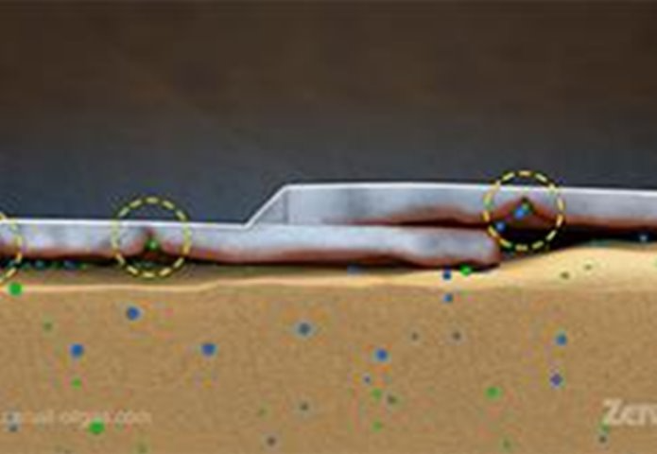

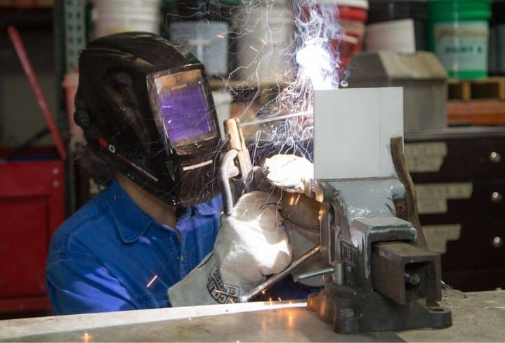

Why a Coating Doesn’t Work.
  Limitations of traditional coatings during welding
Notes:
Do circle around weld zone. Explain how heat will burn off a polymer. And why that increases corrosion locally.
Circle the panel I'm welding. Show that there is no burn through.
Tell them who the welder is. Boilermakers local 26

Slide 7

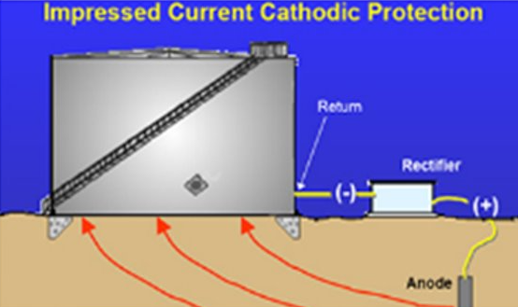
Why Cathodic Protection is Ineffective.
  Distributed anodes and deep well anode bed cathodic protection systems cannot protect tanks sitting on high resistance concrete and/or asphalt layer.
  Deep well anode beds are not recommended inside a plant with congested underground pipes as it may cause stray current interference.
  Difficult to maintain constant voltage across a large flat surface.
Notes:
To get Cathodic protection steel needs to be lower than –800mV.
Much lower than that and salts in the water will produce NaOH.
Think how hard it is to maintain a 5V signal from your cars computer from the front to the back in an insulated wire. A 200mV drop is common.
Now think how hard it is to maintain between –800mV and –1200mV on a 20 meter diameter tank where the entire bottom is attahed to ground.

Slide 8


The Solution:
Chemically Bonded Phosphate Ceramics.
Two Mechanisms for Corrosion Protection
  (1) Reaction between metal (iron) and acid to alloy the surface.
    Alloys the metal surface with an amorphous layer of tri-valent magnesium-iron phosphate.
  (2) Reaction between acid-base to form a ceramic layer which is 100% corrosion inhibitor.
    Creates a huge reservoir of inhibitor intimately bonded to the steel and immediately available to address damage or stress.
Notes:
Explain difference between normal phosphating and amorphous

Slide 9
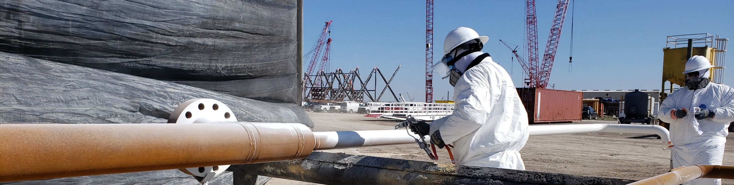


EonCoat is based on new science that works differently than regular paints and coatings
EonCoat is a treatment that is applied like a coating.
EonCoat is NOT paint.

Slide 10

Permanent Corrosion & Corrosion Under Insulation Protection
How Does EONCOAT
Protect Your
Assets
VIDEO

Slide 11
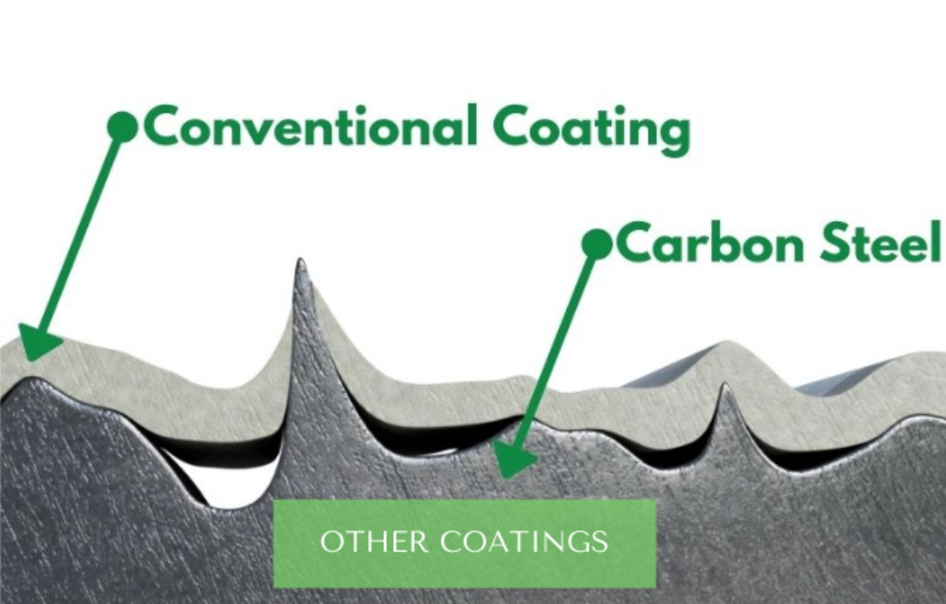
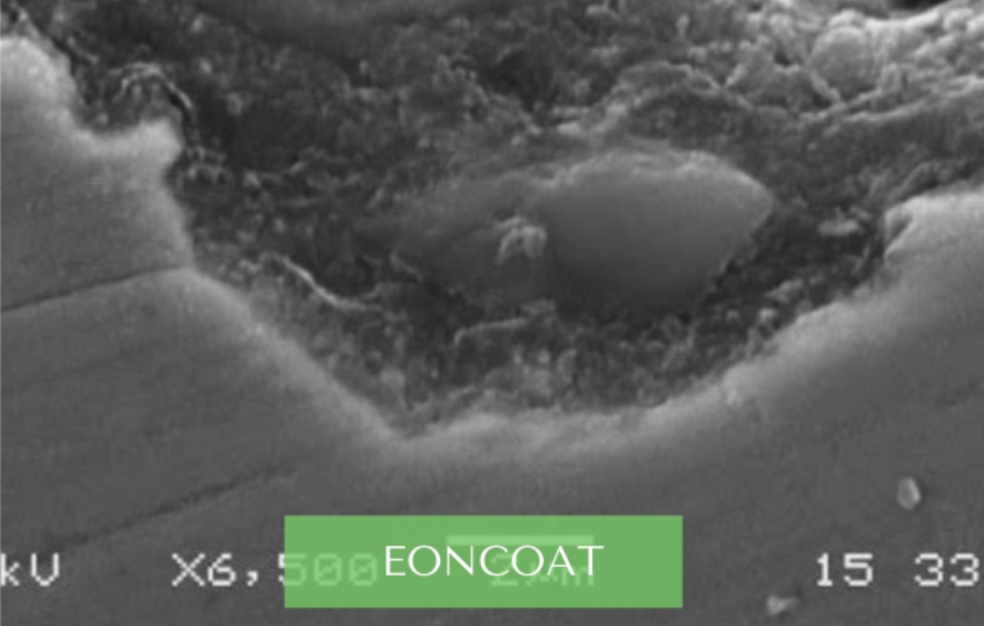

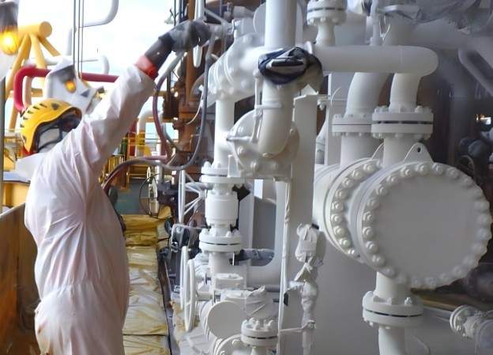
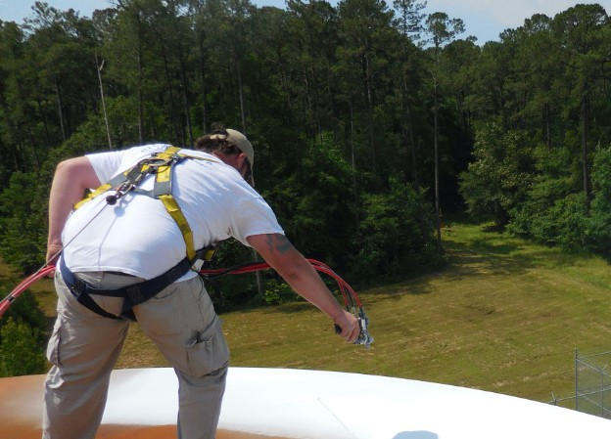
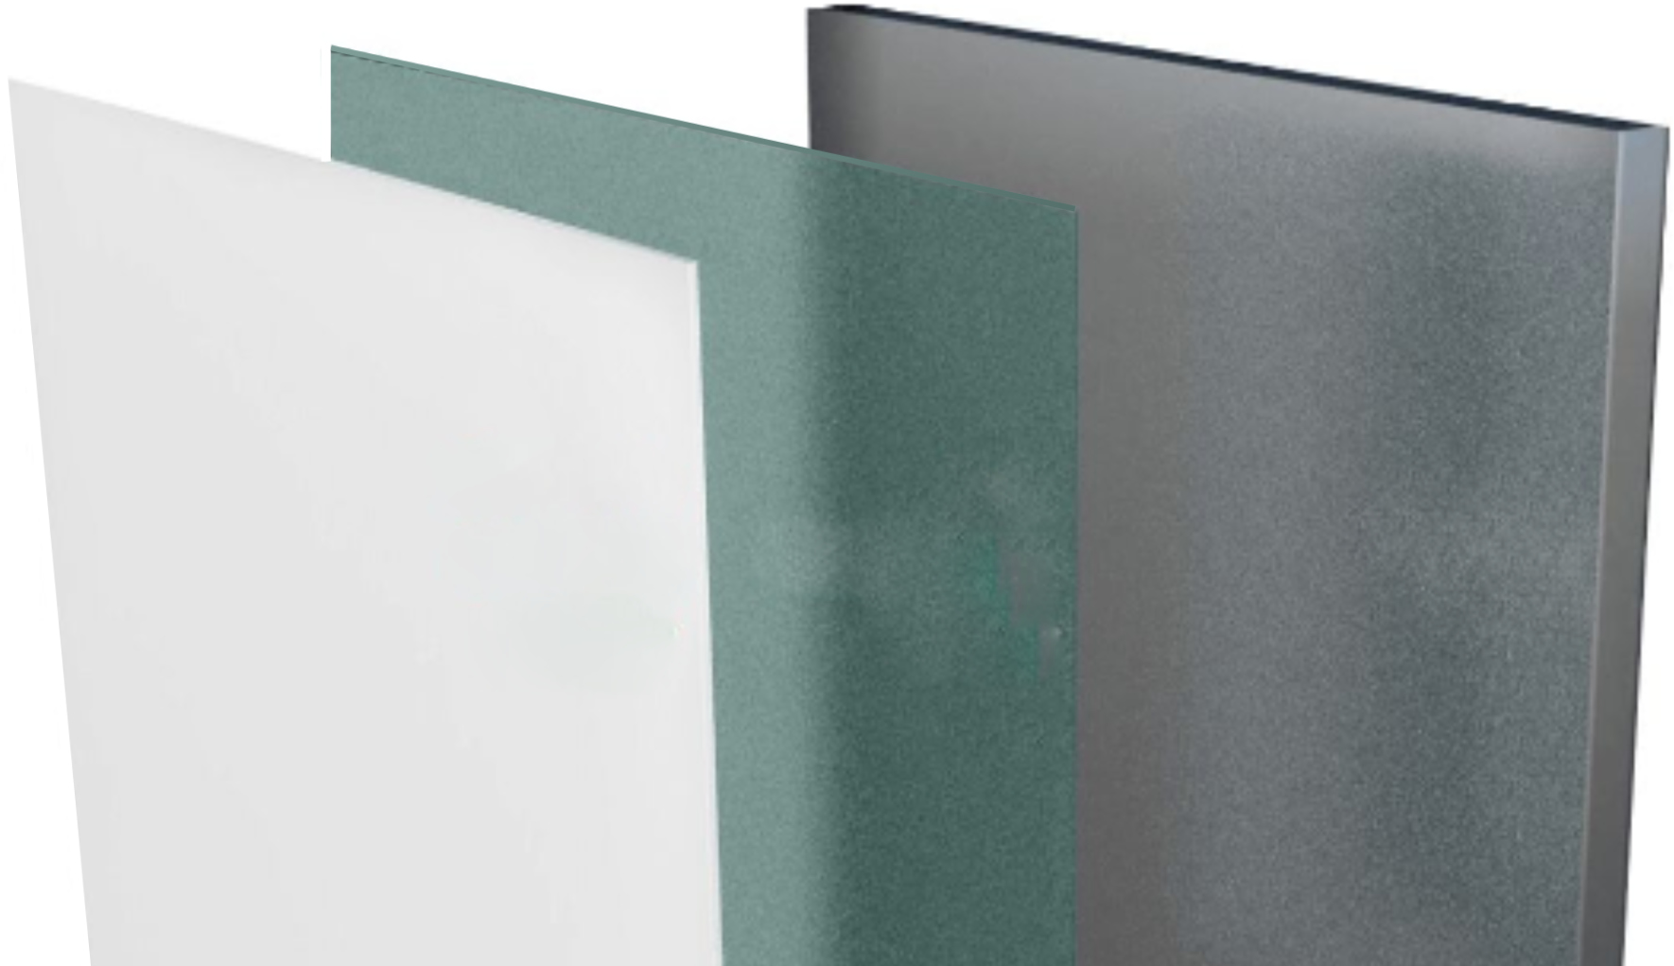
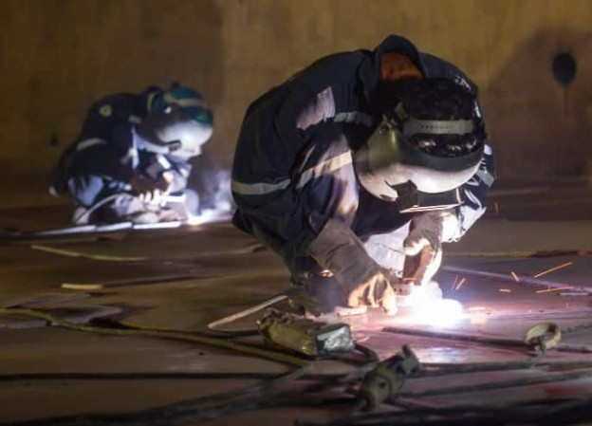
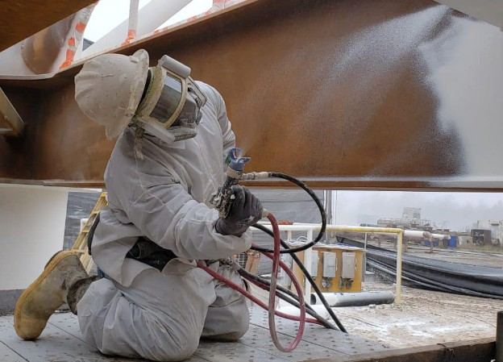
Permanent Corrosion & Corrosion Under Insulation Protection
Why EonCoat is better?
Carbon Steel
EonCoat is based on new science that works differently than regular paints-and coatings
EonCoat is a treatment that is applied like a coating EonCoat is NOT paint
OTHER COATINGS
EONCOAT
Operational Temperature
Up to 650°C (1202°F)
Environmentally Friendly
Inorganic water-based No VOC
No HAP’s
No Odor No Toxins
Suitable for potable water tanks
Ceramic Coating Layer
Iron Phosphate
Layer
Carbon Steel

Slide 12
How does EONCOAT Weldable do against welding?
VIDEO

Slide 13
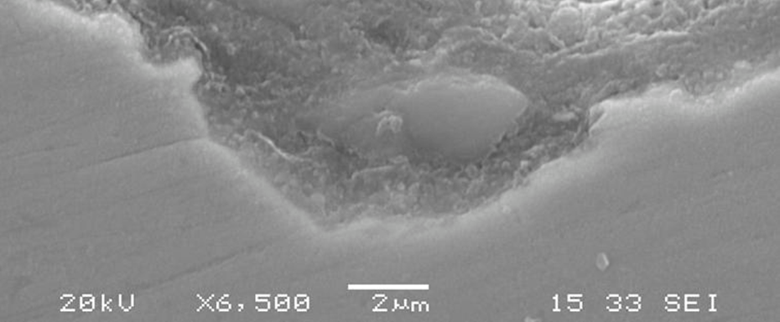
Alloy Layer
A Closer Look:
Intimately Bonded to Steel.
  Thermodynamics perspective
The fundamentals of corrosion-
Iron loses an electron.
Iron cation must bond with something to satisfy the charge imbalance.
Most Negative Gibbs energy (ΔG) determines what Iron will bond with.
The ΔG of the reaction between Fe++ and
1-Oxygen or Hydroxide (-229 to -1015) ----RUST
2-Silicate ( -73 to -1379) ----STABLE ALLY
3-Phosphate (-1657 to -4439) ----STABLE ALLOY
Notes:
In depth discussion. If you don't remember anything else I've told you – remember this!
Corrosion is an incredibly simple thing.
Iron loses an electron.
Discuss lead paint if you have time.

Slide 14

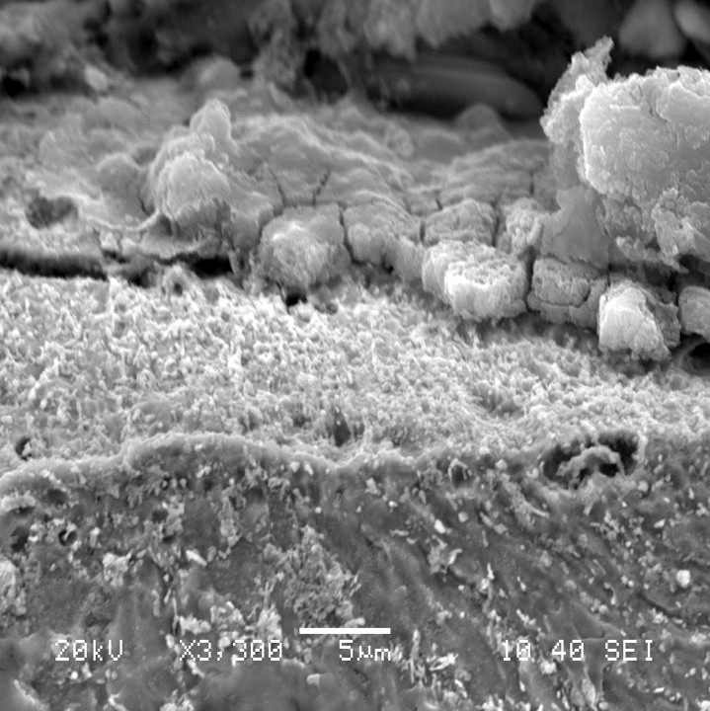
EonCoat Chemical Bond to Substrate vs.
Barrier Coating Mechanical Bond
Iron-Magnesium- Phosphate Layer (~2 micron thick)
Metal

Slide 15
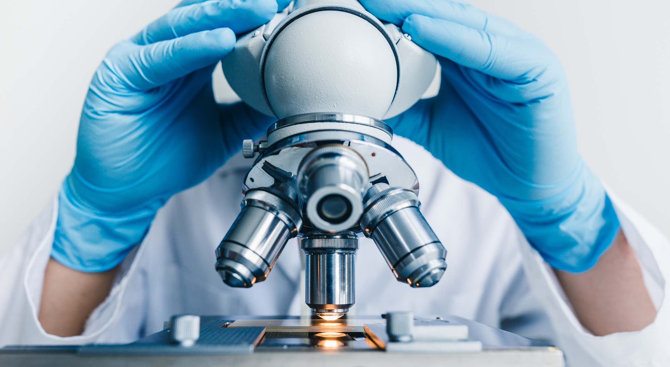

Third-Party Validation
01
  Salt Fog
  Immersion Testing
  Ageing
  Open Circuit
  Polarization
  Pull-off Testing
02
03
04
05
06

Slide 16


Key Findings
Open Circuit Potential
The welded and coated sample showed a decrease in potential, indicating the presence of a passive layer for corrosion protection. The open circuit potential did not significantly differ between welded and non welded samples.
Linear Polarization
Initially, the welded and coated sample exhibited a lower polarisation potential, indicating a higher corrosion rate compared to the non-welded and coated sample. However, after two weeks, both samples showed similar behaviour, suggesting that the top layer provided the necessary protection.
Cycling Polarization
The non-welded and coated samples showed typical passivation behavior with increasing pitting potential and subsequent repassivation. However, the welded and coated samples did not exhibit the same increase in pitting potential, indicating the susceptibility of the first layer to pitting and crevice corrosion.
Immersion Testing
The welded and coated samples, as well as the non-welded and coated samples, showed no signs of blistering, cracking, swelling, rusting, or coating degradation after one to three months of testing. The pull off adhesion strength increased over time for the welded and coated sample, with the mode of the failure shifting from adhesion to steel to cohesive failure within the ceramic layer.
Ageing resistance testing
The welded and coated samples, as well as the non-welded and coated samples, exhibited no blistering, color change, or signs of degradation during the ageing cycles. The pull-off adhesion strength increased for the welded and coated sample, while the non-welded and coated sample remained relatively constant. Artificial scribes on the weld and non-weld samples showed similar performance after the third cycle.

Slide 17
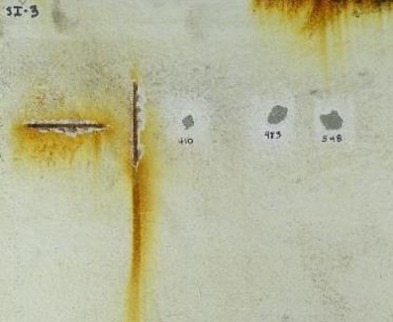
Coated Non-welded
Immersion Testing of Coated Panels Before Welding Process as per ISO 2812-2:2018
  Temperature: 40 °C ± 2 °C
  Duration: 1, 2 and 3 months
  Electrolyte: Artificial seawater
  One horizontal and one vertical scribe line were made on test panels
No loss of adhesion
No blistering, cracking, swelling, rusting, undercreep or any sign of coating degradation

Slide 18
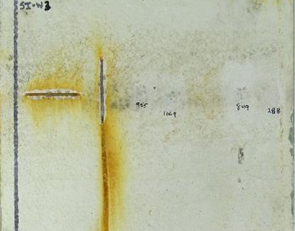

Coated Welded
Immersion Testing of Coated Panels After Welding Process as per ISO 2812-2:2018
  Temperature: 40 °C ± 2 °C
  Duration: 1, 2 and 3 months
  Electrolyte: Artificial seawater
  One horizontal and one vertical scribe line were made on test panels
Slight Improvement in Adhesion
No blistering, cracking, swelling, rusting, undercreep or any sign of coating degradation

Slide 19




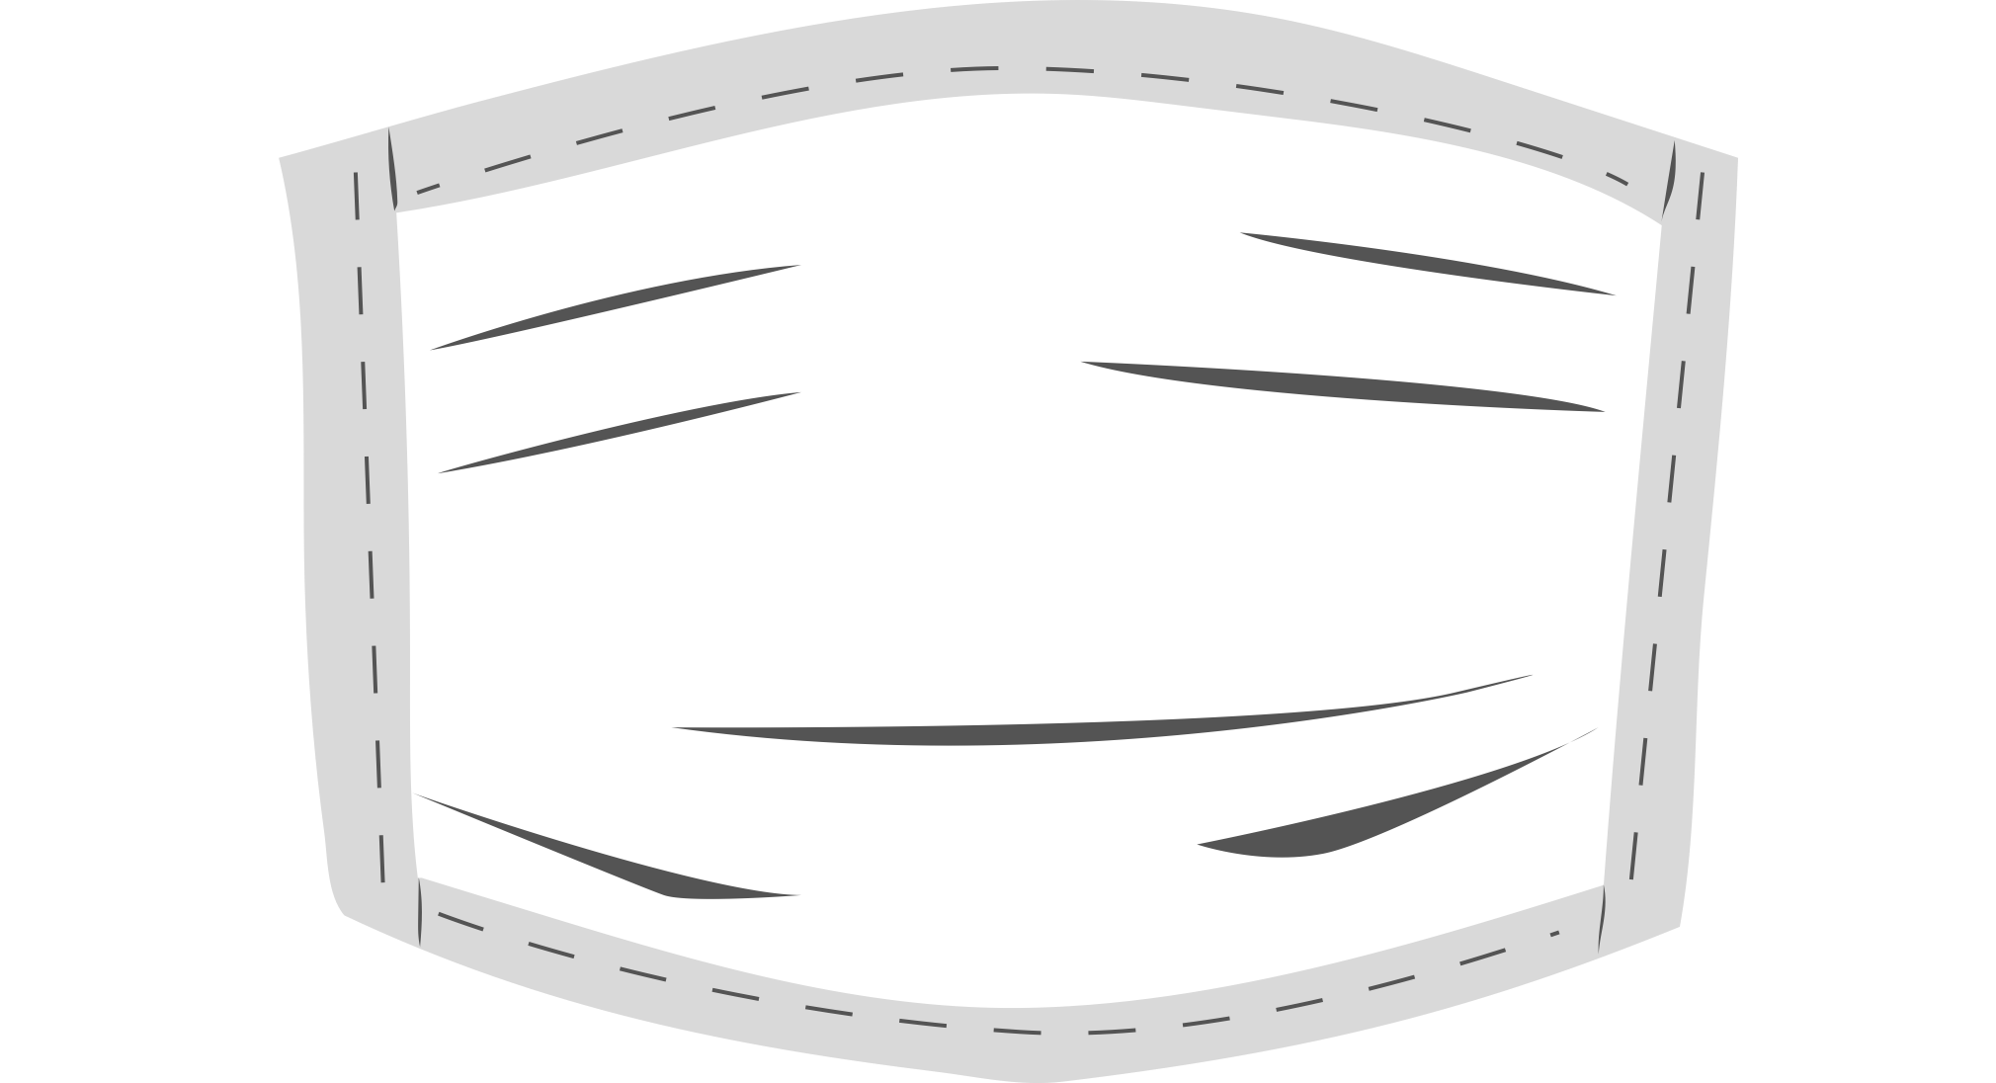

Safety and Environmental Benefits
Inorganic
Water-Based
No VOCs
No HAPs
No Odors
No Toxins
Easy to Dispose & Clean
Safe to Use. Minimum PPE required.

Slide 20
Permanent Corrosion & CUI and Tank Bottom Protection
OSHA's Three Lines of Defense
ENGINEERING CONTROLS | ELIMINATE THE HAZARD
2. ADMINISTRATIVE CONTROLS | CHANGE THE WORK PRACTICE
3. PPE | AS A LAST RESORT |WEAR PPE

Slide 21


QUESTIONS?

Slide 22



JUBCOR
2024
CONFERENCE & EXHIBITION
INNOVATIVE SOLUTIONS FOR CORROSION CHALLENGES
Division
THANK YOU
Reach out.
Calle Cualquiera 123, Cualquier Lugar
phone
email
+9966 54 234 9123
omar.n@izoteck.com

