Slide 1
JUBCOR
2024
CONFERENCE & EXHIBITION
INNOVATIVE SOLUTIONS FOR CORROSION CHALLENGES
Presented By:
V. Dayanidhi Vijayakumar
Jubcor Presentation
Keeping the World in Motion

Slide 2
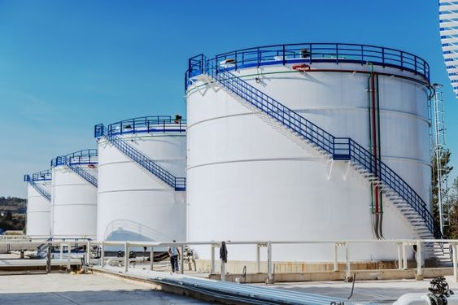
Extending Tank Inspection Intervals:
A Risk-Based Approach for Optimal Asset Management
Saudi Aramco Base Oil Company - LUBEREF
Material & Corrosion Lead Engineer
Bachelor in Mechanical Engineering
Certified in API 510, 570, 653, 580, 571, NACE CIP-1, NACE CP-2 & NACE Certified Refinery Corrosion Technologist
V. Dayanidhi Vijayakumar

Slide 3
Extending Tank Inspection Intervals:
A Risk-Based Approach for Optimal Asset Management
Saudi Aramco Base Oil Company - LUBEREF
Agenda
01
TBI to RBI
02
RBI Methodology
03
Outcome
04
Inspection Interval
05
Damage Mechanism
06
Decision Tree
07
Cost Benefit

Slide 4
Extending Tank Inspection Intervals:
A Risk-Based Approach for Optimal Asset Management
Saudi Aramco Base Oil Company - LUBEREF
TBI to RBI
2023
In 2023, RBI study conducted to above ground storage tanks, as part of transformation from EIS to RBI based inspection

Slide 5
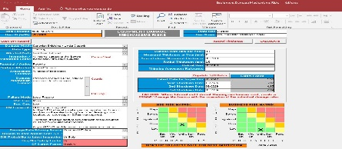
Extending Tank Inspection Intervals:
A Risk-Based Approach for Optimal Asset Management
Saudi Aramco Base Oil Company - LUBEREF
RBI Methodology
The Quantitative RBI methodology & supporting team study based implementation process currently in place

Slide 6
Extending Tank Inspection Intervals:
A Risk-Based Approach for Optimal Asset Management
Saudi Aramco Base Oil Company - LUBEREF
Outcome
Total no of tank RBI completed - 69
Applicable Damage Mechanism [DMs] - 11
Detailed Inspection plan
Insp. Type for each DM : Non-Intrusive Inspection
Insp. Method for each DM : UT map scan, MPI, DPI, UT Flaw, MFL
Insp. Location for each DM: Specific locations where damage likely to occur
Insp. Coverage for each DM: % coverage by NDT inspection

Slide 7
Extending Tank Inspection Intervals:
A Risk-Based Approach for Optimal Asset Management
Saudi Aramco Base Oil Company - LUBEREF
Inspection Interval
Out of 69 / 32
Tank’s Inspection Interval
extended Beyond 10 Years
(some with intermediate
online inspection)

Slide 8
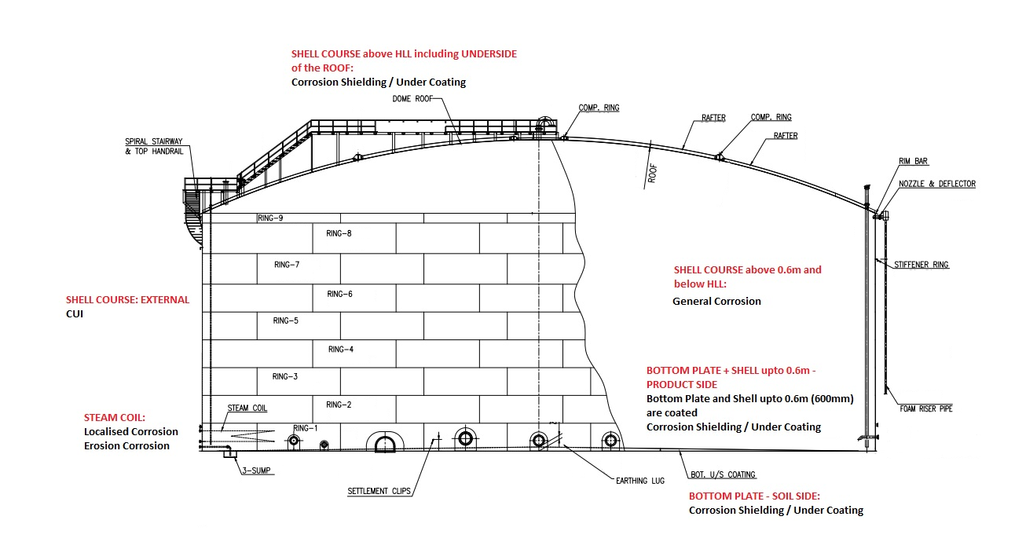
Extending Tank Inspection Intervals:
A Risk-Based Approach for Optimal Asset Management
Saudi Aramco Base Oil Company - LUBEREF
Damage Mechanism
DM | Failure Mode | Susceptible Location
Corrosion - General | Thinning | Shell, Roof, Bottom Plate & Center column
Corrosion - Localised | Thinning | Bottom Plate & Heating Coil
Erosion Corrosion | Thinning | Heating Coil
Corrosion Shielding / Under Coating | Thinning | Bottom Plate [Product side & Soil side], Roof & Nozzle
Corrosion Under Insulation | Thinning | Tank Shell & Nozzles
Brittle Fracture | Time Independent Damage | Tank Shell & Nozzle
Corrosion - Galvanic | Time Independent Damage | Floating roof shoe shunt to shell
Mechanical Damage | Time Independent Damage | Fabric seal & internal structure of the floating roof
H2S - H2 Blistering & Stepwise Cracking (HIC) | Time Independent Damage | Shell
H2S - SOHIC | Time Independent Damage | Shell & Nozzle Welds
H2S - H2 induced SSC | Time Independent Damage | Shell & Nozzle Welds
Buckling | Time Independent Damage | Shell & Roof

Slide 9
Extending Tank Inspection Intervals:
A Risk-Based Approach for Optimal Asset Management
Saudi Aramco Base Oil Company - LUBEREF
Decision Tree
Does all Identified DMs extend beyond 10 Years?
Can the Risk Driver be inspected Non-Intrusively?
Conduct Non-Intrusive Inspection and Carryout Revalidation Study
Set Next Major Inspection Date as per Revalidation Study
No
Yes
Yes
No
Set Next Major Inspection Date as per Risk Driver

Slide 10
Extending Tank Inspection Intervals:
A Risk-Based Approach for Optimal Asset Management
Saudi Aramco Base Oil Company - LUBEREF
Cost Benefit
Inspection Interval Before RBI | Average Inspection Interval After RBI | Approx. Preparation Cost per Tank | Approx. Inspection Cost per Tank
10 Years | 15 Years | SAR 1,50,000 | SAR 15,000
Note: Preparation cost was derived from considering maintenance cost including manpower, erecting scaffolding, compressor for light and fan, etc Inspection cost was derived from considering inspector manhours, NDT technician manhours etc For the purpose of cost saving the below calculation is considered Tank inspection interval 10 years – opened 3 times in 30 years Tank inspection interval 15 years – opened 2 times in 30 years
Total No of Tanks deferred to 15 Years = 30 no’s | Approx. Cost Saving = 5 million SAR

Slide 11
JUBCOR
2024
CONFERENCE & EXHIBITION
INNOVATIVE SOLUTIONS FOR CORROSION CHALLENGES
THANK YOU
Reach out.
+966 593113962
kumard@Luberef.com

